Slide 1
Environmental Surveillance for Biological Traces of Radionuclide Sources
MTV Kickoff Meeting
May 21, 2019
Eric Alm, Adam Arkin, Terry Hazen
MIT, UC Berkeley/LBNL, UT/ORNL

Slide 2
Mission Relevance
Biological organisms respond to changes in their environment
Short term changes are recorded in RNA
Medium term changes are recorded in population levels
Long term changes are stored as DNA
We aim to infer current or prior environmental exposure to radionuclides from nucleic acid signatures

Slide 3
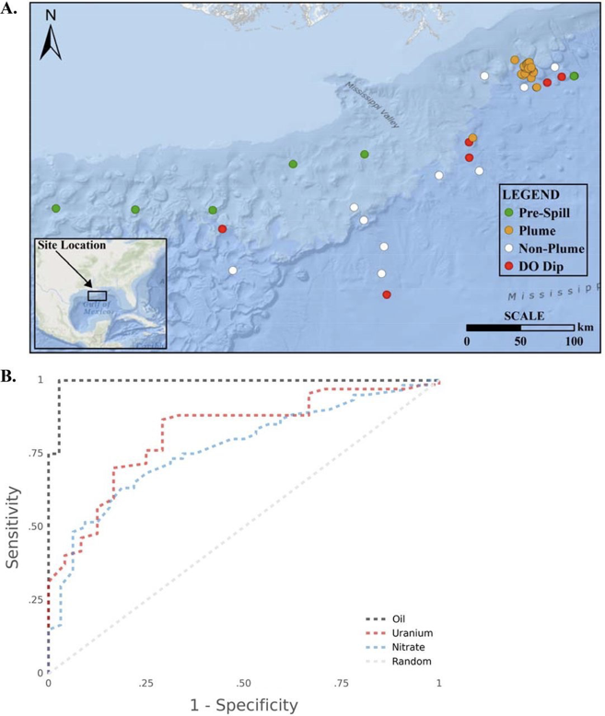
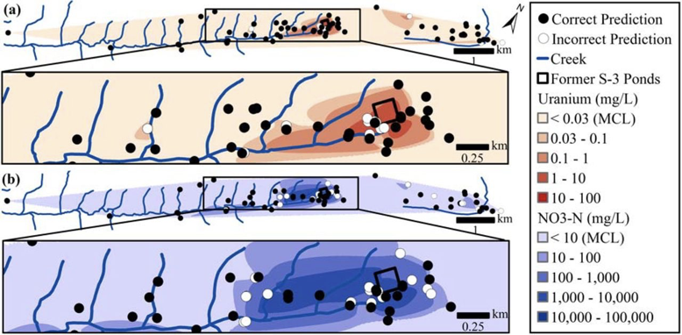
Introduction and Motivation
DNA can be used to infer [U]
Only population levels (16S data) used
Genomic adaptation and gene expression can add predictive power
Modeling can help understand fate and transport

Slide 4
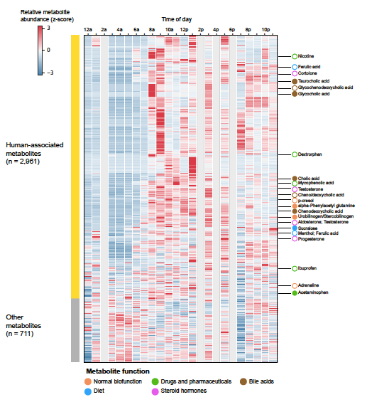
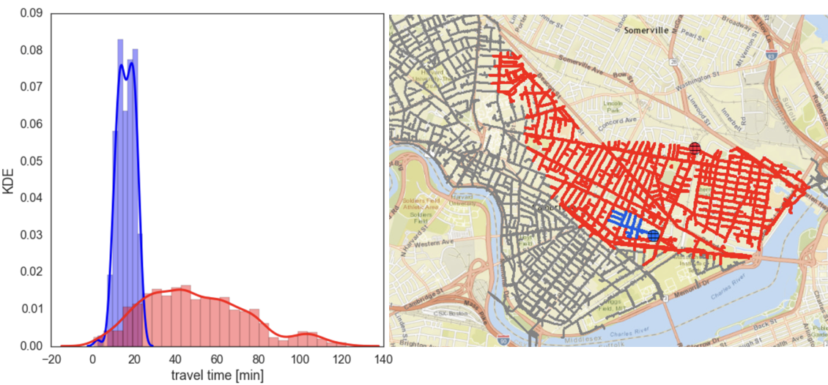
Introduction and Motivation
Sewage networks can be used to monitor human activity
Sampling strategy is as important as chemical/physical measurement accuracy
Radionuclide and biomarker monitoring can be linked to public health applications

Slide 5
Technical Work Plan
YEAR 1 Survey taxa from contaminated and uncontaminated environments to identify species and genes that may serve as effective biomarkers
YEAR 2 Develop culture conditions for microbes of interest
YEAR 3 Infer radionuclide-associated mutations using ground reactor and lab based simulations
YEAR 4 Integrate data types including gene expression, genome adaptation, and population abundances to infer environments
YEAR 5 Test application of model to different systems: controlled and environmental

Slide 6
Expected Impact
Infer exposure to nuclear processes from nucleic acid sequences
Understand the effect of radionuclide exposure on host and microbe at a molecular level
Distinguish recent from prior exposures

Slide 7
MTV Impact
Merge our biological expertise with domain experts
Train scientists with experience in nuclear processes and biological impacts

Slide 8
Conclusion
Radioactivity can already be detected at very low levels
Biology may offer an advantage for detecting prior or long-term exposure
We will build a foundational level of science to enable future applications for monitoring using biology

Slide 9
Acknowledgements
The Consortium for Monitoring, Technology, and Verification would like to thank the NNSA and DOE for the continued support of these research activities.
This work was funded by the Consortium for Monitoring, Technology, and Verification under Department of Energy National Nuclear Security Administration award number DE-FOA-0001875

