Slide 1


Advancements in Cylindrical Time-Encoded Imaging and Explorations in Spherical Time-Encoded Imaging
MTV Workshop, 2023
March 22th, 2023
John R. Kuchta
PhD Candidate
University of Michigan Department of Nuclear Engineering and Radiological Sciences
David K. Wehe

Slide 2
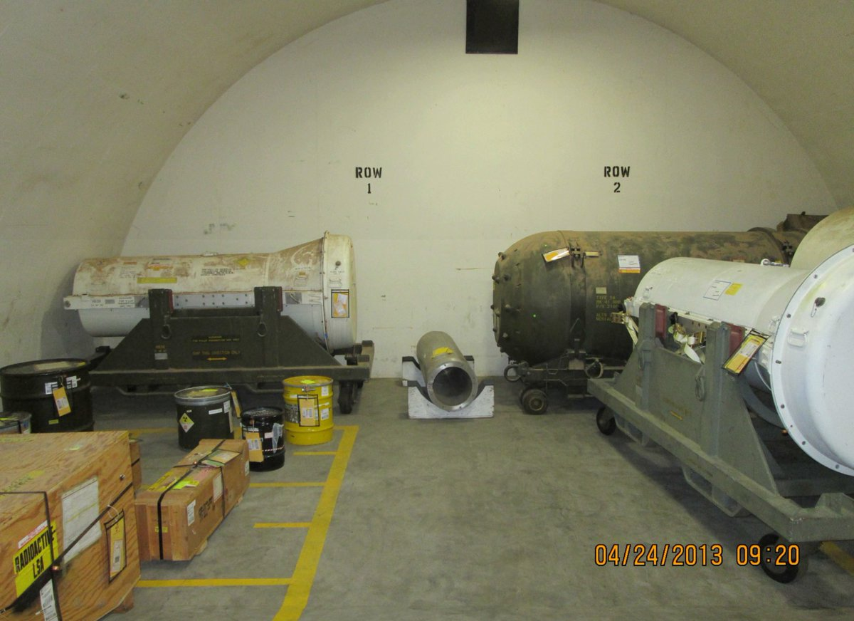
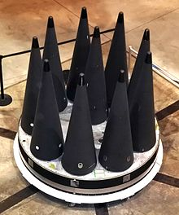
NNSA Mission Relevance
Nonproliferation
NNSA works to prevent nuclear weapon proliferation and reduce the threat of nuclear and radiological terrorism around the world. The agency endeavors to prevent the development of nuclear weapons and the spread of materials or knowledge needed to create them.
Nonproliferation applications: source verification and search operations
Need for compact, cost-effective gamma-ray and neutron imager
Advancing radiation imaging systems and techniques
Motivation
Cylindrical TEI
Spherical TEI
Conclusions
https://en.wikipedia.org/wiki/Multiple_independently_targetable_reentry_vehicle
Monzano Alarm and Nuclear Material Consolidation Project

Slide 3
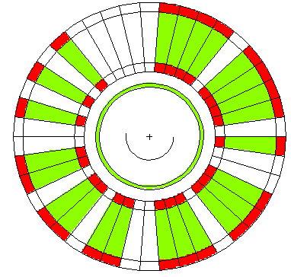
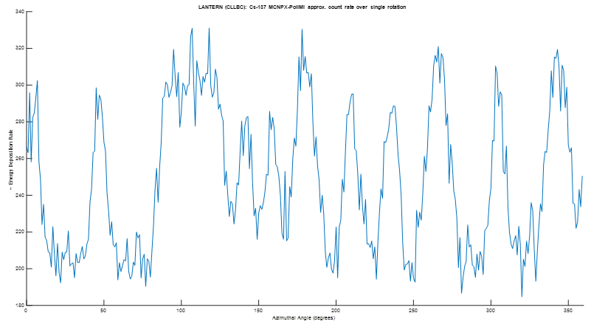
Cylindrical Time-Encoded Imaging
A rotating coded mask modulates a static source, producing a detector count rate over time that resembles the mask pattern.
Count rate influences: mask element material, detector size, distance between detector and mask, mask element size, source distance, source geometry
Top View
Count Rate v. Time
Deconvolved Image
Collect
Count
Rate
Motivation
Cylindrical TEI
Spherical TEI
Conclusions
n,γ
source

Slide 4
LANTERN Project Goals
Cylindrical Time-Encoded Imaging (cTEI)
  Retain image quality when transitioning from a large to small diameter coded mask
  Pseudo-optimize coded aperture patterns for unconventional mask systems
Large Diameter
Small Diameter
Motivation
Cylindrical TEI
Spherical TEI
Conclusions
Thin Mask → Thick Mask

Slide 5
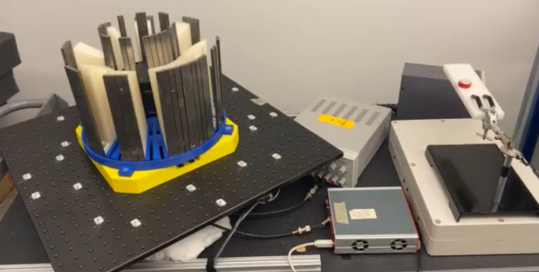
System Comparisons
MATADOR
LANTERN
Motivation
Cylindrical TEI
Spherical TEI
Conclusions
Outer Diameter: 51.4 cm
Inner Diameter: ~25 cm
Outer Diameter: 30.6 cm
Inner Diameter: ~12 cm
(Niral P Shah thesis)
[1]
Geometric Angular Resolution: 10.28º Geometric Angular Resolution: ~25º

Slide 6
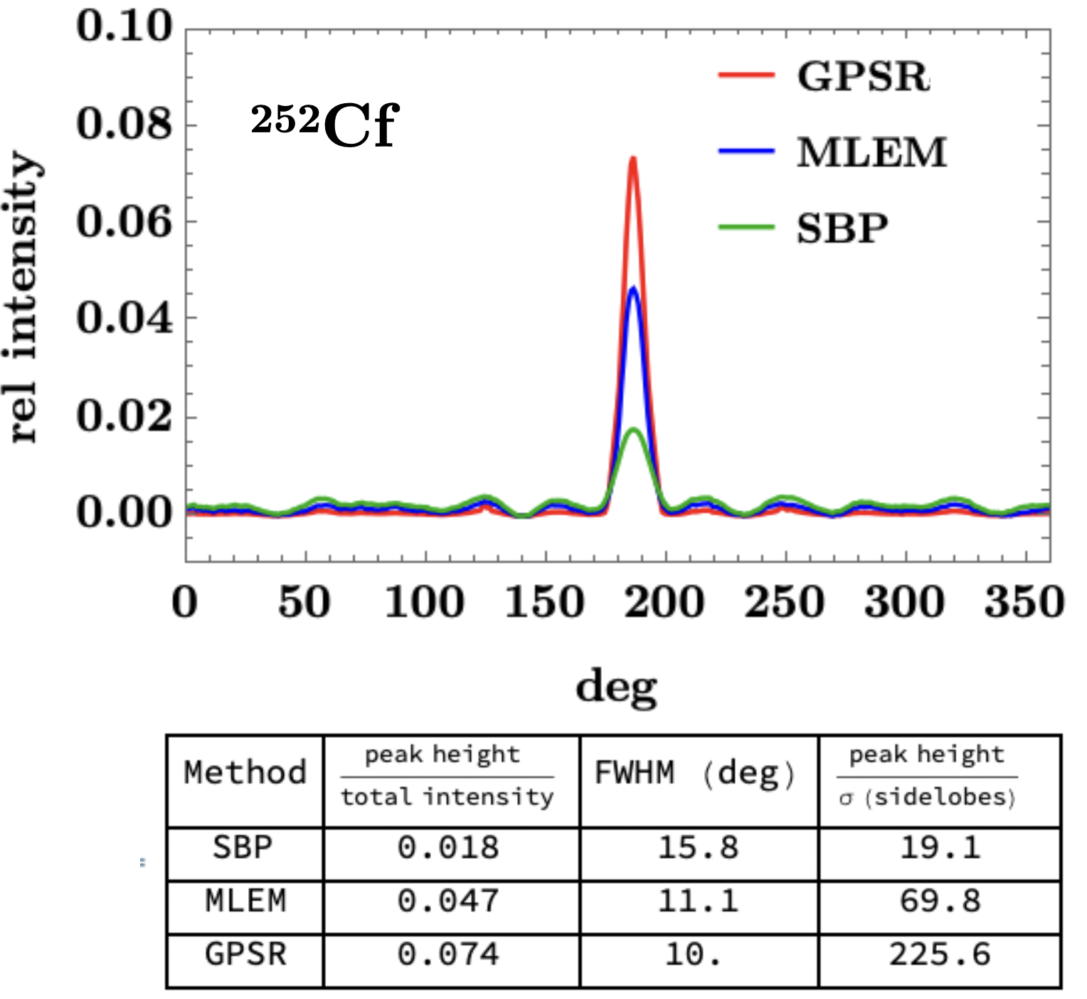
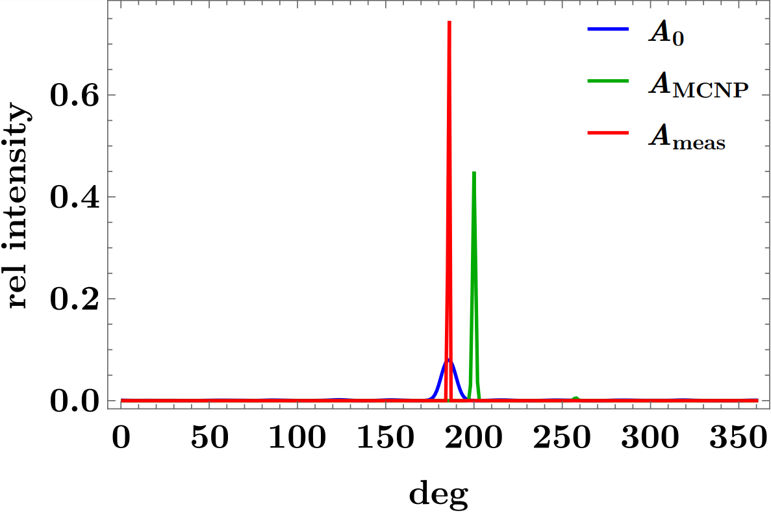
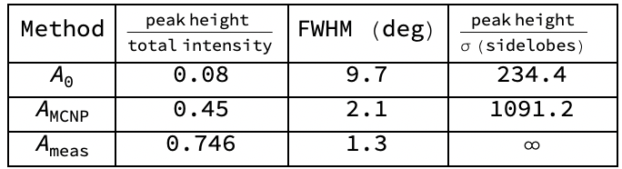
Current Experimental Results
Gradient Projection Sparse Reconstruction (GPSR) performs better than Maximum Likelihood Expectation Maximization (MLEM) and Simple Back Projection (SBP)
Using an experimentally derived sensing matrix for image reconstruction from a Cs-137 point source measurement produces the best image quality
Motivation
Cylindrical TEI
Spherical TEI
Conclusions

Slide 7
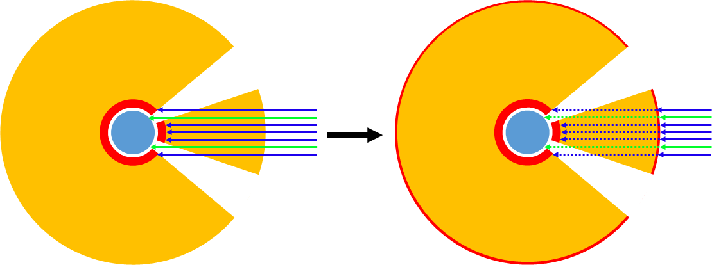
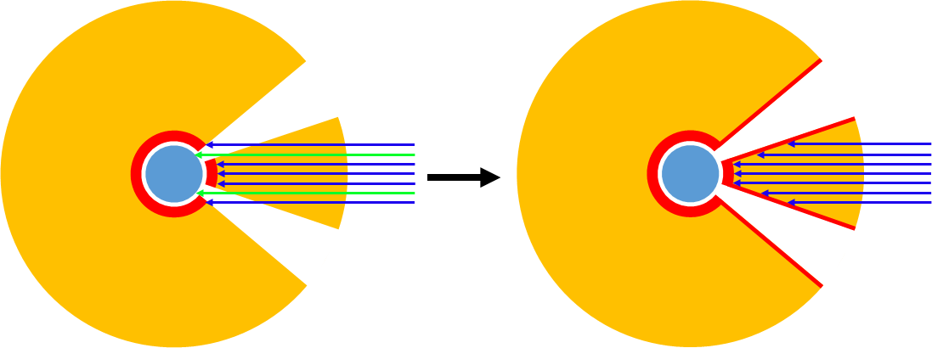
Unconventional Coded Aperture Mask Design
Image quality can be retained with masks designed for increased collimation and decreased scatter
Different materials like borated-polyethylene can be incorporated as neutron “poison” in the mask for thermal neutron modulation
undetected gamma-ray
detected gamma-ray
attenuated undetected gamma-ray
attenuated detected gamma-ray
low-Z material
Motivation
Cylindrical TEI
Spherical TEI
Conclusions
high-Z material
detector material

Slide 8
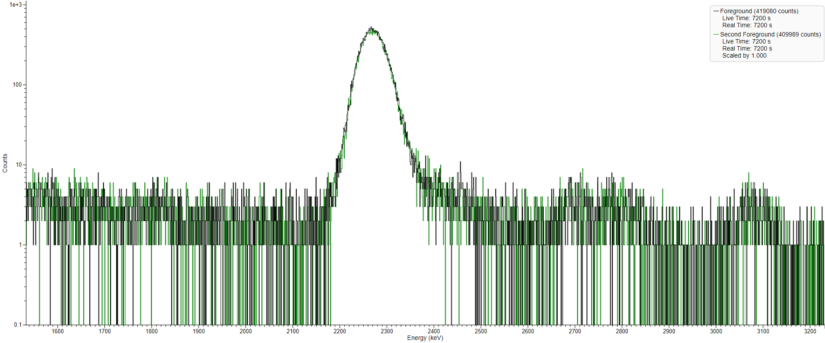
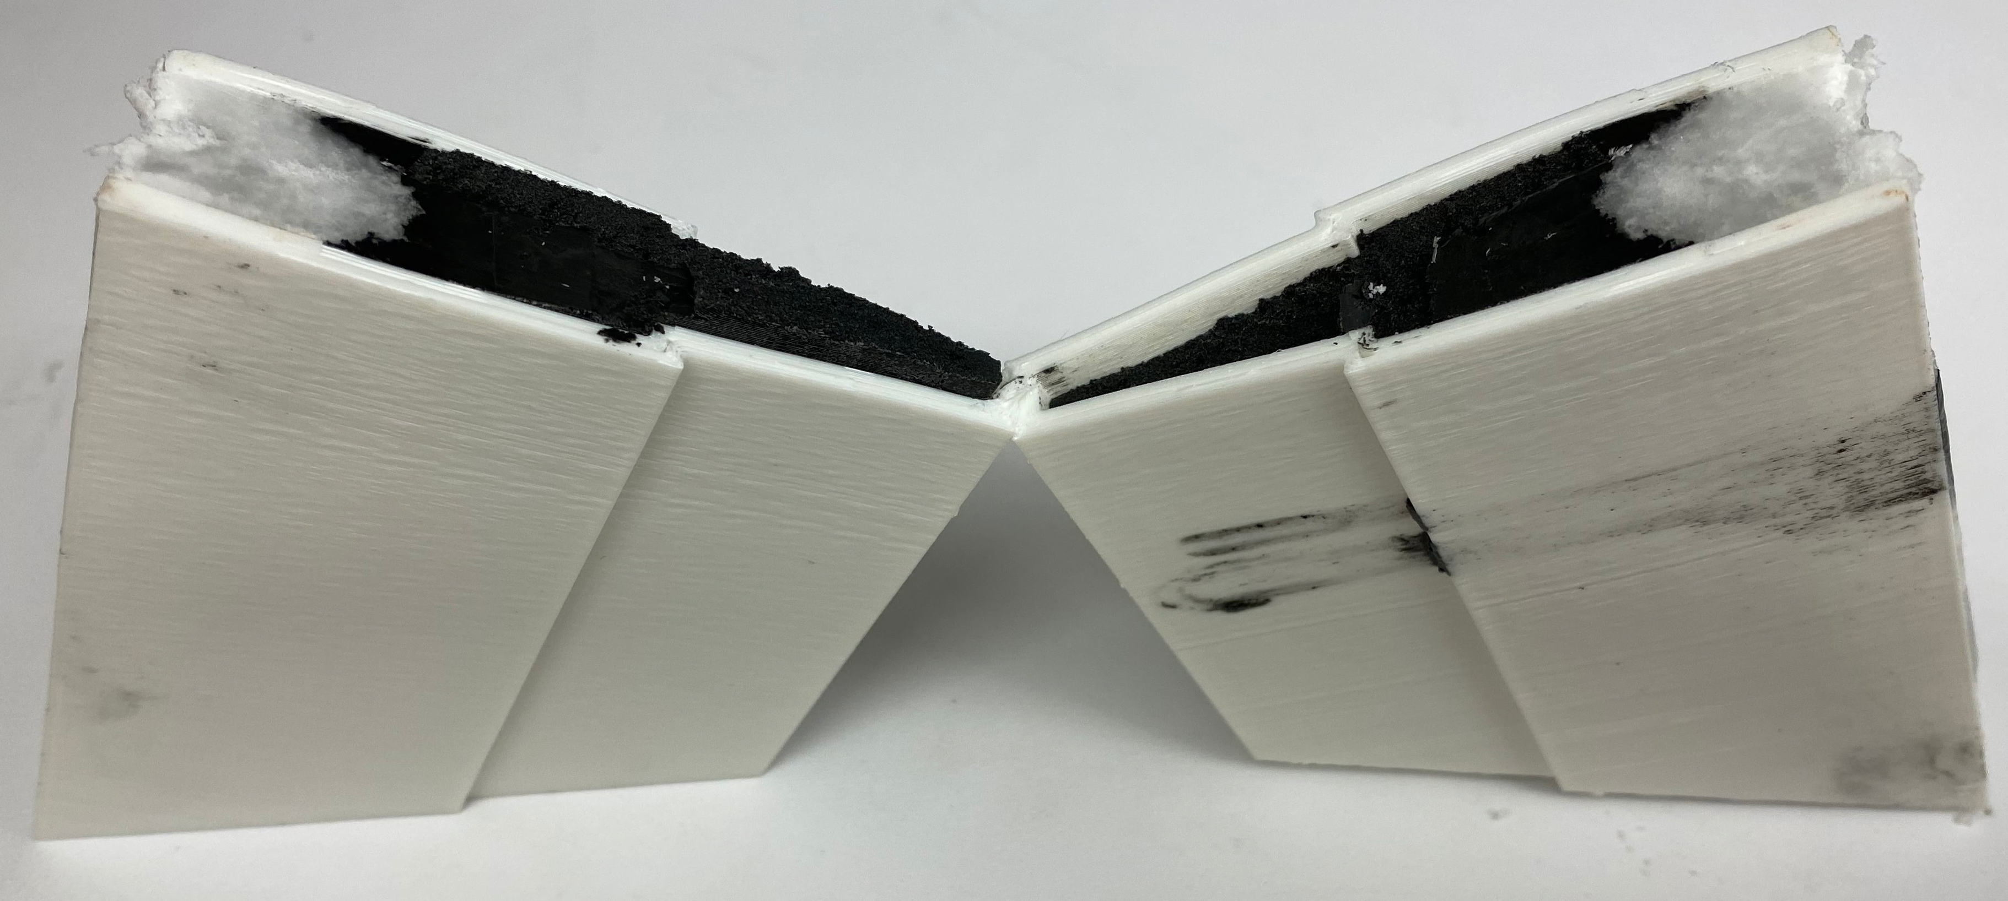
Borated Wax Mask Elements
First attempt resulted in separation between the paraffin wax and B₄C
Second attempt resulted in a more homogeneous mixture
  No noticeable improvement in thermal neutron modulation from boron
  Likely need ¹⁰B-enriched B₄C instead of natural boron
2nd Attempt
Li-6 thermal neutron capture peak
1st Attempt
Motivation
Cylindrical TEI
Spherical TEI
Conclusions

Slide 9
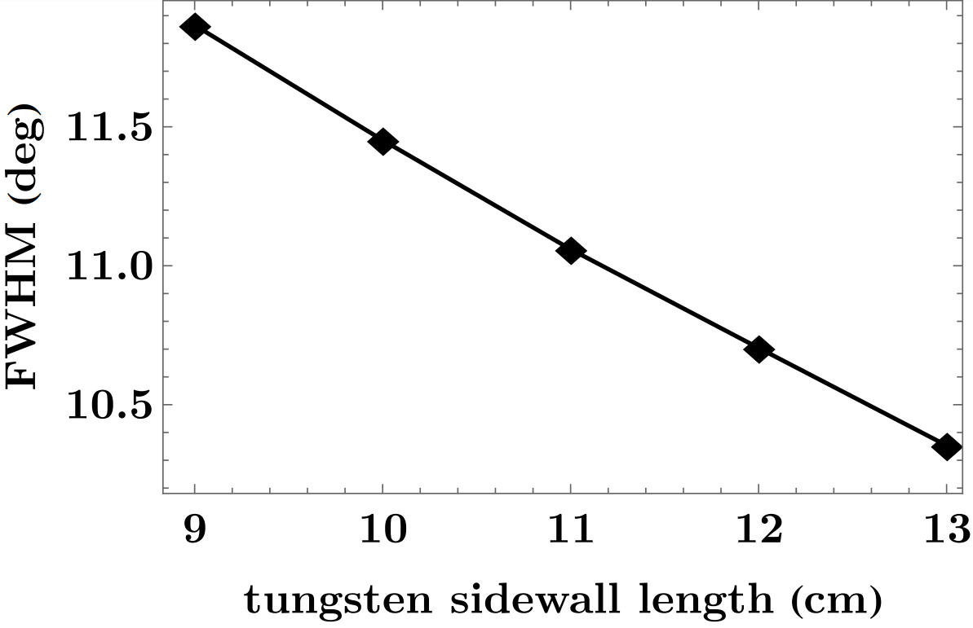
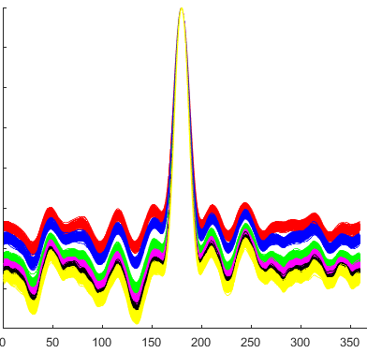
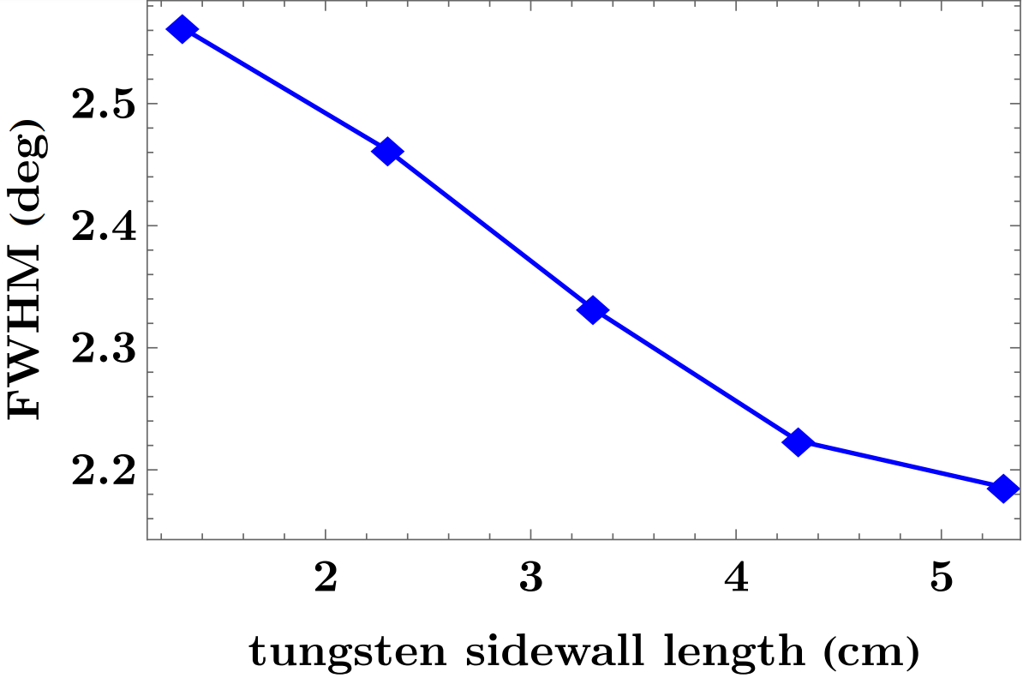
Simulation Results – Tungsten Side Walls
Side wall extension improves source intensity but does not significantly improve angular resolution and increases side lobe noise.
Motivation
Cylindrical TEI
Spherical TEI
Conclusions

Slide 10
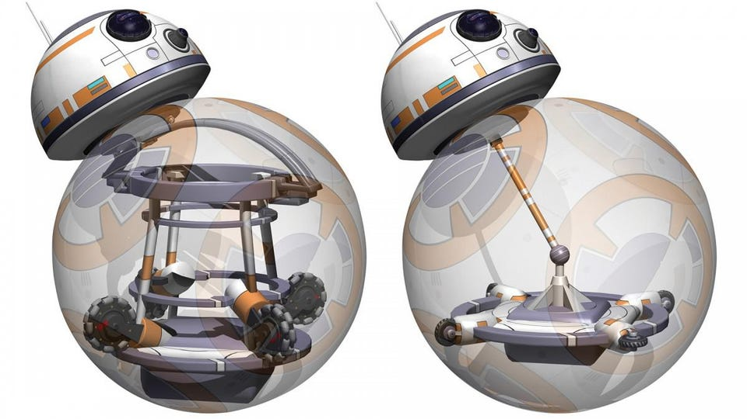
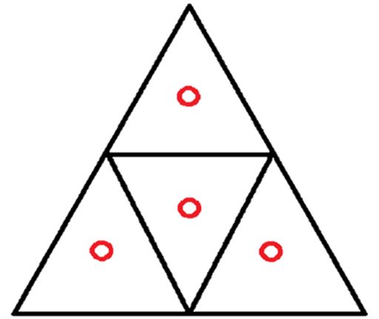
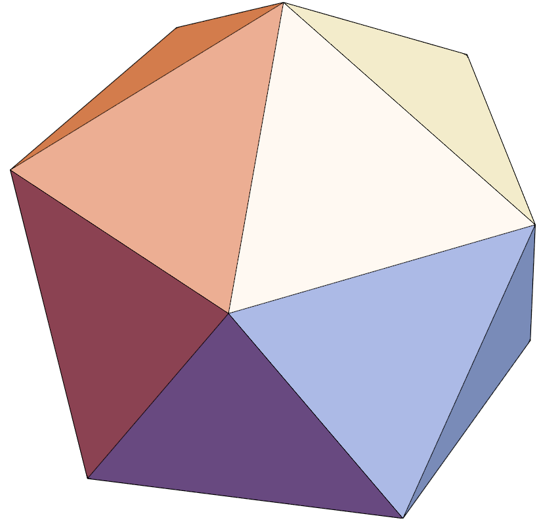
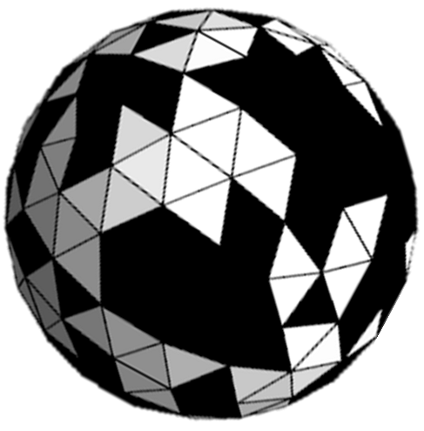
Spherical Time-Encoded Imaging
Regular icosahedron, 20 equilateral triangles
Detector and electronics can be inserted here
[2]
Motivation
Cylindrical TEI
Spherical TEI
Conclusions
Possible numbers of coded aperture voxels: 20, 80, 320…

Slide 11
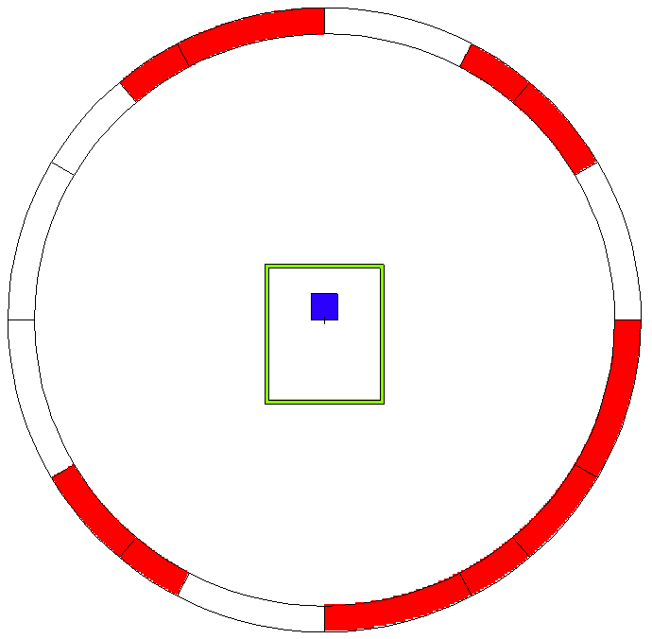
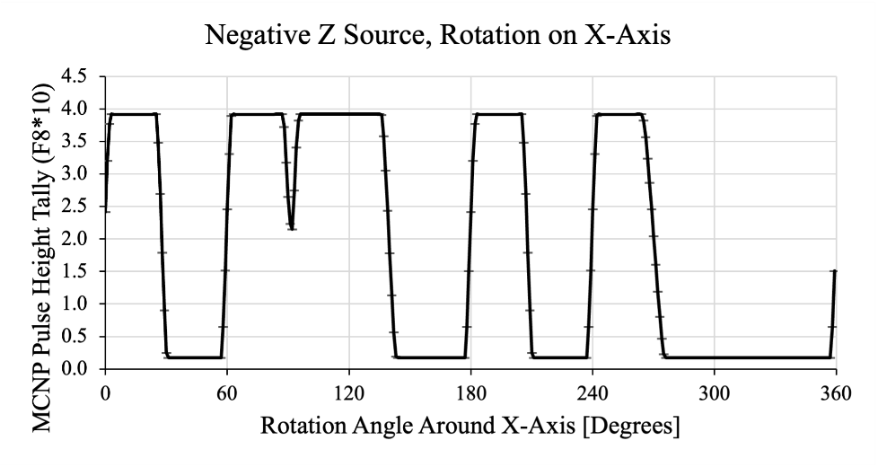
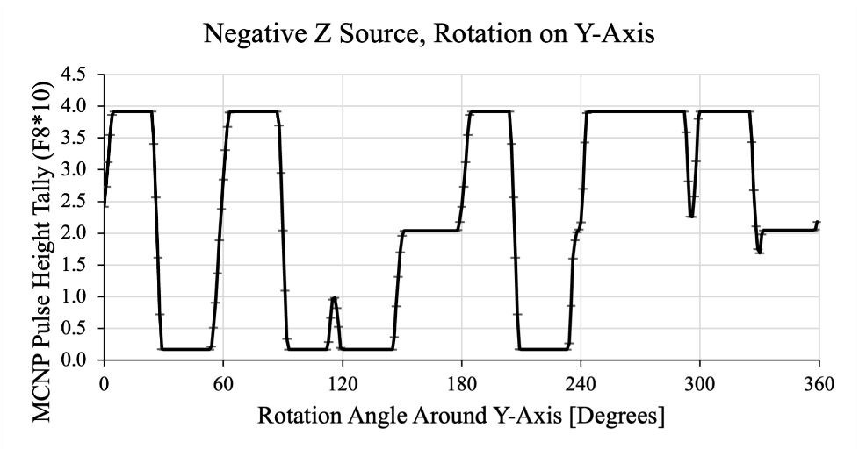
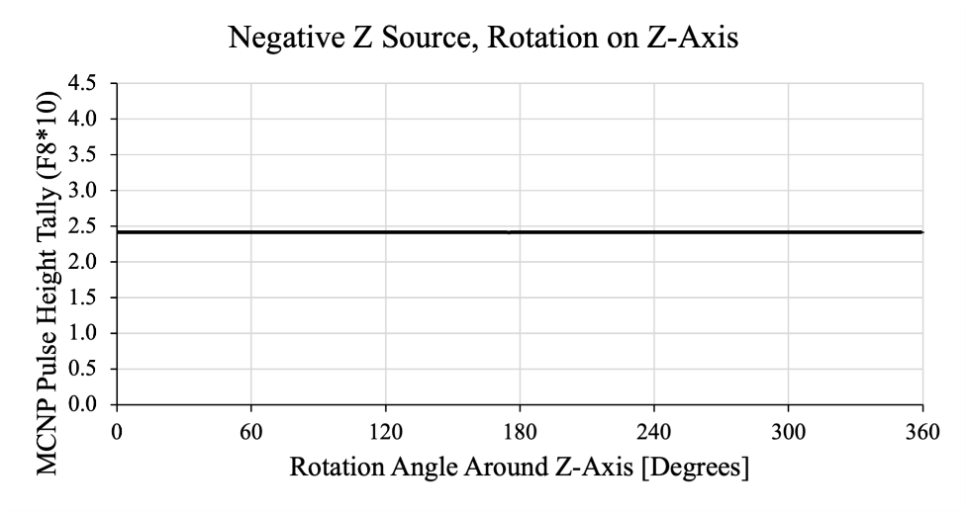
MCNP Simulation Design
Started with a regular icosahedron projected onto a sphere to make triangular wedge apertures
Different modulation pattern when rotating around different axes for a source simulated below the system
Motivation
Cylindrical TEI
Spherical TEI
Conclusions

Slide 12
Inside the Sphere
Arms with ball bearings will keep the detector system from rotating with the sphere for polar rotations
The detector system will rotate with the sphere for azimuthal rotations
  This may be a concern for detectors with nonuniformity or pixelation
MCNP simulations will likely be created to see if the sphere and detector cage obscure the FOV of the crystal
Motivation
Cylindrical TEI
Spherical TEI
Conclusions

Slide 13
Conclusions
Cylindrical Time-Encoded Imaging
  Tungsten side-walls can improve the angular resolution and collimation of gamma-rays through the plastic mask layer
Spherical Time-Encoded Imaging
  Proof-of-concept MCNP simulations of the initial design show different modulation when rotating around different axes
Motivation
Cylindrical TEI
Spherical TEI
Conclusions

Slide 14
MTV Impact
Personnel transitions: John Kuchta was a virtual intern at Sandia National Laboratories working on TEI mask pattern optimizations
Technology transitions
  John’s mentor from the Radiation and Nuclear Detector Systems group at Sandia National Laboratories is now on his Ph.D. thesis committee
Motivation
Cylindrical TEI
Spherical TEI
Conclusions

Slide 15


Acknowledgements
The Consortium for Monitoring, Technology, and Verification would like to thank the NNSA and DOE for the continued support of these research activities.
  This work was funded by the Consortium for Monitoring, Technology, and Verification under Department of Energy National Nuclear Security Administration award number DE-NA0003920.
Motivation
Cylindrical TEI
Spherical TEI
Conclusions

Slide 16
References
[1] Shah, Niral. Adaptive Imaging with a Cylindrical, Time-Encoded Imaging System. Diss. 2020.
[2] BB-8 drive mechanisms (Copyright and trademark Lucasfilm Ltd, all rights reserved. Image: Carlos Sanchez and Emilio Gelardo / howbb8works.com)
Motivation
Cylindrical TEI
Spherical TEI
Conclusions

Slide 17
Extra Slides

Slide 18
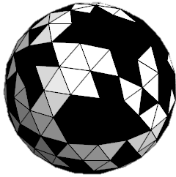
Initial Mechanical Design
Rotary table (green) for azimuthal “z” rotation
Holster for the sphere with several ball bearings and two geared motors for polar “x” and “y” rotations, between rotary table and sphere
May create another holster with ball bearings and motors on top of the sphere depending on sphere weight
Motivation
Cylindrical TEI
Spherical TEI
Conclusions

