Slide 1
Neutron Resonance Analysis for the Identification and Quantification of Nuclear Material
2023 MTV Workshop
March 21, 2023
Ethan A. Klein
PhD Candidate, MIT
Advisor: Prof. Areg Danagoulian

Slide 2
Introduction and Motivation
Objective: on-site material identification and isotopic composition analysis for verification of arms control treaties and nuclear safeguards agreements
Challenge: X-ray imaging and most passive detection techniques are largely not suitable for bulk analysis of mid- and high-Z materials (e.g. Pb, W, U, Pu)
Proposal: use neutron resonance analysis with a portable neutron generator to identify and quantify nuclear material for on-site applications

Slide 3
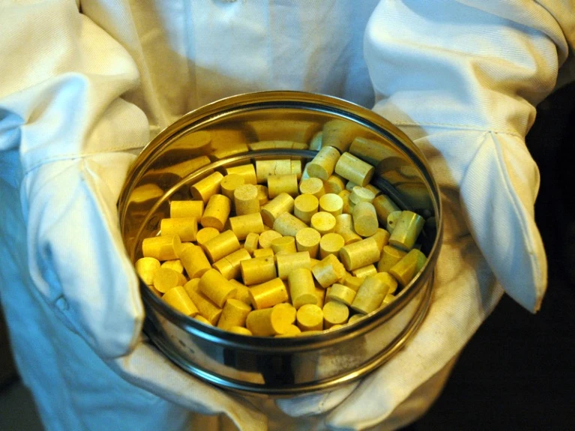
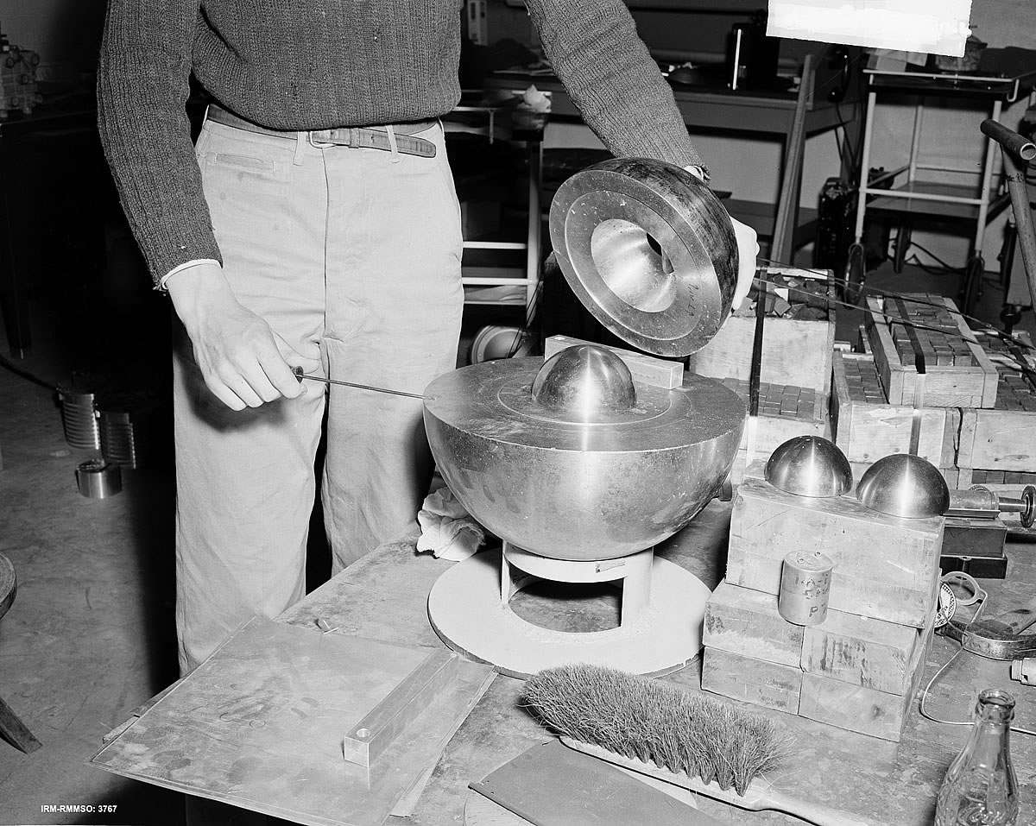
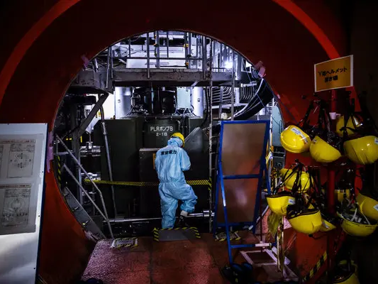
Mission Relevance: Applications For Isotopic Identification & Quantification
International Safeguards (incl. Th-based)
Nuclear Verification
Disaster Response
Worrall, Louise G., et al. "Safeguards Considerations for Thorium Fuel Cycles." Nuclear Technology 194.2 (2016): 281-293. DOI: 10.13182/NT15-103
Danagoulian, Areg. “Verification of Arms Control Treaties with Resonance Phenomena.” Nuclear Physics News 30 (2020). DOI: 10.1080/10619127.2020.1717271
Harada et al. “Neutron Resonance Densitometry for Particle-like Debris of Melted Fuel.” Nuclear Data Sheets (2014). DOI: 10.1016/j.nds.2014.04.118

Slide 4
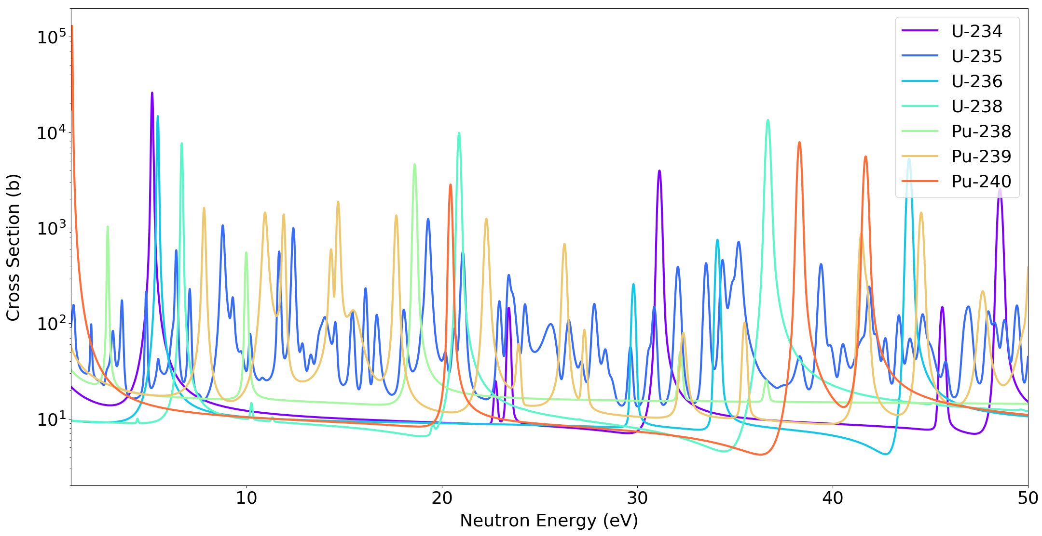
Theory of Epithermal Neutron Resonances
4
E_{n}
n +
^{A}X
^{A+1}X
Source (adapted): F. Gunsing (2005). Neutron Resonance Spectroscopy.
Source: ENDF-VIII.0, National Nuclear Data Center.
If $E_{n}+ E_{A_{X}}≈ E_{{A+1}_{X}}^{∗}$ then $P_{rxn}$ $↑$
$E_{{A+1}_{X}}^{∗}$ are isotopically unique for special nuclear material

Slide 5
Theory of Epithermal Neutron Resonances
5
E_{n}
n +
^{A}X
^{A+1}X
Source (adapted): F. Gunsing (2005). Neutron Resonance Spectroscopy.
Source: ENDF-VIII.0, National Nuclear Data Center.
If $E_{n}+ E_{A_{X}}≈ E_{{A+1}_{X}}^{∗}$ then $P_{rxn}$ $↑$
$E_{{A+1}_{X}}^{∗}$ are isotopically unique for special nuclear material

Slide 6
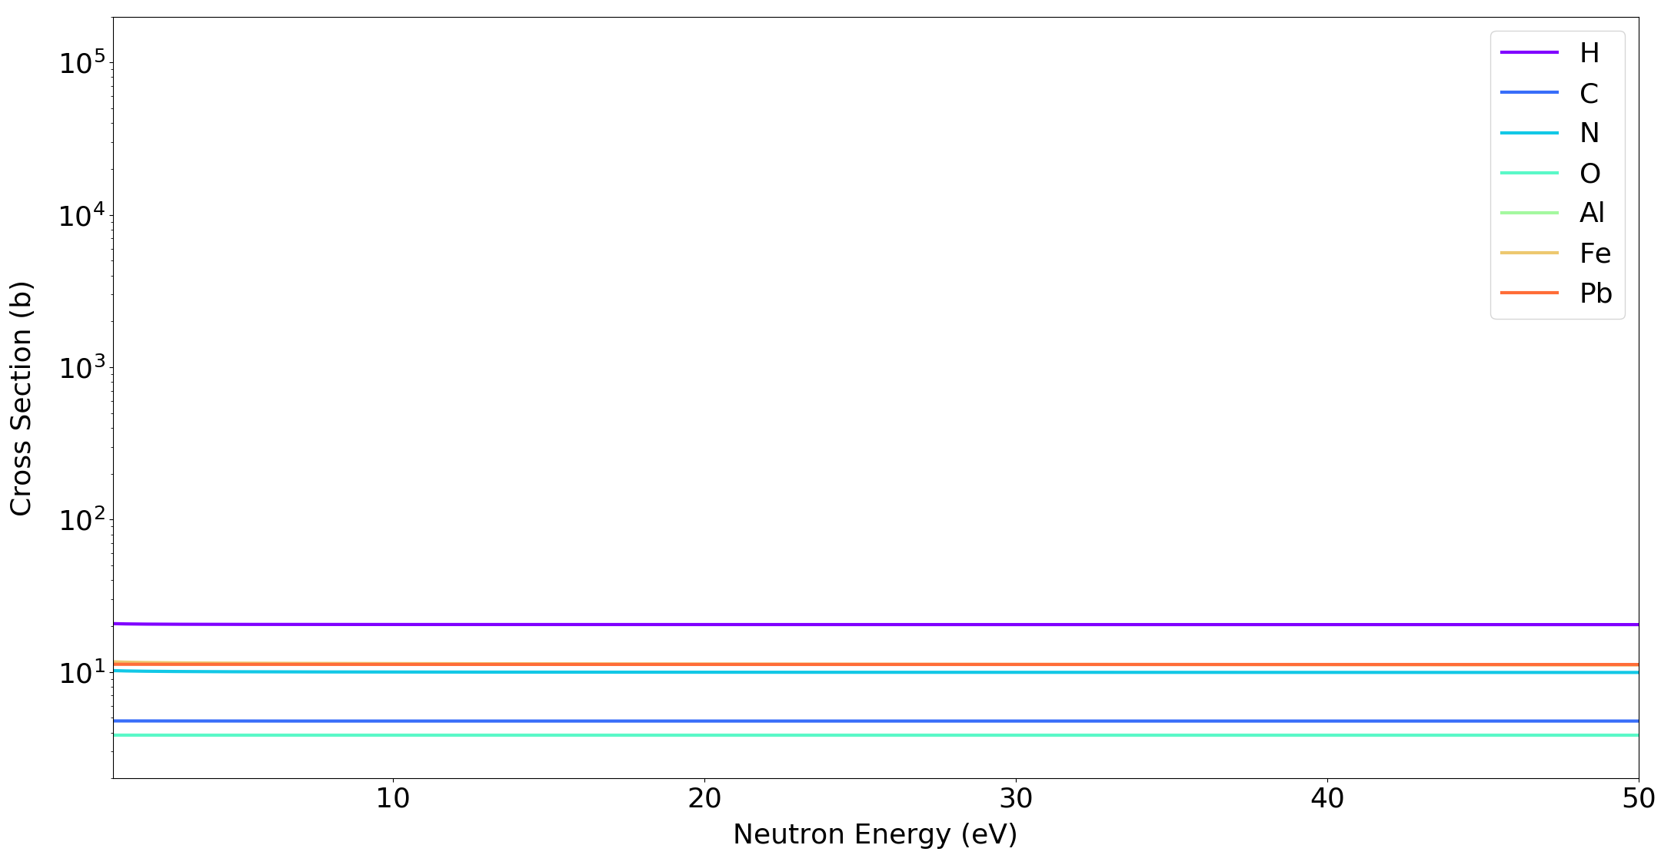
Theory of Epithermal Neutron Resonances
6
E_{n}
n +
^{A}X
^{A+1}X
Source (adapted): F. Gunsing (2005). Neutron Resonance Spectroscopy.
Source: ENDF-VIII.0, National Nuclear Data Center.
If $E_{n}+ E_{A_{X}}≈ E_{{A+1}_{X}}^{∗}$ then $P_{rxn}$ $↑$
No energy-dependent features for common shielding materials!

Slide 7
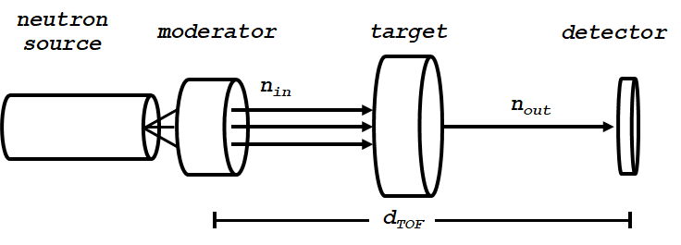
Neutron Resonance Transmission Analysis (NRTA)
$$T_{calc}\left(E_{n}\right)=\frac{I\left(E_{n}\right)}{I_{0}\left(E_{n}\right)}=e^{−\sum_{i}{n_{i} σ_{i, tot}\left(E_{n}\right){ x}_{i}}}$$
Step I: Neutron Production
Step II: Neutron Moderation
Step III: Neutron Transmission
Step IV: Neutron Detection
Step V: Neutron TOF Energy Reconstruction
$i$ different isotopes present in target
$n_{i}$ density of isotope I $\left[at⋅b^{−1}⋅cm^{−1}\right]$
$σ_{i, tot}$ total cross section for isotope I and incident neutron energy $E_{n}$ $\left[b\right]$
$x_{i}$ thickness of layer I $[cm]$

Slide 8
Neutron Resonance Transmission Analysis (NRTA)
$$T_{calc}\left(E_{n}\right)=\frac{I\left(E_{n}\right)}{I_{0}\left(E_{n}\right)}=e^{−\sum_{i}{n_{i} σ_{i, tot}\left(E_{n}\right){ x}_{i}}}$$
Step I: Neutron Production
Step II: Neutron Moderation
Step III: Neutron Transmission
Step IV: Neutron Detection
Step V: Neutron TOF Energy Reconstruction
$$T_{exp}\left(E_{n}\right)=T_{calc}\left(E_{n}\right) ∗R(E_{n})$$
$R(E_{n})$ energy-dependent system resolution function

Slide 9
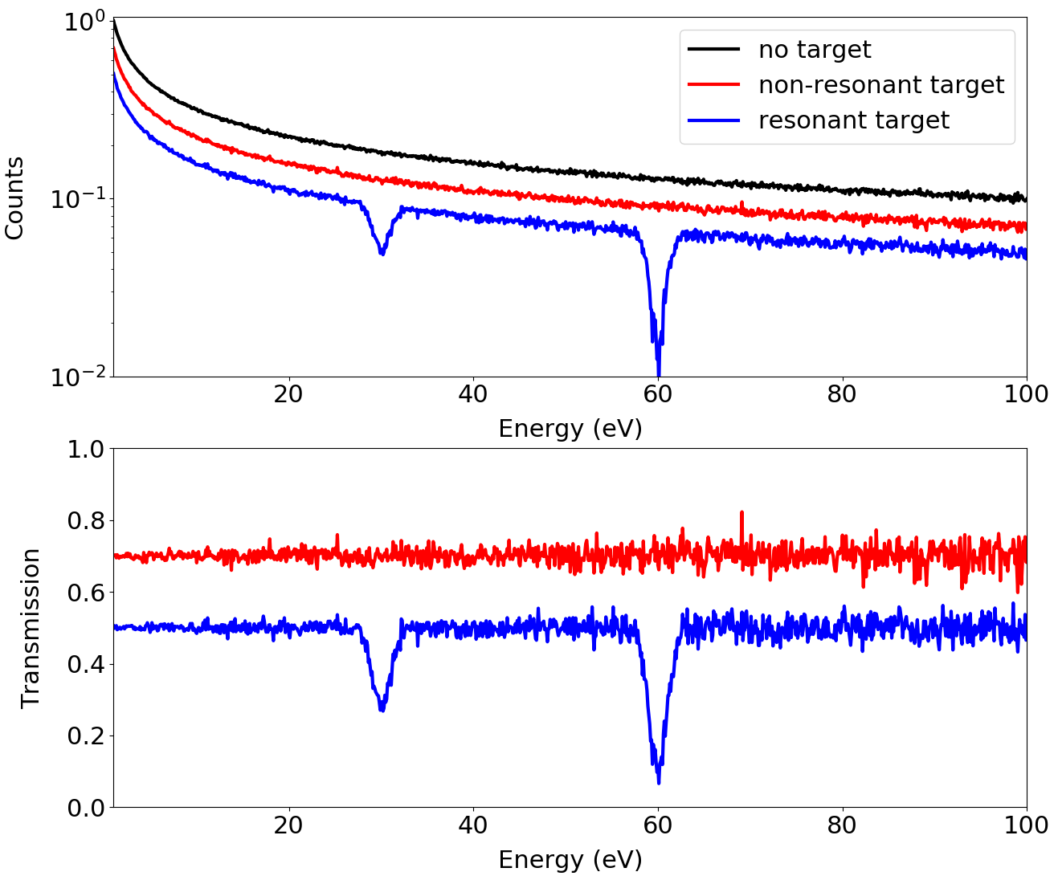
Neutron Resonance Transmission Analysis (NRTA)
NEUTRON RESONANCE TRANSMISSION ANALYSIS (NRTA)
Step I: Neutron Production
Step II: Neutron Moderation
Step III: Neutron Transmission
Step IV: Neutron Detection
Step V: Neutron TOF Energy Reconstruction
$T(E_{n})$ can be measured and $i, n_{i}$ inferred

Slide 10
Portable DT-based NRTA Setup
HDPE MODERATOR
Cd FOIL
B₄C SHIELDING
D-T TUBE
TARGET OBJECT
GS20 ⁶Li-ENRICHED SCINTILLATOR
Pb MULTIPLIER
NEUTRON BEAM
2.00 METERS

Slide 11
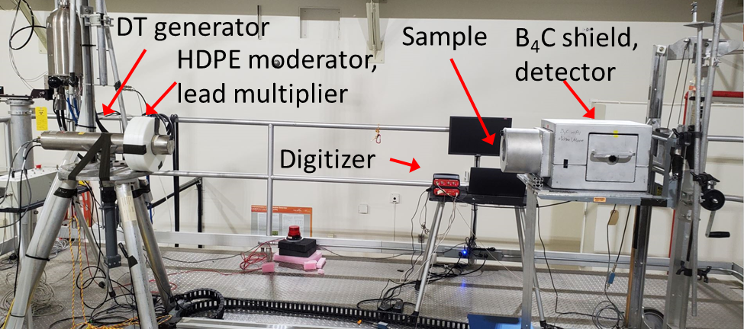
Portable DT-based NRTA Setup

Slide 12
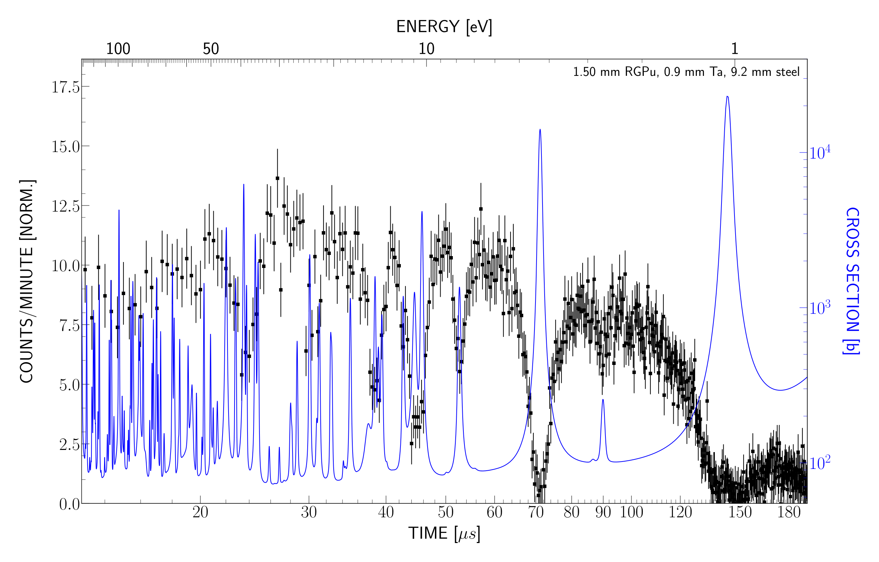
Neutron Transmission: Reactor-Grade Plutonium (RGPu)
$${}_{}^{238}{Pu}$$
$${}_{}^{239}{Pu}$$
Target: 1.50 mm RGPu (+ steel/Ta shielding)
Meas. Time: 1 hours
Note: Cross section shown for isotopic composition as determined by chemical analysis
$${}_{}^{240}{Pu}$$

Slide 13
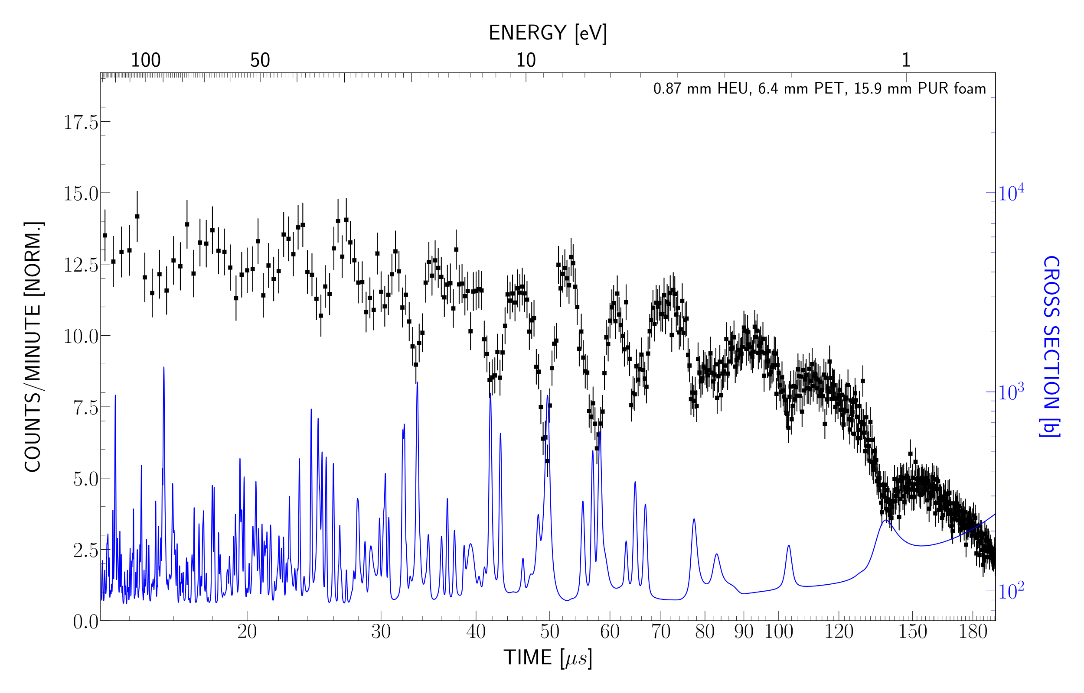
Neutron Transmission: High-Enriched Uranium (HEU)
$${}_{}^{234}U$$
$${}_{}^{235}U$$
Target: 0.87 mm HEU (+ plastic shielding)
Meas. Time: 3 hours
Note: Cross section shown for isotopic composition as determined by chemical analysis
$${}_{}^{238}U$$
13

Slide 14
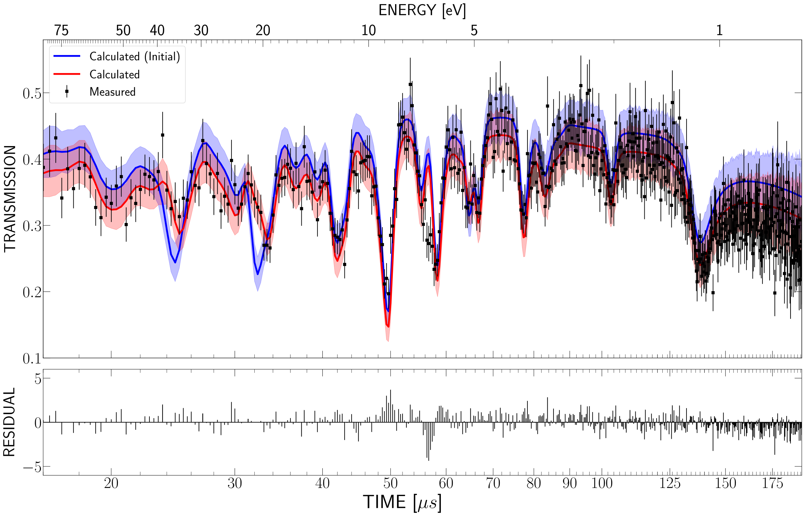
Calculation of HEU Isotopic Composition
Target: 0.87 mm HEU (+ plastic shielding)
Meas. Time: 3 hours
Isotope | Predicted Abundance | True Abundance
U-234 | 0.45% | 1.00%
U-235 | 99.52% | 93.10%
U-236 | 0.02% | 0.50%
U-238 | 0.01% | 5.40%

Slide 15
Simple Metric for U-238 Detection
Measure raw counts at time- of-flight corresponding to 6.7 eV U-238 resonance
Normalize to counts at off-resonance time (1.6 eV) to account for presence of non-resonant isotopes

Slide 16
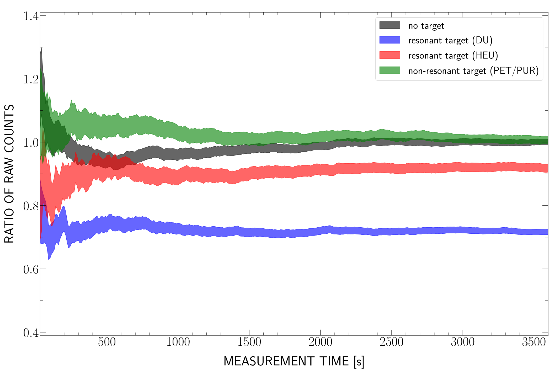
Simple Metric for U-238 Detection
Measure raw counts at time- of-flight corresponding to 6.7 eV U-238 resonance
Normalize to counts at off-resonance time (1.6 eV) to account for presence of non-resonant isotopes
Identification of U-238 presence in <2 mins (DU), ~10 mins (HEU)

Slide 17
Simple Metric for U-235 Detection
Measure raw counts at time- of-flight corresponding to 8.8, 9.3 eV U-235 resonances
Normalize to counts at off-resonance time (1.6 eV) to account for presence of non-resonant isotopes

Slide 18
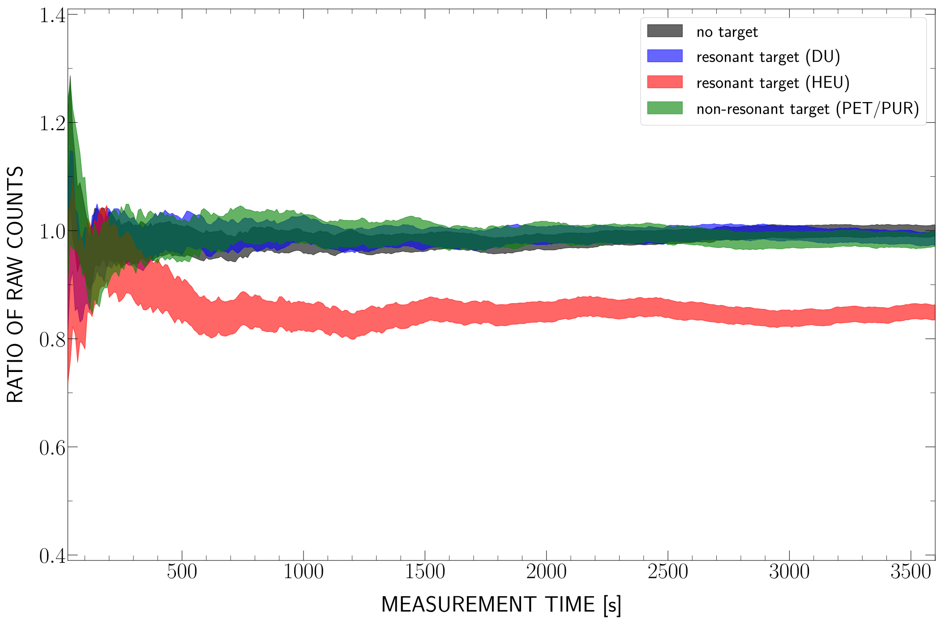
Simple Metric for U-235 Detection
Measure raw counts at time- of-flight corresponding to 8.8, 9.3 eV U-235 resonances
Normalize to counts at off-resonance time (1.6 eV) to account for presence of non-resonant isotopes
Identification of U-235 presence in ~ 6 minutes

Slide 19
Expected Impact
Development of a portable tool to identify and quantify isotopic composition of nuclear material for nonproliferation applications requiring isotopic specificity
Integration of a complementary measurement technique to existing active interrogation measurements using a portable neutron generator
Increased confidence in ability to safeguard new reactor designs relying on non-traditional fuel cycles

Slide 20
MTV Impact
Previous collaboration with PNNL on Isotopic Verification for Arms Control (Collaborators: Dr. Glen Warren et al., March 2021 – February 2023)
Ongoing collaboration with PNNL on NRTA for Thorium Fuel-Cycle Safeguards (Collaborators: Dr. Ben McDonald et al., March 2022 – Present)
Summer internship at LLNL working on Dense Plasma Focus NRTA setup (Supervisor: Dr. Chris Cooper, Plasma Engineering Group, June 2020 – November 2022)
Annual MTV workshops have been a great source of feedback, also participated in MTV 2020 summer tutorial on MCNP6

Slide 21
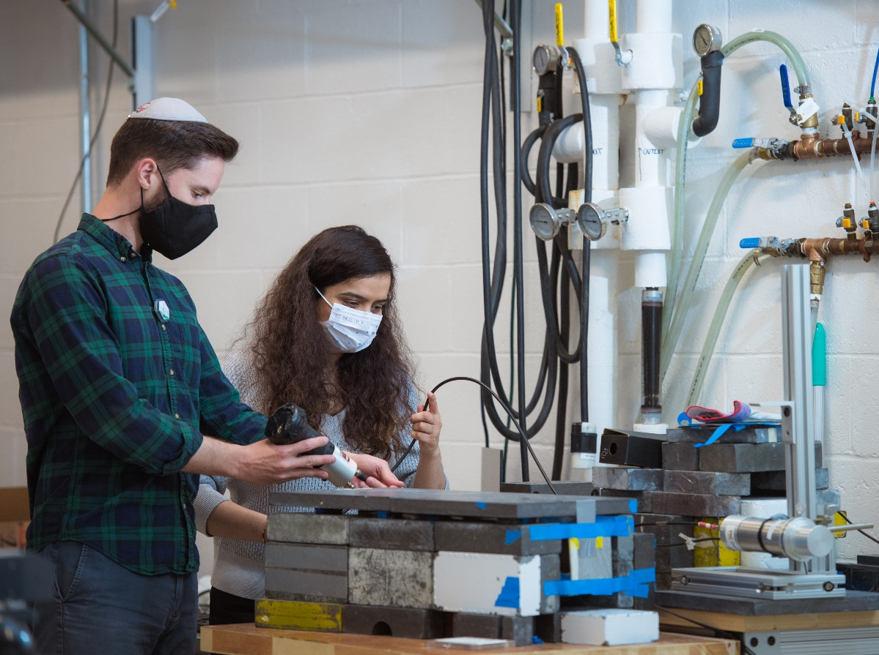
Conclusion
The use of commercial D-T neutron generators to perform neutron resonance analysis is a promising option for on-site analysis of nuclear material
Least-squares fitting routine of transmission spectrum correctly identifies HEU as >90% enriched, but underestimates presence of ²³⁸U
The presence of ²³⁵U and ²³⁸U can be detected from raw spectra on O(~min) for targets with ~1 cm low-Z shielding

Slide 22
Next Steps
Experiments will continue with targets containing U-233 and Th in order to assess viability of using portable NRTA setup for thorium reactor safeguards
Alternate algorithms for rapid identification of isotopic presence in NRTA target will be explored
New detector assembly with 1” spatial resolution and 3x total detector area will be assembled and tested

Slide 23
Acknowledgements
The Consortium for Monitoring, Technology, and Verification would like to thank the NNSA and DOE for the continued support of these research activities.
This work was funded by the Consortium for Monitoring, Technology, and Verification under Department of Energy National Nuclear Security Administration award number DE-NA0003920
This work was performed under appointment to the Nuclear Nonproliferation International Safeguards Fellowship Program sponsored by the National Nuclear Security Administration’s Office of International Nuclear Safeguards (NA-241).

