Slide 1
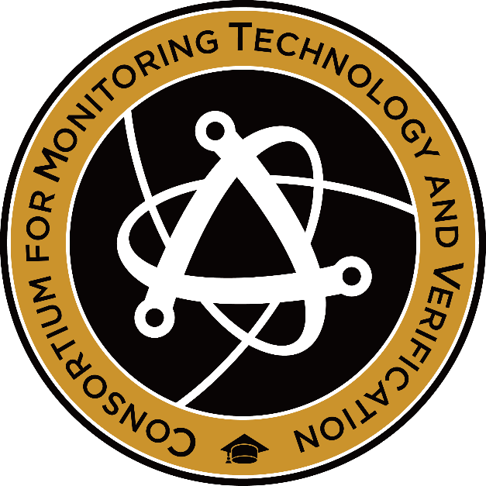
Application of Resonance Ionization Mass Spectrometry (RIMS) to Spent Fuel Analysis
2023 MTV Workshop
March 21
Henry Burns
PhD Student, Georgia Institute of Technology
Steven Biegalski
Georgia Institute of Technology

Slide 2
Introduction and Motivation
Novel forms of isotopic analysis are generally useful for increasing the scope and precision of nuclear forensics.
Ideally, a method of isotopic analysis should be accurate, useful, easily applicable, and suited to the isotopes of interest.
Isotopes with small concentrations (ppb or ppt) may be forensically useful but require sophisticated mass spectrometry methods to measure.
Resonance Ionization Mass Spectrometry is one such method.

Slide 3
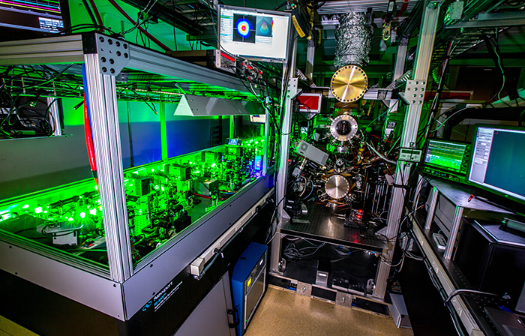
RIMS
Resonance Ionization Mass Spectrometry (RIMS) uses tuned lasers to selectively ionize the element of interest.
The ions are accelerated through an electric field.
Isotopes can be distinguished from each other by time-of-flight (ToF) measurements.
RIMS is highly accurate for many isotopes, distinguishing concentrations on the order of ppb or ppt.
Image source: https://pls.llnl.gov/resources/mass-spectrometry

Slide 4
Mission Relevance
This work relates to the NNSA mission by identifying and verifying applications of RIMS to nuclear forensics.
An understanding of the effects of reactor type and irradiation time on isotope ratios and the ability to measure those isotopes increases the ability to analyze spent fuel samples for nonproliferation studies.

Slide 5
Technical Approach
This work relies on simulations of commercial reactors conducted using the ORIGEN-ARP module in SCALE.
Repeated simulations of multiple reactors over both long and short time frames were conducted, and the resulting isotopic ratios were examined for differences on the order of ppb or ppt.
As part of an internship at LLNL this summer, spent fuel samples will be analyzed with RIMS to confirm both the validity of the simulations and the ability of RIMS to accurately measure the isotopes of interest in low concentrations.

Slide 6
Technical Approach

Slide 7
Results
Strontium isotopes emerged as promising candidates after simulation.
These isotopes were present in small concentrations (ppb) and are not suitable for gamma spectroscopy, which makes them ideal subjects for RIMS analysis.
The Sr-86/Sr-90 ratio varied noticeably between short and long irradiation times and between different reactor types
Sr-86/Sr-90 | Short | Long
bw15x15/ w17x17 | 1.0286 | 1.0255
w17x17/ ge10x10 | 1.3400 | 1.2125
bw15x15/ ge10x10 | 1.3783 | 1.2434

Slide 8
Expected Impact
If successfully verified this summer, this work will expand the possible uses of RIMS for nuclear forensics.
It will confirm the ability to use strontium isotope ratios with small forensic signatures to identify the reactor type that produced the spent fuel and estimate burnup and decay times.
It will further solidify the potential to use RIMS for any nuclear forensic applications involving low-concentration measurements.

Slide 9
MTV Impact
Key verification will take place this summer at LLNL as part of the GTSI program.
I will be working with Michael Savina and his team to conduct verification and test the detection limit of RIMS for these isotopes.
RIMS has already demonstrated usefulness for nuclear forensics; this work will add another aspect by which to evaluate samples.

Slide 10
Next Steps
As part of a continuing effort to identify isotopic ratios previously unused for nuclear forensic purposes (generally those with low concentrations), a full suite of isotopes with potential for RIMS analysis will be identified through repeated SCALE simulation.
Time and funding permitting, we will personally confirm the forensic validity of more isotopes with RIMS measurements. The full list will be published so that other researchers can further confirm the validity of low-concentration isotopes.

Slide 11
Acknowledgements
The Consortium for Monitoring, Technology, and Verification would like to thank the DOE-NNSA for the continued support of these research activities.
This work was funded by the Consortium for Monitoring, Technology, and Verification under Department of Energy National Nuclear Security Administration award number DE-NA0003920

