Slide 1
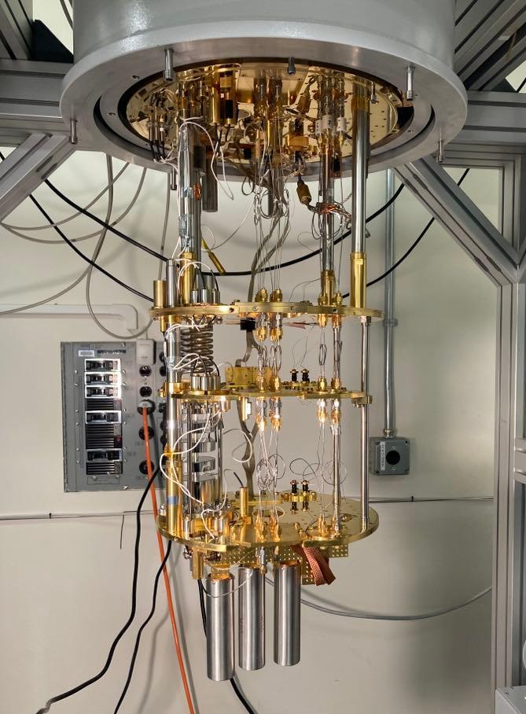
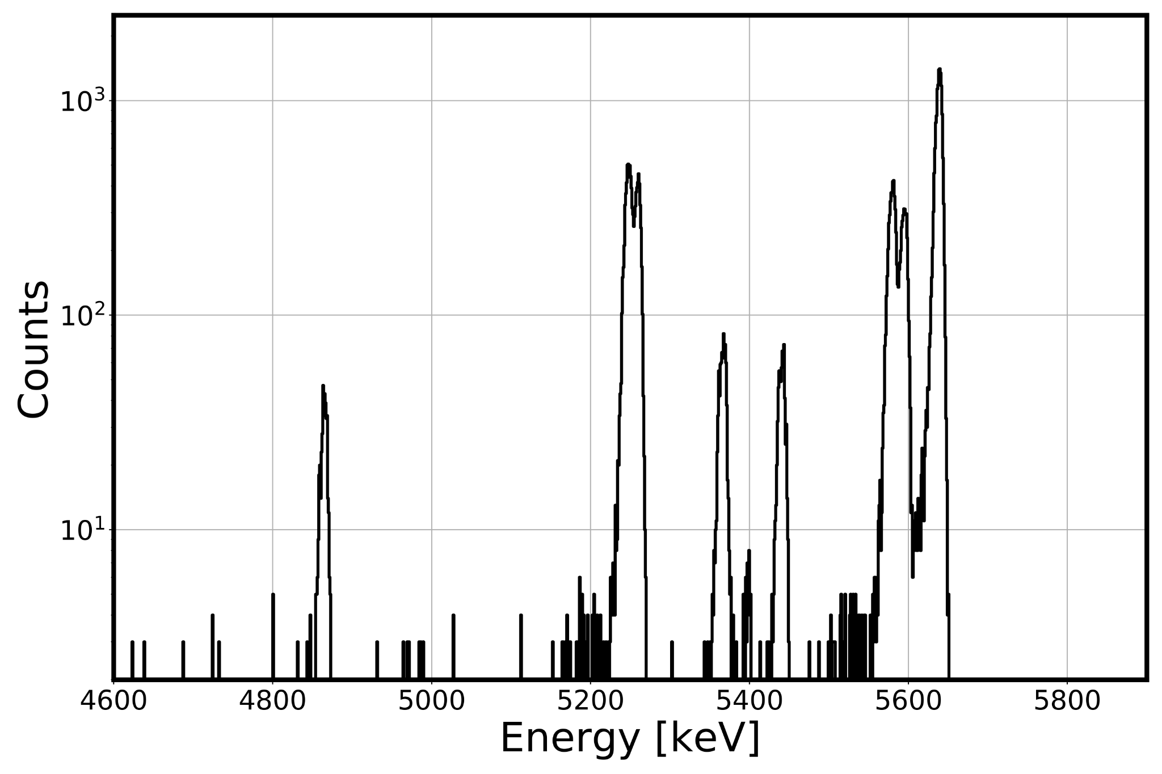
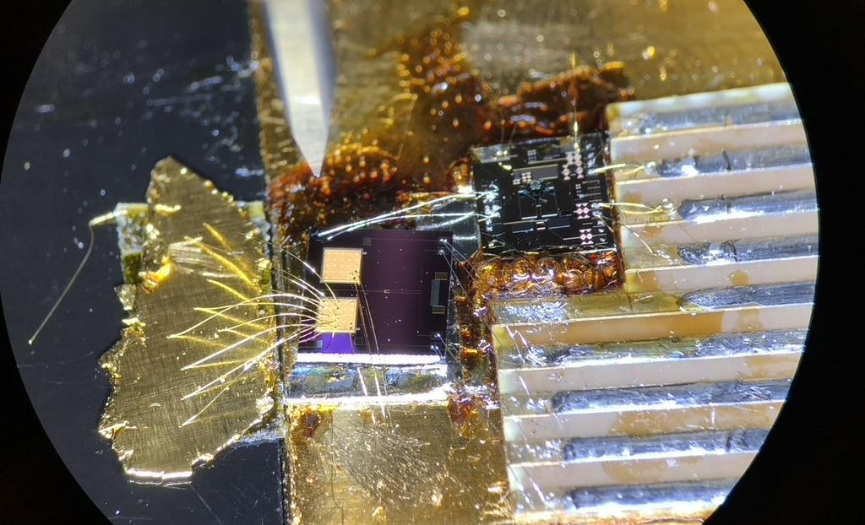
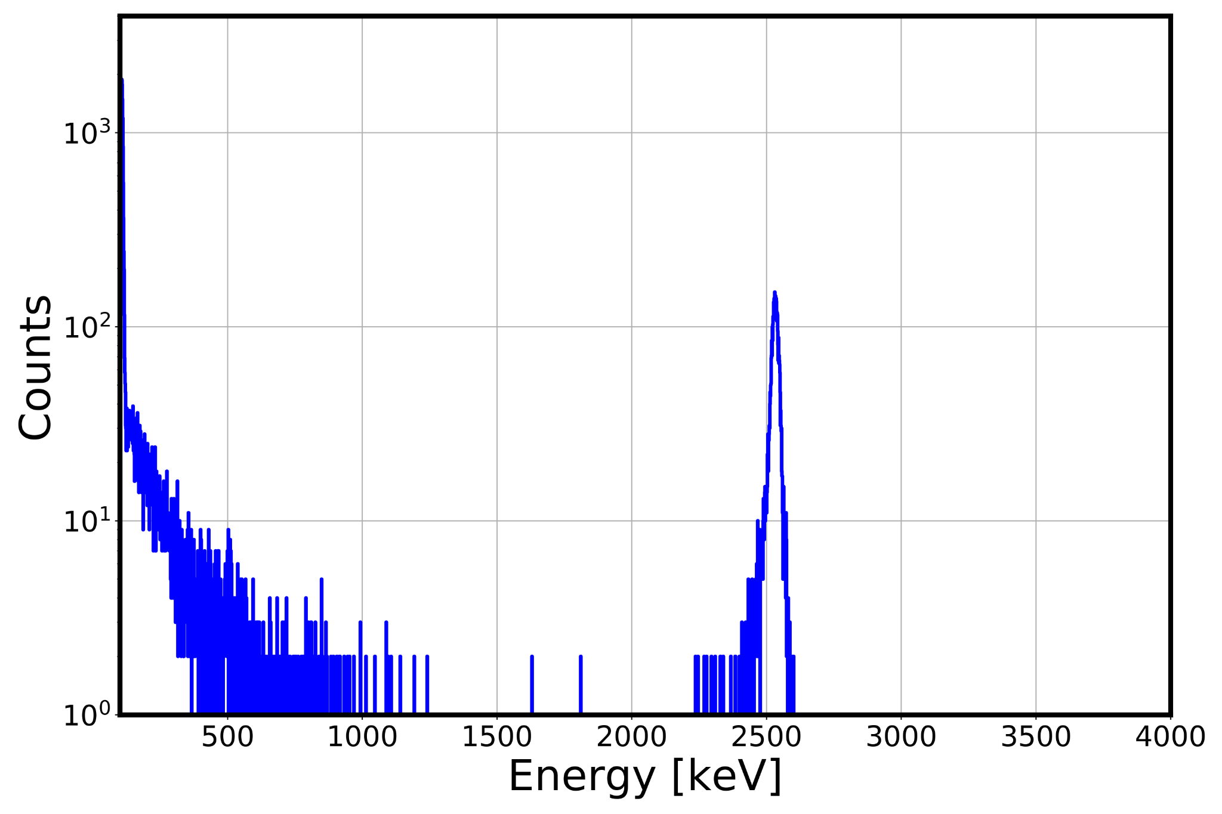
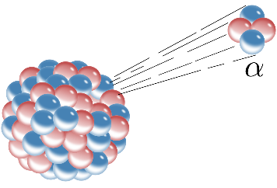
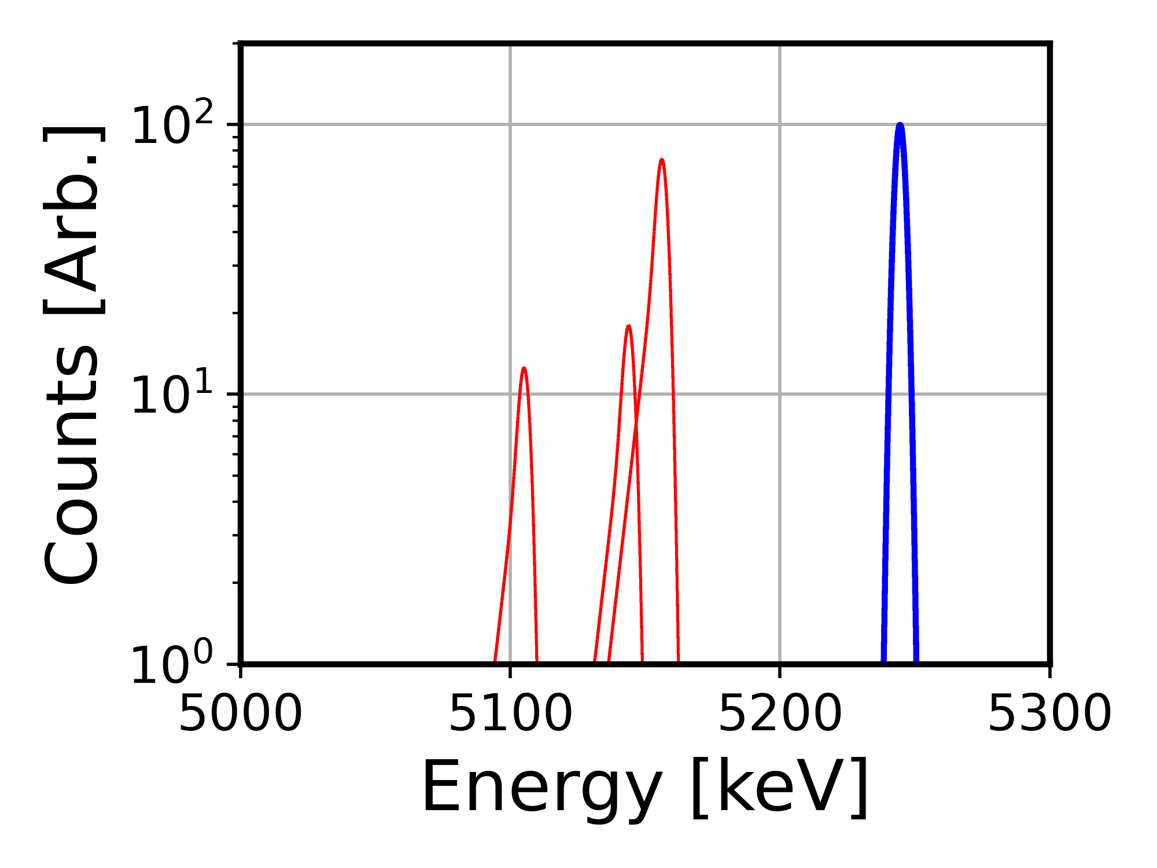
Novel Half-Life Measurement of ¹⁴⁶Sm with Microcalorimetry Alexander Kavner University of Michigan I. Jovanovic¹, G.B. Kim² , K.N. Kmak², Q.R. Shollenberger², S.T.P. Boyd³, S. Friedrich² University of Michigan¹, Lawrence Livermore National Laboratory², University of New Mexico³
Introduction and Motivation
Technical Approach
MTV Impact
In decay energy (Q)-spectroscopy, radiation sources are embedded within detectors such that the entire decay energy is measured as a single peak.
Magnetic microcalorimeters (MMCs) are cryogenic detectors with ultrahigh energy resolution.
Samarium 146 & 147 Important for radio dating of Solar-System timescales.
Currently 30% tension in ¹⁴⁶Sm half-life!!!
Q-Spec ideal for actinide identification: unique Q-values and little gamma branching
Unique benefits/complements:
²³⁸Pu / ²³⁸U and ²⁴¹Am / ²⁴¹Pu
Nondestructive assay
Collaboration with LLNL and UNM
Dilution Refrigerator
¹⁴⁶Sm Production
Ultra Pure ¹⁴⁶Sm
¹⁴⁶Sm Purification
¹⁴⁶Sm 1st Mass Spec.
¹⁴⁶Sm Decay Counting
$$T_{146}^{1/2}=ln⁡(2) \frac{N_{146}}{A_{146}}$$
Detectors (3x)
¹⁴⁶Sm 2nd Mass Spec.
Results
²³⁹Pu
²³⁸Pu
²⁴¹Am
²⁴⁰Pu
Gold Absorber
Paramagnetic sensor
MMC
¹⁴⁶Sm Decay Spectrum
²⁴³Am
Source
¹⁴⁶Sm Decay Energy Peak
²³⁴U
Sample holder
DC SQUID
¹⁴⁵Sm + Cosmogenic Background
Au + Source
Mission Relevance
Novel nuclear safeguards technology for nondestructive assay of uranium, plutonium, and mixed actinide samples
Contributes to fundamental nuclear science
Nuclear data
Particle physics
Interdisciplinary nuclear sciences, e.g., nuclear astrophysics
Signal to Background 500:1
Conclusion & Next Steps
Activity: 20.174 mBq ± 0.67%
# Atoms: 7.877E13 ± 0.32%
New half-life! → 85.76 My ± 0.76%
Successful half-life measurement
Successful measurement of mixed actinide sources
Demonstratable use cases for safeguards and fundamental science
Working with corporate partners for commercialized IAEA system
²³⁹Pu Alpha vs. Q-Spec
Expected Impact
Upcoming publication on novel decay counting
Upcoming publication on lunar formation models
Adaptation of technique to multiple applications in nuclear security and nonproliferation
This work was funded in-part by the Consortium for Monitoring, Technology, and Verification under DOE-NNSA award number DE-NA0003920 This work was performed under the auspices of the U.S. Department of Energy by Lawrence Livermore National Laboratory under Contract DE-AC52-07NA27344. This work was funded by the Laboratory Directed Research and Development program of Lawrence Livermore National Laboratory (20-LW-024).

