Slide 1
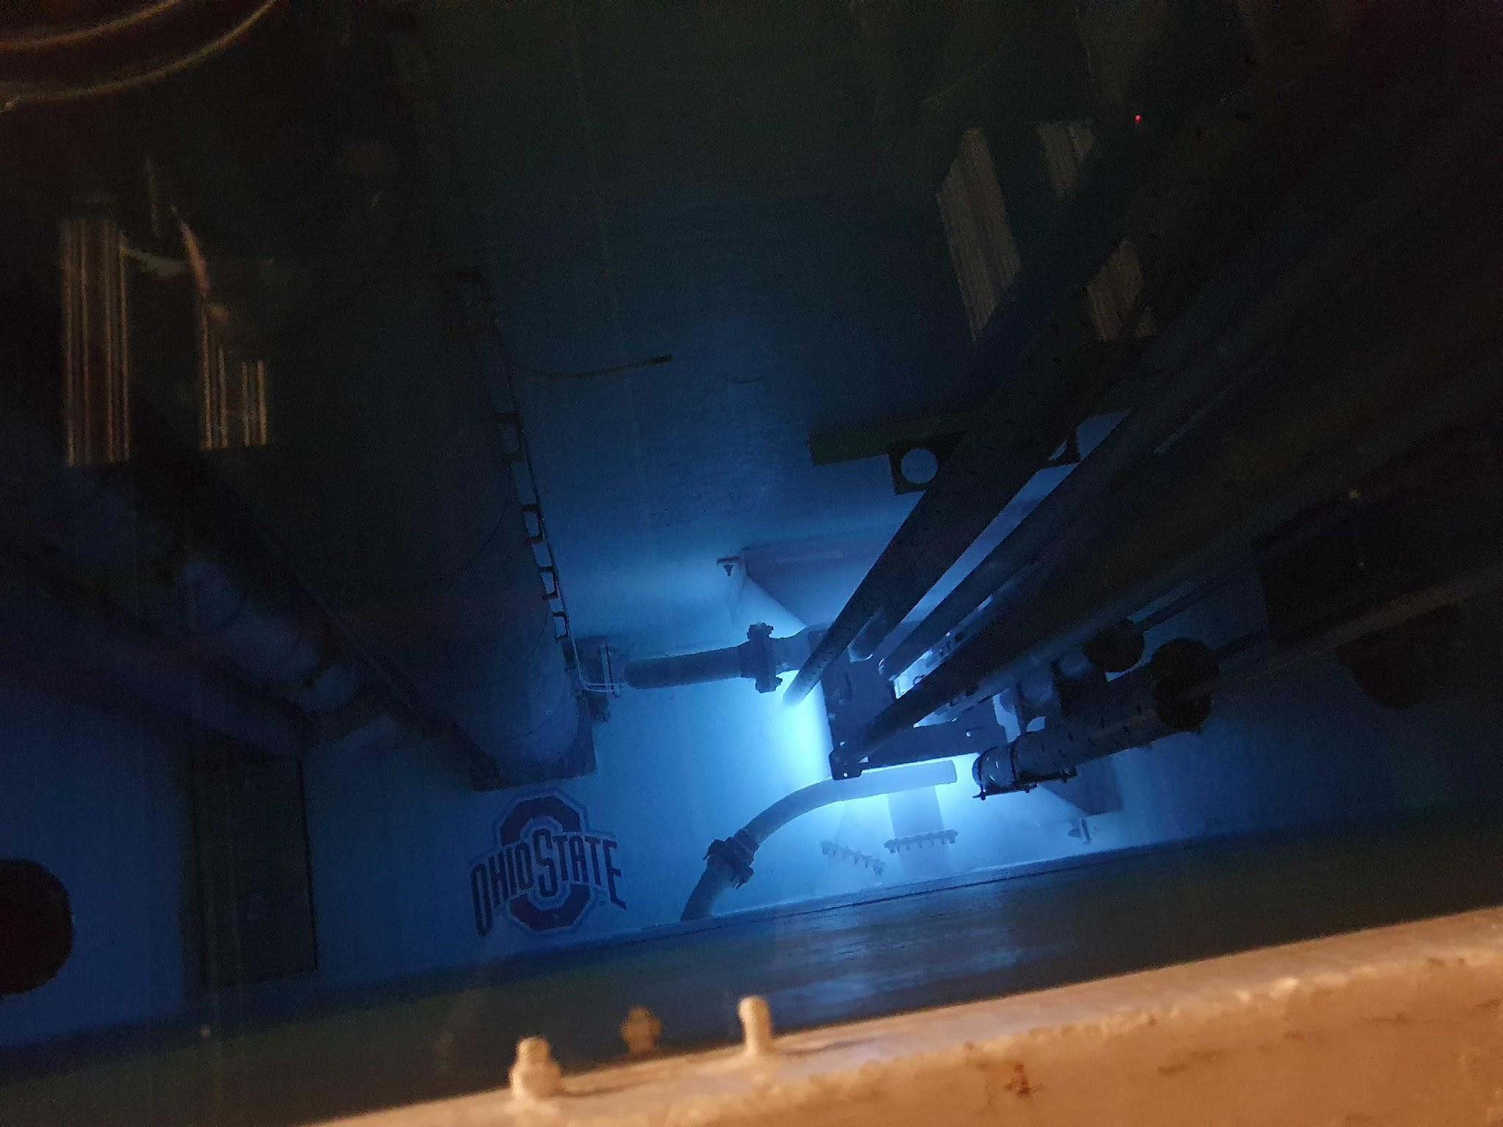
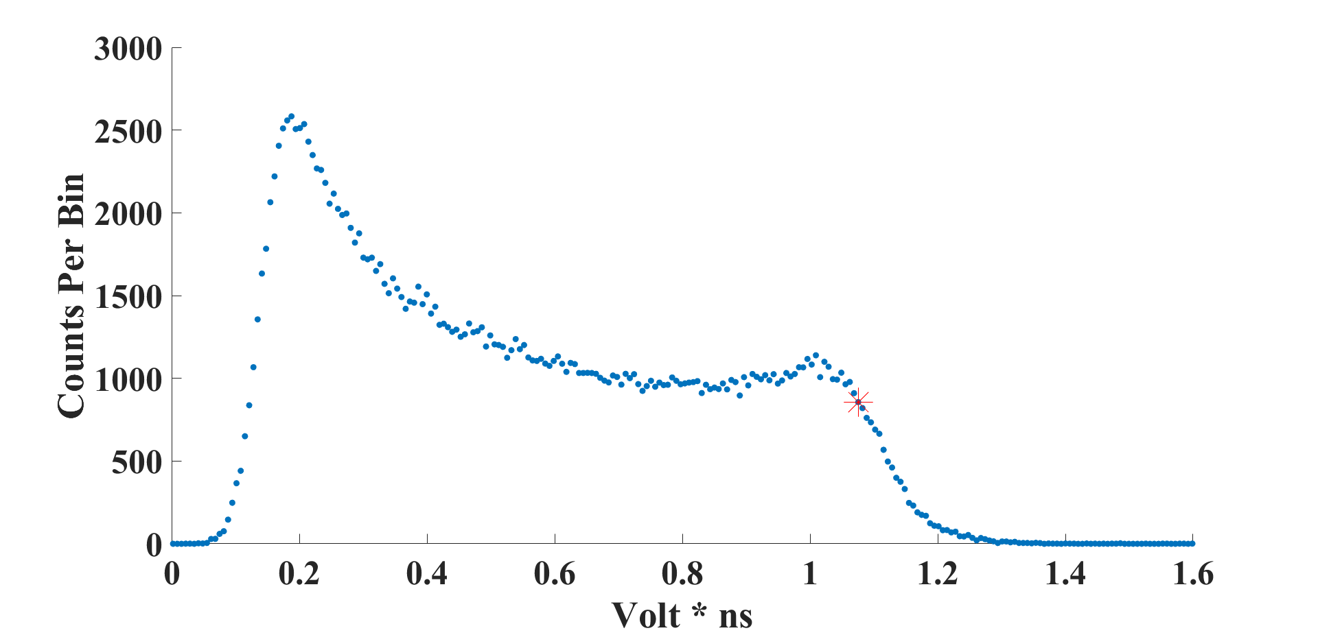
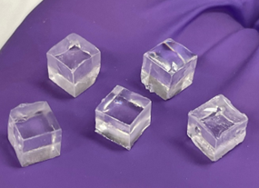
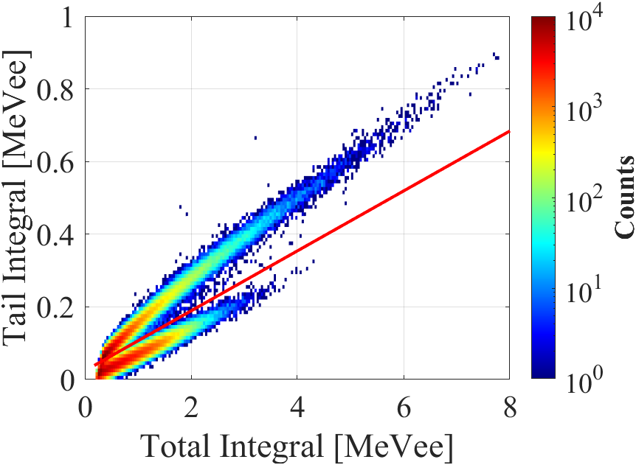
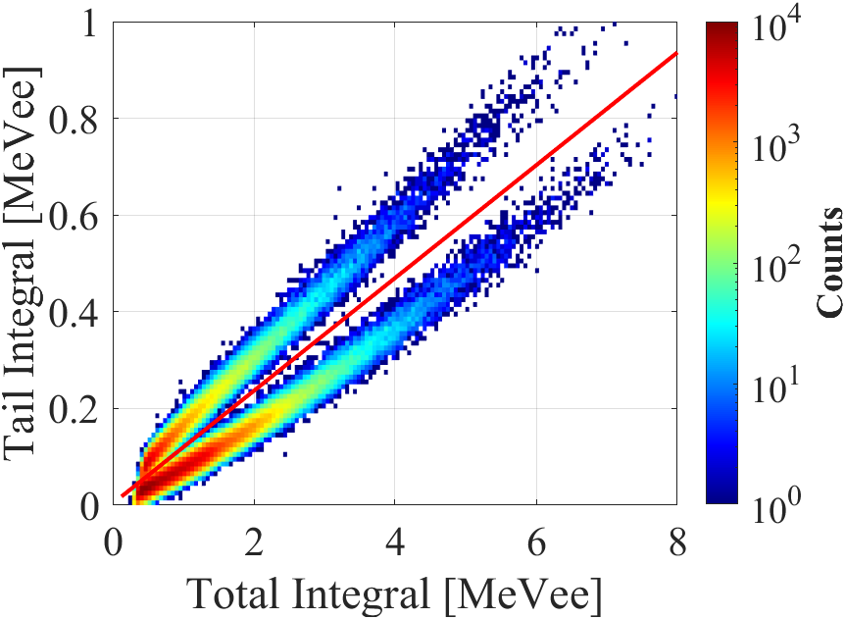
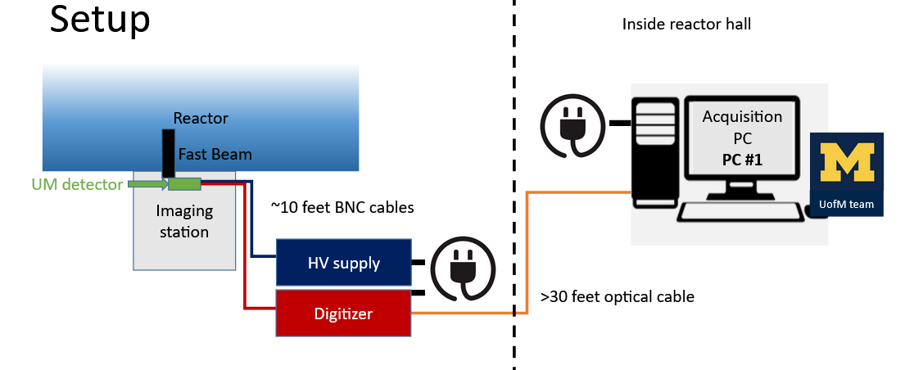
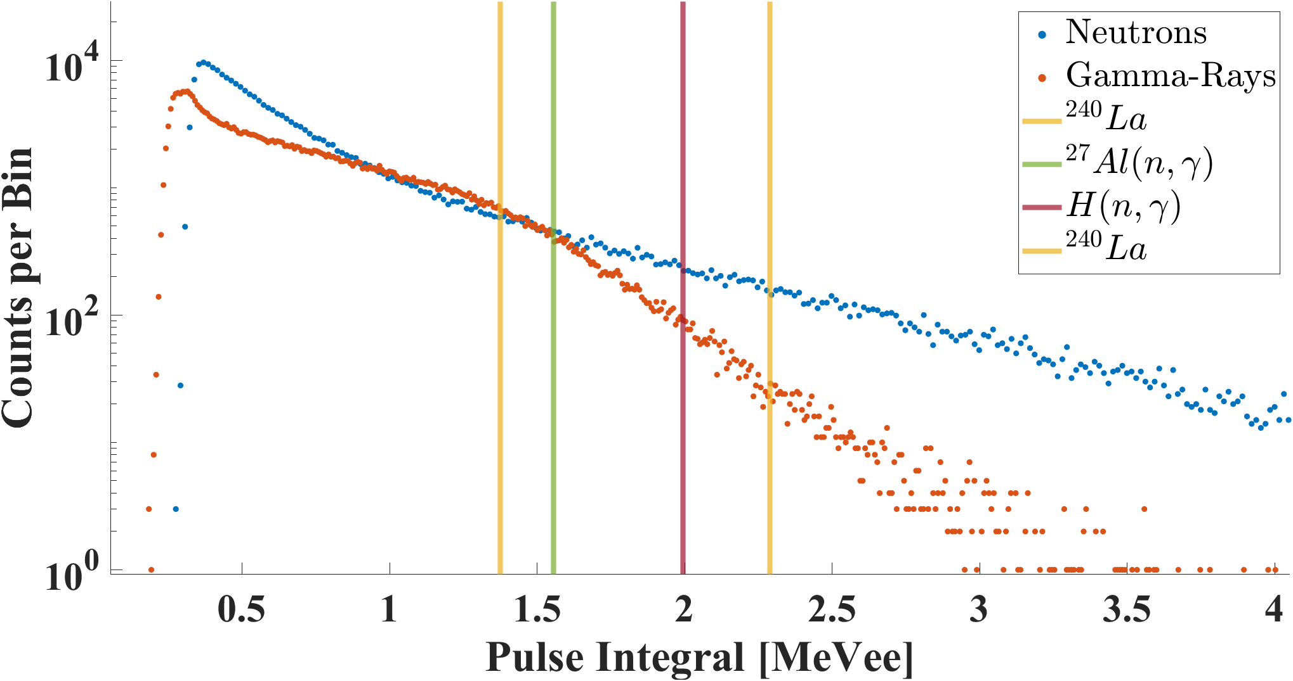
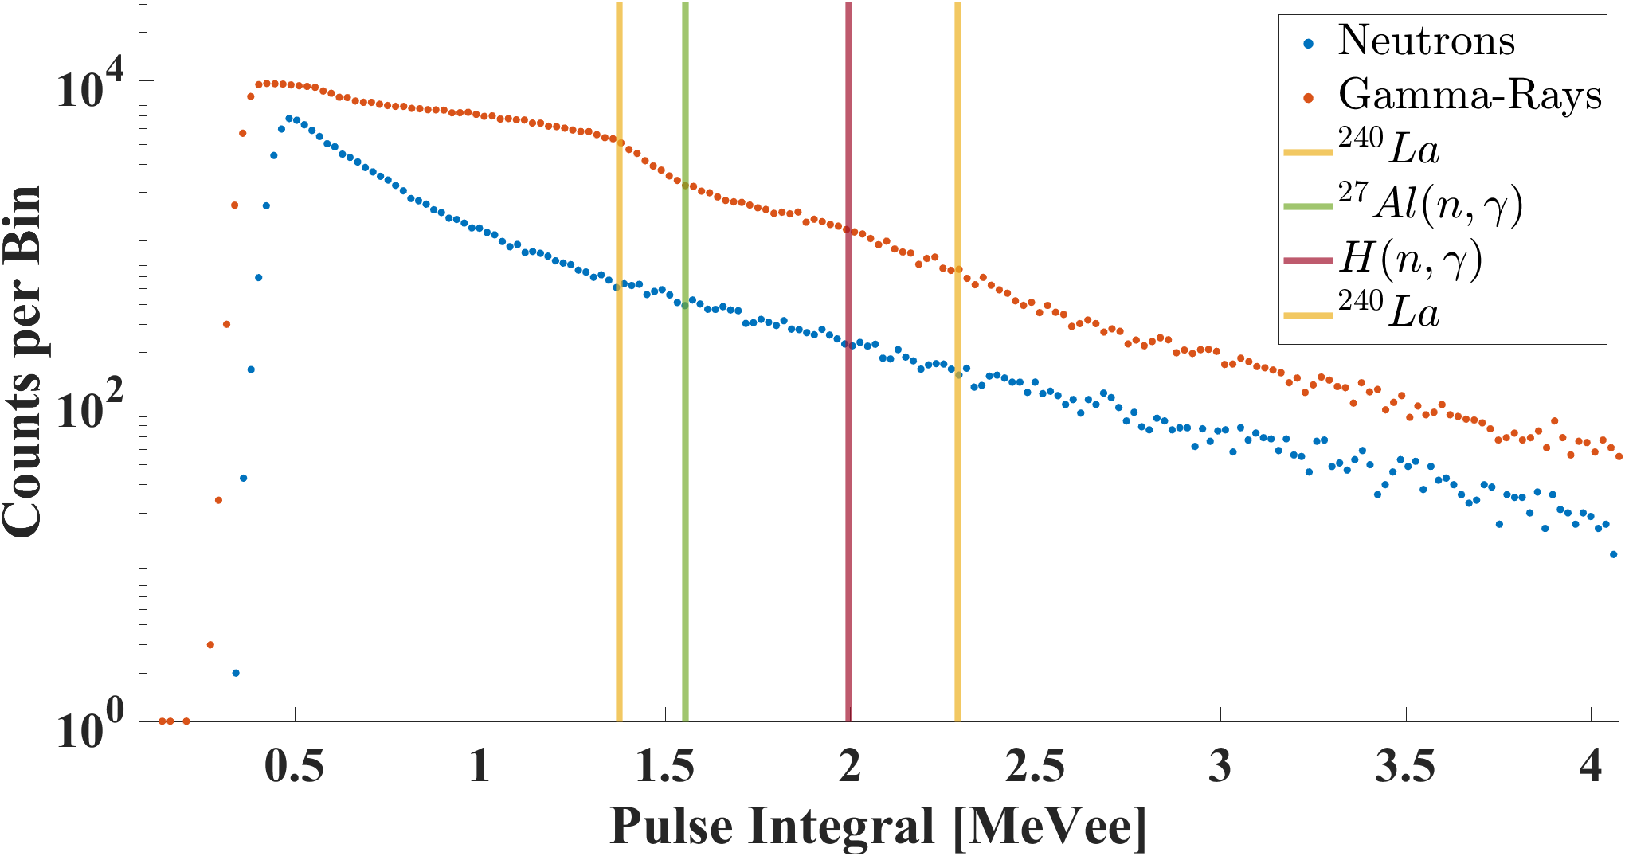
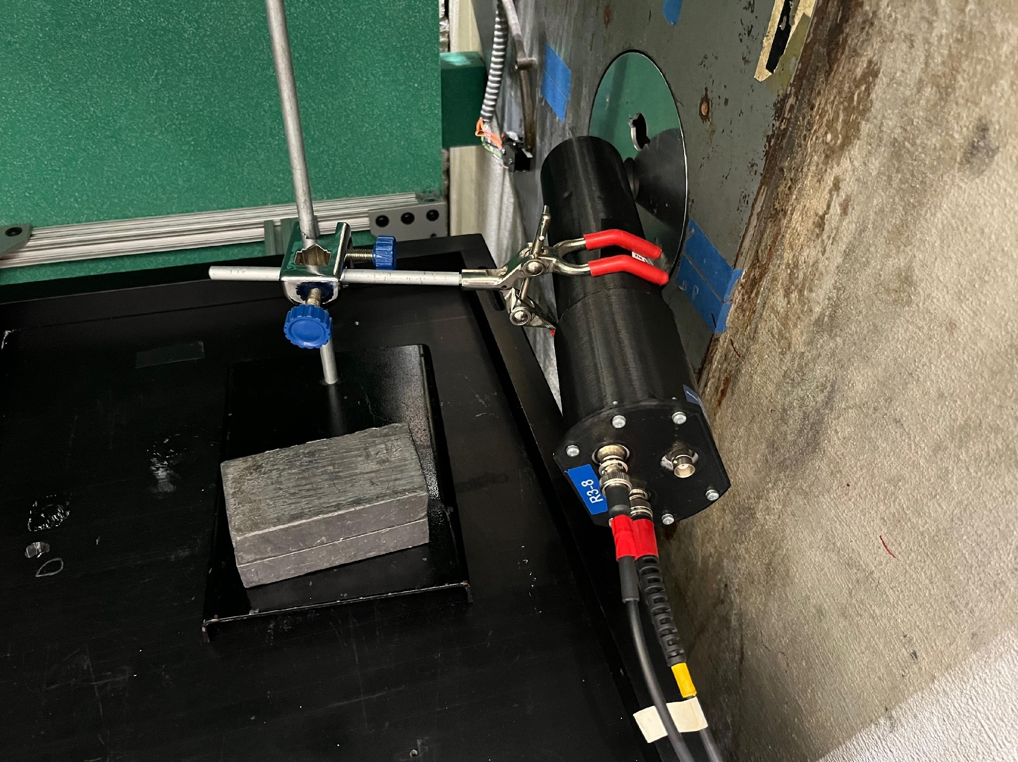
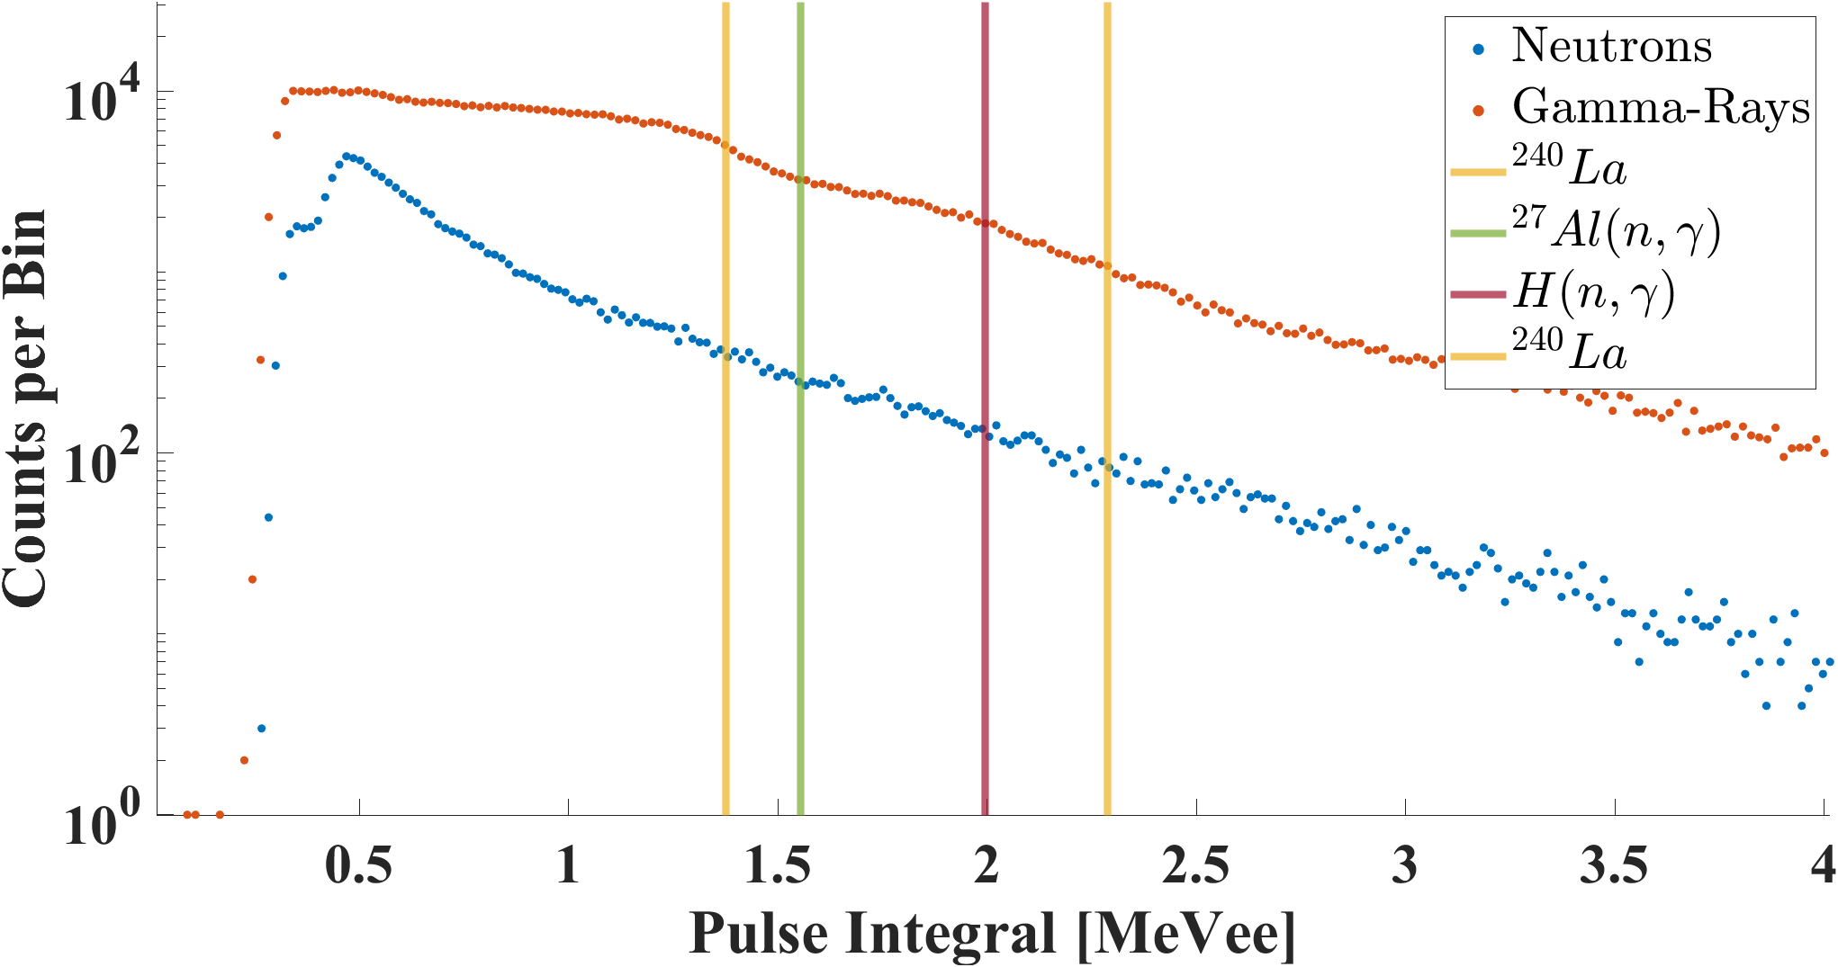
Using Organic Scintillators to Characterize a Reactor Fast Neutron Beam for Nonproliferation Applications
Nicholas Stubblefield¹
Masters Student, University of Michigan
O.Pakari¹, T.E. Maurer¹, S.D. Clarke¹, S.A. Pozzi¹, M. Bisbee², R. Cao²
University of Michigan¹, The Ohio State University²
Introduction and Motivation
Calibration
Discussion
Organic scintillators remain underutilized in reactor field characterization
No literature documenting organic glass in a reactor beam line
4 Organic scintillators placed in Ohio State University Research Reactor's neutron beam port to perform PSD and gamma, neutron spectroscopy
Reactor power 1 kW for 6mm and 10W for larger detectors
137Cs Source
75% of max Compton Edge set equal to 478 keV by a conversion factor
Conversion factor equates volt nanoseconds to electron volts
Organic detectors—both Stilbene and OGS-- demonstrate clear pulse shape discrimination, but a decrease in detector volume correlates with a shorter photon band
Pulse integrals show Compton edges which correlate to known isotopic Compton edge values, indicating a potential for spectroscopy
Compton edges become less resolved with decreasing detector size
6mm OGS Calibration Curve
Organic glass scintillator (OGS) material fabricated at Sandia National Labs.
The OGS was melt cast into desired geometries at UM
Results
First in beam organic glass results
Impact
6mm OGS
25mm OGS
First use of organic glass in a neutron beam port
Attract future collaborations with OSU (cross-consortium) and other research reactor facilities
Provides important insight into OGS properties and limitations, bolstering our partnership with Sandia National Labs
Expands potential tools for nuclear safeguards and treaty verification
6mm OGS Cubes
n
Technical Approach
ƴ
6mm OGS
25mm OGS
Conclusion and Next Steps
Detector | Reactor Powers
6mm Cube Stilbene 6mm Cube OGS | 1000 W Extrap. neutron flux: 3.33*104 n⋅cm-2⋅s-1 Exp. gamma DR: 51.5 mR/hr
51mm Cylinder Stilbene 25mm Cylinder OGS | 10 W Extrap. neutron flux: 3.33*102 n⋅cm-2⋅s-1 Exp. gamma DR: 1.19 mR/hr
Demonstrated OGS can perform in beam measurements
MCNP Modeling for spectroscopy comparison
Collaborate with OSU to identify more novel uses for organic scintillators in nuclear reactors
51mm Stilbene
This work was funded in-part by the Consortium for Monitoring, Technology, and Verification under DOE-NNSA award number DE-NA0003920

