Slide 1
Effect of Plume Hydrodynamics on the Combustion Chemistry of Laser Ablation Plasmas
2023 MTV Workshop
March 21st, 2023
Emily H. Kwapis*^{,1}
PhD Candidate, Nuclear Engineering Program, University of Florida
Enrique Medici¹, Kira Berg², Ryan W. Houim³, Kyle C. Hartig¹
¹Nuclear Engineering Program, Department of Materials Science and Engineering University of Florida
²Department of Agricultural and Biological Engineering, University of Florida
³Department of Mechanical and Aerospace Engineering, University of Florida
Notes:
Hello everyone. I’m Emily. I’m a 4th year PhD student in nuclear engineering at the University of Florida. And today I will be speaking to you on the post-detonation phenomena that characterizes laser-produced plasmas in relation to the standoff detection of nuclear materials using optical spectroscopy.

Slide 2
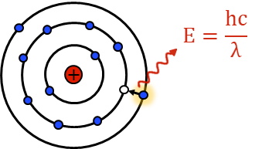
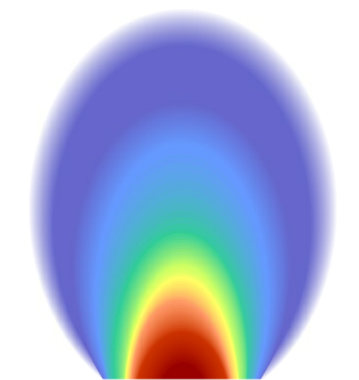
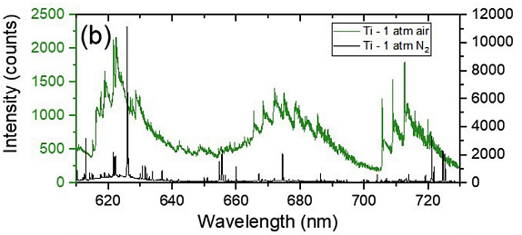
Introduction and Motivation
T, n_{e}
Standoff detection methods using optical spectroscopy are applied towards the
Wide area environmental sampling of nuclear materials to monitor nuclear fuel cycle activities
Rapid characterization of post-detonation nuclear environments to respond to nuclear explosion events
Optical signatures are strongly dependent on laser parameters and environmental conditions
Intermixing between reactive plasma species and oxygen results in oxide formation
Depending on thermodynamic and atmospheric properties, molecular formation may follow different reaction pathways and kinetics
Molecular signatures overlap with and obscure atomic signals for crowded spectra
Time
Plasma core
Edge
T, n_{e}
Plasma length
20 µs
E.J. Kautz et al., Phys. Plasmas 29, 053509 (2022).
Notes:
This research falls under the third thrust area of the consortium, where we aim to support the mission of monitoring nuclear explosion events through the wide area environmental sampling of nuclear materials using optical and laser spectroscopy. With these techniques, lasers are used to vaporize and excite samples at standoff distances to produce a micro-plasma that is representative of the chemical and isotopic compositions of that sample. However, the interpretation of the optical spectrum measured for the sample is strongly dependent on the complex transient conditions of the laser-produced plasma, where the plasma properties are highly sensitive to experimental parameters and environmental conditions. Intermixing between reactive plasma species and oxygen leads to the formation of oxides that alter the composition of the plasma plume, consequently introducing molecular signatures that can overlap and obscure atomic transitions present in the optical spectrum. Depending on thermodynamic and atmospheric properties, molecular formation may follow different pathways and kinetics, further complicating the spectroscopic analysis.

Slide 3
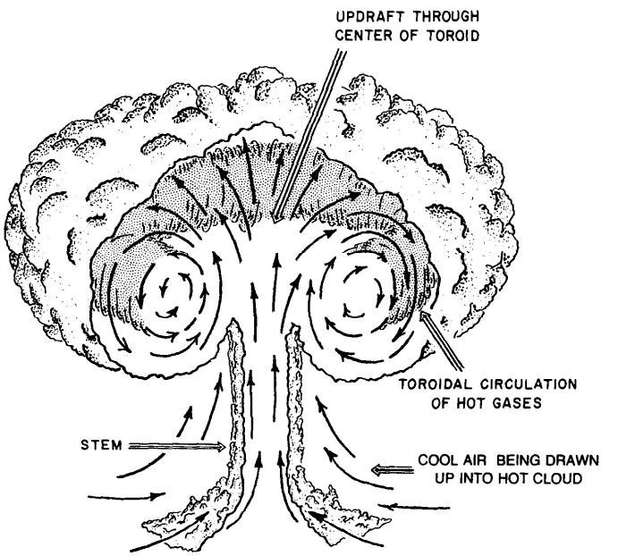
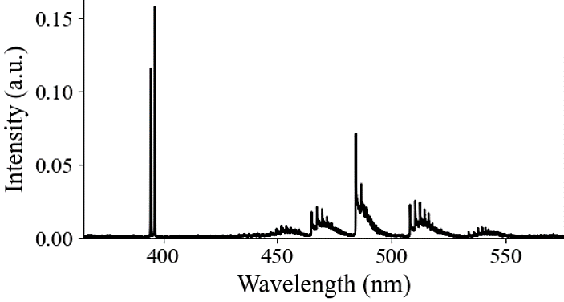
Mission Relevance
Objective: To explain the hydrodynamical intermixing processes between plasma and ambient gas species that govern combustion chemistry in laser ablation (LA) plasmas
Develop a more advanced understanding on the mechanisms of molecular formation in LA plasmas
Spatial distributions of reactants and products
Timescales and reaction rates
Investigate the role of turbulence on the morphology of plasma plume chemical reaction zones
Address opposing viewpoints on the involvement of shockwaves in LA plasma chemistry
Predict debris formation in nuclear fireballs and corresponding fate and transport of radionuclides in the environment
S. Glasstone & P.J. Dolan. The Effects of Nuclear Weapons, 3rd ed., DoD & DOE, (1977).
Atomic
Molecular
Notes:
Therefore, in this work we aim to explain the hydrodynamical intermixing processes between the plasma and ambient gas species that drives the post-detonation phenomena and chemistry of these laser-produced plasma. We know that reactive laser ablation plasmas undergo oxidation in atmospheres such as air, and we also understand some of the basic mechanisms of this process. Yet there are still questions on these general and basic characteristics of laser-produced plasmas., such as specifics on where reacting species are located within the plasma or values for reaction rates. Reaction mechanisms and rates are largely unknown and have not been measured for high-temperature plasmas for elements such as uranium, cerium, and plutonium. It is believed that mixing processes such as diffusion and turbulence drive chemical reactions while laser-induced shockwaves do not impact reaction rates in any way. Others strongly support their argument that shockwaves are involved and work to prevent chemical reactions from occurring at earlier times. One of the motivations for this work is to address these opposing viewpoints on the involvement of shockwaves on plasma ablation plasma chemistry.

Slide 4
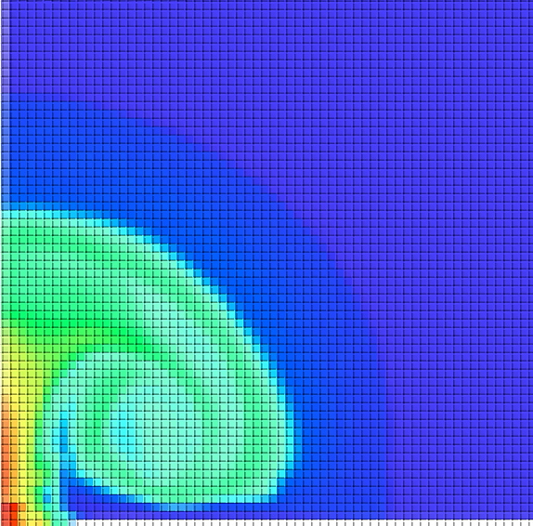
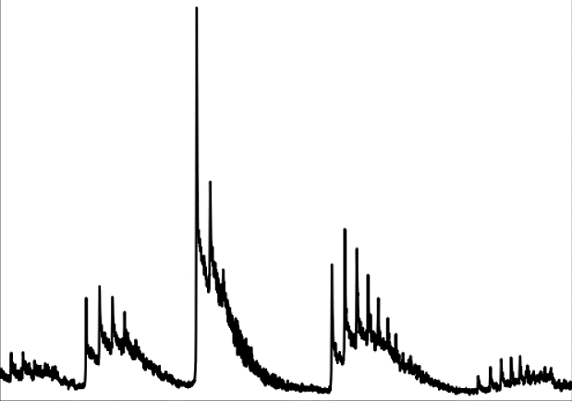
Technical Approach
Experimental Methods
Computational Modeling
Using high-fidelity, multi-physics CFD code HyBurn
State-of-the-art Eulerian multi-phase flow model
Post-detonation physics and turbulent chemistry
emICCD
ns-LA using Nd:YAG laser (25 mJ, 1064 nm)
Shadowgraphy Setup Only
emICCD
Nd:YAG Laser
(532 nm)
Filters
Al
RG6
Laser-Induced Breakdown Spectroscopy
Outflow BC
Time-Resolved Fast-Gated Imaging
Shadowgraphy
Symmetry BC
Outflow BC
Thermal Emission Spectrum
Emission Images
Changes in Flow Density
Slip Wall BC
Notes:
This is done by performing both experimental measurements and computational modeling. We are using three different techniques – laser-induced breakdown spectroscopy, time-resolved fast-gated imaging, and shadowgraphy. The first two methods are aimed towards characterizing the plasma while shadowgraphy is typically used to image shockwaves. Although depending on the imaging setup for shadowgraphy, it is possible to resolve the periphery of the plasma flow behind the shock front as well. This tends to be difficult if there are diffraction patterns in the image, which is why we are using this cuvette filled with a fluorescent dye placed in front of the probe laser for shadowgraphy. Using fluorescence instead of laser light is a method that is used to provide very clean shadowgraphic images because you remove the coherence from the light that results in diffraction patterns. This is not a new technique, but it is not used frequently nowadays, which is why I wanted to highlight it. --- And now, for the computational component of this work, we are using a high-fidelity multi-physics code called HyBurn that has been specifically written and developed at the University of Florida to model post-detonation physics and turbulent chemistry in fireballs. For those of you familiar with multi-physics codes, you probably want to know that HyBurn is a Eulerian CFD code and it uses non-ideal equations of state. I’m running 2D axisymmetric simulations, where I am essentially modeling micro-explosions in this code that are serving as models for laser-produced plasmas.

Slide 5
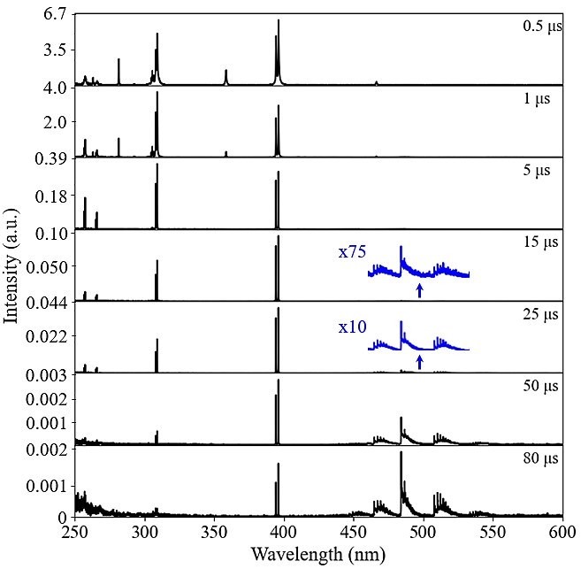
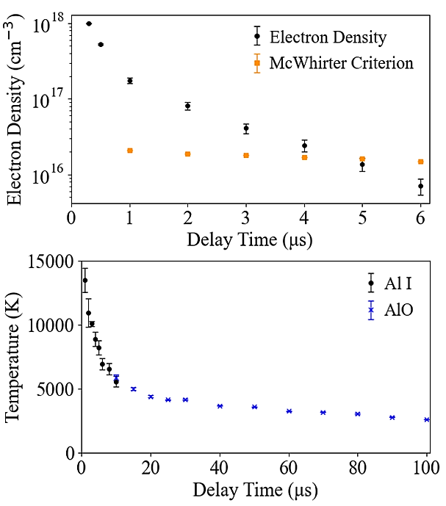
Aluminum Gas-Phase Thermochemistry
Spectroscopic signatures are measured using LIBS to study the formation of AlO in the Al LPP
AlO signals are first observable as early as 1 µs
AlO Formation:
$$Al \left(g\right)+O_{2} \left(g\right)→AlO (g)+O (g)$$
$$Al \left(g\right)+O (g)+M↔AlO (g)+M$$
$$O_{2} \left(g\right)+M↔O \left(g\right)+O (g)+M$$
Formation of Polyatomic Oxides:
$$AlO \left(g\right)+O_{2} \left(g\right)↔AlO_{2} \left(g\right)+O (g)$$
$$AlO \left(g\right)+O \left(g\right)↔AlO_{2} (g)$$
$$AlO (g)+Al (g)↔Al_{2}O (g)$$
$$⋮$$
$$Al_{2}O_{3} (g)↔Al_{2}O_{3} (l)$$
AlO
Overlap between atomic and molecular temperatures
Notes:
There are various different inputs required for HyBurn. Thermodynamic parameters, reaction mechanisms, and reaction rates are among those required inputs. Because of this, we are not able to model any of the lanthanides or actinides because we do not have the data we need to input into the code. But we do have all of this data for aluminum thanks to research on explosives and fire safety. So, we are focusing on aluminum plasmas and aluminum thermochemistry in this work, but the hydrodynamical processes that we are modeling should be general to all laser ablation plasmas. On this slide I’ve included a small handful of the reactions that are included in the multi-physics model, where I do want to highlight that condensation processes are included in our simulation, as given by Al2O3 at the bottom of the list. On the experimental side, we are able to measure atomic Al and AlO formation using laser-induced breakdown spectroscopy. The spectrum that I’m showing on this slide is produced from LIBS measurements that I performed, where I’ve labeled the signatures that correspond to AlO, where all of the other peaks either correspond to neutral or ionized aluminum. If you zoom in on the molecular signatures, AlO is observable as early as 1 us. Which is telling us that chemical reactions do occur pretty early after laser ablation when shockwaves are still present. From this spectrum, we can also pull out estimates on the average plasma temperature. For the conditions in this work, that temperature is around 14,000 K at 1 us and cools pretty quickly to around 5,000 K at 10 us. By this time, AlO signals are strong enough that we can pull temperature from these lines as well. It is clear from this curve that temperatures overlap between atomic and molecular species, which may possibly indicate that the species are emitting from the same general location in the plasma and are mixing together.

Slide 6
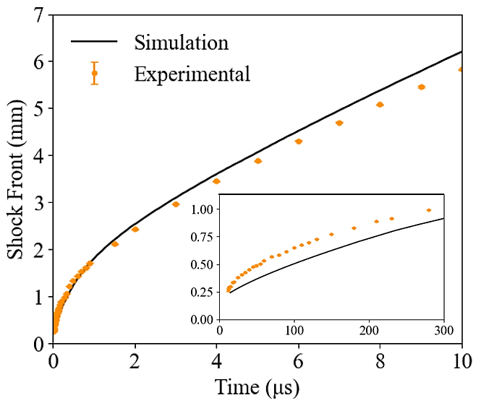
Multi-Physics Modeling of Multi-Phase Chemistry
HyBurn simulation initialized based on experimental data
Initialized post-LA at 15 ns
Homogeneous Al fireball
Initial temperature: 20,000 K
Initial pressure: 70 MPa
Al Fireball Multi-Phase Thermochemistry
Al (g)
Mass Fraction
AlO (g)
Mass Fraction
Al₂O₃ (l)
Mass Fraction
Condensation
Max
Shockwave Propagation
0
AlO is formed almost immediately after laser ablation
Notes:
To investigate the spatial component of the chemistry is where the multi-physics simulation comes in. I don’t want to go into detail on how the initial conditions are determined for the simulation because I want to focus on the thermochemistry results, but I will say that these values are determined using experimental data on the laser-induced shockwave. And we are initializing the simulation at some time after laser ablation because the code doesn’t currently model the heat conduction and ionization processes involved in LA. --- So, I’ll start the simulation. And what you will see in the middle plot is that AlO is formed almost immediately after laser ablation. This animation here is showing you mass fractions of Al, AlO, and the condensation product Al2O3. The molecular species tend to be concentrated around the periphery of the fireball at early times, and then as vortices form and the fireball expands outwards, those spatial distributions change as the species mix together. --- I’ll let this play out a little bit longer. By this time, Al and AlO are concentrated in the vortices of the plume and are being used up as reactants to form higher polyatomic oxides, that eventually lead to the formation of this condensation product shown on the right.

Slide 7
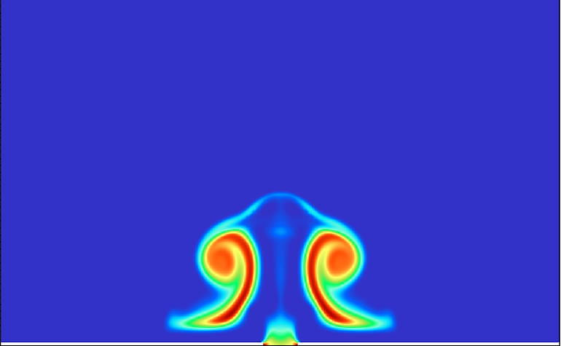
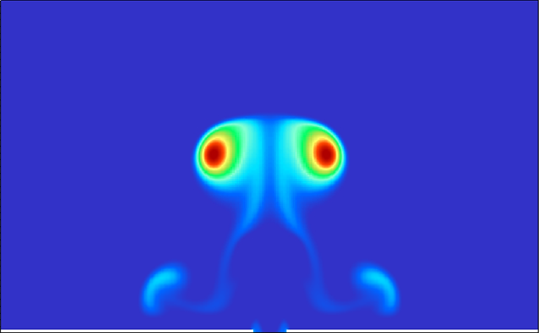
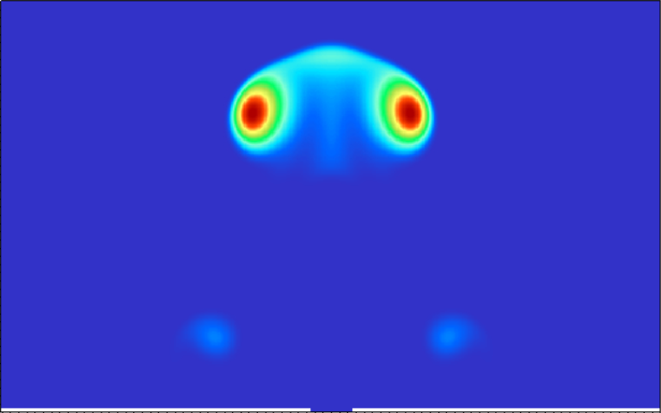
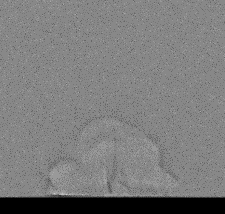
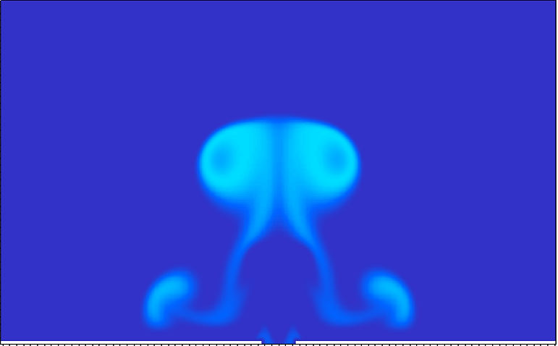
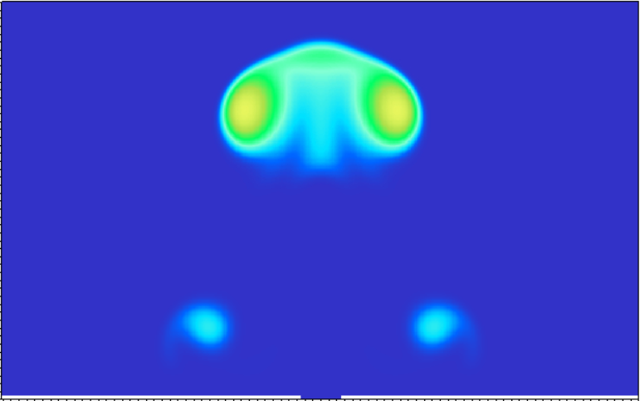
Comparison of Results
HyBurn Simulation of Al and AlO Mass Fractions
Measured Emission Images
0.5 µs
5 µs
0.5 µs
5 µs
Features simulated in the simulated measurements using HyBurn are observable in the experimental measurements
Timescales and lateral dimensions are comparable
Al (g)
1.0
0.85
Al I
2 mm
Y-axis (mm)
0.5
0.43
0
0
0
Atmospheric mixing and vortex formation
20 µs
40 µs
20 µs
40 µs
Al (g)
0.44
0.14
Al I
20 µs
40 µs
0.22
2 mm
Y-axis (mm)
0.07
Measured
Simulated
Measured
Simulated
0
0
2 mm
AlO (g)
AlO
Y-axis (mm)
HyBurn generally predicts larger fireballs
0
AlO emission is initially strongest towards the sample surface
Notes:
We can put the results of this simulation side-by-side with experimental measurements. The grayscale images are showing you measured images of the plasma using shadowgraphy compared to simulated Schlieren images in HyBurn. And the take-away here is that the lateral dimensions and overall shape of the plume between the two datasets tends to be comparable while the simulation overestimates the height of the fireball. So, this is something that will need to be addressed in collaboration with the code developers in the future, but right now the code is still giving us encouraging and promising results on the hydrodynamics and chemistry. We see vortex formation is both the simulation and measured images of the plasma emission using time-resolved fast-gated imaging. We also see parallels between the AlO features, where experimentally we measure AlO to be emitting strongest around the sample surface at 20 us, while geometrical features that agree with this spatial distribution are observed in the simulation. ---

Slide 8
Expected Impact
Through computational modeling using HyBurn, it was shown that
Molecular formation occurs almost immediately post-LA along the periphery of the plasma plume where thermal gradients are large
Vortex formation and turbulence pulls oxygen into the vortices and stem of the plasma
Shockwaves play no role in preventing mixing and chemical reactions between plasma-oxygen species
Supports belief that chemical reactions are driven by temperature and density gradients
Disagrees with shockwave mediated chemistry hypothesis
O
O
O
O
O
O
O
O
O
O
Al
O
Al
Al
O
O
O
O
O
O
O
O
Al
Notes:
So, what’s the impact of being able to perform these advance multi-physics simulations of the laser ablation plasma? I’m going to pull you back to the statement I made earlier during the introduction of this presentation when I spoke to addressing opposing viewpoints on the role that shockwaves play in laser plasma chemistry. In this work, aluminum monoxide was observed in experimental measurements as early as 1 us while in the computational models molecular formation was shown to occur along the periphery of the plasma plume almost immediately after laser ablation. Strong shock waves are definitely still present at this time, yet they were not shown to preventing mix or chemical reactions between the plasma-gas species in any way. This means that our results support the belief that chemical reactions are driven by plume hydrodynamics, turbulence, and temperature gradients at the edge of the plasma as compared to theory on shockwave mediated chemistry.

Slide 9
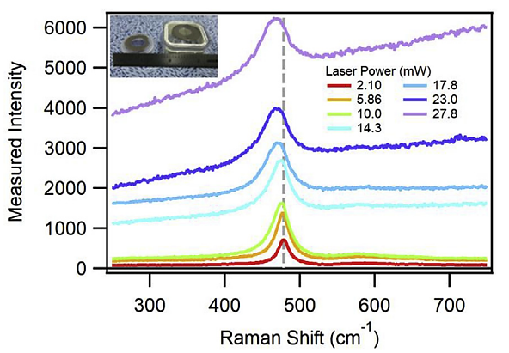
Next Steps
Perform further modeling using HyBurn to study
Effect of ambient gases and bulk pressure on the plume confinement and heterogeneous Al LPP properties
Effect of oxygen concentration on Al LPP thermochemistry
Turbulence effects
Possible future updates to HyBurn include
Adding theory on atomic and molecular spectroscopy to the code to model spectroscopic signatures
Adding equations to the code on heat conduction and ionization processes to model the laser ablation process
Sample of PuO₂ (80% ²³⁹Pu/20% ²⁴⁰Pu) has been obtained for laser spectroscopy experiments
Various experimental methods including LIBS and Raman are planned
100 Torr
760 Torr
Collaboration with Savannah River National Laboratory
E. Villa-Aleman et al., J. Nucl. Mater. 515, 140-149 (2019).
Notes:
There’s still more we can do to investigate the chemistry of laser-produced plasma. This work focused on plasmas generated at atmospheric pressure in air. We can also change background gases and pressures to further investigate confinement effects and the effect of oxygen concentration on chemistry. We can also introduce more effects in regards to turbulence to the simulations. It is also of interest to provide updates to the source code for HyBurn, where there has been talk about adding capabilities to simulate spectroscopic signatures as well as model the laser ablation process, which would require ionization processes to be added as well. Both of these options are very feasible and out collaborator that writes the code definitely has interest in bringing in students to perform these updates. --- Now, for a quick aside on other work. I typically speak on cerium laser-produced plasmas as a surrogate for plutonium, which is performed in collaboration with Savannah River National Laboratory. About a week ago, our collaborator at the lab – Dr. Eliel Villa-Aleman – obtained a sample of plutonium. Within the next month experiments are planned to be performed, so there should be progress and publications on that project as well.

Slide 10
MTV Impact
Internships:
Previous (Summer 2022): DTRA, DoD, Vanderbilt NSF REU
Upcoming (Summer 2023): DTRA, DoD, LANL, LLNL Seaborg Fellowship
DoD SMART graduate fellowship (x2)
Conference Presentations:
Previous (2022-2023): MARC (x2), OSA Optical Sensors and Sensing Congress (x2), INMM (x1), SciX (x2), LIBS (x1)
Upcoming: INMM (x1), SciX (x3), CLEO (x1)
Journal Publications:
Published/Accepted: Applied Spectroscopy, Spectrochimica Acta Part B (x2), Optics Express
Submitted: Optics Express, Analytical Chemistry, Appl. Spectrosc.
Research collaborations: SRNL, LLNL, SNL, AFTAC, UM
Notes:
As for other updates on internships, conferences, and publications, I have listed the involvement of myself and other students that perform work to support the MTV mission. The items I’m involved in are bolded. I am a graduate fellow with the department of defense, so every summer I intern with the DoD and this summer will be my third and hopefully last internship before I graduate. Another student in my research group was also recently notified that he was awarded the Seaborg fellowship at Lawrence Livermore, so he’ll be there this summer interning with a group that does a lot of plasma chemistry work. --- There’s been several presentations over the past year. I’ll be presenting at the INMM conference in May and I’ve also been invited to give a talk at SciX in October. My research group has also had 4 journal articles published since December and by the time I’m giving this talk at the MTV meeting, I’ll have submitted a paper on the work presented in this presentation to Anal. Chemistry.

Slide 11
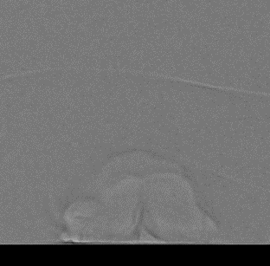
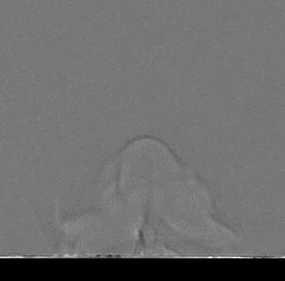
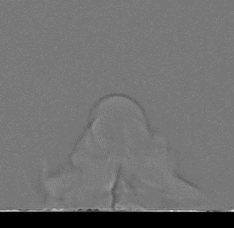
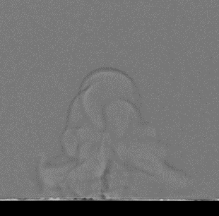
Conclusion
Supports the NNSA nuclear nonproliferation mission by researching optical measurements and signatures towards the characterization of nuclear materials in the environment
Experimental and computational measurements of Al LPPs were performed to explain the general hydrodynamic processes that govern laser ablation plasmas
Showed that molecular formation depends on thermodynamics and turbulent mixing between plasma-gas species
Results indicate that laser-induced shockwaves do not influence LPP plasma chemistry
1 µs
5 µs
10 µs
30 µs
50 µs
70 µs
100 µs

Slide 12
Acknowledgements
The Consortium for Monitoring, Technology, and Verification would like to thank the DOE-NNSA for the continued support of these research activities.
This work was funded by the Consortium for Monitoring, Technology, and Verification under Department of Energy National Nuclear Security Administration award number DE-NA0003920
Notes:
I would like to thank the University of Michigan for hosting this meeting and the NNSA for funding this research.

