Slide 1
Response of a High-Pressure ⁴He Scintillation Detector to Nuclear Recoils up to 9 MeV
2023 MTV Workshop
March 22, 2023
Oskar Searfus
PhD Candidate, University of Michigan
Peter Marleau, Sandia National Laboratories
Igor Jovanovic, University of Michigan

Slide 2
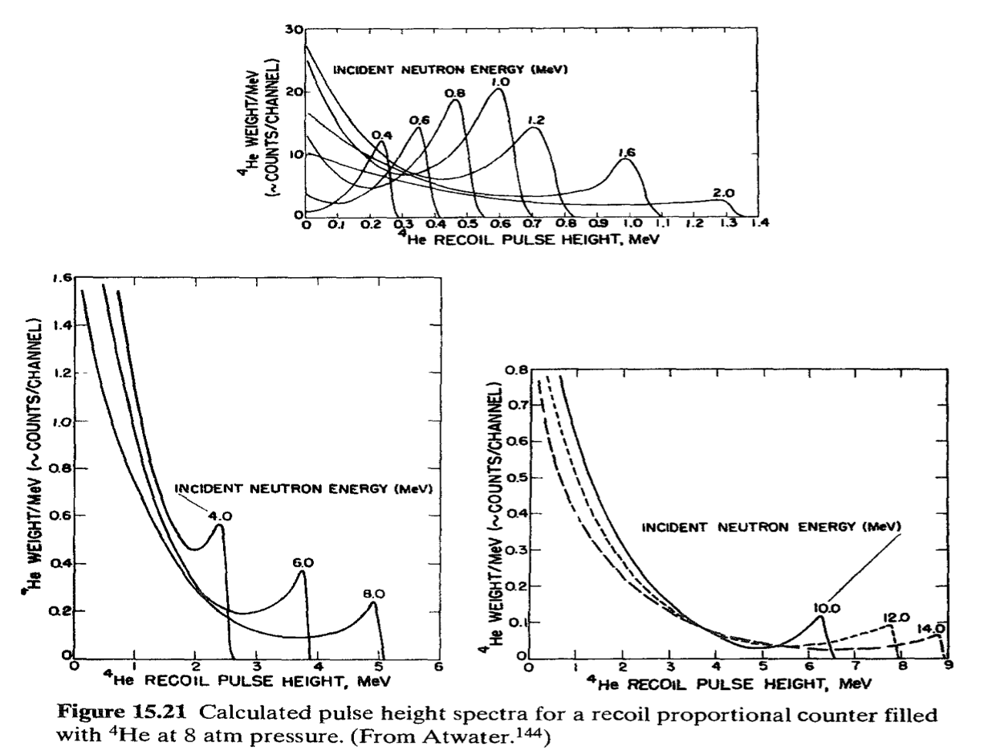
Introduction and Motivation
⁴He neutron detectors:
γ-ray insensitive alternative to organic scintillators for fast neutron spectroscopy
Fast neutrons interact via elastic scattering; kinematic energy transfer up to 64%
Major issue: no energy resolution function in the literature

Slide 3
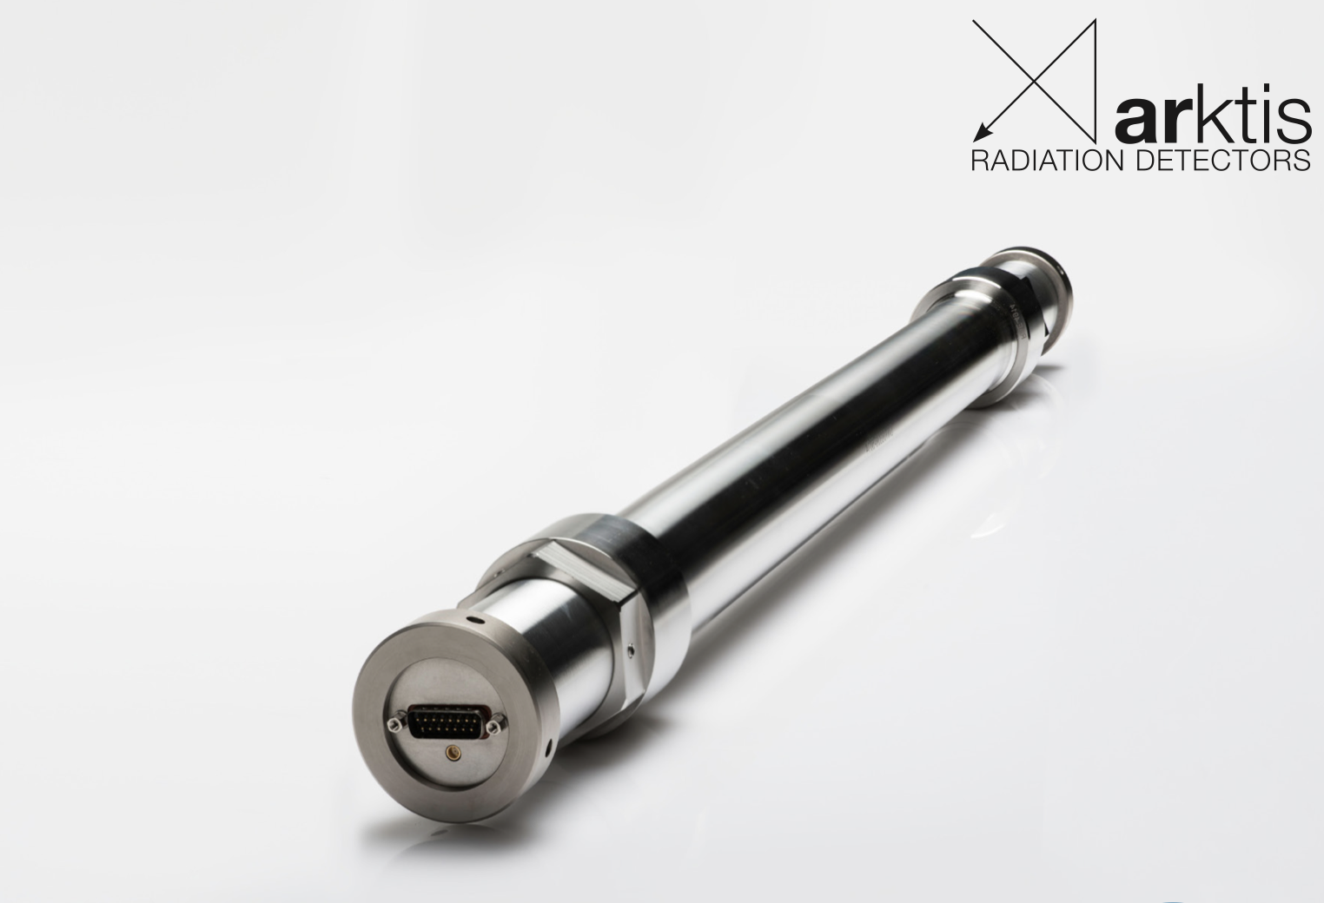
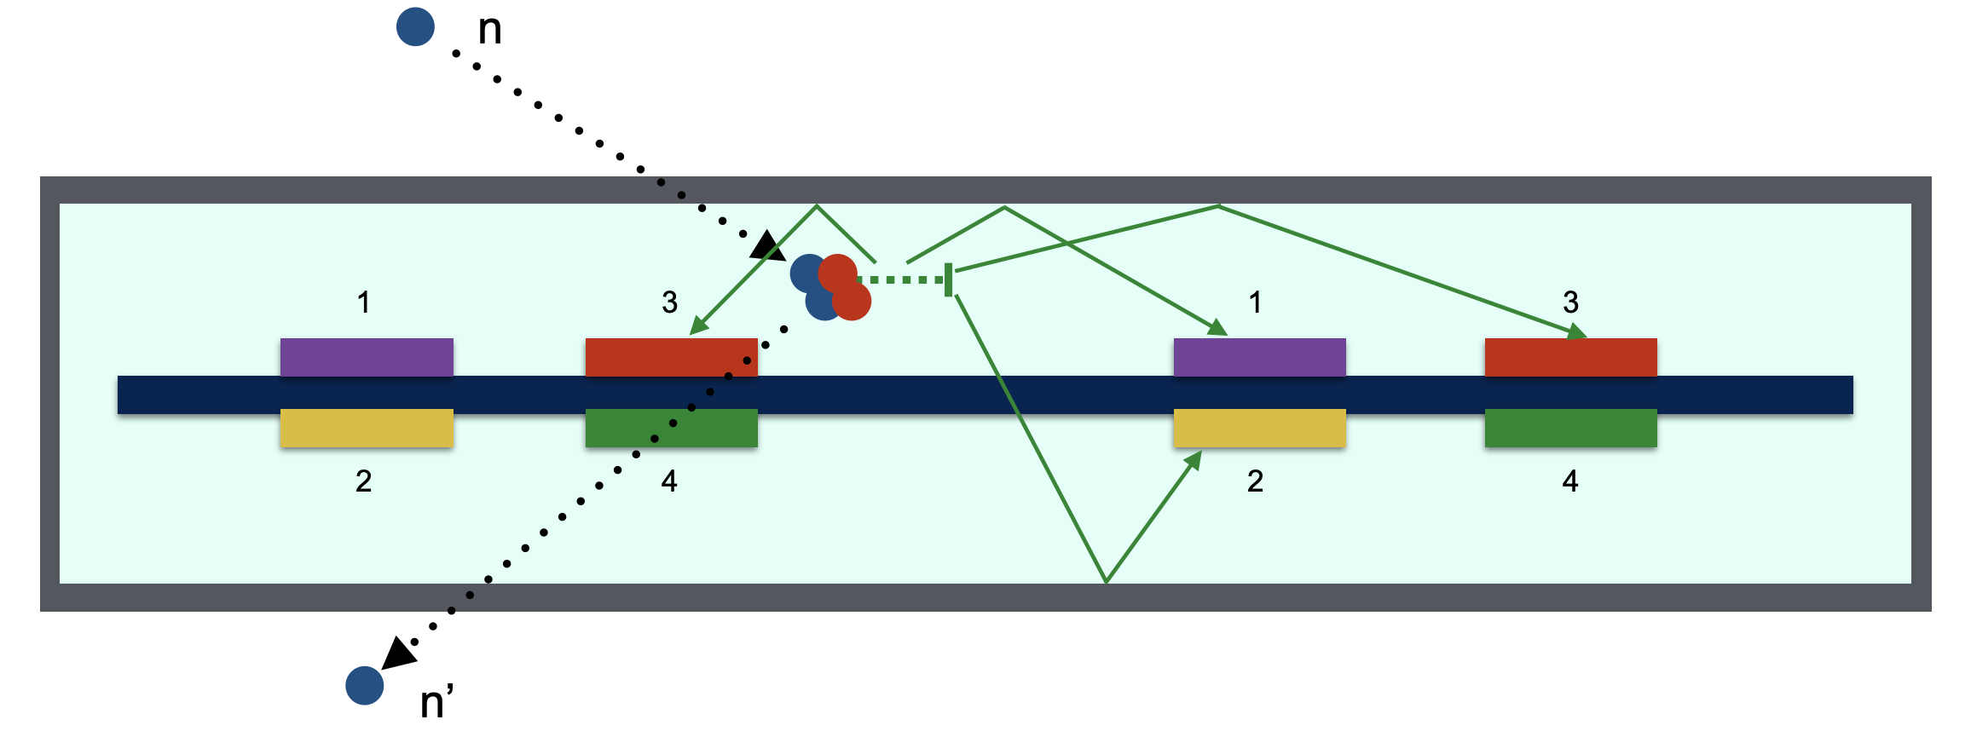
High-pressure ⁴He Scintillation Detectors
Arktis S670:
~190 atm natural He (⁴He)
Optically segmented into 3
Each segment read out by 8 SiPMs along the detector axis
SiPM outputs summed in pairs & passed through internal shaping amplifier
12 total output channels

Slide 4
S670 Output Processing
Multi-channel readout for each segment presents analysis challenges:
Independent analysis of channels:
leads to over-counting
Splits optical signal, increasing time & energy resolution
Technique developed to condense outputs to one list per segment
More information:
O. Searfus, K. Ogren, I. Jovanovic. Digital pulse analysis for fast neutron recoil spectroscopy with a ⁴He scintillation detector, NIM A Volume 1046, 2023, 167703. ISSN 0168-9002,
https://doi.org/10.1016/j.nima.2022.167703.
Event pulse height: sum of pulse heights in window
Event time stamp: mean of time stamps in window

Slide 5
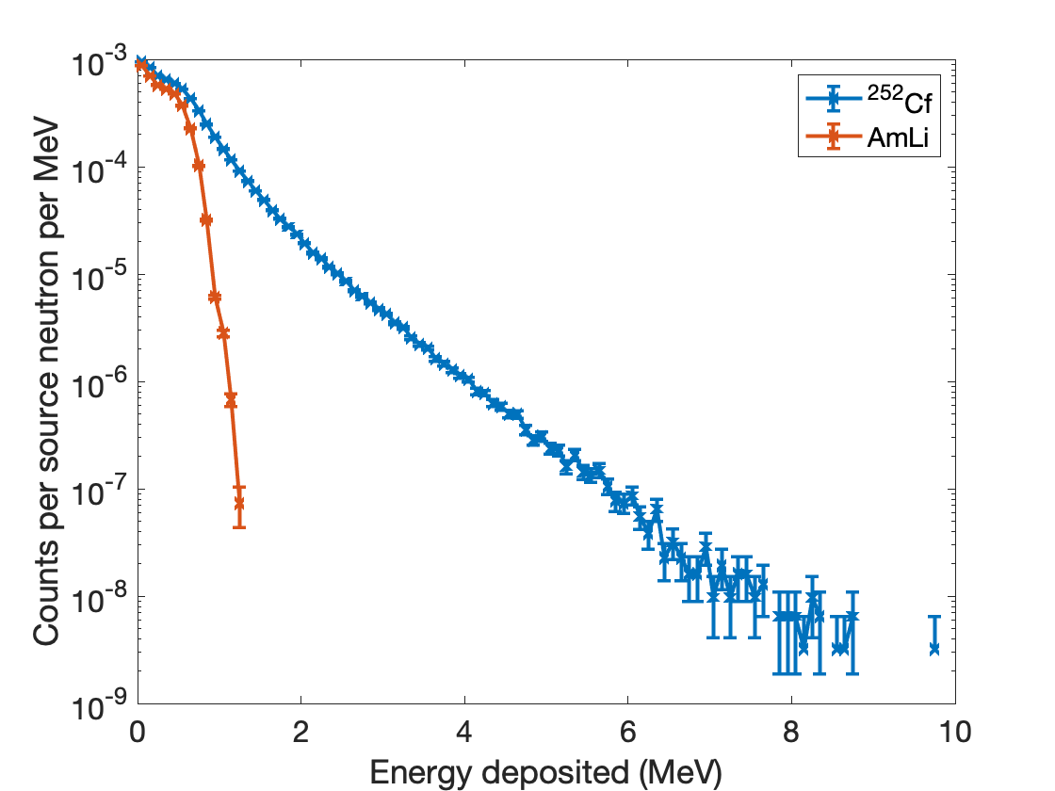
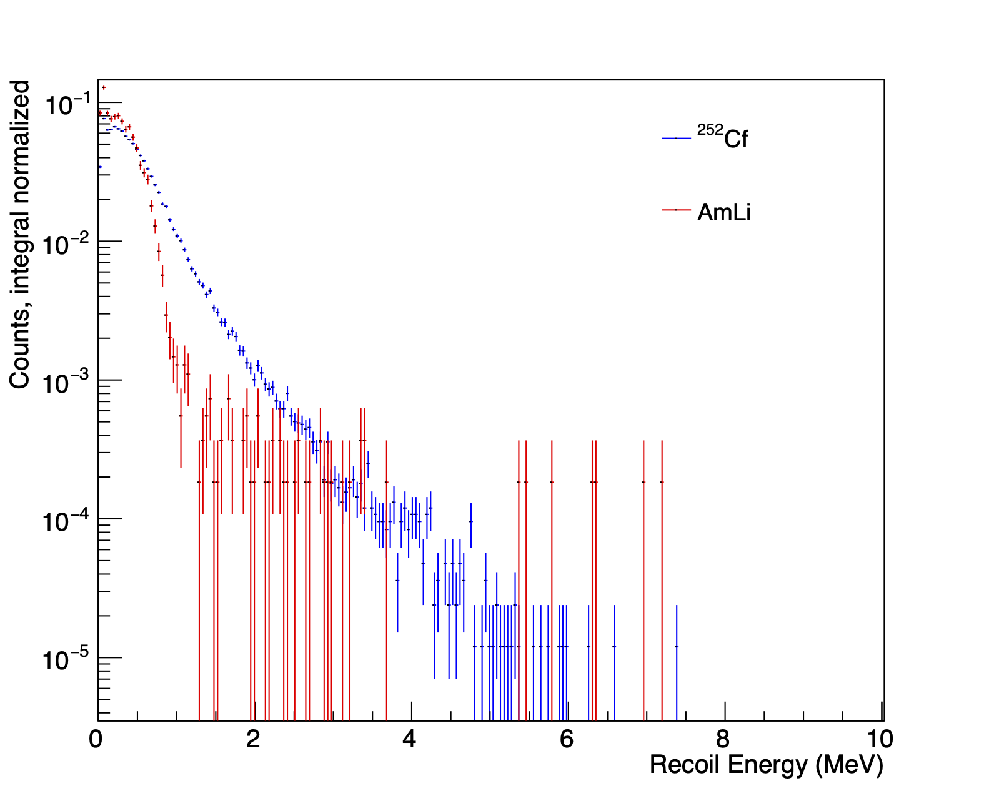
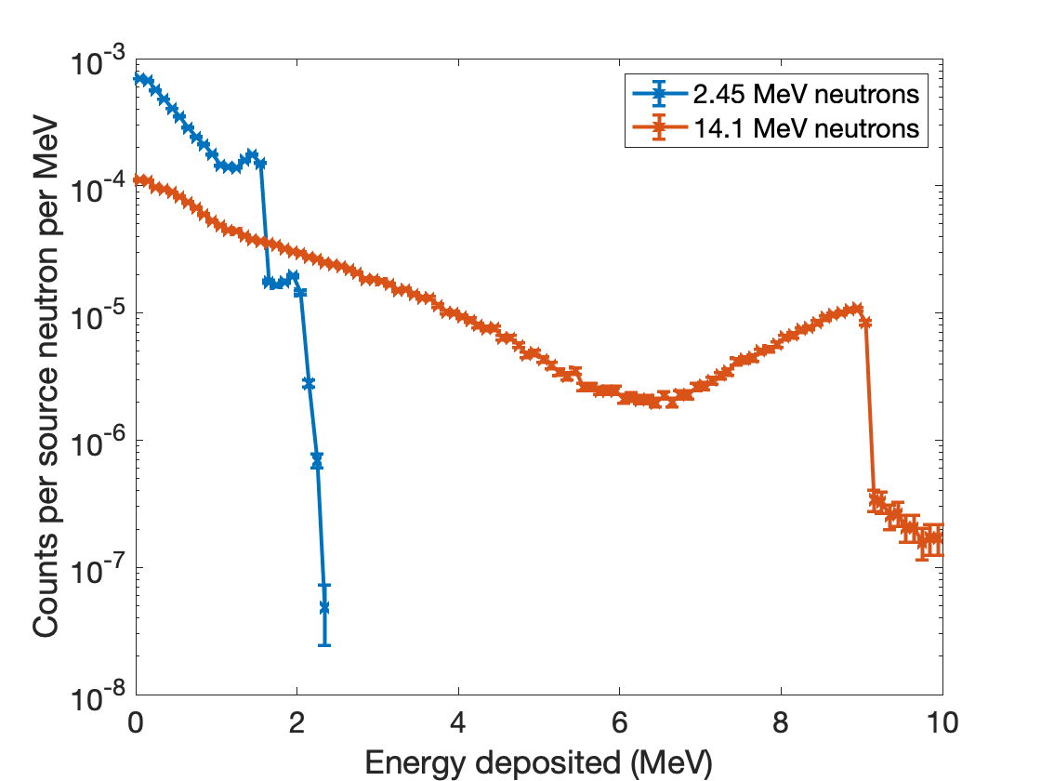
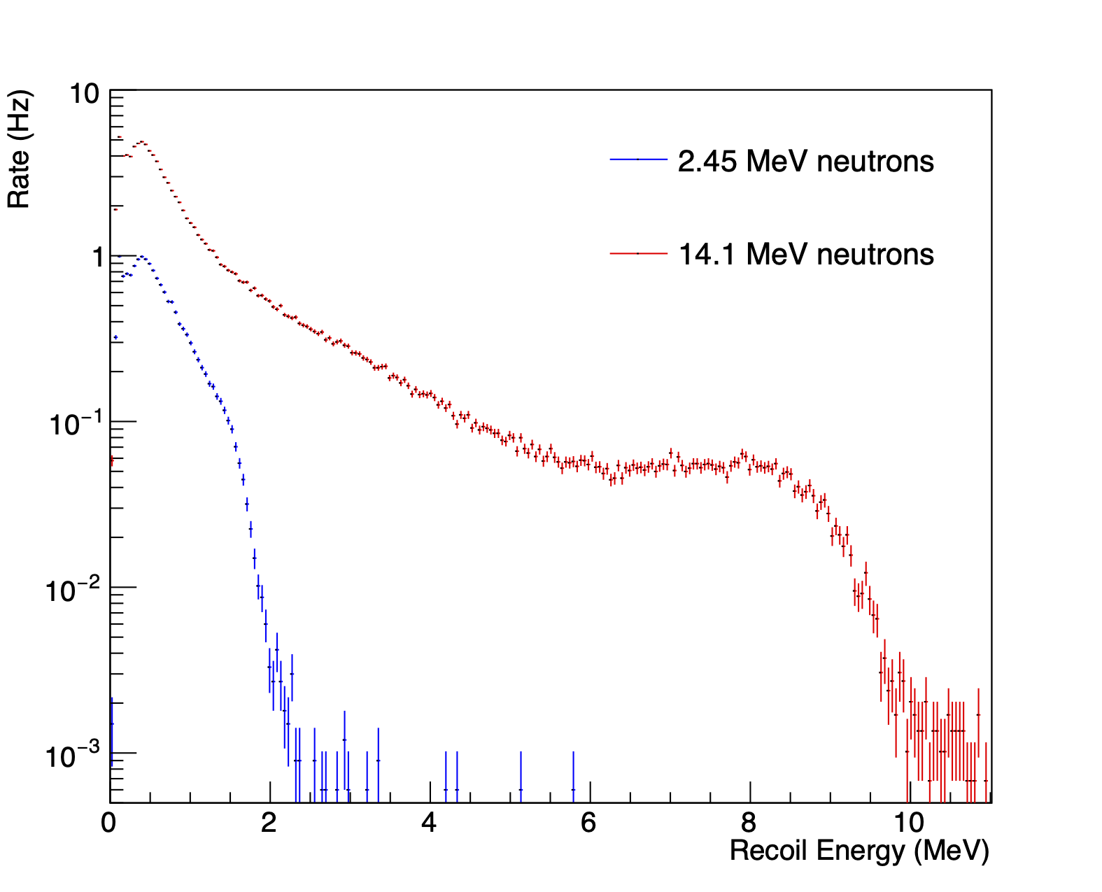
Why should we care about energy resolution?
Simulation of ⁴He detectors is limited to exact energy deposition (zero energy resolution) without gaussian energy broadening
Past measurements indicate ⁴He scintillation energy resolution is relatively poor
Energy resolution degrades ability to discriminate between different neutron spectra
Simulation (MCNPX-PoliMi)
Measurement

Slide 6
Mission Relevance
⁴He scintillation detectors have many potential applications of interest to NNSA
Operable in extreme γ environments where solid/liquid detectors not practical
Non-destructive assay of ²³³U for international safeguards
Safeguarding spent nuclear fuel
Measurement of photofission and photonuclear neutron spectra
Neutron recoil spectrum measurable without pulse-shape discrimination
Digitization/dual integration of waveforms unneccesary
Significantly smaller computational load per system
Scalable
Characterization of energy resolution essential for simulations, future development

Slide 7
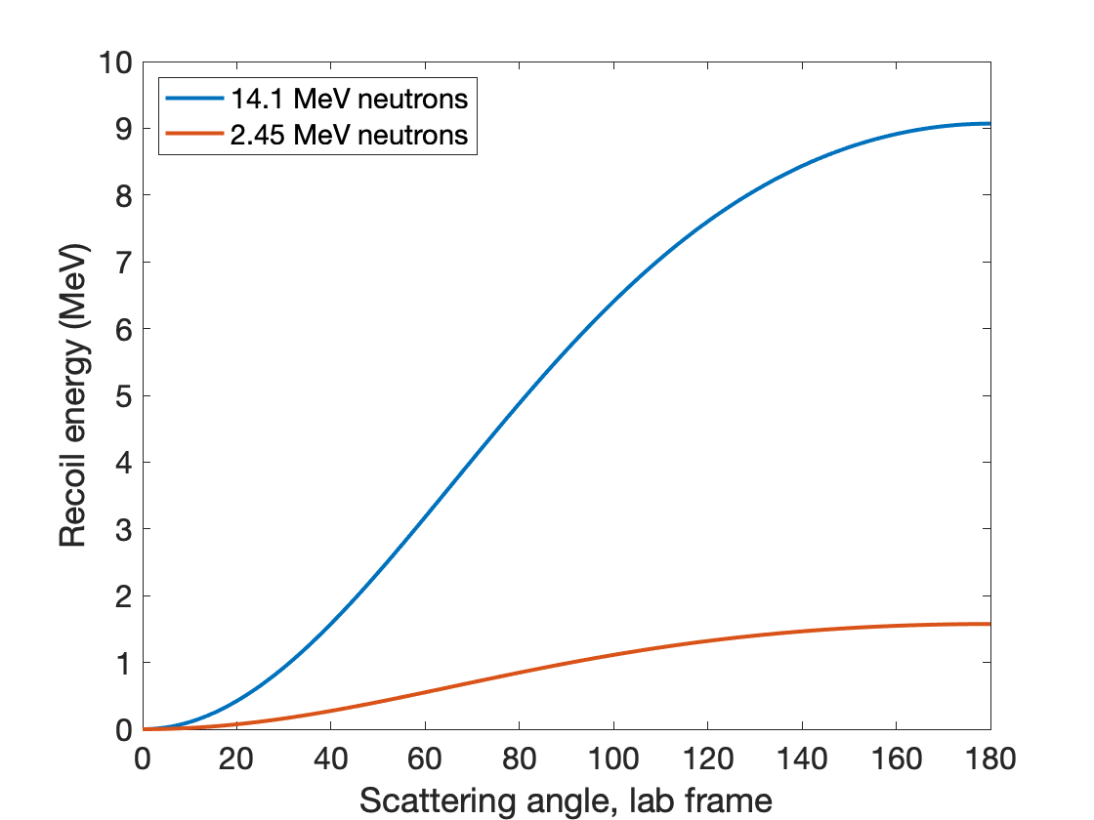
Technical Approach
⁴He neutron detection based on elastic scattering:
To obtain spectral peaks, both incident neutron energy and scattering angle must be constrained
Readily available sources of monoenergetic neutrons: D-D (2.45 MeV) and D-T (14.1 MeV)
D-D and D-T generators with intensity tunable, DC output available at Sandia California Active Neutron Interrogation (SCANI) lab
7 constrained scattering angles yields 14 unique data points

Slide 8
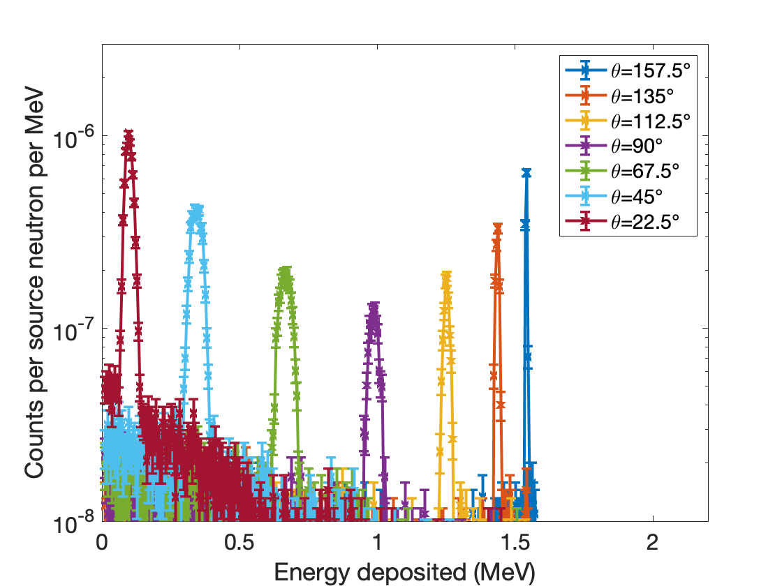
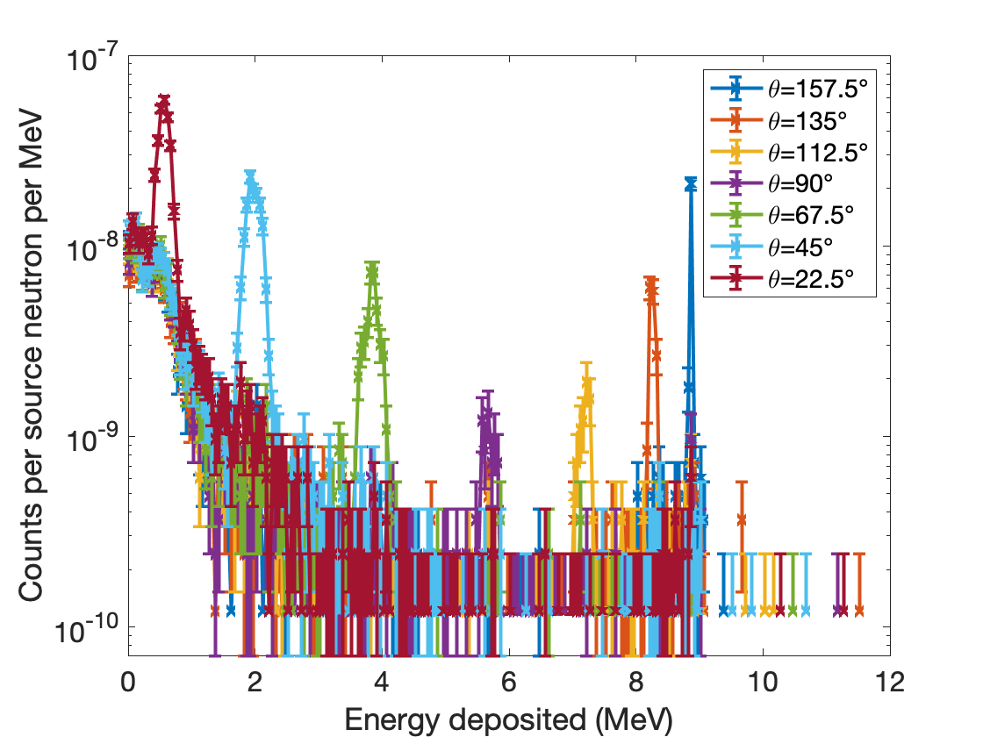
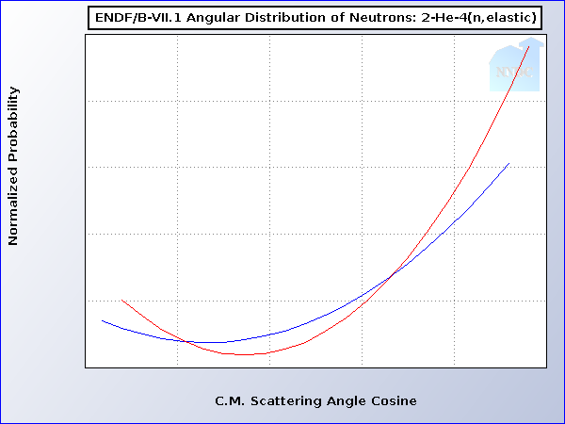
Technical Approach
Major challenges for measurement:
High neutron rates in organic scintillators adjacent to neutron generator leads to significant random coincident background
Differential scattering cross-section is biased to forward-scatter, further challenging the same detectors
14.1 MeV
2.45 MeV
14.1 MeV
2.45 MeV
Higher energy dep.

Slide 9
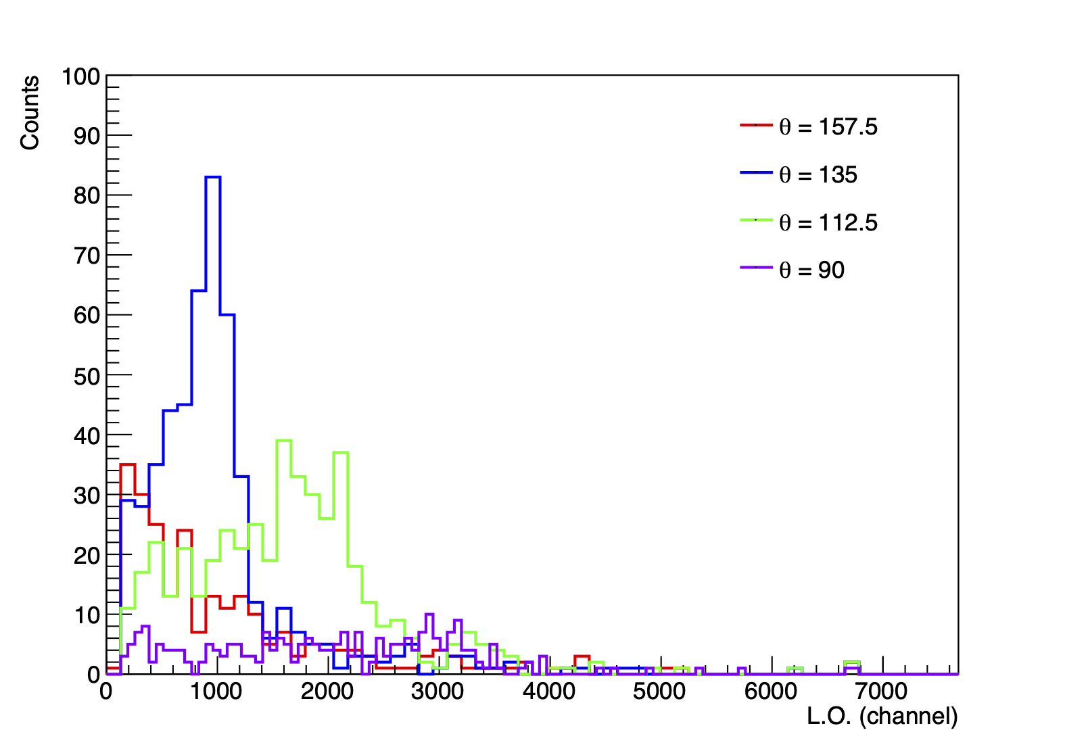
Results
Measurements so far:
9 hours of DT generator run-time @ 10⁸ n/s
56 hours of DD generator run-time @ 10⁶ n/s
Preliminary data show peaks for small-angle scatters:
Corresponding to highest angular cross-section & lowest coincident background
Ongoing work to further constrain cuts on energy, time of flight, and PSP for large-angle scatters
More generator run-time needed to build statistics
PRELIMINARY
2.45 MeV neutrons
+/- 100 ns coincidence
w/ OS detectors

Slide 10
Expected Impact
Completion of this project will result in:
The first energy resolution function for ⁴He scintillation detectors
Essential for prediction of spectral discrimination capabilities via simulation
Validation of prior work
Quantitative demonstration of energy resolution improvement with output condensation technique
Confirmation of scintillation linearity
Confirm accuracy of two-point endpoint energy calibration technique

Slide 11
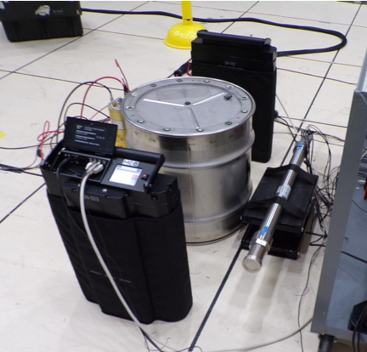
MTV Impact
Drum containing ~ 1kg ²³³U
MTV supports collaboration between UM and SNL essential to this project
I have been working with Dr. Pete Marleau on-site at SNL since August 2022
In addition to this project, I concurrently support a separate NA-22 project to develop neutron-based NDA for ²³³U in emerging thorium fuel cycles at SNL
²³³U project significantly leverages ⁴He and its gamma-insensitive characteristics, will benefit from results of energy resolution characterization
⁴He detector

Slide 12
Conclusion
This project is significant progress for technological maturity of ⁴He scintillation detectors
Capability for full simulation of detector response will accelerate development of this technology
Simulation capability could allow for exploration of new applications of ⁴He technology for challenging applications of interest to NNSA that are not suitable for conventional detector technology due to extreme gamma ray environments:
Safeguards: non-destructive assay of spent nuclear fuel and ²³³U
Homeland security: active interrogation photofission neutron detection

Slide 13
Next Steps
Neutron generator measurements are ongoing at SNL to increase statistics for low-yield data points @ high recoil energies
Improved energy, pulse shape, and time-of-flight cuts are being developed for each OS detector to reduce coincident backgrounds
Once all peaks are characterized, an energy resolution function will be developed:
In simulation, this function is used to determine the width of a gaussian broadening PDF applied to each energy deposition event
$$\frac{∆E}{E}=\sqrt{α^{2}+\frac{β^{2}}{E}+{(\frac{γ}{E})}^{2}}$$
Energy resolution
⍺,β,γ: fit parameters

Slide 14
Acknowledgements
The Consortium for Monitoring, Technology, and Verification would like to thank the DOE-NNSA for the continued support of these research activities.
This work was funded by the Consortium for Monitoring, Technology, and Verification under Department of Energy National Nuclear Security Administration award number DE-NA0003920. The work of O. Searfus was performed under appointment to the Nuclear Nonproliferation International Safeguards Fellowship Program sponsored by the National Nuclear Security Administration’s Office of International Nuclear Safeguards (NA-241). Sandia National Laboratories is a multimission laboratory managed and operated by National Technology Engineering Solutions of Sandia, LLC, a wholly owned subsidiary of Honeywell International Inc., for the U.S. Department of Energy’s National Nuclear Security Administration under contract DE NA0003525. SAND2023-00434PE

