Slide 1
Development of ²⁴¹Am¹³C Calibration Source for a Large Water Cherenkov Detector
2023 MTV Workshop
March 22, 2023
Colton Graham
PhD Candidate, University of Michigan
K. Ogren, Los Alamos National Lab S. A. Dazeley, Lawrence Livermore National Lab
M. Malek, University of Sheffield I. Jovanovic , University of Michigan

Slide 2
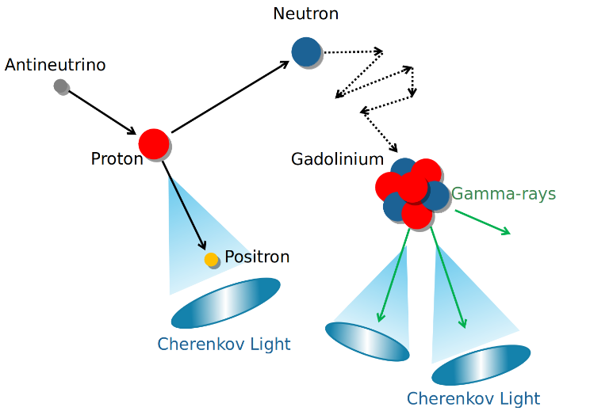
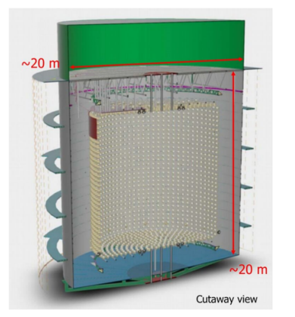
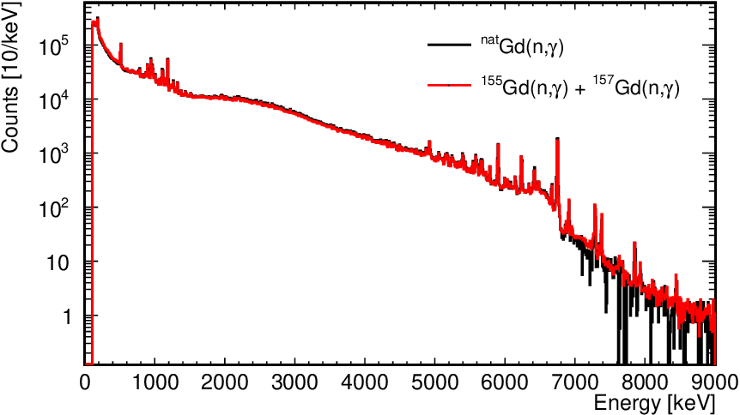
Water Cherenkov Detectors for Antineutrinos
M. Malek, University of Sheffield
WATer CHerenkov Monitor for ANtineutrinos (WATCHMAN)
Kiloton gadolinium doped water based detector
Detection of antineutrinos by inverse beta decay (IBD)
Problem of energy calibration requires custom designs
Y. Schnellbach et al., arXiv:2301.08079 (2023)
Neutron capture on Gd
Inverse beta decay (IBD)
Detection process for electron antineutrino in Gd doped water
Tanaka, Tomoyuki et al.
Progress of Theoretical and Experimental Physics (2019)
Representative detector design
Gd neutron capture de-excitation spectrum

Slide 3
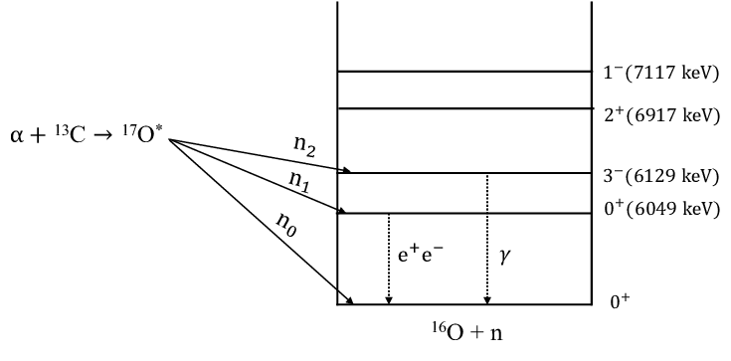
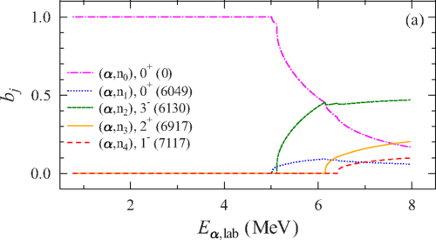
Calibration of Water Cherenkov Detectors
Electroplating substrate
Monoenergetic high energy gamma ray source
Avoids neutron generator by use of radioisotopes
Ability to actively turn on and off
Correlated particle emission for background rejection
Alpha source (²⁴¹Am, ²¹⁰Po)
Source ON
Source OFF
Thin layer of ¹³C
Copper substrate
Proposed source geometry
α energy threshold for γ ray production
P. Mohr, Phys. Rev. C 97 064613 (2018)
I. J. Arnquist et al., Phys. Rev. C 105 064610 (2022)
Emission of 6.1 MeV γ with correlated ¹n
¹³C(α,n)¹⁶O
Branching ratio for ¹³C (α,n)

Slide 4
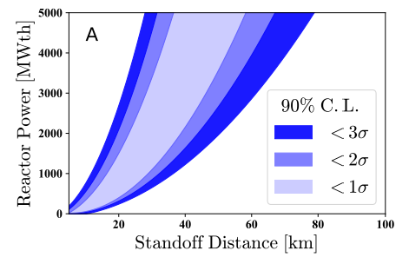
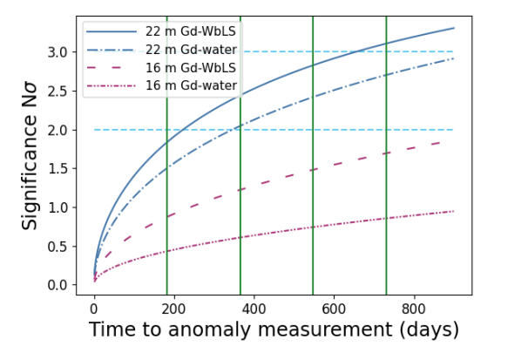
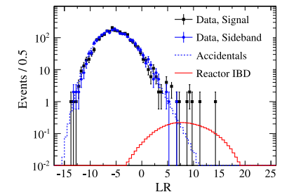
Mission Relevance
Simulated WATCHMAN sensitivity for 1 month dwell time
O. Akindele et al., arXiv:2210.09391
Large antineutrino detectors offer prospects for nonintrusive far-field reactor monitoring
Remote detection of reactor operations inconsistent with declarations
Detection of undeclared reactors
Simulated WATCHMAN sensitivity for 150 km standoff
L. Kneale et al., arXiv:2210.11224
Detection of aggregate reactor antineutrino signal in pure water from weighted mean distance of 650 km in 190 days
A. Allega et al., Phys. Rev. Lett. 130, 091801 (2023)

Slide 5
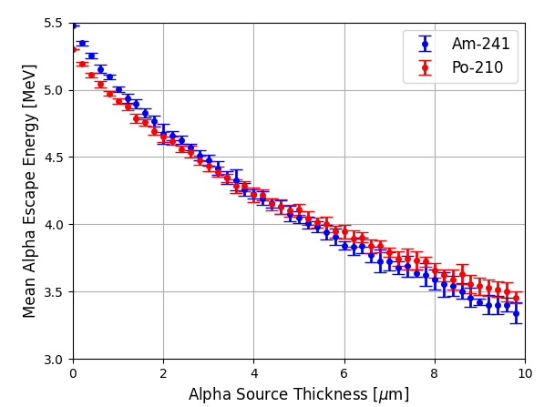
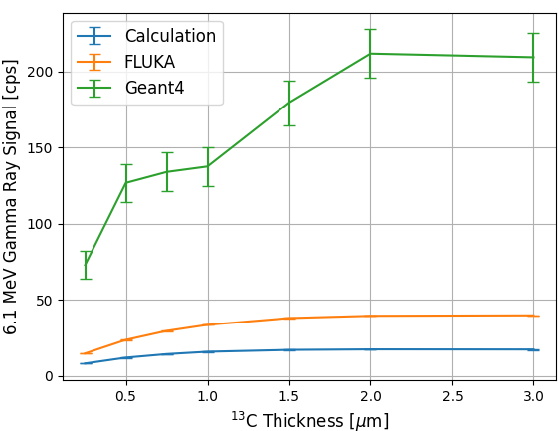
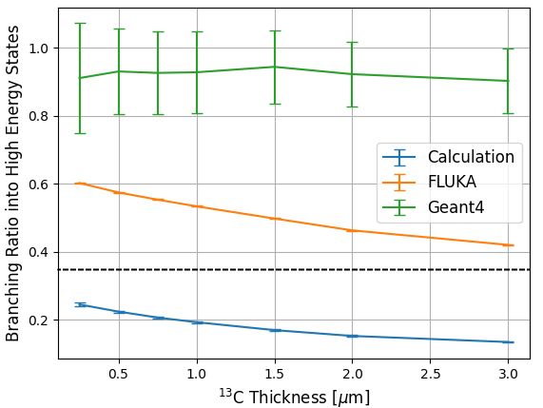
Simulation Models Disagree in Source Emission
Suggested source design relies on thin, difficult to manufacture geometry, necessitating use of simulation to optimize source before construction
Simulation with common radiation transport codes (Geant4, FLUKA) yields unphysical gamma ray to neutron production ratio
Motivates combination of new modeling and experiment to resolve discrepancies
Geant4 10.06 and FLUKA show discrepancy with initial α energy branching ratio
γ ray production threshold
Branching ratio
Alpha source internal energy loss
Gamma ray yield for ²⁴¹Am¹³C source
Branching ratio of gamma ray to neutron emission from ²⁴¹Am¹³C source

Slide 6
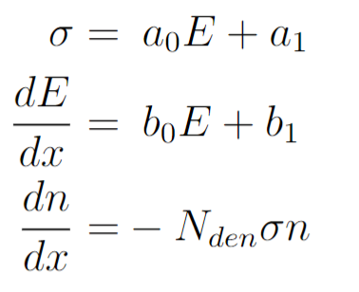
Alpha Particle Transport Model
Energy ranges
R₀
Measurement point of cross section
R₁
R₂
R₃
R₄
R₅
R₆
R₇
R₈
R₉
R₁₀
R₁₁
R₁₂
Energy space
Measurement point of stopping power
Initial energy
End of geometry element (Or E=0)
Geometry handled by particle ray tracing
Approximation yields analytical expression for interaction probability within energy range
Approximations
Neglect energy and range straggling
Assume alpha particle travel in straight line
Does not model secondary particle emission and transport (e.g. delta rays)

Slide 7
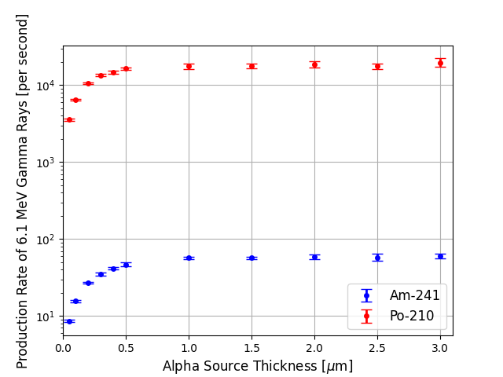
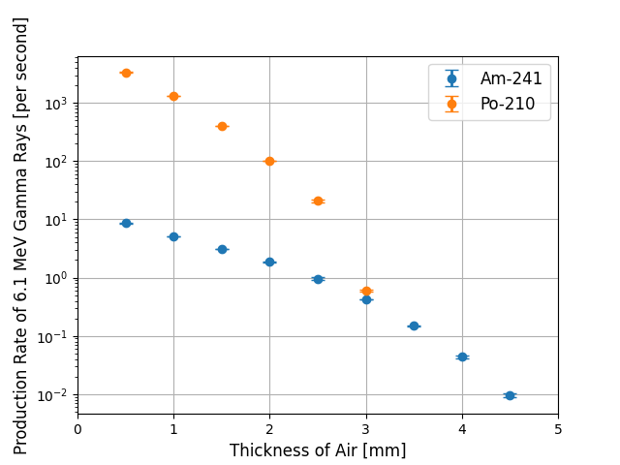
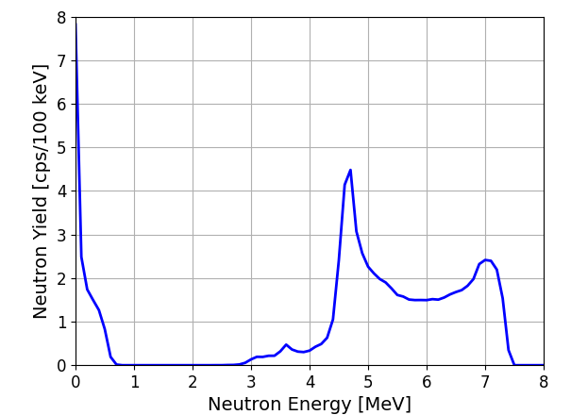
Source Optimization via Simulation
γ ray yield with thickness of air between actinide and graphite source components
Simulated neutron spectrum from ²⁴¹Am¹³C source
γ ray yield with alpha source thickness
Rapid fall off with thickness
γ ray correlated neutrons
Uncorrelated neutrons
Yield quickly falls off, confirming ability to turn off source by simply moving components apart

Slide 8
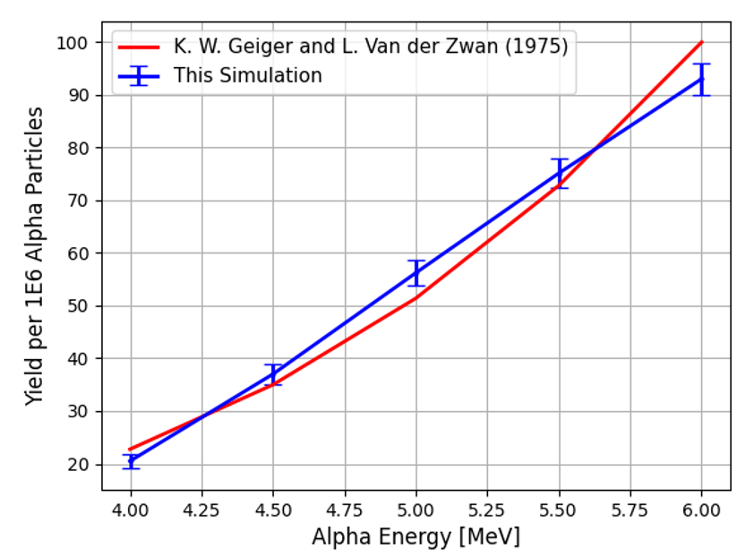
Validation of Simulation Methods
Comparison with traditional actinide beryllium neutron source
Common commercial neutron source
Neutron yield and spectrum characterized in literature
Source modeled as simple sphere of Be metal with homogeneously dispersed alpha source
Reasonable agreement of simulation code with literature data
Increases confidence in ²⁴¹Am¹³C simulation
K. W. Geiger and L. Van der Zwan, Nucl. Instr. and Meth. 131 (1975) 315
Yield of homogenous α-Be source

Slide 9
Expected Impact
Enabling technology for calibrating large water Cherenkov antineutrino detectors
Prototype calibration source of immediate interest for multiple prototype detectors under study
UK BUTTON project
LLNL prototype detector
LBNL prototype detector
BNL prototype detector
Future full scale demonstrator experiment

Slide 10
MTV Impact
Support for conference presentations to publicize work
MTV Workshop 2022
UPR Workshop 2022
IEEE NSS-MIC-RTSD 2022
MTV Workshop 2023
Facilitating national lab collaboration on source development
Collaboration with Dr. Steven Dazeley at LLNL for source design
Discussion with ORNL for actinide deposition
Transitioning technology for use in future detectors
Fabrication underway for calibration source prototype

Slide 11
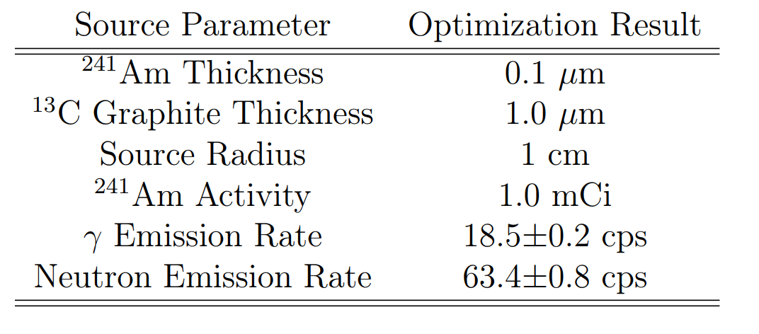
Conclusions
Determined optimized geometry for ²⁴¹Am¹³C calibration source
Maximize yield of 6.1 MeV γ rays
Minimize yield of uncorrelated neutrons
Developed custom heavy charged particle transport code to predict source yield
Simulated source yield to compare against measured signal of prototype source for verification

Slide 12
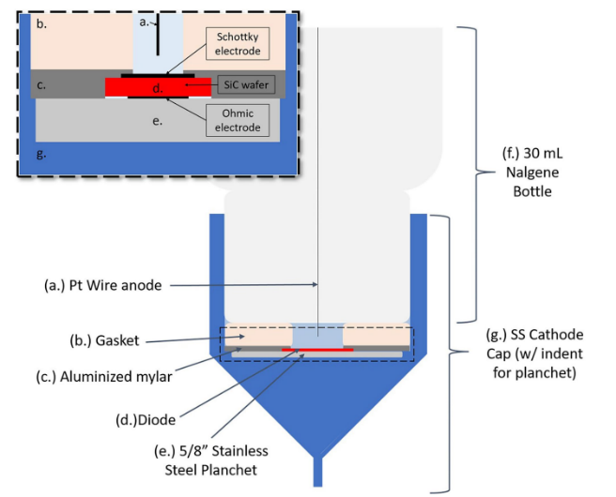
Next Steps: Source Manufacturing Underway
C. Dong, Pennsylvania State University
Carbon deposition on copper foil underway at Pennsylvania State University Material Research Institute
Deposition by ¹³C enriched methane
²⁴¹Am deposition underway at University of Cincinnati
Deposition of americium in nitric acid and isopropyl alcohol solution demonstrated on SiC Schottky diode
.Copper foil .without carbon.
.Copper with. .carbon deposition.
Copper foil showing discoloration from carbon
Hoffman, M.K. et al. J Radioanal Nucl Chem 331, 5423–5431 (2022).
Americium deposition scheme

Slide 13
Acknowledgements
The Consortium for Monitoring, Technology, and Verification would like to thank the DOE-NNSA for the continued support of these research activities.
This work was funded by the Consortium for Monitoring, Technology, and Verification under Department of Energy National Nuclear Security Administration award number DE-NA0003920. This material is based upon work supported under an Integrated University Program Graduate Fellowship. Any opinions, findings, conclusions or recommendations expressed in this publication are those of the author(s) and do not necessarily reflect the views of the Department of Energy Office of Nuclear Energy.

