Slide 1
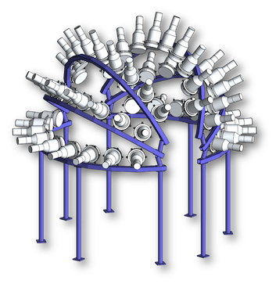
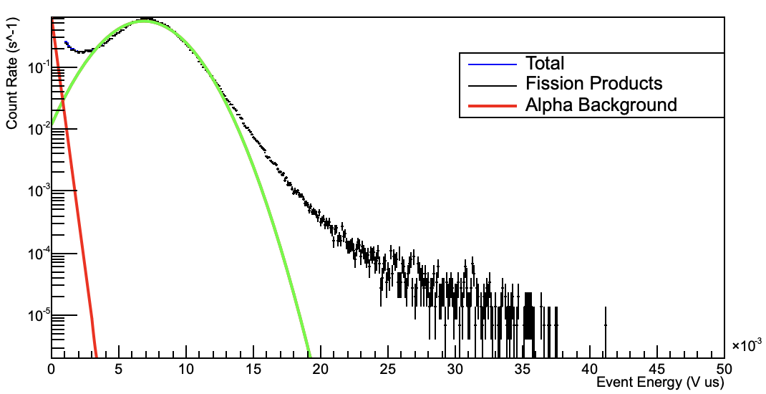
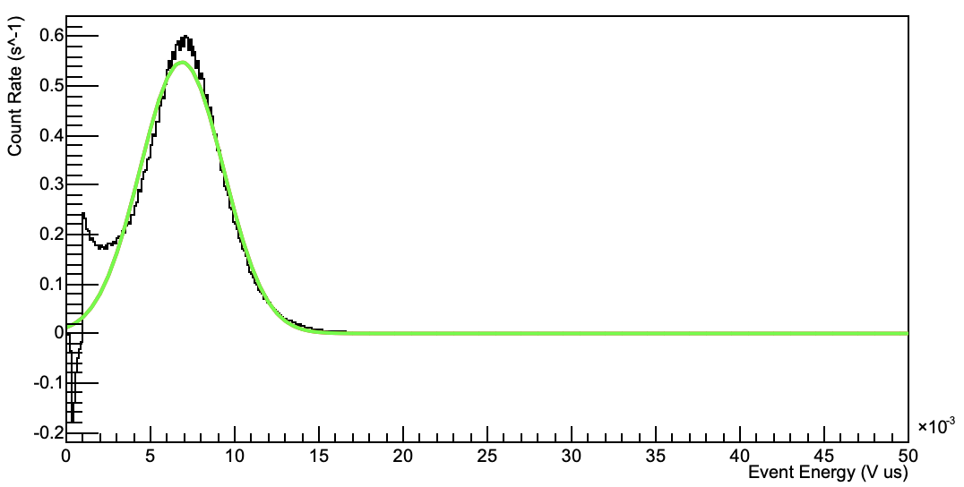
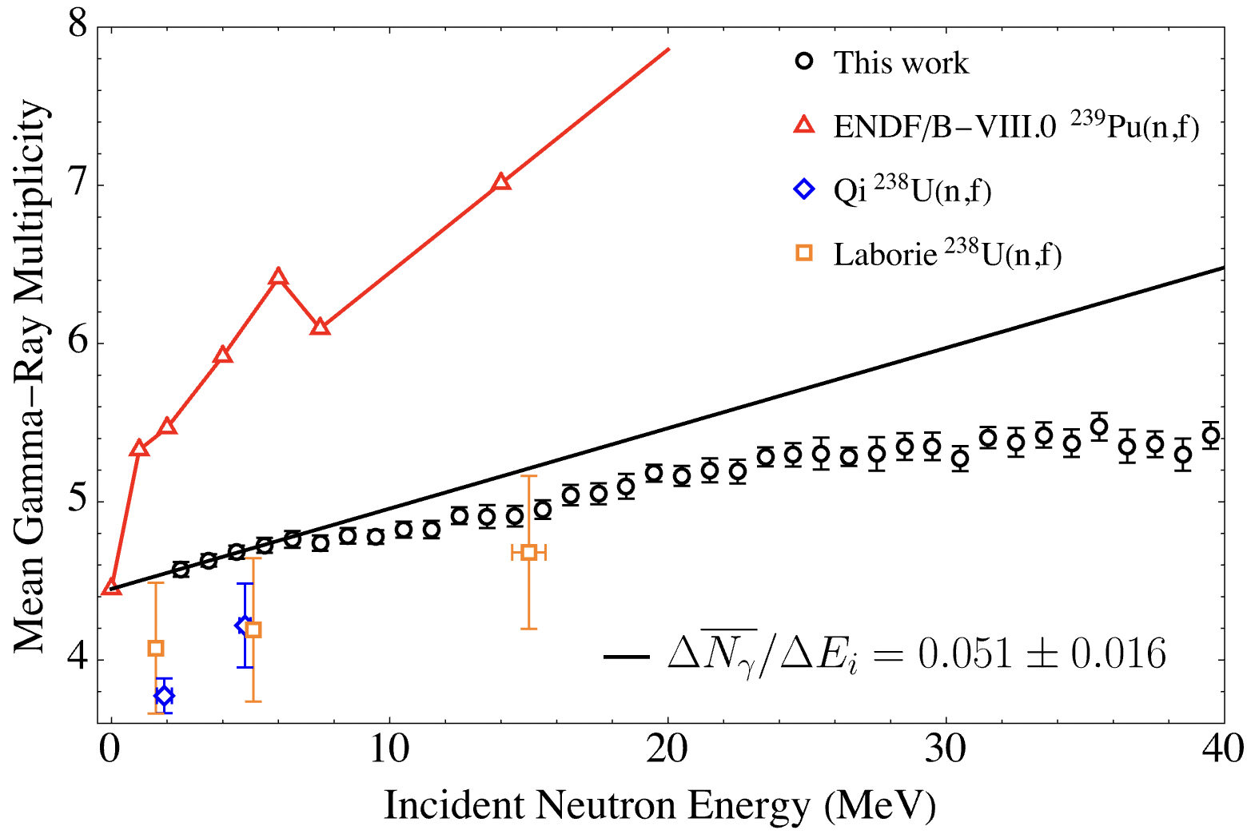
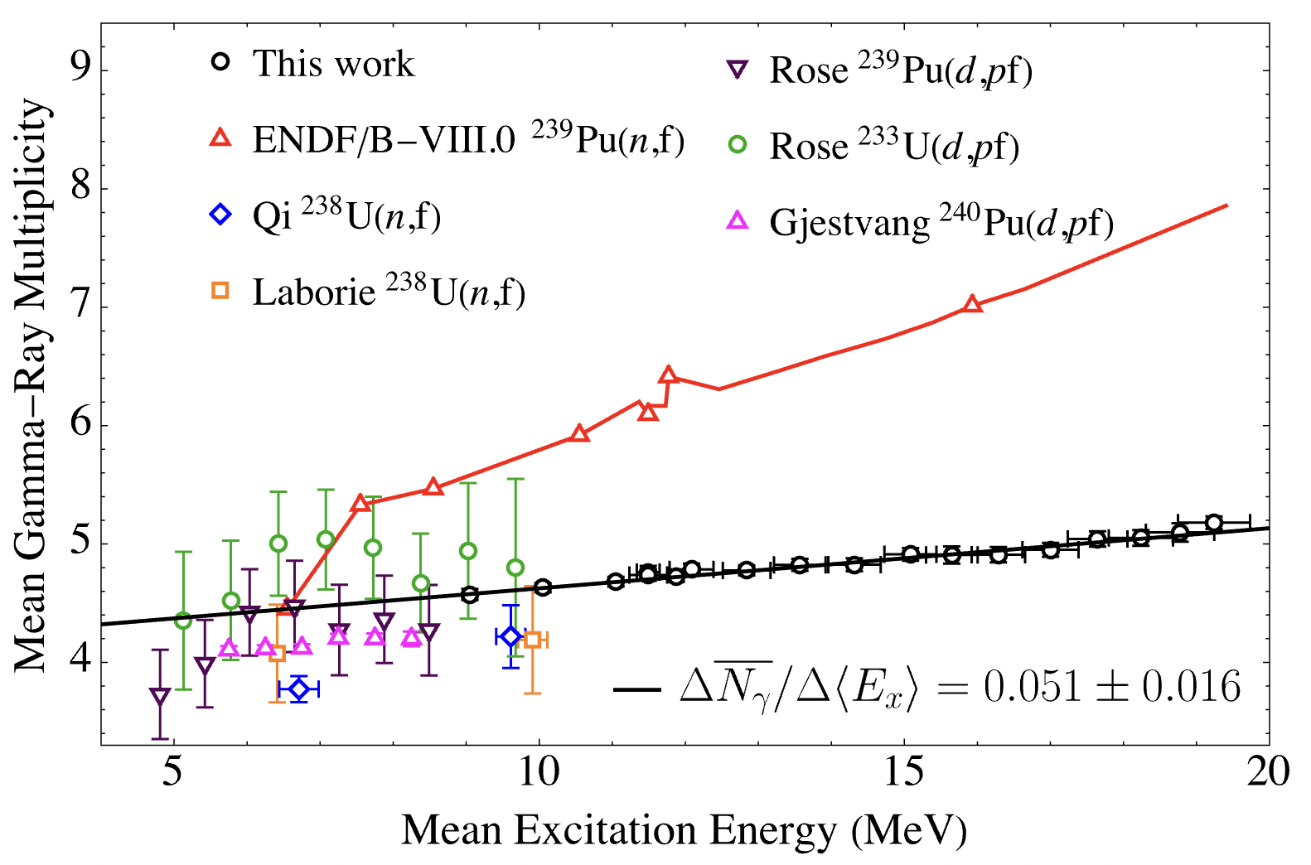
Gamma-ray Emission of ²³⁵U(n,f) James Baker Jr Undergraduate Senior, University of Michigan N. Giha , S. Marin, S. D. Clarke, S. A. Pozzi University of Michigan
Introduction and Motivation
Technical Approach
MTV Impact
There is little experimental investigation into dependence of the excitation energy of the fissioning system on gamma-ray emission for ²³⁵U
What does the Chi-Nu detector array at LANSCE allow us to determine about gamma-ray emission of neutron induced fission of ²³⁵U?
MTV has impacted me in these multiple amazing ways:
Develop research and data analysis skills which I would have not achieved in my academic courses
Collaboration with national labs (LBNL, LLNL, ORNL, BNL, LANL)
Present and participate in the MTV workshop better preparing me for the scientific community
MTV has also allowed me to earn an internship at BNL focusing on development of a hexagonal boron-nitride thermal neutron detector during the summer of 2022. As well as a fellowship at LANL for the summer of 2023.
Technology transitions
Theorists would be interested in our results because it supports a different model than is currently accepted for fission
This research and analysis was done in collaboration with LANL
LANL was instrumental to the success of this project
Experiment
White spectrum neutron beam to induce fission
²³⁵U foils contained within PPACs
Chi-Nu detector array recorded fission observables with liquid organic scintillators
Analysis
Separate fission events from alpha pile-up and wrap around contamination
Invert system response matrix to unfold actual gamma-ray spectrum from measured gamma-ray spectrum
Mission Relevance
Conclusion
Improve fission gamma-ray nuclear data libraries, where experimental data is limited
Discovering new signatures of fission could substantially improve nuclear material accountancy
Fig. 1. Total PPAC spectrum (black) with fits of alpha background (red) and fission products (green)
Fig. 2. Isolated fission products PPAC spectrum (black) with fit (green)
For the first time, a statistically significant increase in the mean gamma-ray multiplicity for an incident neutron energy range of 2-40 MeV was recorded
Better understanding of fission allows for higher quality fission models, yielding superior signature characterization or discovery of new signatures
Results
Incident Energy
Measured average gamma-ray multiplicity ($\overline{N}$_{γ}) for incident neutron energy from 2-40 MeV
Observed expected structure from multi-chance fission thresholds
Nonlinear dependence observed because incident neutron energy is not linearly proportional to excitation energy when multi-chance fission is present (i.e. E_{i} > ~6 MeV)
Excitation Energy
Transforming to excitation energy from incident energy yields linear dependence
Mean gamma-ray multiplicity increased by ~1 for every 20 MeV of excitation energy before fission
Expected Impact
Better nuclear data library allows for enhanced descriptions of fission physics
Help improve theoretical models and understanding mechanisms behind the angular momentum-excitation energy relationship in fission
Next Steps
Compare to fission models from LANL (CGMF) and LLNL (FREYA) as well as our previous ²³⁹Pu results
Perform spontaneous fission experiment at ANL with Gamma-sphere
Fig. 3. Mean gamma-ray multiplicity as a function of incident neutron energy with fit of data below 2nd chance fission threshold
Fig. 4. Mean gamma-ray multiplicity as a function of excitation energy before fission with fit from fig. 3 shifted by the neutron separation energy
This work was funded in-part by the Consortium for Monitoring, Technology, and Verification under DOE-NNSA award number DE-NA0003920

