Slide 1
HITMAN: A Deep Learning Approach to
Building Likelihood Functions for Neutrino Detectors
2023 MTV Workshop
March 21st, 2023
Garrett Wendel
Doctoral Candidate, Penn State University
Prof. Douglas Cowen, Penn State University
Notes:
I am going to briefly discuss HITMAN, A Deep Learning Technique used to build likelihood functions, primarily for neutrino detectors

Slide 2
Introduction & Motivation
Provide neutrino event reconstruction that does not hard code information about neutrino detector
Target medium properties: Scintillating material (WbLS [1]) , water, etc.
Photosensor properties: PMTs, SiPMs, LAPPDs [2], Dichroicons [3]
Geometry (Target volume, photosensor layout, etc.)
Ethos: “If you can simulate it, we can reconstruct it”
Technique outlined in “A flexible event reconstruction based on machine learning techniques” [4]
Notes:
To give a little background and motivation as to what we are trying to accomplish with this technique. We are ultimately trying to determine properties of neutrino interactions that occur in a neutrino detector based on its response. Typically, this response can vary wildly from detector to detector, depending on characteristics such as the target medium properties. For example, a scintillating target material will behave differently than a water based medium. There are also numerous types of photosensors that can be employed in a neutrino detector such as PMTs SiPMs LAPPDs Dichroicons, and the list goes on. Each of these types of sensors provides different information in different ways in our detector. Geometry of the detector itself can also have a large effect on detector response.
The goal here is to provide a tool that can learn all of these properties directly through simulation data; If you can simulate it, we can reconstruct it. Technical detail of this technique has been published, but I plan to convey the main points here in the upcoming slides

Slide 3
Mission Relevance
Reactor antineutrinos have a very long attenuation length making the signal difficult to shield
Enables monitoring reactor activity at long range
HITMAN (Highly-parallelizable Inference Technique for Monitoring AntiNeutrinos)
Provide quantification of performance for novel neutrino detection technologies
Eos (LBL and LLNL)
LiquidO
Improve reactor detection characteristics of neutrino detector
Improving resolutions: Increases detection range, decreases reactor dwell time, reduces required detector volume, etc.
General method can be re-applied to other nuclear detection techniques
Notes:
Before I dive into the technique itself, there are a few key points to touch on as to why we are doing this in the first place. The overarching goal we are trying to achieve is the detection of reactor antineutrinos, which provides a unique opportunity to continuously monitor reactors for nonproliferation purposes without the need of being onsite.
A bit more directly, HITMAN itself aims to achieve a couple of goals in support of antineutrino detection:
The first is to provide a metric for how these detectors are performing. In the R&D process we need quantitative feedback as to how each design will perform, and HITMAN is able to provide figures of merit which can be used to inform a large variety of designs in a straightforward manner. Currently, we are studying the performance of Eos and LiquidO detectors with this technique.
In addition to providing easy to access metrics for detector design, we aim to improve the effective resolutions of these detectors by avoiding making simplifying assumptions that would artificially degrade performance. By improving these resolutions, we enable these detectors to see farther, determine reactor activity faster, and so on
Finally, we want this technique to be as general as possible. Since measuring photons from nuclear interactions is by no means unique to neutrino detection, this tool could be extended to other techniques.

Slide 4
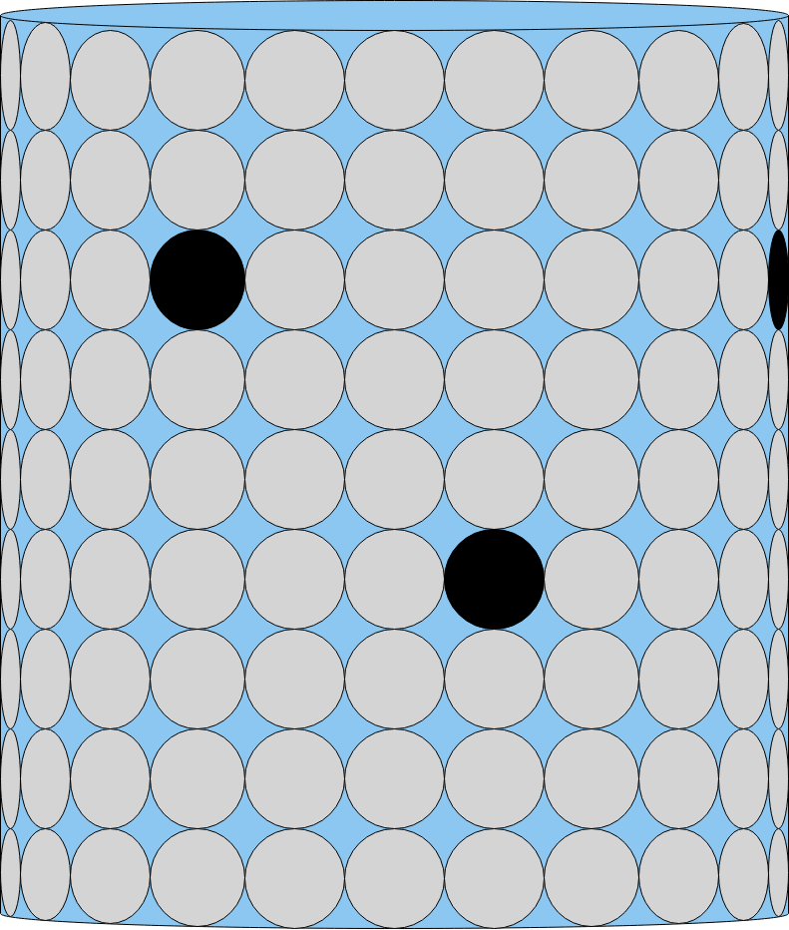
The Inference Problem:
Detector Response: $x$
Particle Hypothesis :$θ$
For a given particle event we have:
Observables $x:$[Photon arrival time, Photosensor Hit ID]
Hypothesis $θ$: [particle interaction vertex, direction, energy]
$$p$$
$n$
$$\overline{ν_{e}}$$
$$β^{+}$$
Given access to a simulation model, we perform inference combining:
Neural ratio estimators
Extended Maximum Likelihood (EML) decomposition
Parallelizable optimization routine
Notes:
Now a bit information on the technique itself, HITMAN is an inference tool, and the problem we are trying to solve is: given some measurement using a large array of photosensors, how can we solve for the most likely physics interaction that occurred inside our detector. I will call “x” the information from our detector response and “theta” which will be our hypothesis for what happened inside the detector.
Assuming we have a simulation available for our detector, combine Neural ratio estimators, the Extended Maximum Likelihood decomposition, and a parallelizable optimization routine to perform inference and that is what we call HITMAN

Slide 5
Neural Ratio Estimators
1) A set of sample particle events is presented to a neural network in two forms: correlated detector response and particle parameters and uncorrelated detector response and particle parameters.
$$Correlated (Simulation) Data$$
$$Uncorrelated (Shuffled) Data$$
Detector Response 1
Particle Event 1
Detector Response 1
Particle Event 1
Detector Response 2
Particle Event 2
Detector Response 2
Particle Event 2
Detector Response 3
Particle Event 3
Detector Response 3
Particle Event 3
2) Neural network is trained differentiate between the correlated and uncorrelated data sets.
Regression Feedback (Training)
Detector Response
Correlated or Uncorrelated?
Neural Network
Particle Event
The resulting neural network can then be used to provide a quantity proportion to the likelihood function
Notes:
To perform our inference, we need a way to generate likelihood functions. A Neural Ratio Estimator is a neat mathematical trick that allows us to directly use the tools of deep learning in the well studied problem of classification to generate a likelihood function. The basic idea is as follows:
First, we generate some Monte Carlo simulation data on our detector. This dataset is a sample of the mapping of particle events to detector responses, and we call this the correlated set. Next, we generate a second set, called the uncorrelated set by randomly shuffling the mappings provided by the simulation data.
Next, we train a neural network to determine whether a given detector response and particle event is from the correlated set, or the uncorrelated set. Once this process is complete, we can perform elementary mathematical operations on this neural network to produce the likelihood function we are interested in. The mathematical foundation of this technique is included in the backup slides at the end of the presentation, for those interested.

Slide 6
Extended Maximum Likelihood (EML)
The dimension of typical detector response varies widely
Scales with number of photons collected
Difficult to handle computationally
Solution: decompose likelihood into a constant-length term for each photon arrival and total detector response (EML) [5]
Neural ratio estimator provides we can decompose the detector response into independent components for training
Extended Maximum Likelihood
Bulk Photon Info
(Chargenet)
Information per photon (Hitnet)
Notes:
The fact we generate the full likelihood space with a Neural Ratio Estimator is a crucial point of this technique. Neutrino detectors have a large array of photosensors, and the dimension of our detector response “x” can be on the order of thousands of parameters. We can solve this issue by decomposing our likelihood into independent components using the Extended Maximum Likelihood. This decomposition requires two terms. the first called Chargenet, which counts the total number of photons and can be though of as calorimetry measurement. The second term is a called hitnet which looks at the location and time of a single photon arrival. Multiplying these terms for all photons produces the full likelihood we need and removes the explicit geometry information we would otherwise need to encode into the neural network structure.

Slide 7
Optimization Routine
Maximum Likelihood Estimate for Inference
Gradient descent algorithm leveraging deep learning’s automatic differentiation tools
$$θ$$
$$x$$
Neural Network (Trained)
$$L(θ|x)$$
Optimizer
Most Likely $θ$ Value
7
Notes:
Now that we have access to generating the likelihood function, we can perform a maximum likelihood estimate to inform us as to what physics event happened in our detector. This is currently implemented using a gradient descent algorithm using automatic differentiation tools that are included standard with deep learning toolkits.
Here is an example event reconstruction: Each of these points on the graph shown is a sample of the likelihood space. They each follow the path of steepest descent (in this case) to find the minimum of the negative logarithm of the likelihood.
You can see the points quickly fall down these slopes and converge to a solution which becomes our maximum likelihood estimate.
Now that all of the pieces of HITMAN have been put together, lets talk a bit about the performance and some results that can be generated using this technique.

Slide 8
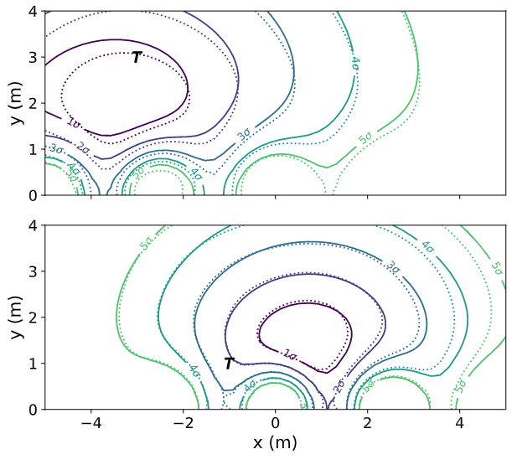
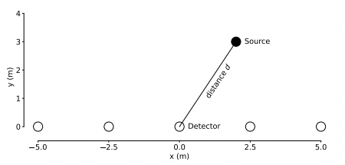
Analytic Reconstruction Study
2D “Toy Model” with generated with simple photon dynamics and analytic Likelihood to verify network training
Contours of likelihood space generated by neural network (NN) and the analytic likelihood match
[4]
Notes:
The first thing I want to discuss here is a test to see how well we are ‘learning’ this likelihood space. To accomplish this, we looked at a toy model with 5 photon sensors in a 2d plane with an analytic likelihood. Here we are looking at two different detection events, with the photon source marked with a T, and the contours the measurements generated. The solid lines are the likelihood contours produced by HITMAN and the dashed lines are the analytic solution. You can see that these contours are within close agreement.

Slide 9
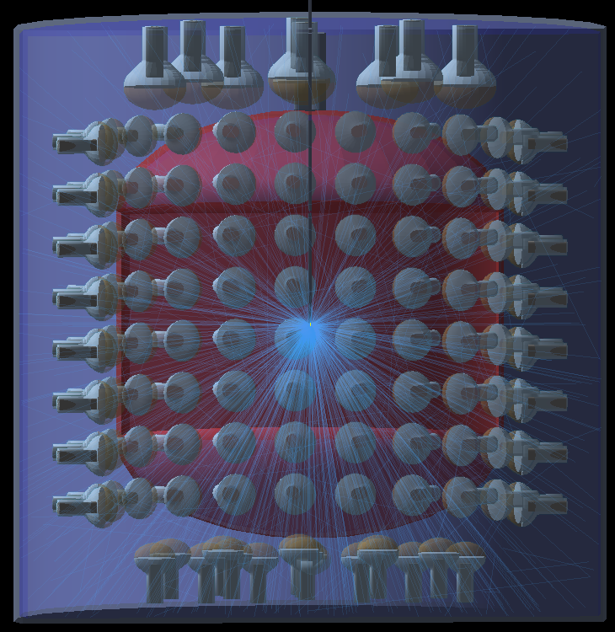
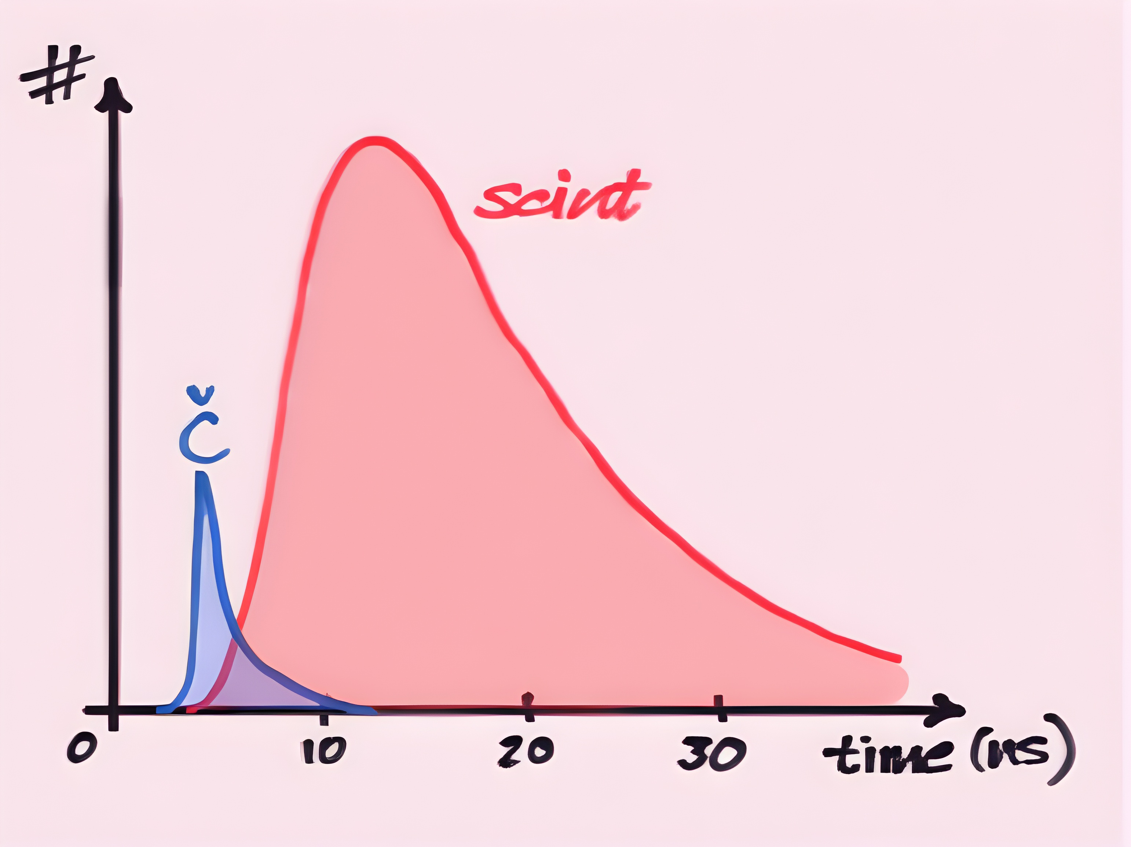
Eos [6]
Testbed for hybrid neutrino detection technology (LBNL/Berkeley)
See Ed Callaghan’s talk for more detail
Mix Cherenkov and Scintillation light
Cherenkov Light
Directional light informs particle direction
Scintillation Light
High light yield improves energy and vertex resolution
Notes:
Moving on to a more realistic case, HITMAN is currently being used to study Eos, a testbed for hybrid neutrino detection technology. I will keep the details sparse here as Ed will give a talk dedicated to this detector later, but one of the primary goals of Eos is to mix scintillating material and water to get the ‘best of both worlds’ in the sense that Cherenkov light provides us with information about the directionality of the particle and scintillation light has a high light yield providing additional statistics on energy and vertex information.

Slide 10
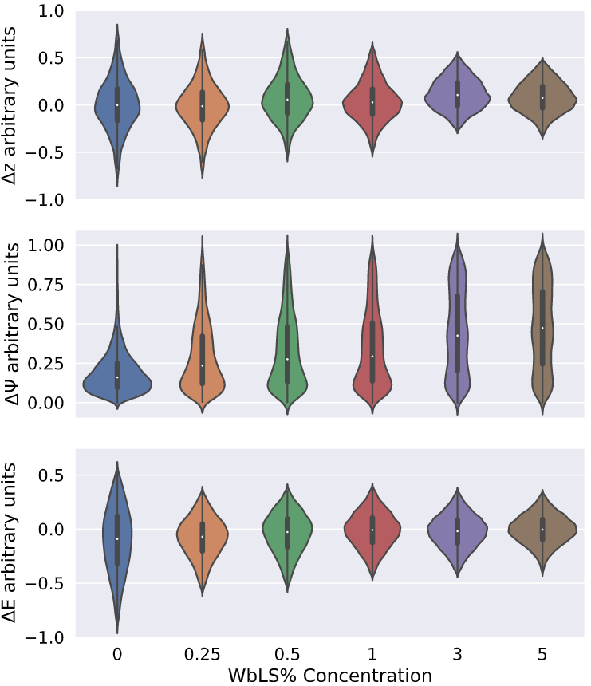
Eos Reconstruction Study
Integrate HITMAN into a complex MC simulation (RATPAC) to study EOS design and simulation features
Resolutions as a function of scintillator concentration (WbLS)
Z: particle vertex z position
Ψ: particle direction
E: Particle energy
Published in Eller, et al.
Performed studies > 500 configurations
[4]
Notes:
So now we are going to look at an example reconstruction study using Eos.
What was done here was to integrate HITMAN into a more complex Monte Carlo simulation called RATPAC to study design parameters of EOS. Here we a small study where we vary the percentage of liquid scintillator in the target volume to see how the resolutions for various physics parameters change as a function of this concentration.
It is noted that moving left to right in one of these rows gives results one might expect when increasing scintillation yield, the vertex and energy resolution improves while the directional resolution gets washed away.

Slide 11
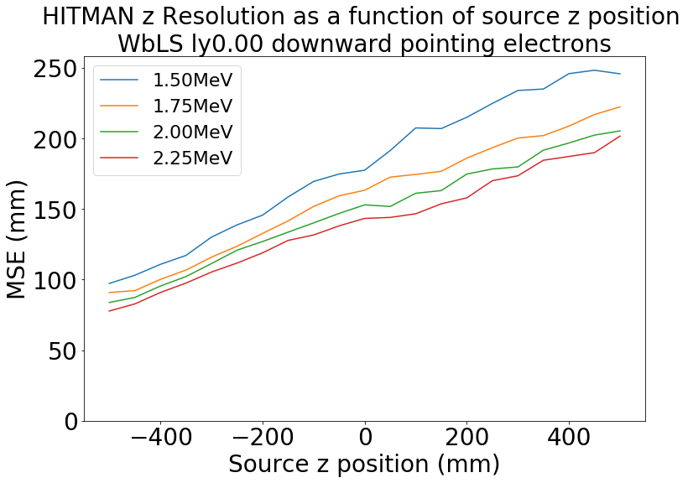
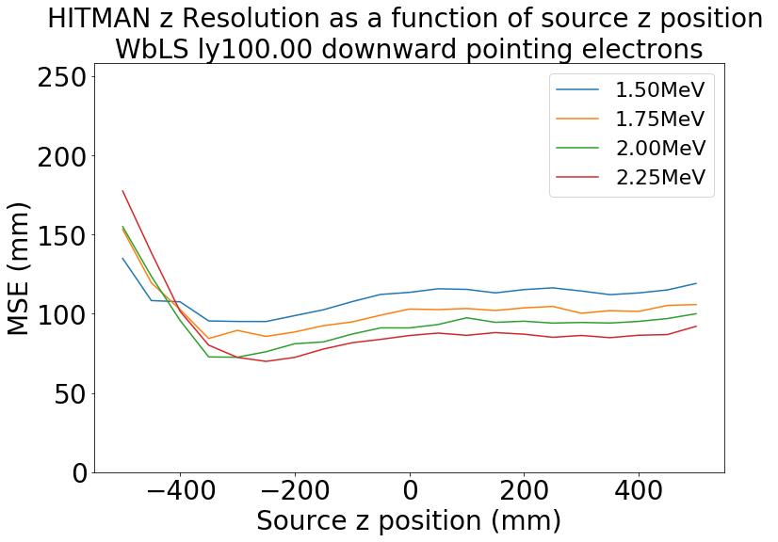
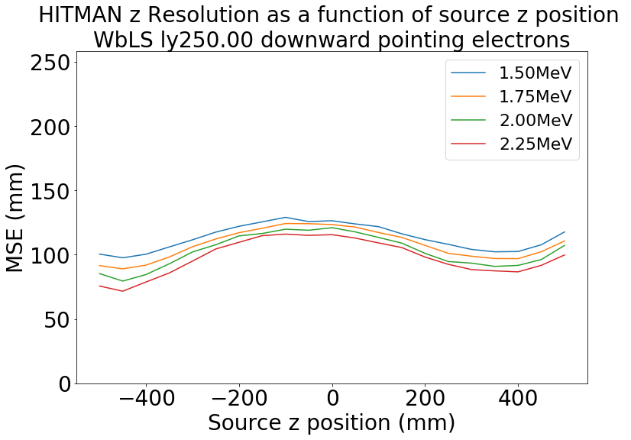
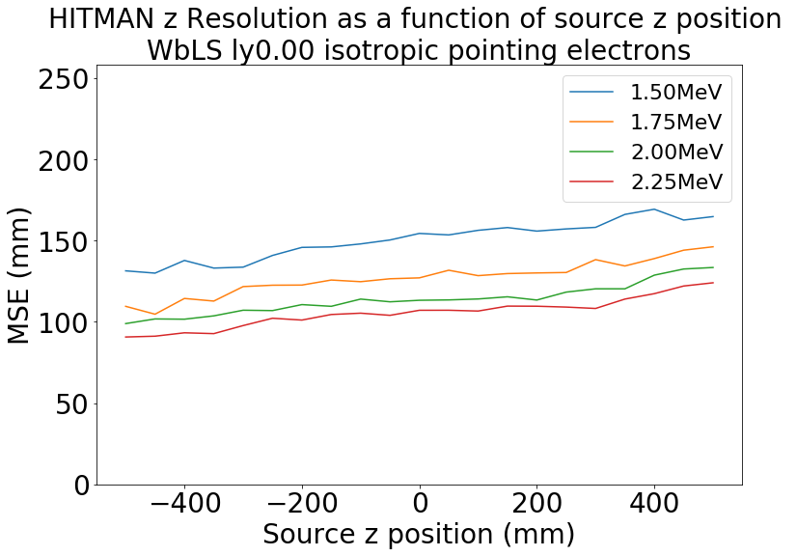
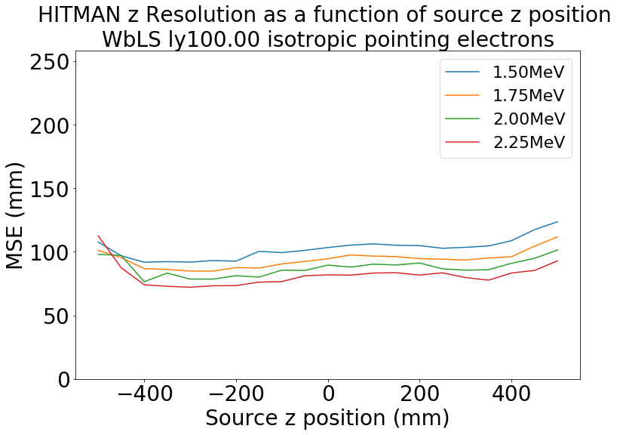
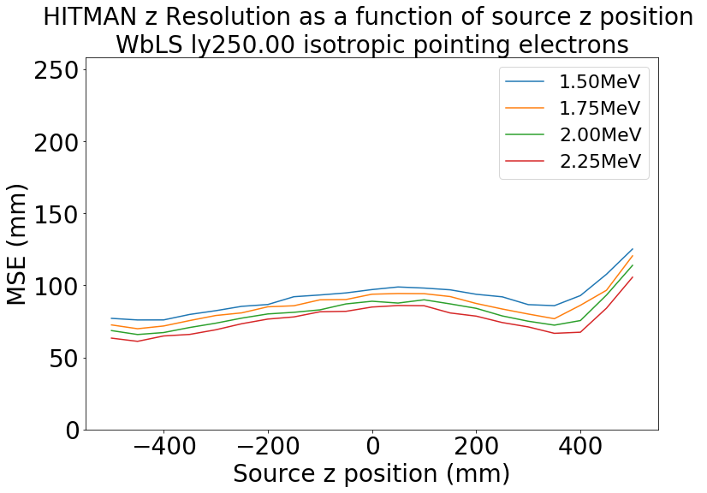
H2O
H2O +WbLS
H2O + 2.5 WbLS
$$β^{−}$$
PRELIMINARY
PRELIMINARY
PRELIMINARY
$$β^{−}$$
PRELIMINARY
PRELIMINARY
PRELIMINARY
Notes:
Here is a more detailed study looking at over 500 configurations of a prototype version of the Eos detector. This table is a bit complex; we are varying 4 different design parameters here. The main takeaway for this talk is that with this technique, we can perform large studies like this is a finite amount of time.

Slide 12
HITMAN Workflow
Generate correlated & uncorrelated dataset from simulation
Generate network using neural ratio estimation procedure
Perform optimization for MLE or scans of likelihood space
Advantages:
General particle reconstruction in optical neutrino detectors
Detector features added implicitly in simulation data
Streamlines workflow of iterative design process
Computations are highly parallelizable
Rapid prototyping turnaround time without sacrificing inference quality

Slide 13
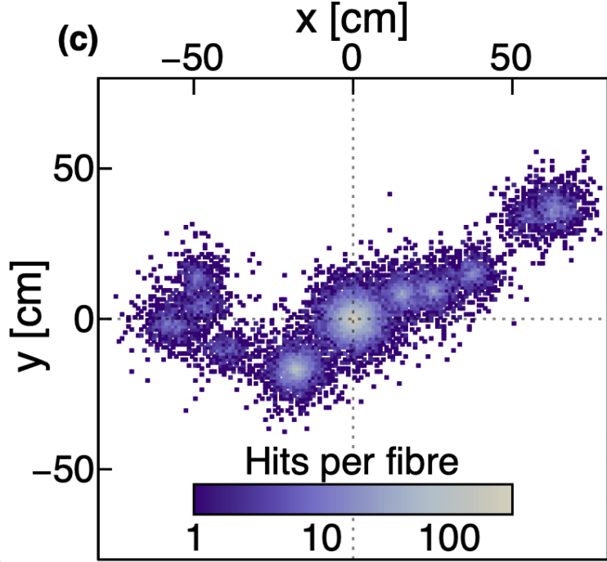
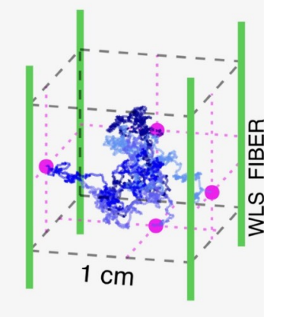
Future Work
Eos
Incorporate particle ID in reconstruction
Continue providing quantitative performance metrics as detector design and simulations are refined
Integrate HITMAN in simulation and analysis toolchain developed and used at LBNL & LLNL
LiquidO [A. Cabrera, et al.]
Apply HITMAN to LiquidO style neutrino detector
Technology has inherently strong background rejection, potentially useful above-ground detector deployment
Positron

Slide 14
MTV Impact
MTV supported collaborations
Prof. Gabriel Orebi Gann (PI of Eos, LBNL)
Dr. Marc Bergevin (Eos, LLNL)
UK collaboration at University of Sussex on LiquidO project (Prof. Jeff Hartnell)
Plans for future relationship with national labs
Summer travel planned to Berkeley/LBNL and LLNL to collaborate on simulation and analysis methods
Technology transitions
Apply technique to nuclear reactor monitoring for non-proliferation; particle physics; PET scanners
Collaborations with Eos/DNN, LiquidO/Uni. of Sussex/U. Mich./EDF
Notes:
Finally, I would like to discuss the impact MTV has had on my graduate career thus far
In particular, MTV has supported collaboration with the PI of Eos at LBNL, as well as other scientists at LLNL who are interested in using the HITMAN technique for lab affiliated projects. Beyond the national labs, I have also been able to take advantage of the UK collaboration initiatives and discuss the LiquidO project with individuals at the University of Sussex.
In the immediate future I plan to travel between Berkeley and LLNL to collaborate on simulation and analysis methods specifically pertaining to Eos
Ultimately the technology developed will be used primarily for nuclear reactor monitoring and particle physics, but also is finding external application in PET scanner usage scenarios for the LiquidO paradigm

Slide 15
Acknowledgements
The Consortium for Monitoring, Technology, and Verification would like to thank the DOE-NNSA for the continued support of these research activities.
This work was funded by the Consortium for Monitoring, Technology, and Verification under Department of Energy National Nuclear Security Administration award number DE-NA0003920

Slide 16
Citations
[1] Yeh, M., Hans, S., Beriguete, W., Rosero, R., Hu, L., Hahn, R. L., … Littenberg, L. (2011). A new water-based liquid scintillator and potential applications. Nuclear Instruments and Methods in Physics Research Section A: Accelerators, Spectrometers, Detectors and Associated Equipment, 660(1), 51–56. doi:10.1016/j.nima.2011.08.040
[2] Kaptanoglu, T., Callaghan, E. J., Yeh, M., & Orebi Gann, G. D. (2022). Cherenkov and scintillation separation in water-based liquid scintillator using an LAPPDTM. The European Physical Journal C, 82(2), 169. doi:10.1140/epjc/s10052-022-10087-5
[3] Kaptanoglu, T., Luo, M., Land, B., Bacon, A., & Klein, J. R. (2020). Spectral photon sorting for large-scale Cherenkov and scintillation detectors. Phys. Rev. D, 101, 072002. doi:10.1103/PhysRevD.101.072002
[4] Eller, P., Fienberg, A. T., Weldert, J., Wendel, G., Böser, S., & Cowen, D. F. (2023). A flexible event reconstruction based on machine learning and likelihood principles. Nuclear Instruments and Methods in Physics Research Section A: Accelerators, Spectrometers, Detectors and Associated Equipment, 1048, 168011. doi:10.1016/j.nima.2023.168011
[5] Barlow, R. (1990). Extended maximum likelihood. Nuclear Instruments and Methods in Physics Research Section A: Accelerators, Spectrometers, Detectors and Associated Equipment, 297(3), 496–506. doi:10.1016/0168-9002(90)91334-8
[6] Anderson, T., Anderssen, E., Askins, M., Bacon, A. J., Bagdasarian, Z., Baldoni, A., … Zimmerman, E. D. (2023). Eos: conceptual design for a demonstrator of hybrid optical detector technology. Journal of Instrumentation, 18(02), P02009. doi:10.1088/1748-0221/18/02/P02009
[7] LiquidO Consortium. Neutrino physics with an opaque detector. Commun Phys 4, 273 (2021). https://doi.org/10.1038/s42005-021-00763-5

Slide 17
Backup Slides…

Slide 18
Neural Ratio Estimator: Theory
1) Generate two sets of data:
Set 1 is a joint distribution describing correlated events $p_{1}=p\left(x,θ\right)$
Set 2 is a product of the marginal probabilities $p_{2}=p\left(x\right)p\left(θ\right)$ describing uncorrelated events
2) Define a classification function $\{d\left(x,θ\right)|0≤d\left(x,θ\right)≤1\}$ that describes the likelihood $(x,θ)$ are correlated (from Set 1). Thus:
$q_{1}=d\left(x,θ\right)$ the probability $(x,θ)$ is from Set 1
$q_{2}=1−d(x,θ)$ the probability $(x,θ)$ is from Set 2
3) Define binary cross entropy between distributions $p$ and $q$: $H\left(p,q\right)=−\sum_{i}{p_{i}ln(q_{i})}$
$H=−p_{1}ln(d(x,θ))−p_{2}ln(1−d(x,θ))$
4) Find a $d^{∗}(x,θ)$ such that it satisfies ${\left.\frac{δH}{δ\left(d\left(x,θ\right)\right)}\right|}_{d^{∗}}=0$, implying:
$\frac{d^{∗}}{1−d^{∗}}=\frac{p(x|θ)}{p(x)}∝L\left(θ | x\right)$ (for constant x)
See Likelihood-free MCMC with Amortized Approximate Ratio Estimators (arxiv.org) for more information

Slide 19
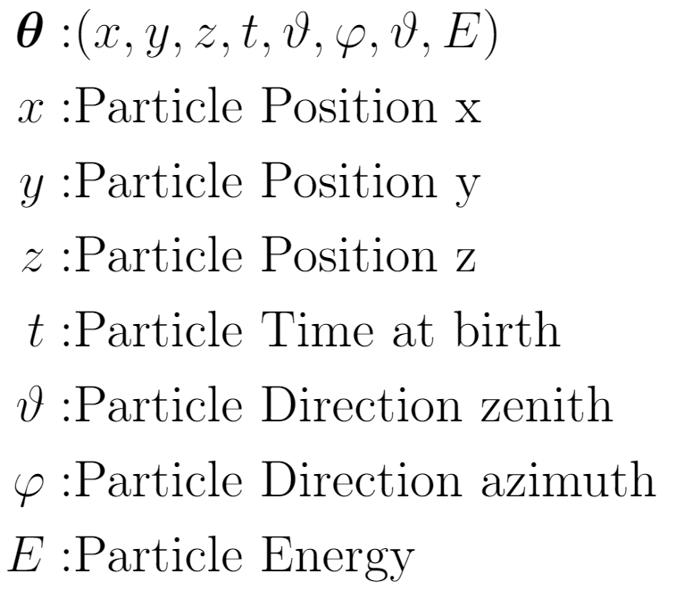
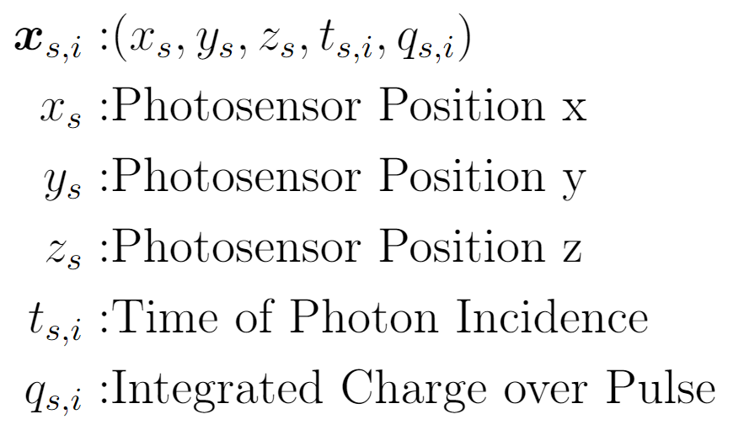
The Extended Maximum Likelihood: Explicit Inputs
Include information about total charge collected and each photon’s arrival time
Extended Maximum Likelihood
Total Detector Info
(Chargenet)
Information per photon (Hitnet)

Slide 20
Network Architecture:

