Slide 1
Electric Zero Knowledge
2023 MTV Workshop
(March 22)
Areg Danagoulian
Laboratory of Applied Nuclear Physics (LANPh), MIT
Lab collaborators: Glen Warren, Mital Zalavadia
PNNL

Slide 2
Introduction
Warhead verification -- requirements:
Sensitivity == detect a hoax Treaty Accountable Item (TAI)
Specificity == ability to clear honest TAI
Privacy == protect all classified information about the TAI

Slide 3
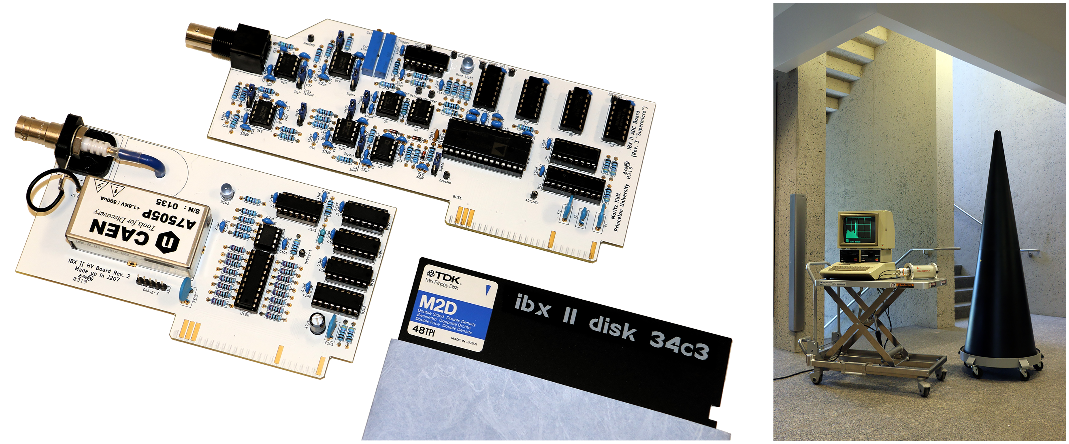
Electronic Concepts in Privacy
Information Barriers (IB), electronic and computational – national labs
problem: shifts the burden of verification to the IB
component size << σ_{X-ray}
millions of components
Kutt and Glaser, ” Vintage electronics for trusted radiation measurements and verified dismantlement of nuclear weapons,” (2019) https://doi.org/10.1371/journal.pone.0224149
Our approach: abandon digital altogether

Slide 4
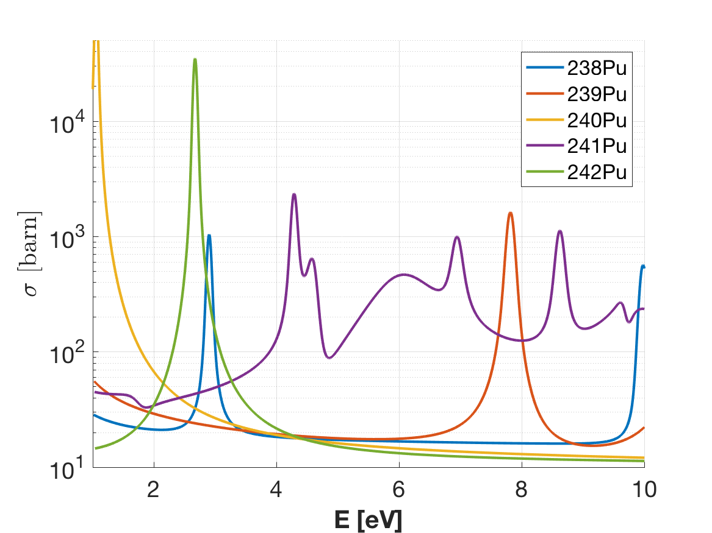
Privacy in Neutron Resonant Transmission Analysis (NRTA): Our Past Work
Encrypting mask
cryptographic
golden copy
candidate object
(TOF)
$$\ln{(signal)}=[object+mask]$$
?
=
SIGNAL_{golden}
SIGNAL_{candidate}
[Engel, Danagoulian, Nature Communications 10, 4433 (2019)]
[Klein, Naqvi, Bickus, Lee, Danagoulian, Goldston
Physical Review Applied 15 (5), (2021)]

Slide 5
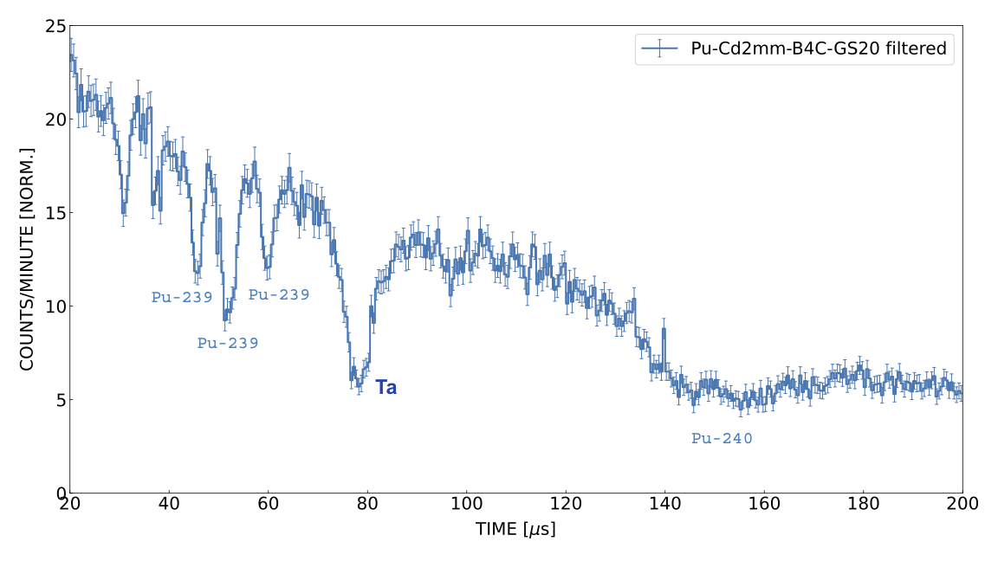
Challenge: additional cryptographic layer – with electricity
BLOCK
BLOCK
BLOCK
TOF data with
a DT generator →
(from a run at PNNL, July 2022)
→ Use an analog (non-digital) electric mask to block parts of TOF

Slide 6
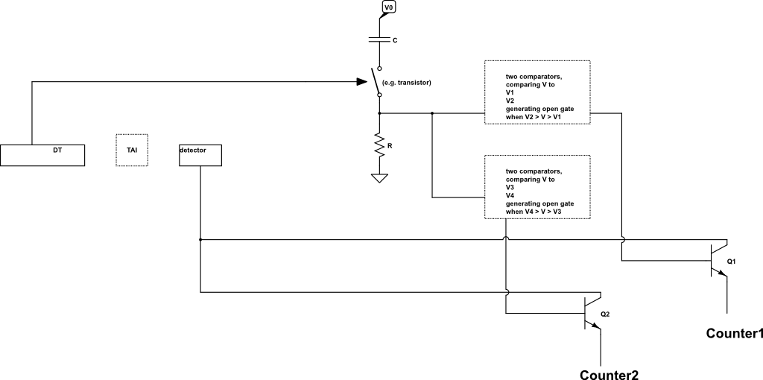
Technical Approach
Convert time to a voltage via an RC circuit: t → V
Send V to a series of comparators → gates
gates → block the analog output from the detector
t → Voltage → gate
gate1
gate2

Slide 7
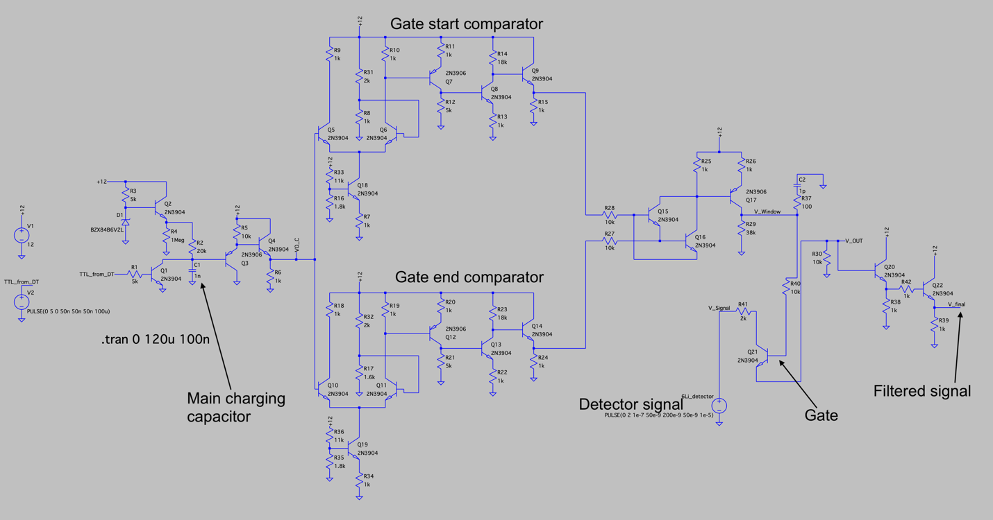
LTSpice Simulation
TTL from DT
Original work:
Colin Chaney
(currently at NI)

Slide 8
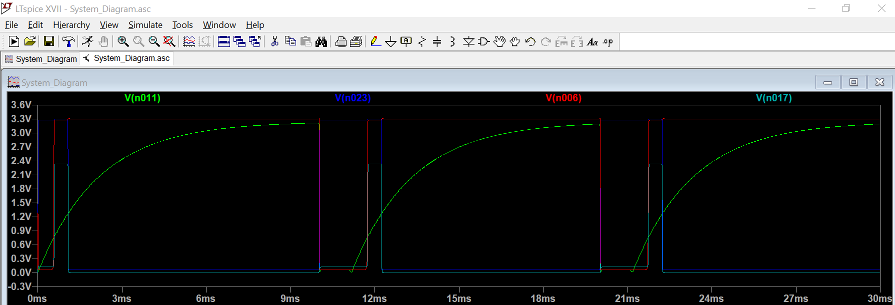
LTSpice Simulation Results
Output for a single gate1
end_comparator
start_comparator
capacitor charging
GATE
DT pulse
DT pulse
DT pulse

Slide 9
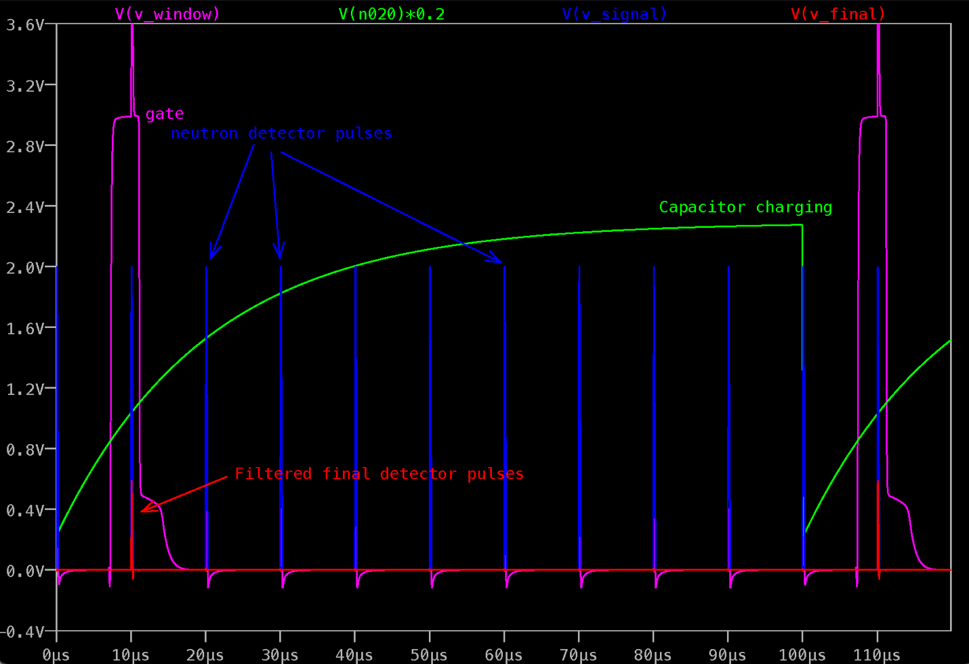
Filtered signal:

Slide 10
Expected Impact
Will add futher security / confidence in the warhead verification protocol
Applies to any TOF-based technique

Slide 11
MTV Impact
Collaboration with national laboratories
Current collaborators:
Glen Warren, Mital Zalavadia, Michael Moore and others – PNNL, IVAC project
Ben McDonald – PNNL, NRTA-SG project
Rob Goldston -- PPPL
Possible future lab and university collaborations:
Jason Nattress, ORNL (white paper submitted)
Jason Hayward, UTK
Technology transitions – possible users:
NNSA, NA-22
IAEA?

Slide 12
Conclusion
Use digital electronics electricity to reduce a spectrum to two numbers: counts1, counts2… for a ZK comparison
Analog primitive devices – simple and easy to verify:
component size >> σ_{X-ray}, easy to test and verify
O(100) components
Preliminary simulation results show that this is feasible

Slide 13
Next Steps and Challenges
Collaborate with colleagues / electrical engineers at national labs
improve the design
develop a breadboard prototype
apply to the output of our DT-based NRTA
Possible challenges ahead:
Comparators require transistors with identical β – not easy (variability of dopant levels)
Possible solution: produce two transistors on a single silicon wafer

Slide 14
Acknowledgements
The Consortium for Monitoring, Technology, and Verification would like to thank the DOE-NNSA for the continued support of these research activities.
This work was funded by the Consortium for Monitoring, Technology, and Verification under Department of Energy National Nuclear Security Administration award number DE-NA0003920

