Slide 1
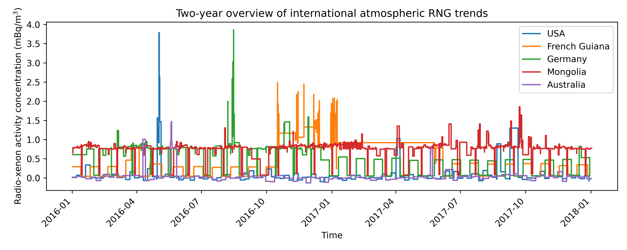
Comprehensive Nuclear Test Ban Treaty Organization Radioactive Noble Gas Monitoring System Data for Nuclear Detonation Characterization Brice Turner 1st-year PhD Student, University of Florida Andreas Enqvist, PhD, Principal Investigator, University of Florida
Introduction and Motivation
Technical Approach
MTV Impact
Monitoring is required to ensure compliance with the CTBT.
CTBTO International Monitoring System (IMS) contains seismic, hydroacoustic, infrasound, and radionuclide (with noble gas) monitors.
Radio-noble gas (RNG) production is the only signature nonexistent without Anthropogenic nuclear activities.
Improved atmospheric transport models (ATM) can enable IMS RNG data to be used for detonation localization and characterization, improving international abilities to verify violations of the CTBTO and evaluate adversarial capabilities
Find systematic noise
Machine learning-based improvement of existing forward-modeling. Source terms: US Nevada Test Site legacy test data.
Utilize high-performance computing resource at Lawrence Livermore National Laboratory
Backwards modeling to localize detonation. Source terms: IMS data.
MTV created connections with National Laboratory Scientist
Completing internship with LLNL National Atmospheric Release Advisory Center.
Stakeholders: CTBTO, USA National Laboratories Global Security Divisions, and international arms reduction community.
Conclusion
Results
Evaluating systematic noise and periodic trends ongoing.
This research will enable better monitoring of international nuclear activities of all types and improve knowledge of clandestine nuclear tests.
Mission Relevance
Nonproliferation: in addition to detonations, reactor operation, uranium enrichment, and other nuclear activities will release RNGs
Verification: determining if Treaty violations have occurred and the nature of such.
Next Steps
Forward-model development with machine learning and legacy Nevada Test Site data.
Determine how to properly integrate IMS data.
Expected Impact
Improve atmospheric modeling capabilities beyond hemisphere-scale
Forward modeling of RNG spread from known source term
Backwards modeling with IMS data to improve accuracy of detonation location, time, and yield estimates.
This work was funded in-part by the Consortium for Monitoring, Technology, and Verification under DOE-NNSA award number DE-NA0003920. We thank the CTBTO for making available the virtual Data Exploitation Center (vDEC, https://www.ctbto.org/specials/vdec/) for distributing data to the authors.

