Slide 1
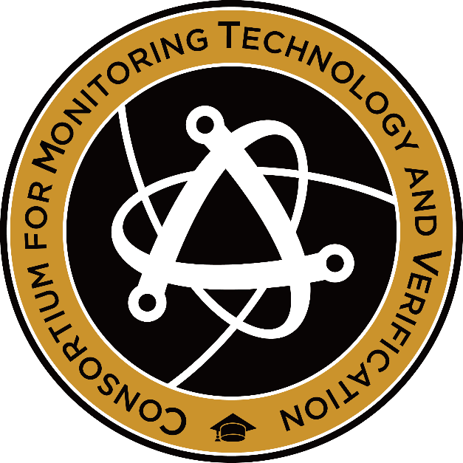
New Developments in
Zero-knowledge Verification:
Toward 2D-Radiography and
Real-time Confirmation Measurements
2023 MTV Workshop
(March 22)
Jihye Jeon
PhD student, Princeton University
Co-authors: Alex Glaser¹, Andy Gilbert², Erik Gilson³, Rob Goldston^{1,3}
¹Princeton University, ²Pacific Northwest National Laboratory
³Princeton Plasma Physics Laboratory
Notes:
Hello, everyone. I am Jihye Jeon, a phD student from Princeton University. Today, I would like to walk you through our new developments in zero-knowledge verification, which are 2D radiography and real-time confirmation measurements.

Slide 2
Mission Relevance
Developing and maintaining the technical means to monitor whether the terms of a nuclear arms control treaty or other international agreement are fulfilled is a critical factor in ensuring that such agreements are successful.
This study presents a pathway toward a practical and robust system for the development and implementation of arms control treaties.
Zero-Knowledge Protocol approaches can address one of the challenges in arms control verification, not revealing any sensitive information of nuclear weapons.

Slide 3
Introduction and Motivation
We have previously studied Zero-Knowledge-Protocol (ZKP) differential neutron radiography for warhead verification, using superheated droplet (bubble) detectors.
We successfully showed the proof-of-concept using one dimensional radiography experiments under CVT.
In this study, for the first time, we conducted calculations and preliminary experiments with a test object with 3D structure (64 voxels) combined with 2D radiography.
Also, we propose a real-time confirmation system using radiographic image on 2D scintillators and a digital camera.

Slide 4
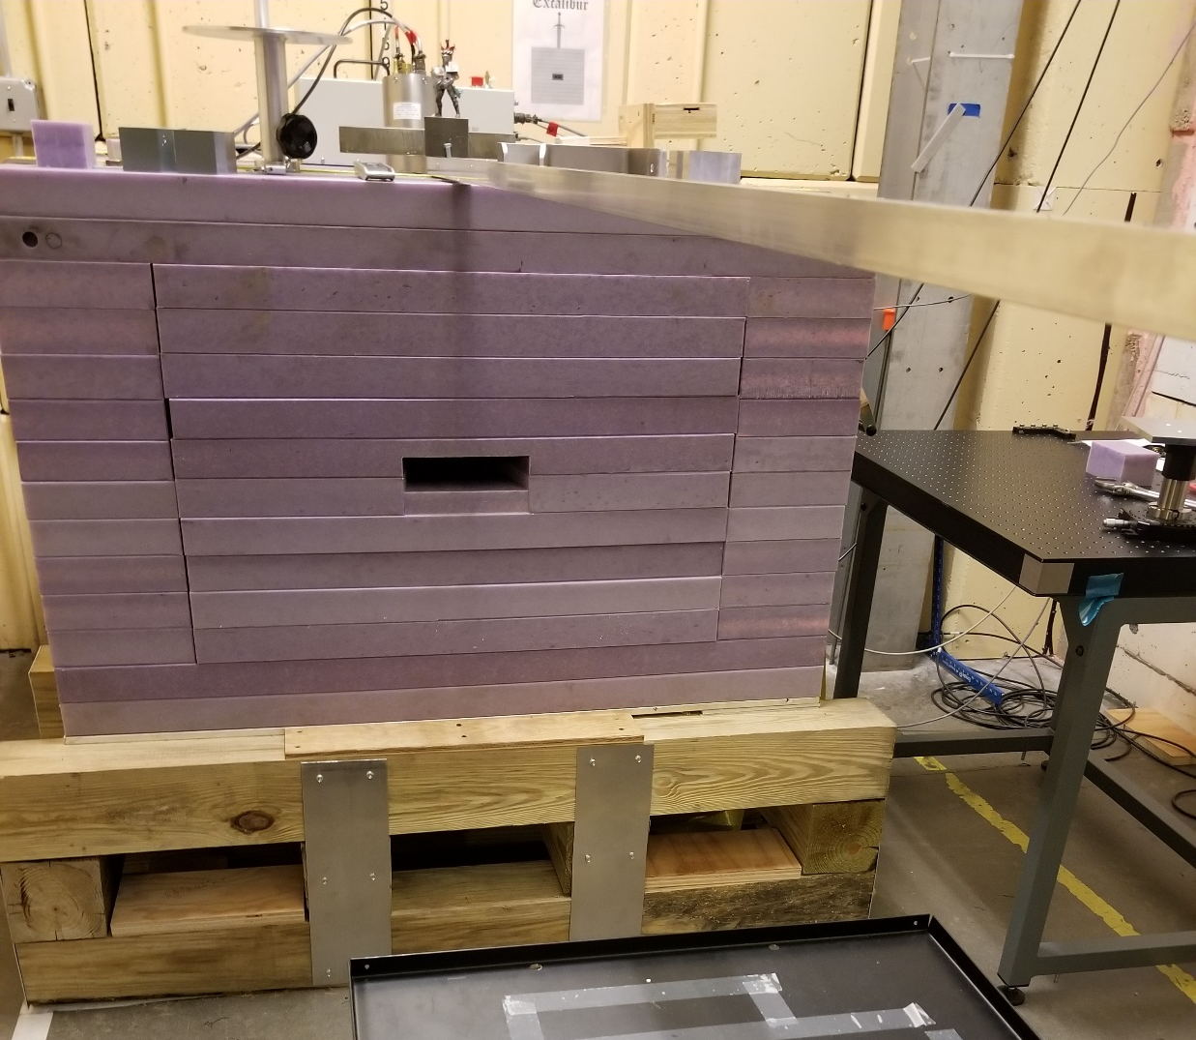
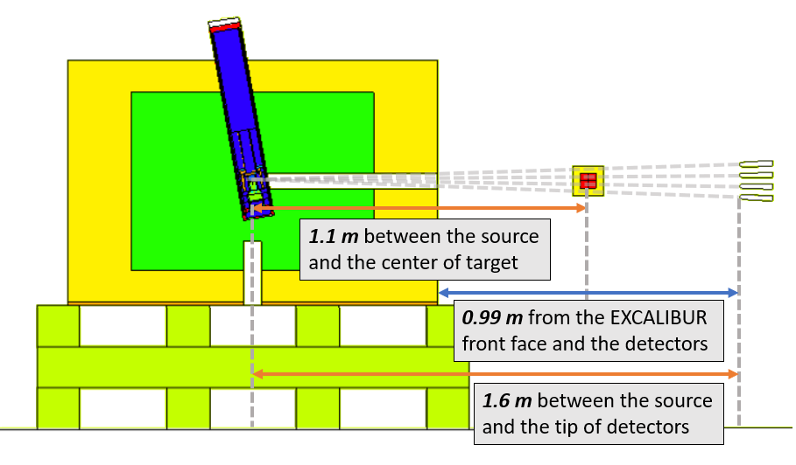
2D Radiography of 3D Object
EXCALIBUR @PPPL
MCNP modeling for 4X4X4 voxel
Elevation view
EXCALIBUR @PPPL
Notes:
First, here is our MCNP model for 2D radiography as you can see in the picture on the left. We use a neutron source at PPPL called EXCALIBUR in the picture on the right. EXCALIBUR has a D-T generator, and we can use the direct 14 MeV neutrons through this fan-shaped collimator. As I mentioned previously, we tested 2D objects with a single array of bubble detectors but for the first time, now we test this 4X4X4 voxel which consists of 1” cubes of polyethylene, stainless steel and aluminum with bubble detectors in 4X4 grid. We placed the target at 1.1 m and detectors at 1.6 m from the neutron source, so that we can give some space around the target, assuming that it could be in a container.

Slide 5
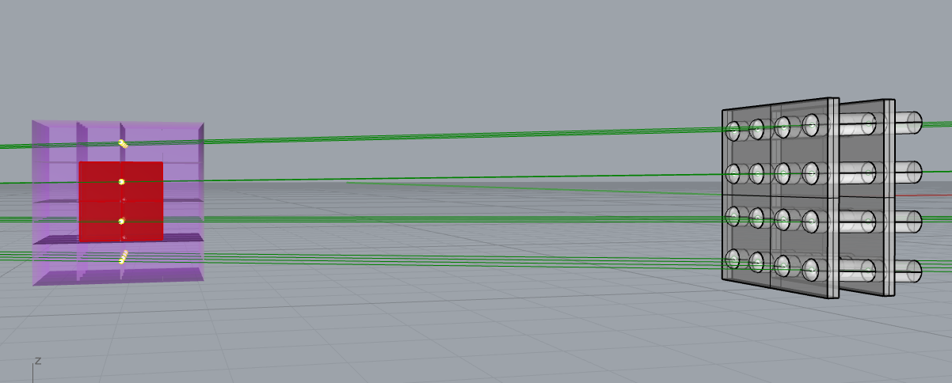
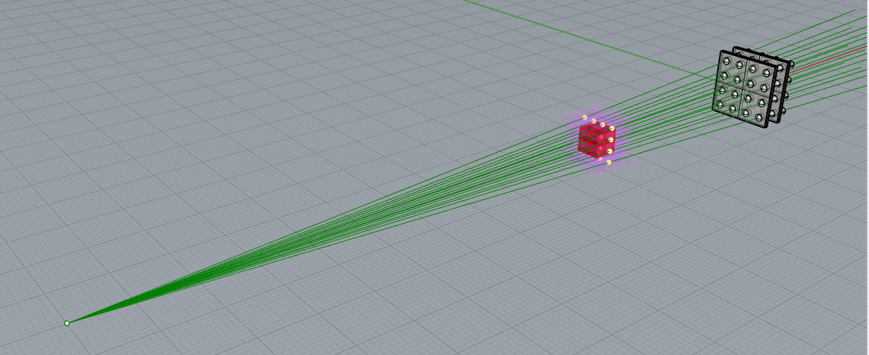
2D Radiography of 3D Object
MCNP modeling for 4X4X4 voxel
Source
Notes:
For your better understanding on our model, here is the 3D image. The line connecting the neutron source and the center of cubes goes through the axis of bubble detector.

Slide 6
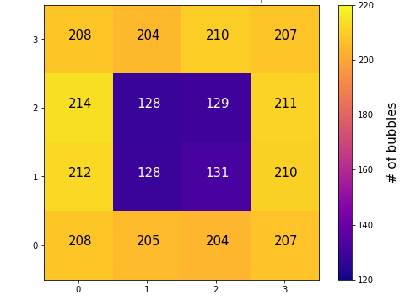
2D Radiography of 3D Object (simulation)
Looking from the back of the target (bubble detectors)
toward the source
Neutron beam 70 μA, 130 kV (5*10⁸ n/s)
Exposure time: 10 min
Poly X 4 | Poly X 4 | Poly X 4 | Poly X 4
Poly X 4 | Poly SS X2 Poly | Poly SS X2 Poly | Poly X 4
Poly X 4 | Poly SS X2 Poly | Poly SS X2 Poly | Poly X 4
Poly X 4 | Poly X 4 | Poly X 4 | Poly X 4
From 1e9 MCNP neutron source particles
Notes:
Here are the results of MCNP calculations. The table on the left shows the configuration of the target when we see it from the back. So this corner has four polyethylene cubes while this region has one poly cube in front, two stainless steel cubes in the middle and another poly cube in the back. When we suppose measurement at 5*1e8 neutrons/s for 10 minutes, we could see the clear distinction between the bubble detectors looking at only poly cubes and those looking at two poly and two steel cubes. We have an upgraded neutron source with power of 1e9 n/s at PPPL and we can have a shorter exposure time with it, if needed.

Slide 7
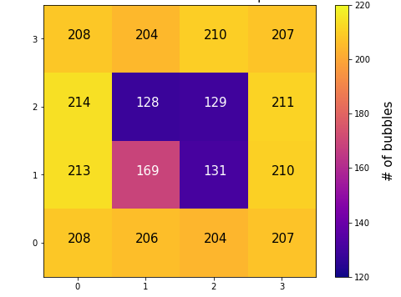
2D Radiography of 3D Object (simulation)
Looking from the back of the target (bubble detectors)
toward the source
Neutron beam 70 μA, 130 kV (5*10⁸ n/s)
Exposure time: 10 min
Al* closer to the beam
Poly X 4 | Poly X 4 | Poly X 4 | Poly X 4
Poly X 4 | Poly SS X2 Poly | Poly SS X2 Poly | Poly X 4
Poly X 4 | Poly Al*/SS Poly | Poly SS X2 Poly | Poly X 4
Poly X 4 | Poly X 4 | Poly X 4 | Poly X 4
From 1e9 MCNP neutron source particles
Notes:
When we swapped one steel cube with one aluminum cube, we see more bubbles since we have less attenuation.

Slide 8
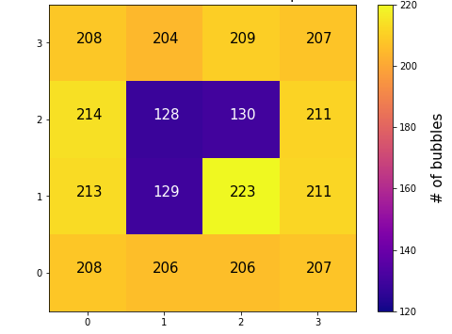
2D Radiography of 3D Object (simulation)
Looking from the back of the target (bubble detectors)
toward the source
Neutron beam 70 μA, 130 kV (5*10⁸ n/s)
Exposure time: 10 min
Poly X 4 | Poly X 4 | Poly X 4 | Poly X 4
Poly X 4 | Poly SS X2 Poly | Poly SS X2 Poly | Poly X 4
Poly X 4 | Poly SS X2 Poly | Poly Al X2 Poly | Poly X 4
Poly X 4 | Poly X 4 | Poly X 4 | Poly X 4
From 1e9 MCNP neutron source particles
Notes:
When we swapped two steel cubes with two aluminum cubes, the difference increased.

Slide 9
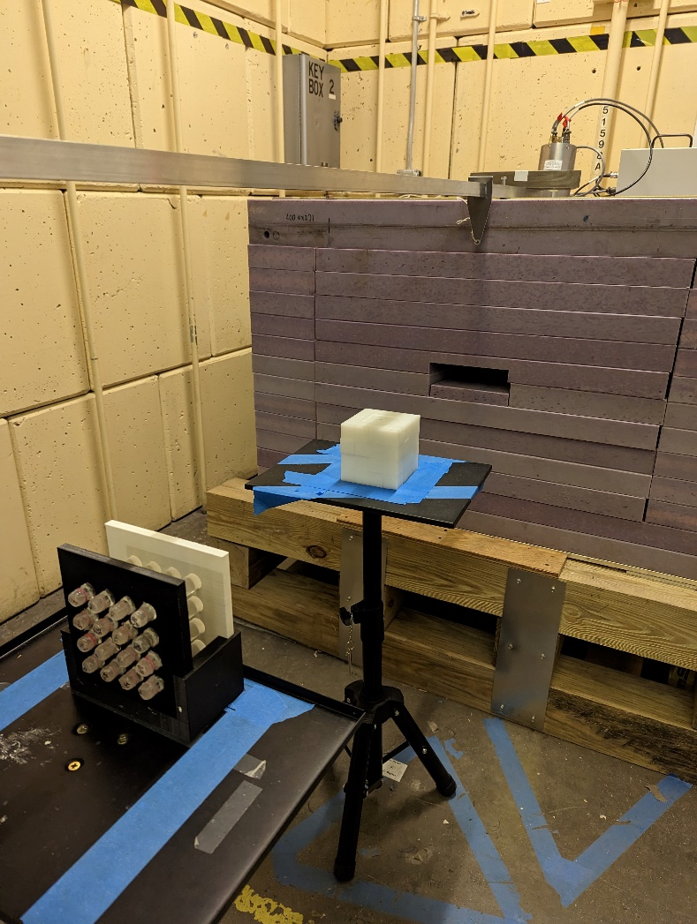
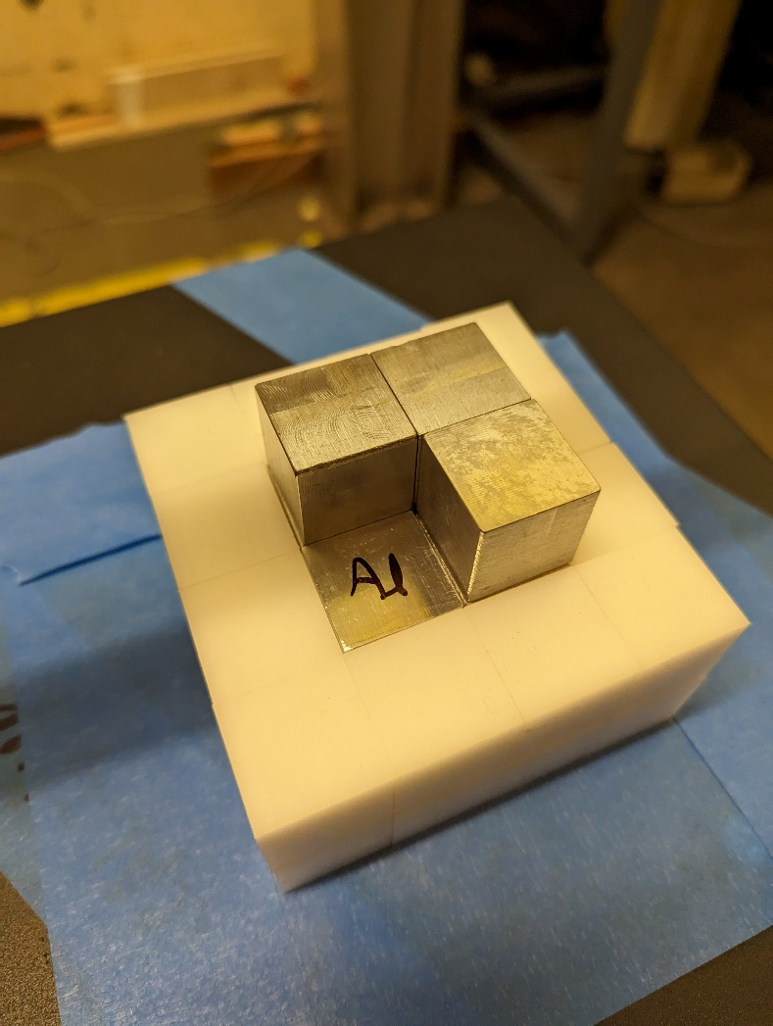
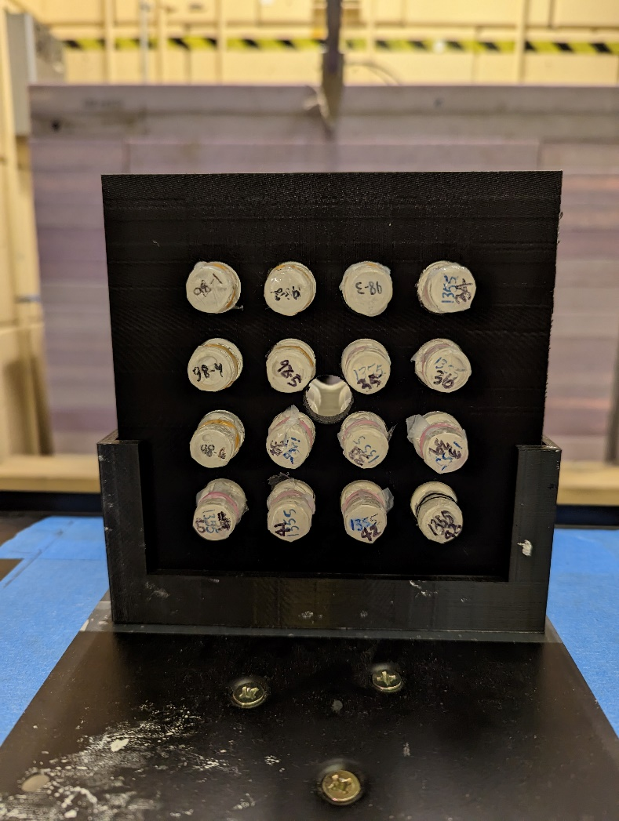
2D Radiography of 3D Object (set up)
Experiment at PPPL, using 14 MeV D-T neutron source
Notes:
This shows the set up for the preliminary experiment. We have EXCALIBUR neutron source, target with 1” cubes and bubble detectors in 4X4 grid, as we saw in the MCNP model. From this run, we didn’t have enough bubbles to make a statistically sound conclusion. We are working on more exposures and improving bubble counting algorithms at the same time.

Slide 10
New idea: Real-Time ZKP– Imaging
Use low-noise digital camera for higher-resolution imaging.
Only require a single complement, not one pre-load per warhead.
Shine neutrons thru warhead, convert to light with scintillator.
ZKP– complement plate behind scintillator subtracts light to form pre-agreed flat, gray image for all warheads – if they are all identical.
Host can check image before Inspector.
Neutron source
Neutrons
Scintillation

Slide 11
Alternative Real-Time ZKP Imaging: ZKP+
Shine neutrons thru warhead, convert to light with scintillator.
Shine neutrons onto a second scintillator. Use ZKP+ complement plate to form negative image.
Add light from two scintillators to form flat image, as if no object had been in first neutron beam.
Better statistics, easy to agree on final image, more complex.
Neutron source
Neutrons
Scintillation

Slide 12
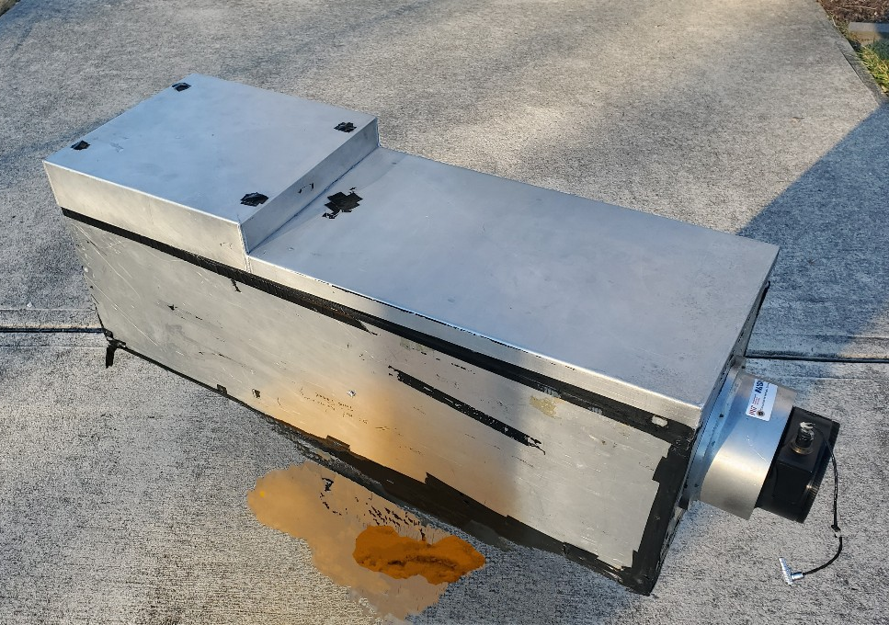
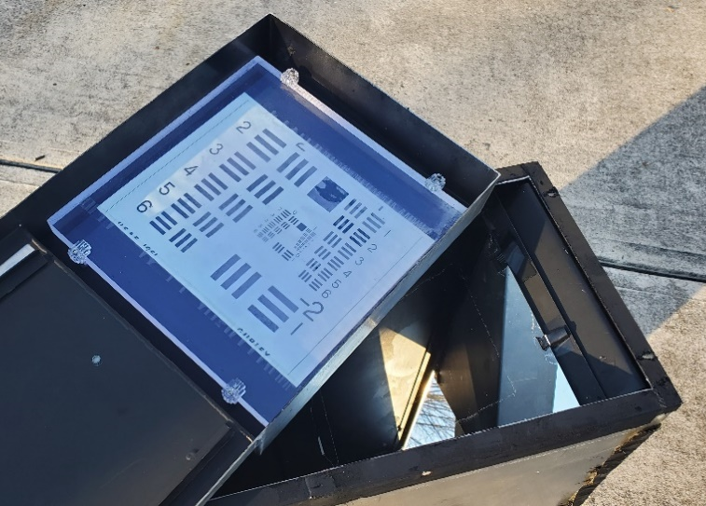
Real-Time ZKP- System
Scintillator &
ZKP- complement
Neutrons
Scintillator &
ZKP- complement
Mirror
Scintillation
Cameras
Mirror
Lens
Equipment courtesy of Dick Lanza (MIT)
Notes:
Here is the equipment for the real-time ZKP- system, thanks to Dick Lanza from MIT. It’s like a periscope in the submarine. We have a box containing a mirror which can hold scintillator and ZKP- complement. We also have a CCD camera and a CMOS camera with cooling capability ~-30°C.

Slide 13
Expected Impact/MTV Impact
2D imaging system with 3D objects enables more realistic zero-knowledge protocol studies.
Real-time ZKP confirmation system allows high-resolution electronic data acquisition.
Close collaboration with Princeton Plasma Physics Laboratory (PPPL) enabled neutron experiments in a safe and seamless manner.
Close collaboration with and internship at Pacific Northwest National Laboratory (PNNL) provided important insights.
Starting in 2023, we will work with PPPL, PNNL and LLNL through PROACTIVE Venture.

Slide 14
Conclusion/Next Steps
MCNP calculation showed the results as we expected. In theory,
we can distinguish the 1” cube of SS and Al.
We will perform experiments with the tilted bubble detector configuration at PPPL and improved bubble counting algorithm.
We are now mounting the MIT cameras to the mirror box. We will expose the system to 14 MeV neutrons to determine the signal level and neutron sensitivity.
We plan to test a liquid nitrogen-cooled Teledyne Princeton Instruments camera with the very low dark current.
In 2024: Simulated field tests with external participants!

Slide 15


Acknowledgements
The Consortium for Monitoring, Technology, and Verification would like to thank the DOE-NNSA for the continued support of these research activities.
  This work was funded by the Consortium for Monitoring, Technology, and Verification under Department of Energy National Nuclear Security Administration award number DE-NA0003920
Notes:
That brings us to the end of the presentation. I would like to thank MTV for this opportunity for collaborative work. I’d like to thank you for your time and attention today.

