Slide 1


Muon Tomography Optimization for Dry Cask Storage
2023 MTV Workshop
March 21, 2023
Jesus Valencia
PhD Student, University of New Mexico
Adam Hecht¹ (PI), Daniel Poulson², Matthew Durham², Christopher Morris²
University of New Mexico¹, Los Alamos National Laboratory²

Slide 2
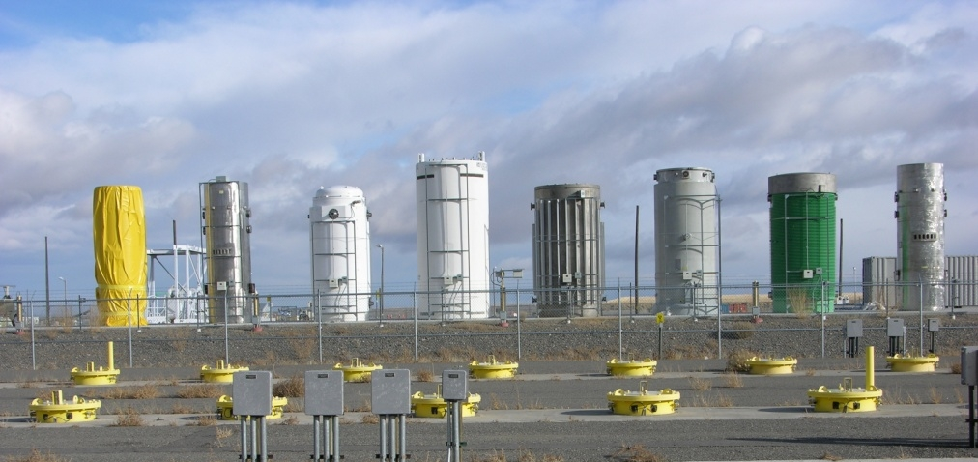
Introduction and Motivation
Almost all spent nuclear fuel in U.S. resides in spent fuel pools or in dry cask storage containers
Containers are heavily shielded, dense contents
In-situ verification difficult
Natural muons can penetrate containers
  Useful for imaging
  Subject to long measurement times
Various types of dry storage casks at Idaho National Laboratory. https://www.energy.gov/em/services/waste-management/nuclear-materials-disposition/spent-nuclear-fuel

Slide 3
Mission Relevance
Muon imaging techniques can be used to…
  Ensure that all spent nuclear fuel at a facility is accounted
  Identify if nuclear material has been removed from storage containers
In line with NNSA Mission
  Website: https://www.energy.gov/nnsa/missions/nonproliferation
  NNSA's Office of Defense Nuclear Nonproliferation works globally to prevent state and non-state actors from developing nuclear weapons or acquiring weapons-usable nuclear or radiological materials, equipment, technology, and expertise.

Slide 4
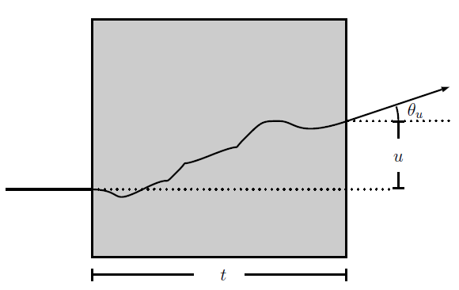
Overview of Muon Interactions
Cosmic-ray muons are very energetic, highly penetrating
Muons are charged particles
  Primarily interact via many Coulomb scatter events
Overall deflection angle proportional to Z²/A
Muon trajectory measured before and after interaction with target to find deflection angle

Slide 5
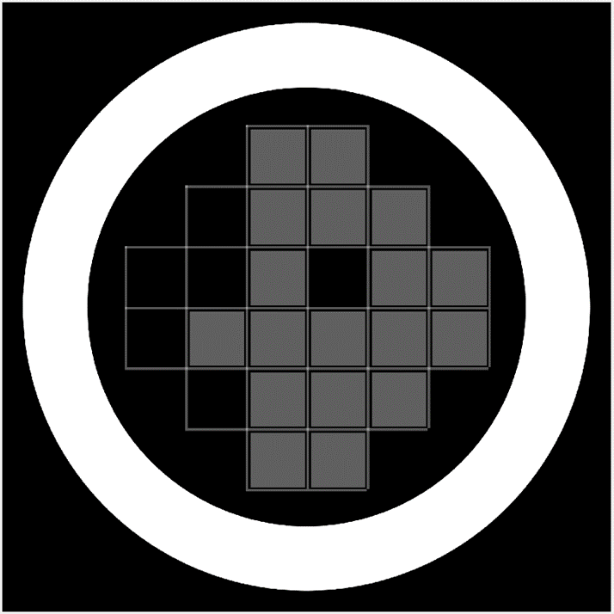
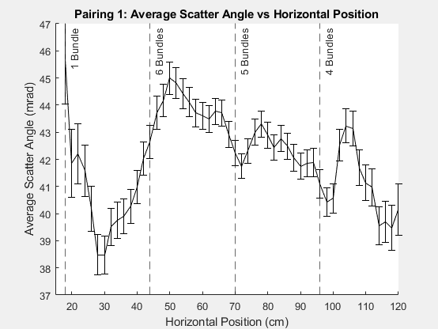
Results from Prior Cask Measurements:
1-D Cask Images
Muons projected to cask centerline and binned by horizontal position.
Find average scatter angle in each bin and plot versus horizontal position.

Slide 6
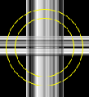
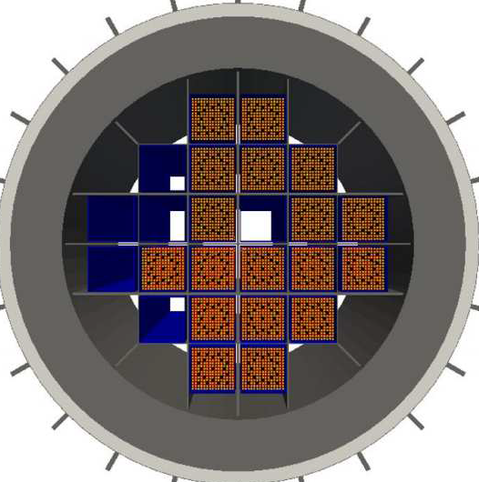
Our Results from Prior Cask Measurement Data:
Backprojection Tomography
6

Slide 7
Optimization Plan
90,000 muons per 10 day runs with cask at INL, poor tomographic images
Need to make best image with lowest amount of data
Examine tomography with fewer angles (detector-cask orientations)
Examine tomography with different reconstruction techniques
  Highest muon flux straight down
  Cask imaging is performed from sides
    no preferred orientation, examine all orientations
  Compare backprojection vs. “combined plenoptic” (our new approach).

Slide 8
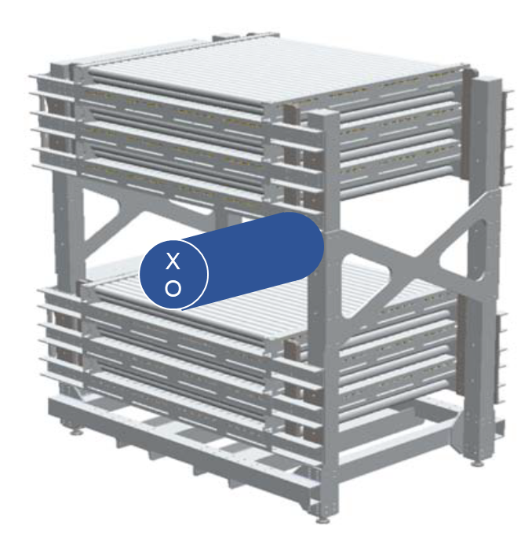
Multi-angle Tomographic Improvements
Our LANL collaborators have provided a comprehensive set of mock-up data.
Muon tracks through a concrete filled barrel
  Brass, lead and tungsten wedges placed at different locations in barrel
Barrel rotated in 15-degree increments, resulting in 24 total detector-barrel orientations

Slide 9
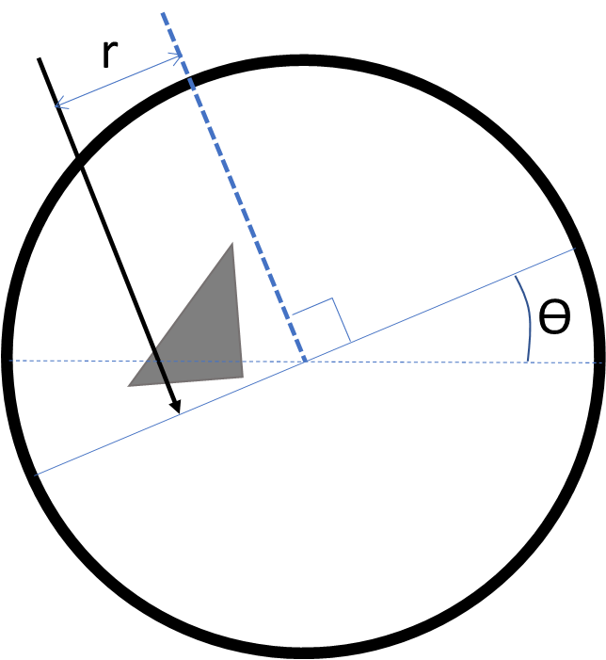
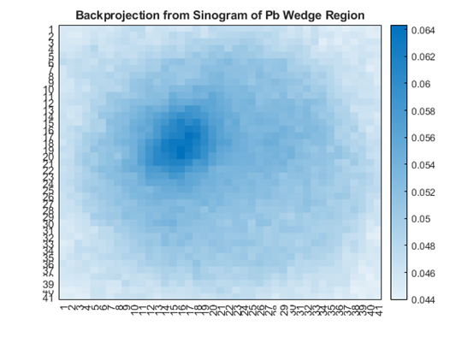
Multi-angle Method 1: Backprojection
Standard method in medical imaging
Each muon is binned according to
  Distance of closest approach from center (r)
  Angle between abscissa and centerline (ϴ)
  The small muon deflection angle is tallied
Sinogram created and inverse radon transform used to create image.

Slide 10
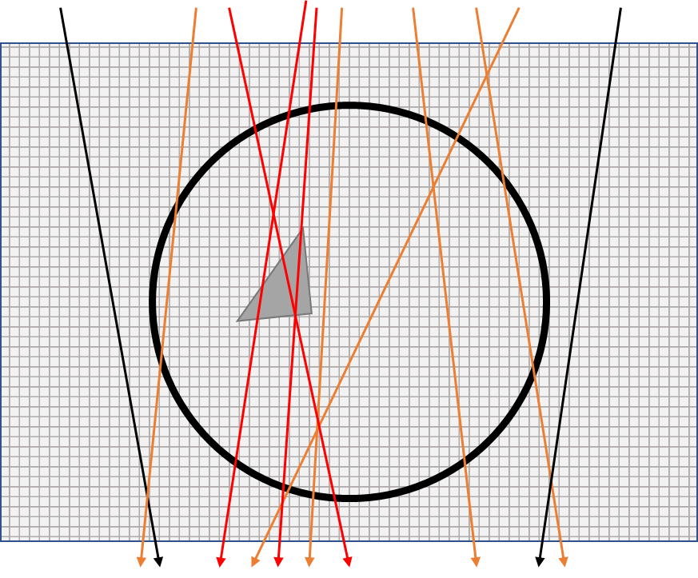
Multi-angle Method 1: Plenoptic Depth of Field
Muons projected from top detector through a three-dimensional voxelated volume
  Can make 3D depth image using each orientation
Muon scatter angle is tallied and weighted by the muon path length in each voxel
Combine several detector-barrel orientations Average scatter angle in each bin mapped to image intensity

Slide 11
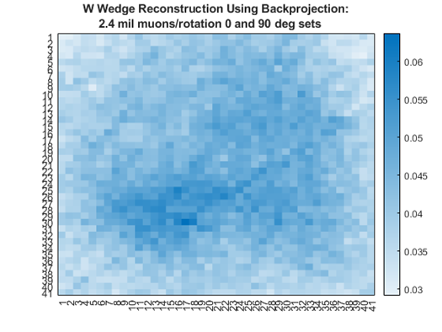
Reconstruction Comparisons:
Decreasing Number of Detector View Orientations
Plenoptic 2 orientation: W wedge still clear, concrete barrel not
Backprojection
24
4
2
Plenoptic
24
4
2

Slide 12
Reconstruction Comparisons:
Decreasing Number of Muons in Single Measurement
Backprojection
5M muons
1M muons
Single angle orientation:
BP - wedge unclear with 5 million muons
Plenoptic – wedge apparent even with 1 million muons
Plenoptic
5M muons
1M muons

Slide 13
Conclusion
Using our new technique of combined plenoptic depth of field imaging, we can use fewer orientations and fewer number of muons to resolve metal wedges in concrete barrel.
We should be able to use just a few orientations to create tomographic images of used fuel casks.
Next Steps
Simulations to help us plan times required for imaging casks at INL
We are in contact with INL trying to organize measurement

Slide 14
MTV Impact
What is the impact of the MTV on your project development?
  Funds the project, fostered interactions with national labs
  Student Jesus Valencia is supported by this project
List current collaborations with national labs (include names if possible)
  Collaborating with LANL, discussions with Sandia CA, INL
Plans for future relationship with national labs
  Continued work with LANL on muon imaging
Technology transitions
  Toshiba working with LANL collaborators to evaluate fuel remnants at Fukushima
  Possible depth of field imaging applications to visual 3D mapping
  Working with Egyptian university on Giza pyramid imaging - unpaid collaboration made possible by MTV connection with Dick Kouzes

Slide 15


Acknowledgements
The Consortium for Monitoring, Technology, and Verification would like to thank the DOE-NNSA for the continued support of these research activities.
  This work was funded by the Consortium for Monitoring, Technology, and Verification under Department of Energy National Nuclear Security Administration award number DE-NA0003920

