Slide 1
Simulations of Prompt-Gamma Response to Epithermal-Neutron Activation for Nuclear Forensics
2023 MTV Workshop
March 21
Brad Nethercutt
PhD Student, Pennsylvania State University
Marek Flaska
Associate Professor, Pennsylvania State University

Slide 2
Introduction and Motivation
There is a need to enhance the capabilities of non-destructive analysis
A neutron chopper system has been designed for the Penn State Breazeale Reactor which will allow for the isolation of epithermal neutrons between 0.5-40 eV along a beamline
One proposed use for this system is neutron activation analysis (NAA)
This work focuses simulating the prompt gamma response from samples which undergo NAA at different neutron energies
This may complement the traditionally used delayed gamma response

Slide 3
Introduction and Motivation
The prompt gamma response is utilized less frequently than the delayed gamma response
Deexcitation via prompt gamma emission is typically characterized by:
Ground state reached in 10⁻⁹-10⁻¹² s
2 to 4 gammas in a cascade
Total emitted gamma energy equals neutron binding energy plus kinetic energy of capturing neutron
6-10 MeV for ~80% of stable nuclei
Hundreds or thousands of possible prompt gamma energies per isotope
Regardless of the stability of the resulting nucleus, prompt gamma deexcitation will still occur
For many isotopes, prompt gamma emission levels are only well known up to 2 or 3 MeV

Slide 4
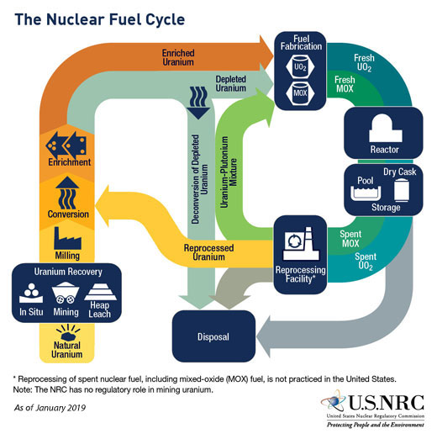
Mission Relevance
The ultimate aim of this work is to perform nuclear forensic characterization of samples which may come from the nuclear fuel cycle, using the neutron chopper system, which will be installed at the PSU Breazeale Reactor
Successful identification of a sample is the first step toward discerning:
Sample provenance
Possible points of diversion
Sample age
Successful identification is reliant upon a having validated set of references, which often can be difficult to find

Slide 5
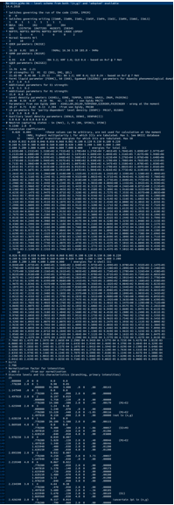
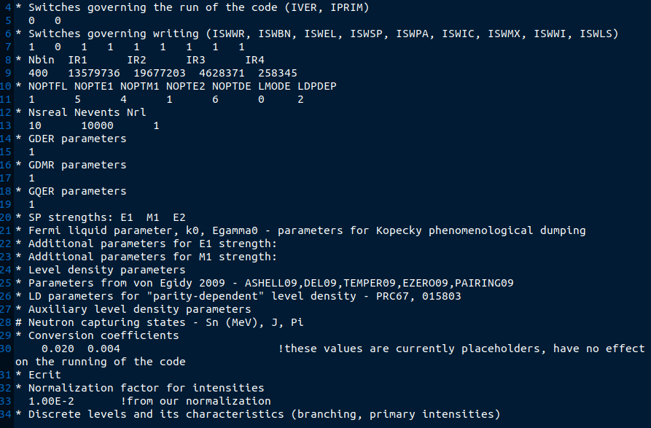
Technical Approach
DICEBOX is a Monte Carlo code, which simulates gamma cascades from an excited nucleus
DICEBOX is open source and available through IAEA Nuclear Data Services
Prompt Gamma Response Simulation (PROGRESS) – a software package designed to quickly, accurately, and largely automatically assemble DICEBOX input files, run DICEBOX, and interpret the output
Left: a complete DICEBOX input file
Right: the same file, in which all element-specific data is removed

Slide 6
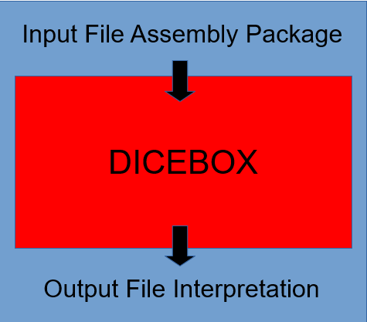
Technical Approach
PROGRESS is a Python wrapper around DICEBOX comprised of two main parts:
The assembly package, which aggregates all necessary data and writes it into a blank DICEBOX input file
The output interpretation package pulls the simulated cascades from DICEBOX output and formats the data in an accessible way

Slide 7
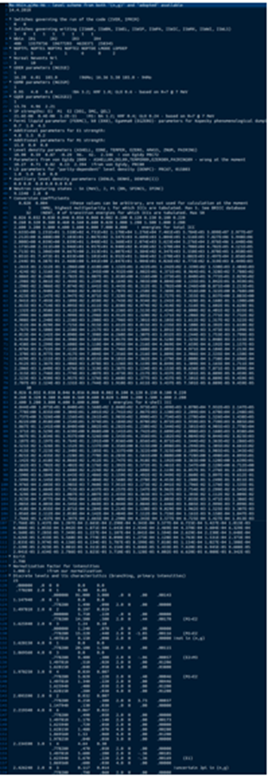
Technical Approach – Assembly Package
Statistical Parameters
Monte Carlo parameters
Nuclear level density model and parameters
EM transition photon strength functions
The assembly package automates the writing of a DICEBOX input file
Very little user input is required:
Isotope to be simulated
“Critical energy” – energy above which simulation of gamma levels is required
Selection of statistical parameters
Internal Conversion Coefficients (ICC)
ICC at an array of energies are taken from the BrIcc database using a self-contained executable
Known Levels
Experimentally validated known gamma cascades and relative intensities up to a certain user-defined energy
The data are taken from the IAEA NDS API
All levels are simulated above this energy

Slide 8
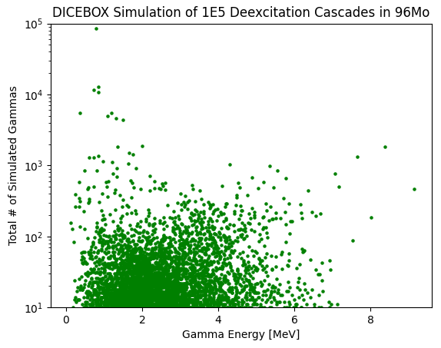
DICEBOX Simulation Example
Initial comparisons to experimentally-published prompt gamma spectra and known prompt gamma emission lines are promising
9.154 MeV (neutron separation energy)
778.28 keV
847.66 keV
8.375 MeV
8.375 MeV
847.66 keV
778.28 keV
Level schema plot for ⁹⁶Mo from IAEA NDS

Slide 9
Expected Impact
The objective of PROGRESS is to develop a library of simulated prompt gamma responses for many nuclei across a wide range of Z in order to encompass the nuclear fuel cycle
The automation utilized in PROGRESS will make it very easy to add new simulations to the library or update existing entries as desired
Experimental results from neutron activation analysis can then be compared to the library of expected prompt gamma responses in order to aid the identification of the sample
Further additions to the code will help predict what level of detection efficiency will be reasonably achievable

Slide 10
MTV Impact
This work is just one example of a possible future use for the neutron chopper system at Penn State
The impact of the neutron chopper system will be magnified with outside collaboration
Isotopic composition of fuel cycle materials is often not publicly available
National lab reference libraries might provide a valuable source of data

Slide 11
Summary & Conclusions
PROGRESS is a software package which utilizes the Monte Carlo code DICEBOX to simulate prompt gamma decays from an excited nucleus
PROGRESS largely automates this process
Prompt gamma spectra obtained through epithermal neutron activation analysis will be compared to simulated spectra obtained with DICEBOX
Simulation of prompt gamma levels is necessary to bridge gaps in published experimentally acquired prompt gamma spectra, in order to develop a reference library of nuclear fuel cycle materials’ prompt gamma responses

Slide 12
Next Steps
Focus will shift to the second piece of PROGRESS: the output interpretation package
This piece will be responsible for interfacing with any future machine learning applications
Prompt gamma response library will be developed, with primary focus on elements commonly found throughout the nuclear fuel cycle
“composite” expected prompt gamma responses for molecules can be assembled from individual elements’ simulations
Once the chopper system is installed, DICEBOX simulations constructed with PROGRESS will be experimentally verified

Slide 13
Acknowledgements
The Consortium for Monitoring, Technology, and Verification would like to thank the DOE-NNSA for the continued support of these research activities.
This work was funded by the Consortium for Monitoring, Technology, and Verification under Department of Energy National Nuclear Security Administration award number DE-NA0003920

