Slide 1

Characterization of New Organic Glass Scintillators
2023 MTV Workshop
March 21
Tessa Maurer
Graduate Student, University of Michigan
N. D. Stubblefield¹, L. M. Clark¹, S. D. Clarke¹, S. A. Pozzi¹
¹University of Michigan

Slide 2
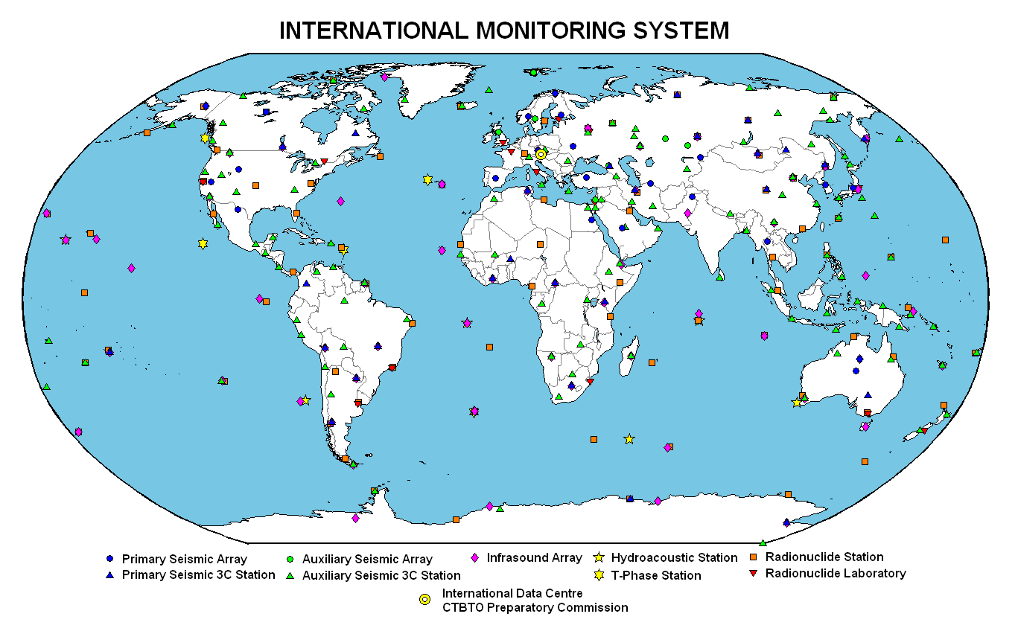
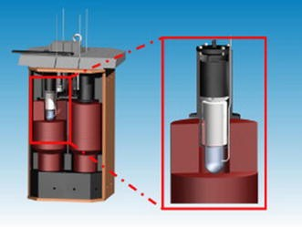
  Motivation
  Radioxenon, indicator of nuclear weapon detonation, can be detected with beta-gamma coincidence detection system that uses plastic scintillators
  Plastic scintillators can exhibit radioxenon “memory effect”¹
  Alternatives like organic stilbenes are expensive and difficult to shape
  Ideally, new scintillating material with high performance, shaping capabilities, and no memory effect of interest
Coincidence detector with rounded plastic cell²
  ¹L. Blackberg, et al., “Investigations of surface coatings to reduce memory effect in plastic scintillator detectors used for radioxenon detection,” NUCL. INSTR. METH. A., vol. 656, no. 1, pp. 84 – 91, 2011. [Online]. Available: http://www.sciencedirect.com/science/article/pii/S0168900211014884
  ²Sivels, C.B., et al., ”A review of the developments of radioxenon detectors for nuclear explosion monitoring,” J Radioanal Nucl Chem 314, 829–841 (2017). https://doi.org/10.1007/s10967-017-5489-2
Notes:
Beta gamma coincidence system looks for
Rounded beta cell allows for use of 1 PMT, refocusing signal on cap side back towards the readout
State previous work shows stilbene has reduced memory effect, but…

Slide 3
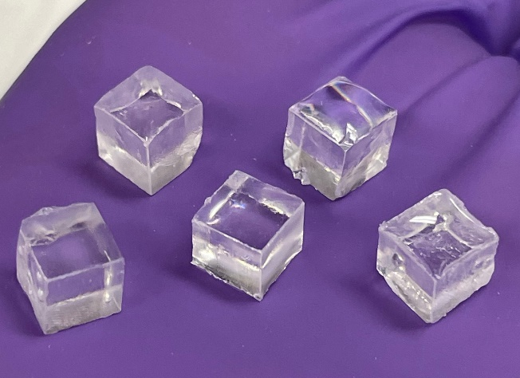
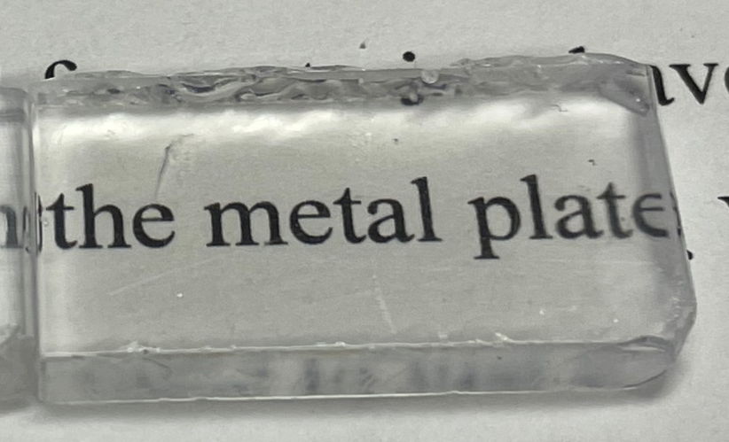

Project Mission
  We are testing and casting new small-molecule organic glass scintillating (OGS) material*
    Potential substitute of plastic scintillators in beta cell
  Currently in early stages of project, goal is to characterize OGS
  We tested OGS various dimensions and reflective wrappings to characterize:
    Energy resolution
    Coincidence timing resolution (CTR)
    Pulse shape discrimination (PSD) capabilities
  *Developed by Sandia National Laboratories
OGS 6 mm edge cubes
OGS 4 mm thick slab

Slide 4

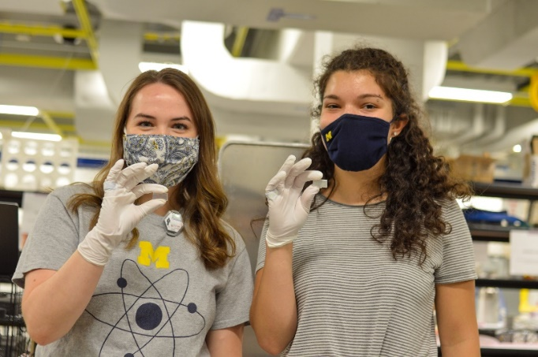
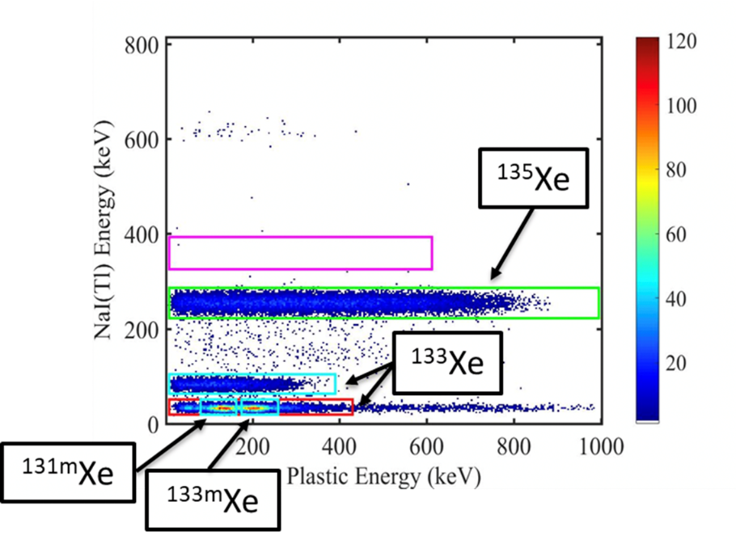
MTV Impact and NNSA Mission Relevance
Project built from collaborations with Sandia National Laboratories
Characterization provides valuable insight into this new scintillator’s potential in radioxenon monitoring
Compared to plastic scintillators, we ideally want…
  Improved energy resolution → better distinction of key radioxenon isotopes used for event identification
  Improved timing resolution → increased confidence in coincidence measurements, reducing background
  Improved PSD → better distinction between radioxenon and radon alpha particles
MTV students Leah and Tessa
C.B. Sivels (2018). Development of an Advanced Radioxenon Detector for Nuclear Explosion Monitoring (Handle: 2027.42/147543) [Doctoral dissertation, University of Michigan, Ann Arbor]. Deep Blue

Slide 5
Organic Glass Scintillating (OGS) Material
OGS material produced by Sandia National Laboratories³
OGS emits blue light
90:10 mixture of P2 and P3 with 0.2 wt% bis-MSB wavelength shifter
Can be used in many applications, including imaging (see oral presentation “Particle Imager and Visualization in Mixed Reality” Ricardo Lopez)
³Lucas Q. Nguyen, et al., “Boron-loaded organic glass scintillators,” NUCL. INSTR. METH. A., Volume 988, 2021, 164898, ISSN 0168-9002
P2 Molecular Formula: C₄₂H₃₆Si
P3 Molecular Formula: C₅₁H₄₄Si

Slide 6
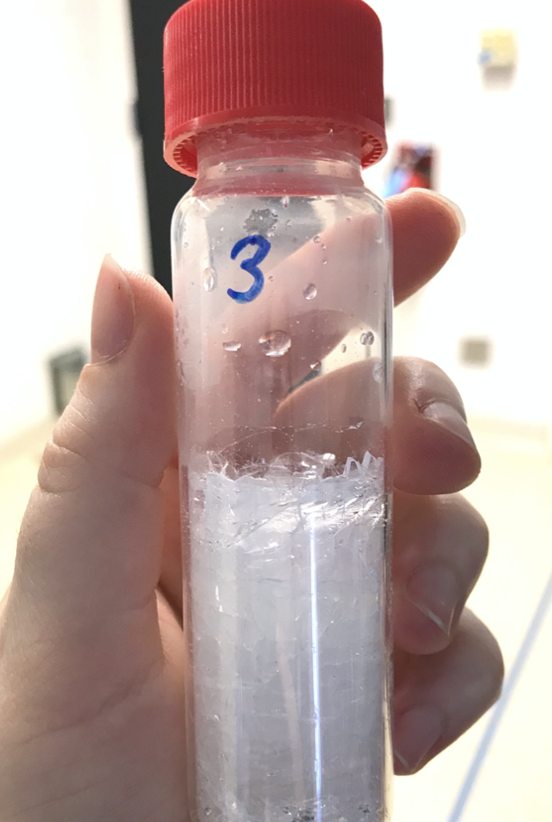
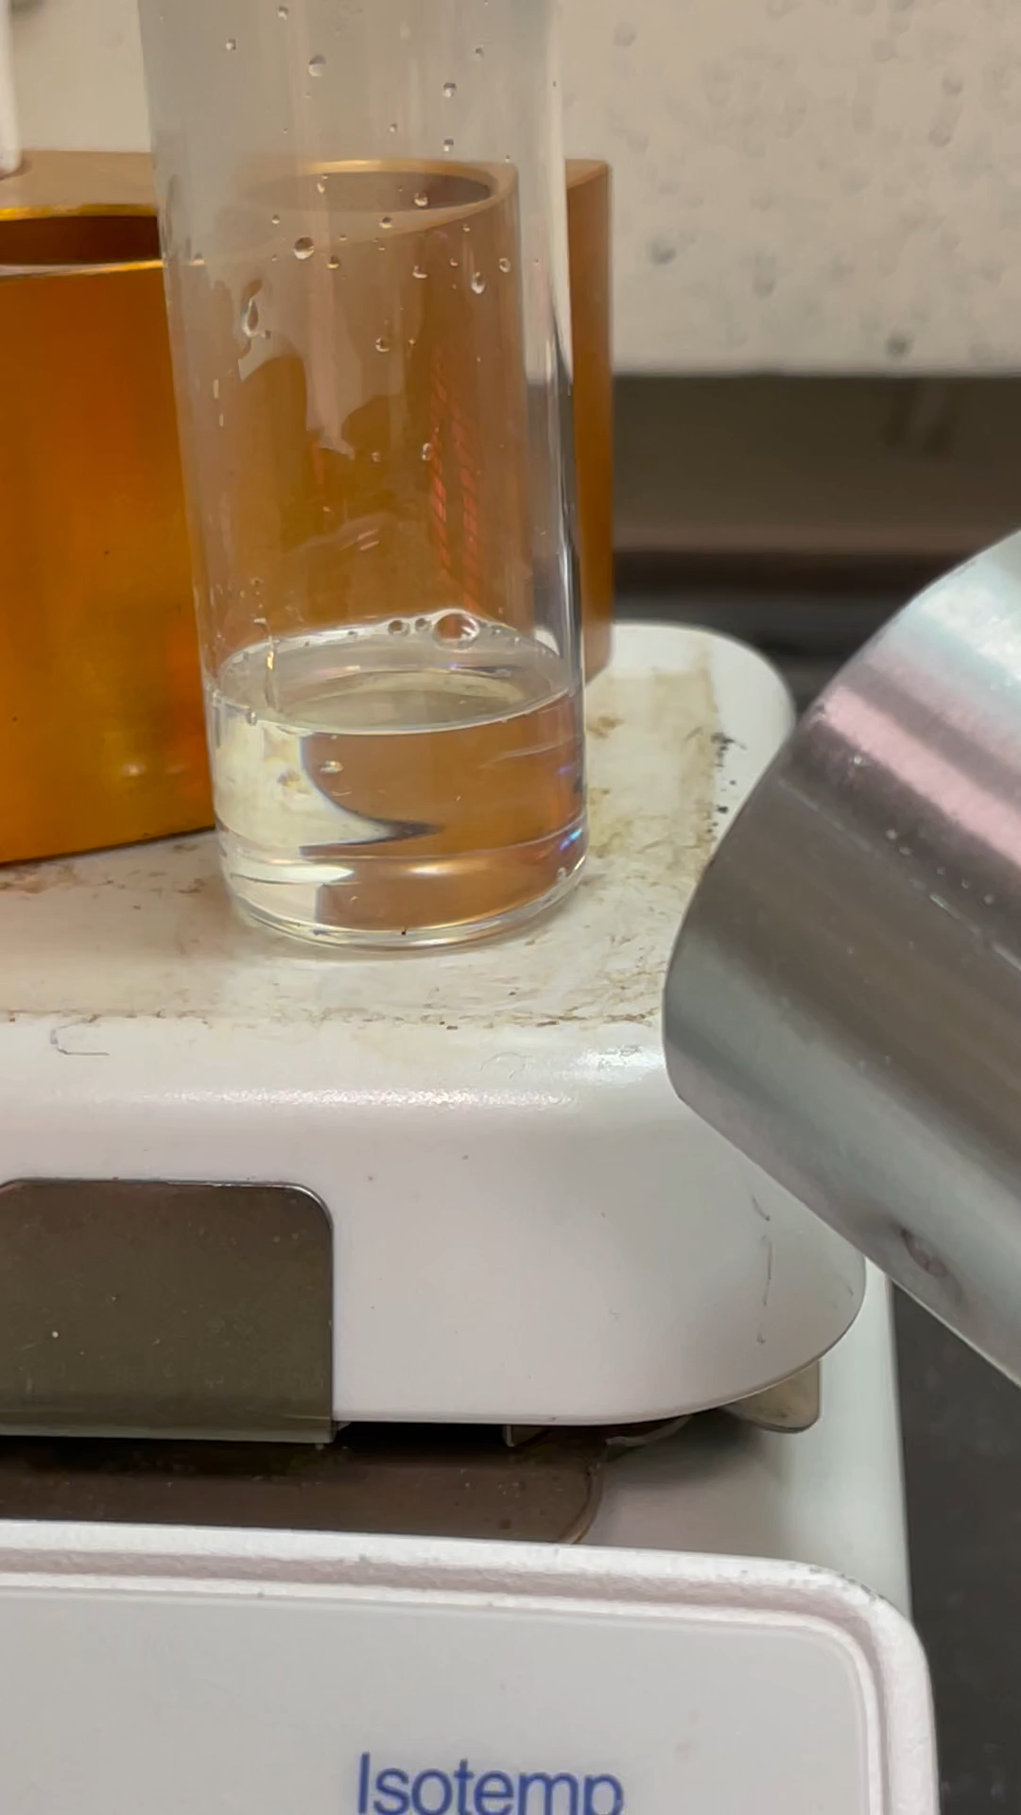
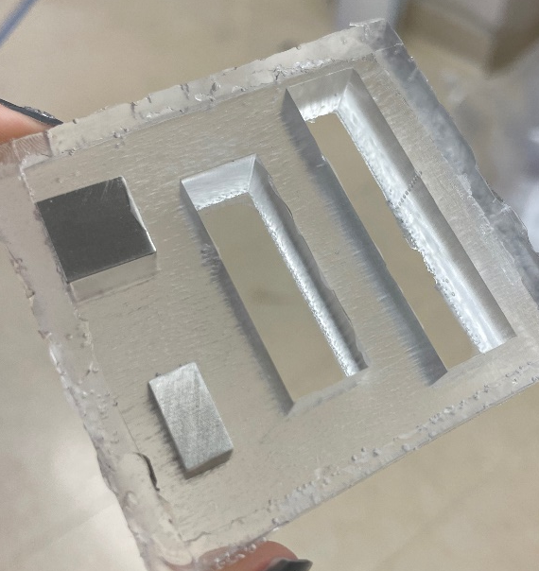
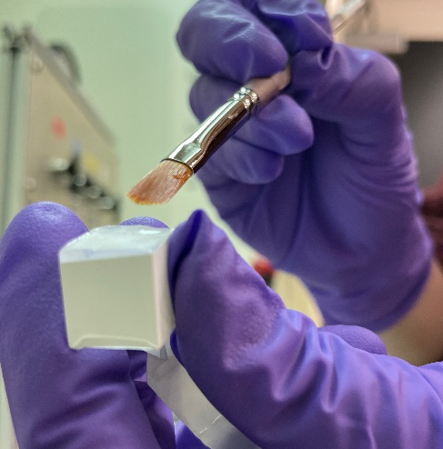
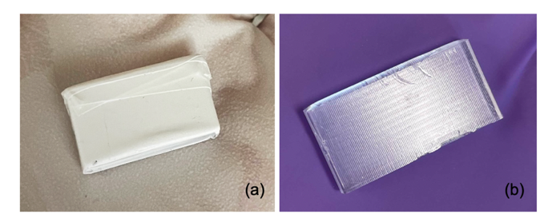
Organic Glass Casting at University of Michigan
4. Apply protective PVA coating
3. Pour molten OGS into custom silicone molds and cool gradually in oven for ~14 hours
1. Bulk OGS
2. Melting and degassing bulk OGS
5. Wrap OGS in reflective wrapping

Slide 7
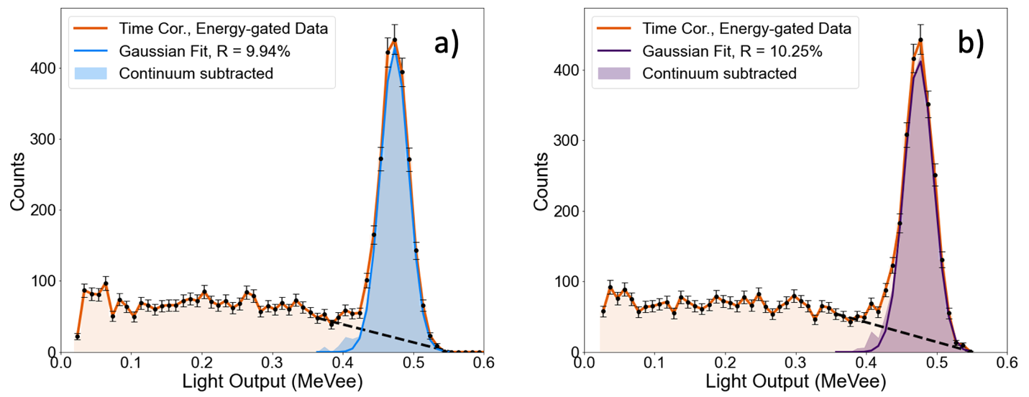
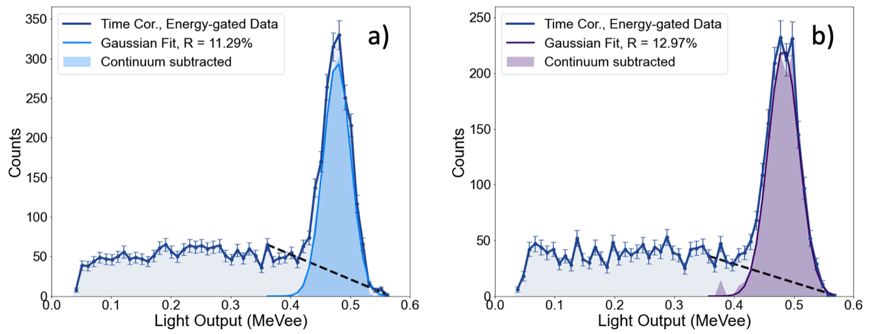
OGS and Stilbene Energy Resolution
OGS Specular
OGS Diffuse
¹³⁷Cs Compton-coincidence technique used both organic and NaI(Tl) detectors to determine resolution at 662 keV
5.08 cm diameter photomultiplier tube (PMT) readout
6x6x6 mm³ OGS and stilbene cubes tested with diffuse and specular wrappings
Material | Reflective Wrapping | Energy Resolution [%]
OGS | Specular | 9.94 ± 0.44 %
OGS | Diffuse | 10.25 ± 0.46 %
Stilbene | Specular | 11.29 ± 0.50 %
Stilbene | Diffuse | 12.97 ± 0.55 %
Stilbene Specular
Stilbene Diffuse
Notes:
A ¹³⁷Cs Compton-coincidence technique was used to determine energy resolutions of diffuse- and specular-wrapped 6×6×6 mm³ OGS and stilbene cubes at the 478 keV Compton edge of ¹³⁷Cs [12]. For each measurement, the organic scintillator cube was wrapped in the respective reflector and coupled to a 5.08 cm diameter PMT using the optical silicone grease. These detectors were placed in the same light-tight holders as for the time-resolution experiments. A ¹³⁷Cs source was placed between the organic scintillator and a Scionix NaI (Tl) 5.08 cm inorganic scintillator separated by 20 cm, with the source placed approximately 7 cm from the organic detector. Data acquisition used a CAEN DT5730 Digitizer, 14-bit resolution with a 500 MS/s sampling rate.
Energy resolution can be determined by finding the FWHM of a photopeak and dividing by the centroid energy; however, photoelectric absorption is not the primary interaction mechanism for photons with organic scintillators [1]. The Compton-coincidence technique was chosen for these experiments because Compton scattering is the main mechanism. Photons emitted from the source can first interact with the organic scintillator and deposit a maximum of 478 keV, Compton backscatter, and deposit the remaining 184 keV into the inorganic scintillator, resulting in correlated detection events. Because the organic and inorganic scintillators are not the same size and shape, some detected events can scatter at slightly different angles above or below the complete backscatter at 180°. This effect is known as geometric broadening and results in captured events not precisely at 184 keV [13,14]. A time correlation and energy gate of 55 keVee (electron equivalent) was applied to the events collected by both the organic and inorganic scintillators to account for this. The backscatter continuum from events not within these restrictions were subtracted from the spectrum, and the resulting peak was fit using a Gaussian distribution. The energy resolution was calculated using Eq. 1 by finding the FWHM of the time correlated, energy gated, and continuum subtracted Gaussian fit peak and divided by the energy centroid.
Eq. (1)
$$R=\frac{FWHM}{Centroid}$$

Slide 8
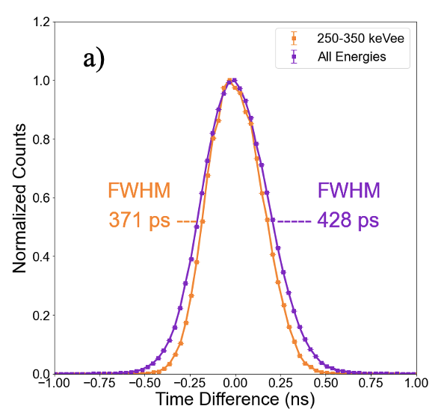
OGS and Stilbene Coincidence Time Resolution
Coincidence timing resolution obtained from pair of detectors in coincidence on ²²Na source
5.08 cm diameter PMT readout
Material | Reflective Wrapping | 250-350 keVee Coincidence Time Resolution [ps]
12 mm edge OGS | Specular | 370
6 mm edge OGS | Diffuse | 380
12 mm edge OGS | Diffuse | 400
6 mm edge stilbene | Diffuse | 440
Specular-wrapped 12 mm edge OGS cube
Notes:
The coincidence time resolution was measured in four scintillator pairings: 12×12×12 mm³ diffuse and specular-wrapped OGS cubes, a 6×6×6 mm³ diffuse-wrapped OGS cube, and a 6×6×6 mm³ diffuse-wrapped stilbene cube. These configurations allow comparisons in detector size, reflector, and scintillation material. In each measurement, cubes of the same configuration were coupled to 5.08 cm diameter PMTs using optical silicone grease. Each PMT window was taped with black electrical tape to form a small, centralized opening to minimize variation in scintillator placement. Figure 1 shows the setup of three different scintillators. The detectors were placed inside a light-tight holder to further minimize light exposure and hold the scintillators in place. The detectors were placed 17 cm apart, with a ²²Na source placed in between them. ²²Na decays by emitting a positron through ß+ decay, which leads to two 511 keV annihilation photons emitted in opposite directions [1]. For each measurement, a minimum of 150,000 coincidence photon events within a 96 ns trigger window were collected between both detectors using a CAEN DT5730 digitizer, 14-bit resolution with a 500 MS/s sampling rate. In each event, the time difference between each detected coincident photon was determined using the analysis software CAEN CoMPASS with digital constant fraction discrimination (CFD) applied at 50% of the pulse peak [4]. Histograms of the time differences with 30 ps bins were generated and normalized by the maximum. The full width at half maximum (FWHM) was determined by linear interpolation of the values nearest the half of the maximum, representing the coincidence time resolution. A ¹³⁷Cs source was used for energy calibration.

Slide 9
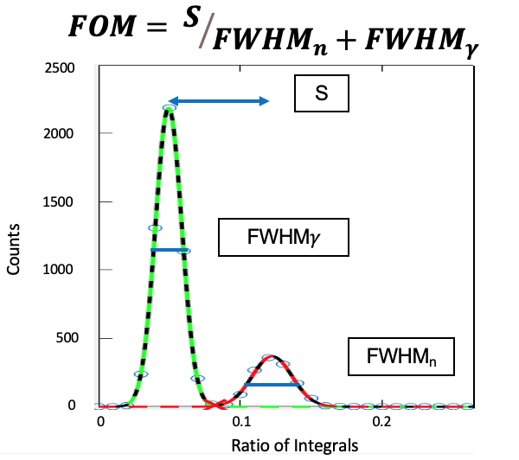
OGS PSD Investigation
Pulse shape discrimination (PSD) is a detector’s ability to distinguish different types of radiation, usually neutrons and gamma-rays
12.7 x 25.4 mm rectangular OGS slabs cast with thicknesses of 2, 3, 4, and 5 mm with bare, specular, and diffuse wrappings measured ²⁵²Cf source
7.62 cm diameter PMT used for readout
Optical reflective wrappings significantly improve PSD capabilities
(Left) Figure of merit (FOM) definition and (right) ²⁵²Cf measured with a 2 mm thick OGS slab with various reflectors

Slide 10
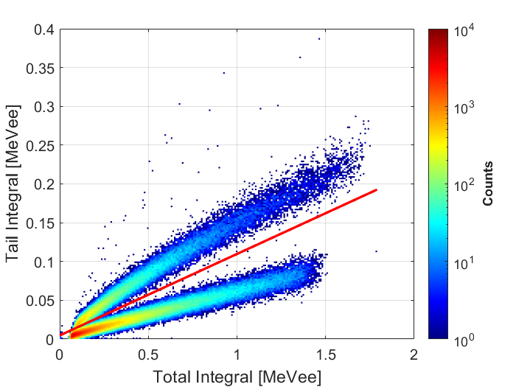
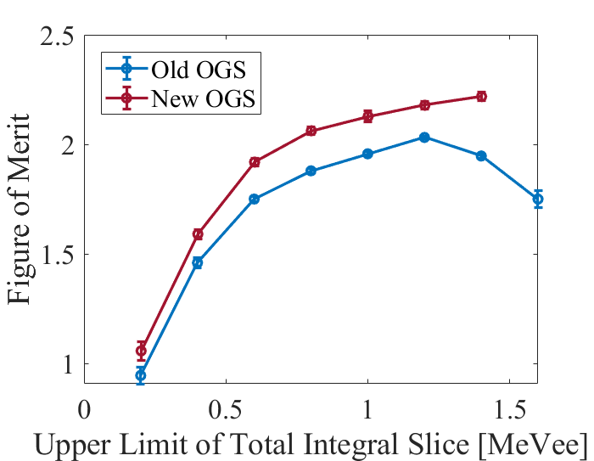
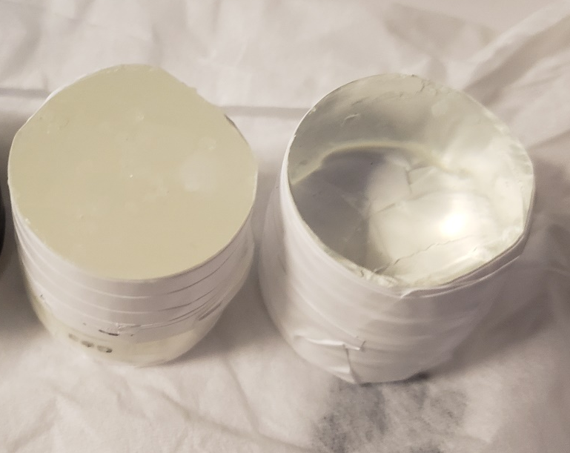
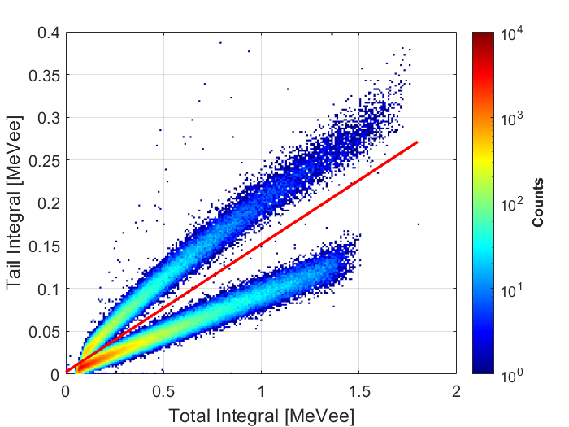
Age Impact on PSD Performance
Newly cast within month
PSD characterization on two samples cast approximately three years apart
Two 2.54 cm diameter OGS cylinders PSD compared using ²⁵²Cf source
7.62 cm diameter PMT used for readout
New OGS outperformed old OGS cylinder, but old OGS still PSD-capable
Cast ~years ago
Cast 2019
Cast 2022

Slide 11
OGS in Research Reactor Experiment
Two OGS detectors used to measure a reactor
Organics previously not used in literature for reactor measurements
In partnership with the Consortium for Enabling Technologies and Innovation (ETI) and the Ohio State University
See MTV Workshop Poster 25 (N. D. Stubblefield)
PSD of 2.54 cm ⌀ OGS at 10 W
Energy distribution of 2.54 cm ⌀ OGS at 10 W

Slide 12
Conclusion and Summary
Studied OGS samples comparable to stilbene counterparts in energy and coincidence timing resolution
  Stilbene leading detector for organic scintillators, can be used as benchmark
  OGS potential amongst organic scintillators established, especially compared to plastics
Reflective wrapping improves pulse shape discrimination capabilities for rectangular OGS slabs
Aged, yellowed OGS scintillators still PSD-capable
Next steps:
  Further characterization of OGS material and direct comparison to plastic scintillators
  Develop OGS beta cell for radioxenon memory effect measurements

Slide 13


Acknowledgements
The Consortium for Monitoring, Technology, and Verification would like to thank the DOE-NNSA for the continued support of these research activities.
  This work was funded by the Consortium for Monitoring, Technology, and Verification under Department of Energy National Nuclear Security Administration award number DE-NA0003920

Slide 14
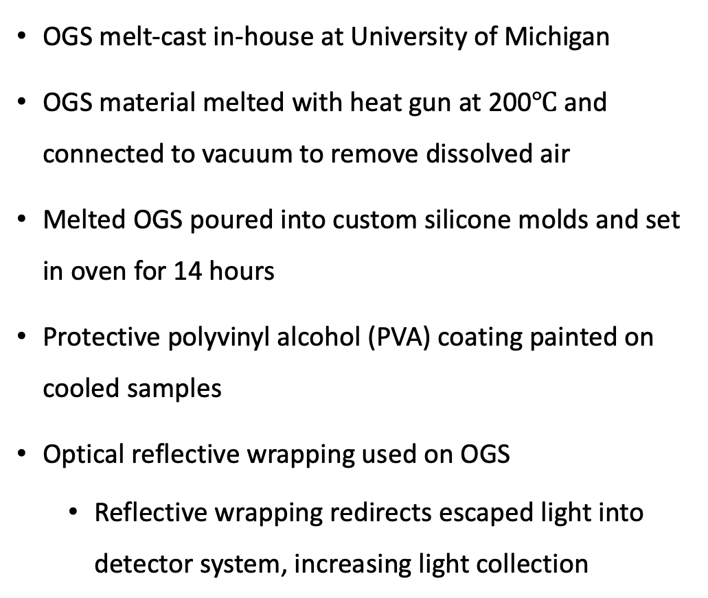
Organic Glass Casting
OGS melt-cast in-house at University of Michigan
OGS material melted with heat gun at 200$℃$ and connected to vacuum to remove dissolved air
Melted OGS poured into custom silicone molds and set in oven for 14 hours
Protective polyvinyl alcohol (PVA) coating painted on cooled samples
Optical reflective wrapping used on OGS
  Reflective wrapping redirects escaped light into detector system, increasing light collection
OGS 3 mm slabs diffuse- wrapped
Mold for slabs of varying sizes

