Slide 1

Quantifying Effects of Measurement Uncertainty on Separated Plutonium Attribution Methodology
2023 MTV Workshop
March 22, 2023
Patrick O’Neal and Dr. Sunil Chirayath
Center for Nuclear Security Science and Policy Initiatives (NSSPI)
Department of Nuclear Engineering, Texas A&M University

Slide 2
Introduction and Motivation
Forensics Signatures
¹³⁵Cs/¹³⁷Cs
¹³⁴Cs/¹³⁷Cs
¹³⁶Ba/¹³⁸Ba
¹⁵⁰Sm/¹⁴⁹Sm
¹⁵²Sm/¹⁴⁹Sm
¹⁵⁴Eu/¹⁵³Eu
²⁴⁰Pu/²³⁹Pu
²⁴¹Pu/²³⁹Pu
Objective: Use machine learning (ML) techniques to produce a robust nuclear forensics methodology capable of identifying a separated plutonium sample’s reactor-type of origin, fuel burnup, and time since irradiation (TSI)
Current methodology capabilities include identifying between 6 different reactor types, and all binary “mixed” reactor-type combinations.
Focus of this presentation:
  Analysis of methodology performance with a new validation sample
  examining measurement uncertainty effects on methodology performance

Slide 3
Mission Relevance
Nuclear forensics techniques can identify Pu produced in foreign nuclear fuel cycles
Methodology can also be used to verify declared activities occurring at facilities under safeguard agreements
NNSA Mission
  Preventing nuclear weapons proliferation and reducing the threat of nuclear and radiological terrorism around the world are key U.S national security strategic objectives that require constant vigilance.
  NNSA's Office of Defense Nuclear Nonproliferation works globally to prevent state and non-state actors from developing nuclear weapons or acquiring weapons-usable nuclear or radiological materials, equipment, technology, and expertise.

Slide 4
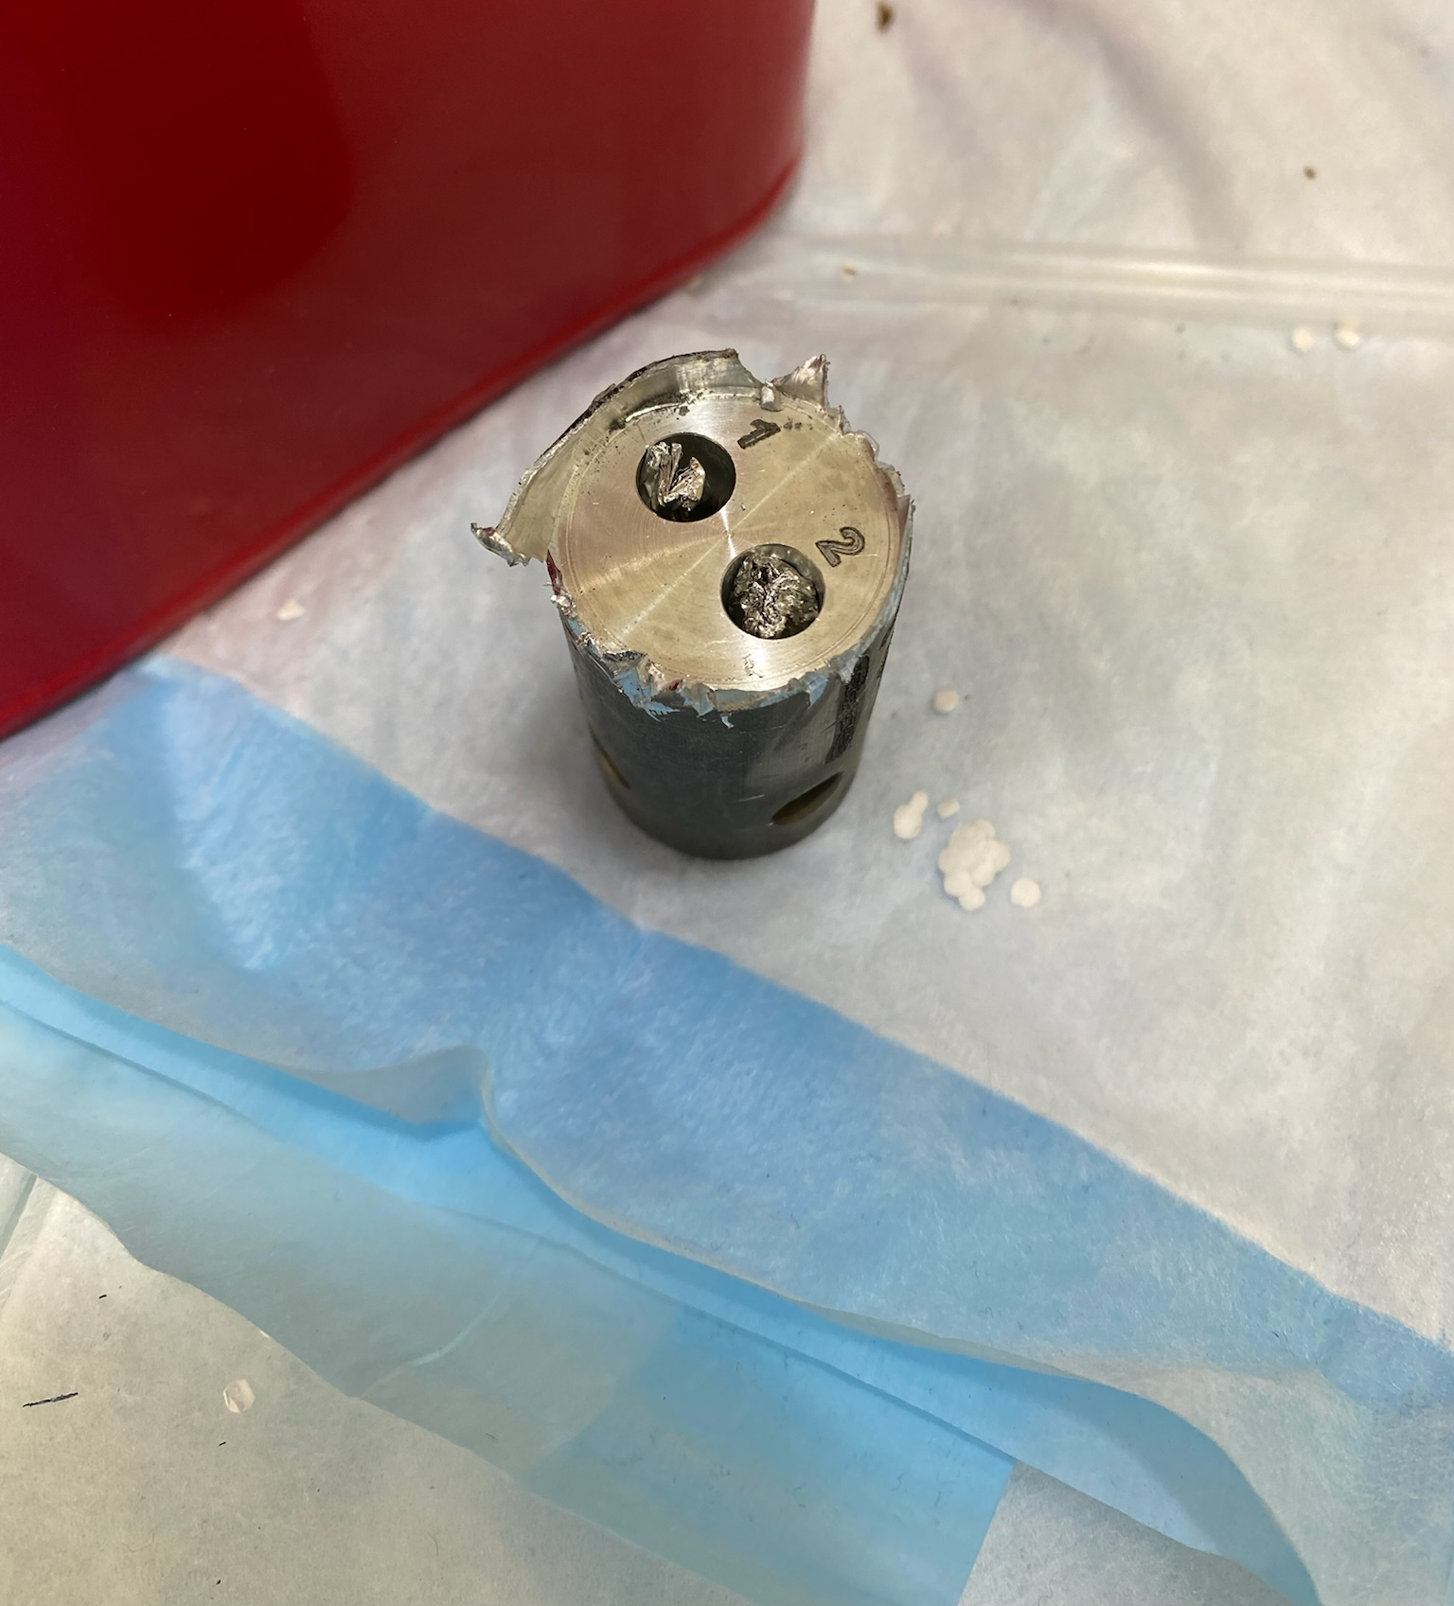
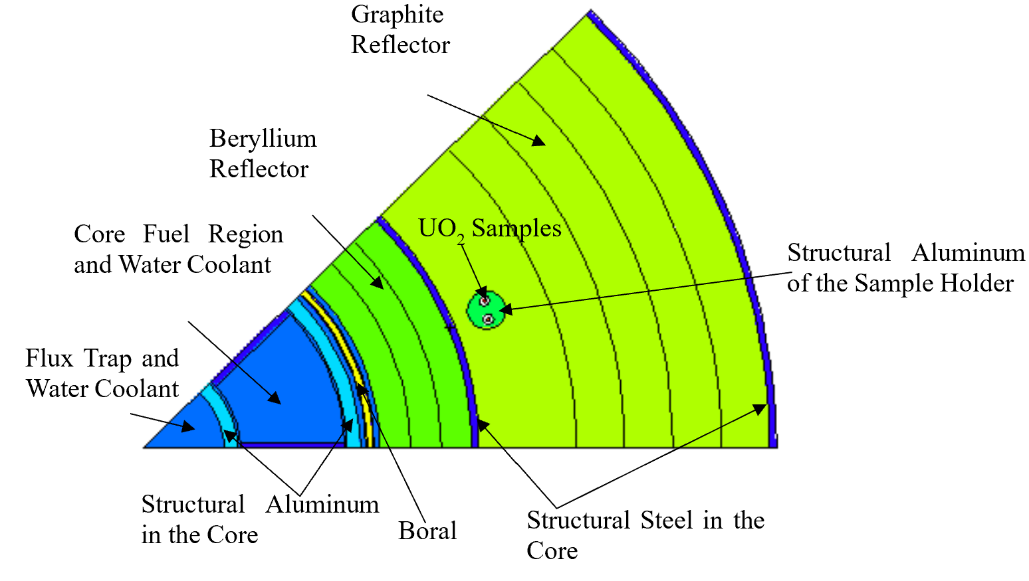
New Validation Data: MURR 3.44 Sample
LEUO₂ Sample with enrichment of 3.44%
Irradiated from August-September of 2021 at University of Missouri Research Reactor (MURR)
Irradiation conditions were in MCNP
Sample was dissolved, plutonium separated, and isotopic ratios characterized using gamma and mass spectroscopy.
ICP-MS measurements were conducted at a TSI of 139 and 449 days

Slide 5
Initial Predictions using MURR 3.44
¹³⁶Ba/¹³⁸Ba and ¹³⁴Cs/¹³⁷Cs ratios had to be excluded from the analysis
Reactor classification and burnup quantification were satisfactory
TSI predictions were poor or unavailable
Reactor-Type | PWR | PHWR | FBR | HFIR | MURR (Natural) | MURR (3.44%)
Machine Learning Scores | -0.156 | -0.307 | -0.339 | -0.273 | -0.250 | 0
Max Likelihood | -6.99 | -17.4 | -2.18E4 | -59.5 | 11.6 | 13.1
 | Burnup (GWd/MTU) | TSI
Measured | 0.94 ± 0.02 | 449
Maximum Likelihood | 1.32 ± 0.13 | 2239 ± 1038
Machine Learning | 1.22 ± 0.14 | N/A

Slide 6
Solution: Addition of Ce ratio
The ratio ¹⁴⁴Ce/¹⁴⁰Ce was selected as an additional indicator of TSI
Preliminary results indicate Ce ratio provides a good indication of TSI, but should be omitted from reactor-type or burnup predictions
Inclusion of Ce ratio changes maximum likelihood from predicting a reactor-type of MURR 3.44 to MURR natural
 | Burnup (GWd/MTU) | TSI (days)
Measured | 0.94 ± 0.02 | 449
Maximum Likelihood | 1.26 ± 0.06 | 468
ML | 1.22 ± 0.14 | 447 ± 3
ML w/ Ce for burnup | 1.69 ± 0.19 | 440 ± 3

Slide 7
Measurement Uncertainty Quantification Technical Approach
Data from two experimental samples (MURR Natural and HFIR) were used to produce test datasets to evaluate the effect measurement uncertainty has on predictions
Each isotope ratio was independently randomly sampled from a normal distribution with mean and standard deviation of the originally measured values
Each set consisted of 10,000 isotope ratio sets that were evaluated by the ML and Maximum Likelihood methodologies to obtain a distribution of predictions.

Slide 8
MURR Natural Results
93.5% of the dataset’s reactor-types were classified correctly, 6.5% classified as MURR 3.44

Slide 9
HFIR Results
95.9% of the dataset’s reactor-types were classified correctly, 4.1% classified as PWR

Slide 10
Comparison with Maximum Likelihood
HFIR – 100% of the dataset’s reactor-types were classified correctly
  Burnup – 89.8% calculated as 4.28 (GWd/MTU), , 8% calculated 4.34 (GWd/MTU), 0.2% calculated 4.22 (GWd/MTU)
MURR Natural – 84.2% reactor-types classified correctly, other 15.8% classified MURR 3.44
  Burnup – 69.6% calculated as 1.050 (GWd/MTU), 30.4% calculated 0.9573 (GWd/MTU)

Slide 11
Conclusion and Future Work
The validation work with the MURR 3.44 sample has shed light on an over-reliance on the ¹³⁴Cs/¹³⁷Cs ratio, and a possible solution has been found in the ¹⁴⁴Ce/¹⁴⁰Ce
Early indications from the measurement uncertainty study indicate the ML methodology is well equipped to handle a typical level of measurement uncertainty
Next Steps:
Evaluate ¹⁴⁴Ce/¹⁴⁰Ce performance as a forensics signature using the other two validation samples
Devise study to examine the effect simulation uncertainties have on model performance
Continue development of mixed reactor-type ML models

Slide 12


Acknowledgements
The Consortium for Monitoring, Technology, and Verification would like to thank the DOE-NNSA for the continued support of these research activities.
  This work was funded by the Consortium for Monitoring, Technology, and Verification under Department of Energy National Nuclear Security Administration award number DE-NA0003920

