Slide 1
Analysis of Explosion Data Collected from the Stratosphere
2023 MTV Workshop
21 March 2023
Sarah Popenhagen
PhD student, University of Hawai’i at Mānoa
Daniel Bowman², Cleat Zeiler³, Milton Garcés¹
¹University of Hawai’i, ²Sandia National Laboratories, ³Nevada National Security Site

Slide 2
Introduction and Motivation
Ground-based stations are widely used for infrasound monitoring
Infrasound monitoring from airborne platforms is much less common
The goal is to increase our understanding of the possibilities and limitations of airborne monitoring

Slide 3
Mission Relevance
Explosion monitoring is relevant to nuclear nonproliferation efforts
The stratosphere is an unexplored realm for explosion monitoring platforms
Balloon-borne infrasound sensors can capture explosion signals far from the source

Slide 4
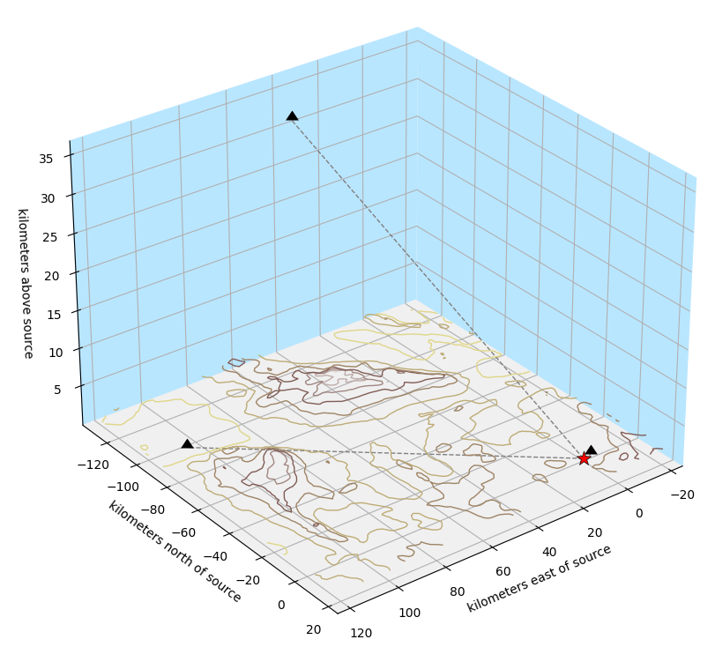
Technical Approach
Data collected at NNSS in collaboration with NNSS and SNL
Mylar balloon carrying:
Redvox smartphone
Condenser microphone
Microbarometers
Bounder
Redvox surface stations also collecting data
Station | Propagation distance
Balloon (35.2 km altitude) | 126.8 km
Ground #1 | 3.1 km
Ground #2 | 130.5 km

Slide 5
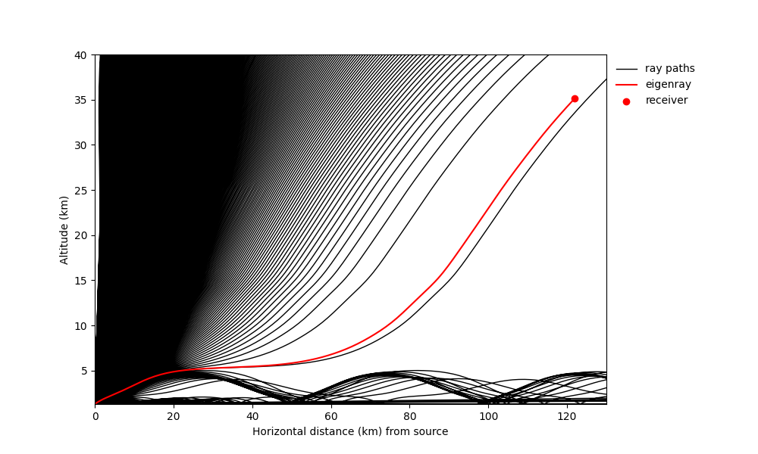
Propagation Modelling with infraGA
Audio signal at 3 km range
Weakly non-linear waveform evolution at 120 km range

Slide 6
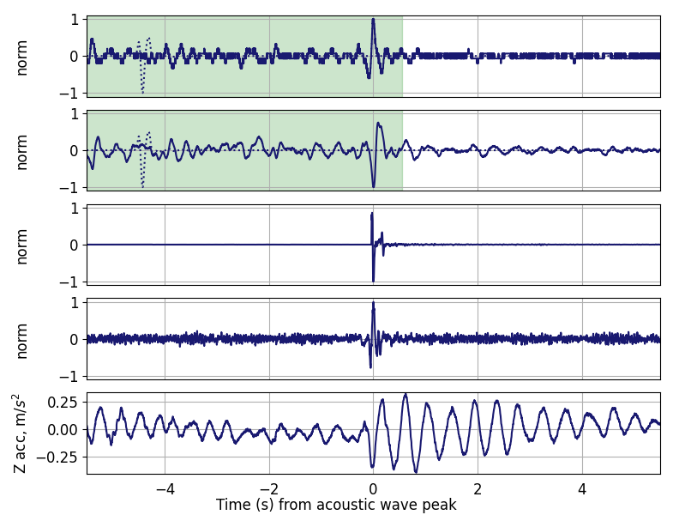
Results
Airborne smartphone audio (solid), waveform evolution model results (dotted)
Airborne condenser microphone audio (solid), waveform evolution model results (dotted)
Surface smartphone audio (3 km)
Surface smartphone audio (131 km)
Airborne smartphone Z acceleration

Slide 7
Results
CWT of airborne smartphone audio signal
CWT of airborne condenser microphone signal
CWT of surface smartphone audio signal (3 km)
CWT of surface smartphone audio signal (131 km)

Slide 8
Results
CWT of airborne smartphone audio signal
CWT of airborne condenser microphone signal
CWT of surface smartphone audio signal (3 km)
CWT of surface smartphone audio signal (131 km)

Slide 9
Results
CWT of airborne smartphone audio signal
CWT of airborne condenser microphone signal
CWT of surface smartphone audio signal (3 km)
CWT of surface smartphone audio signal (131 km)

Slide 10
Expected Impact
Better understanding of how and where airborne stations can detect acoustic signals
Increased flexibility in future data collection campaigns using airborne platforms
Accelerometer as signal discriminant
Potential Venus applications

Slide 11
MTV Impact
Collaboration with national labs on LSECE
Ongoing relationship with NNSS
Continuing collaboration with SNL on airborne data collection
Paper to be published this year

Slide 12
Conclusion
Successful collection of a signal from an ascending balloon provides reason to doubt current understanding of the limitations of airborne platforms
Despite the direct path of the signal through the atmosphere, the waveform was distorted, likely due to being temporarily trapped within the tropospheric duct
Accelerometer data from smartphones can potentially be used as a signal discriminant

Slide 13
Next Steps
Paper to be published this year
Analysis of more data collected from balloons
Continued collaboration with NNSS to collect more explosion data
Continued collaboration with SNL on airborne collection platforms

Slide 14
Acknowledgements
The Consortium for Monitoring, Technology, and Verification would like to thank the DOE-NNSA for the continued support of these research activities.
This work was funded by the Consortium for Monitoring, Technology, and Verification under Department of Energy National Nuclear Security Administration award number DE-NA0003920

