Slide 1
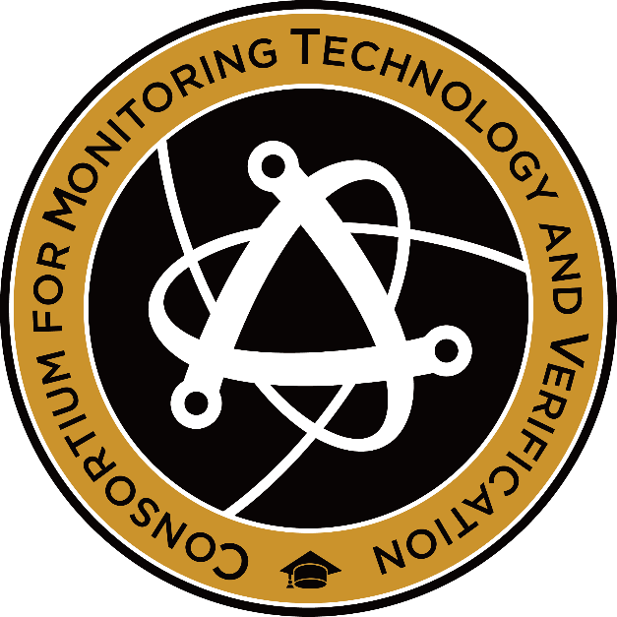

Building Towards Coherent Elastic Neutrino Scattering For Reactor Monitoring
2023 MTV Workshop
March 21st, 2023
Ryan Bouabid
Graduate Student, Duke University
COHERENT Collaboration

Slide 2
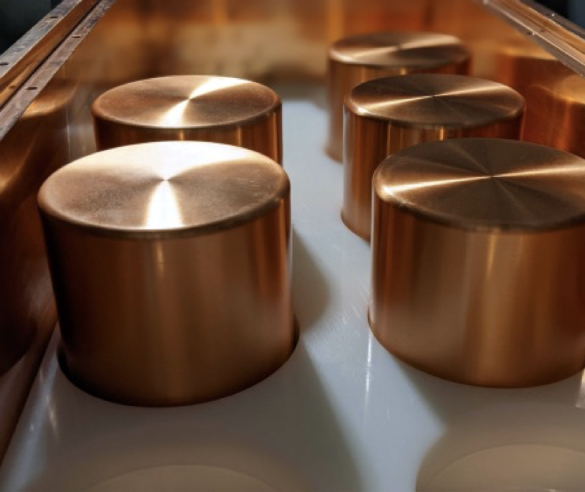
Introduction and Motivation
ˠ
Core
n
ν
Neutrinos can play a unique role in monitoring nuclear material.
Detecting neutrinos is challenging.

Slide 3
Mission Relevance
“There is interest in the policy community in neutrino detection as a possible element of future nuclear deals involving cooperative reactor monitoring or verifying the absence of reactor operations.”
– Nu Tools Report 2021
Can be a “new tool in the toolbox” for negotiating diplomats.
This depends heavily on our ability to develop the technology further.

Slide 4
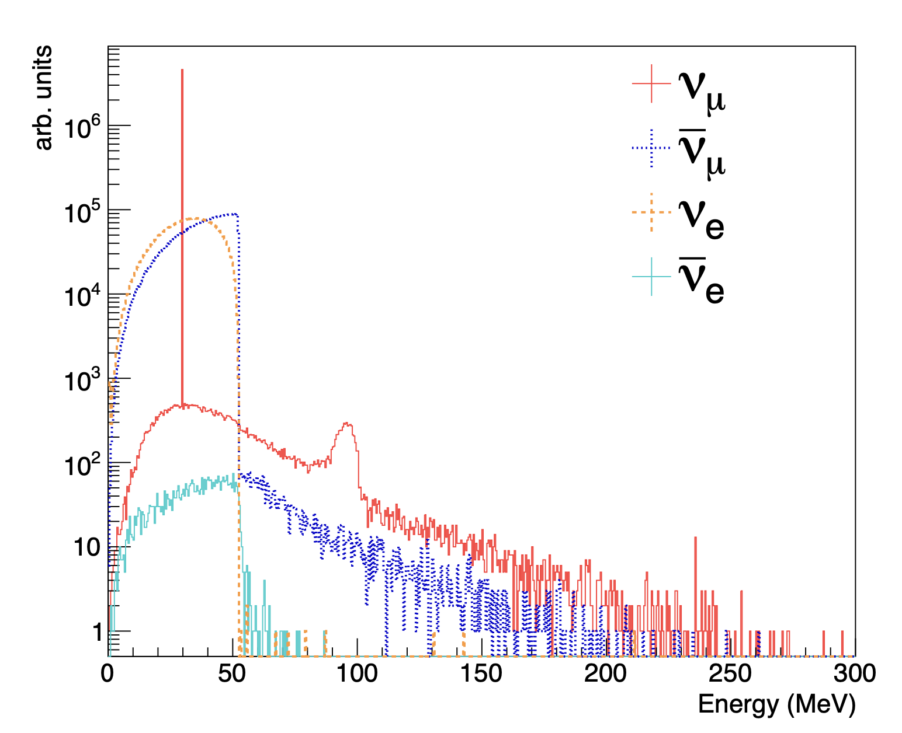
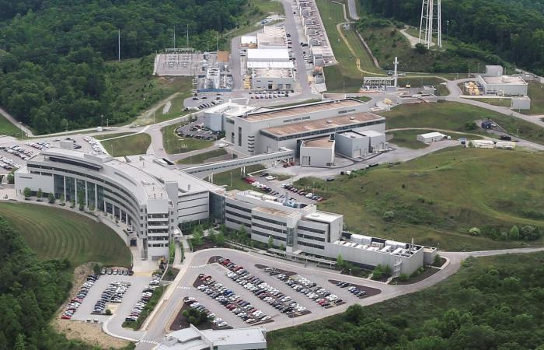
Technical Approach
Coherent Elastic Neutrino Nucleus Scattering (CEνNS) is one way to detect neutrinos.
CEνNS has a higher cross-section and no lower energy threshold.
CEνNS was first detected in 2017 by the COHERENT Collaboration.
CEνNS Recoil on High Purity Germanium Detectors
Goes Here
10.1103/PhysRevD.106.032003

Slide 5
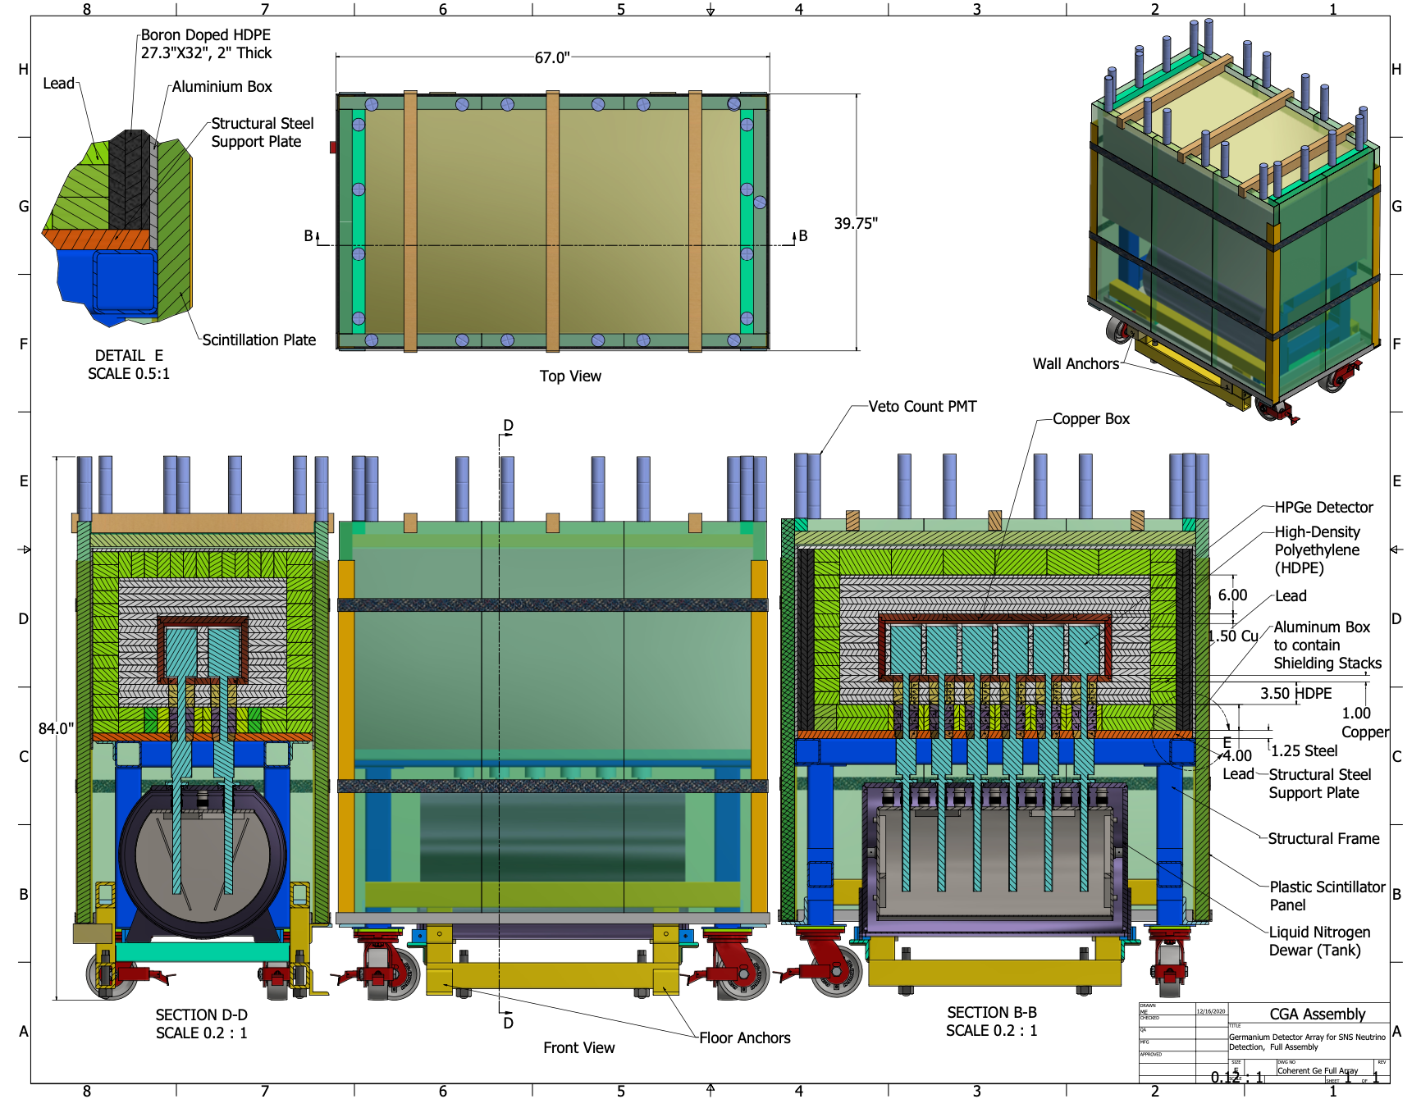
Results
Shielding design of the COHRENT subdetector system: Gemini

Slide 6
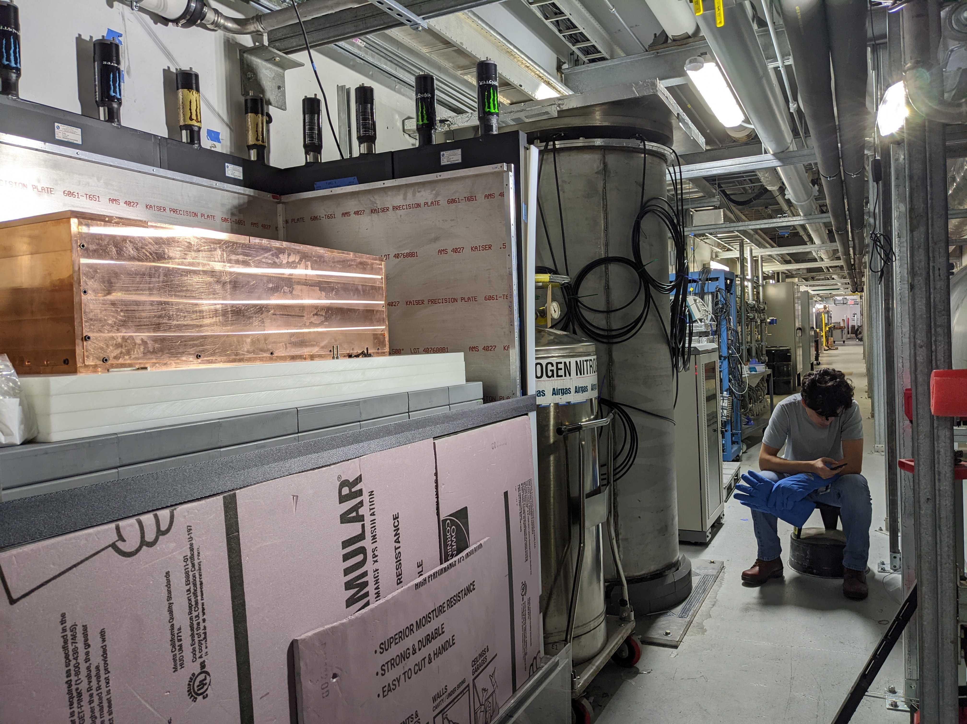
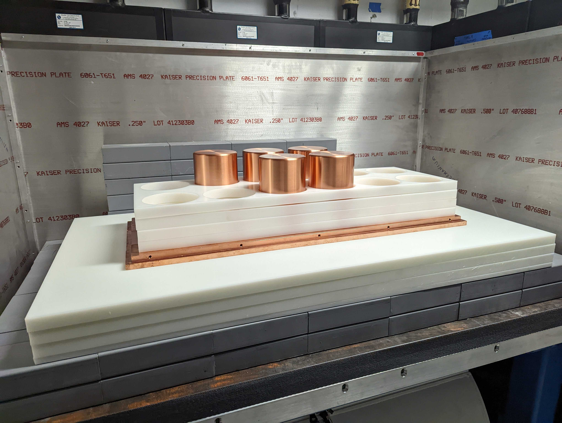
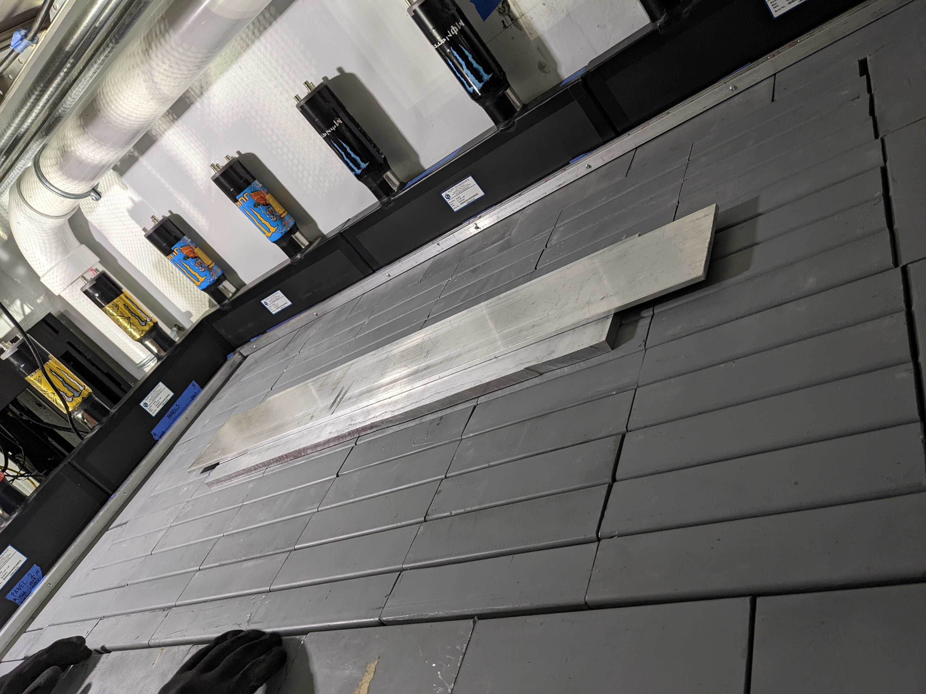
Results

Slide 7
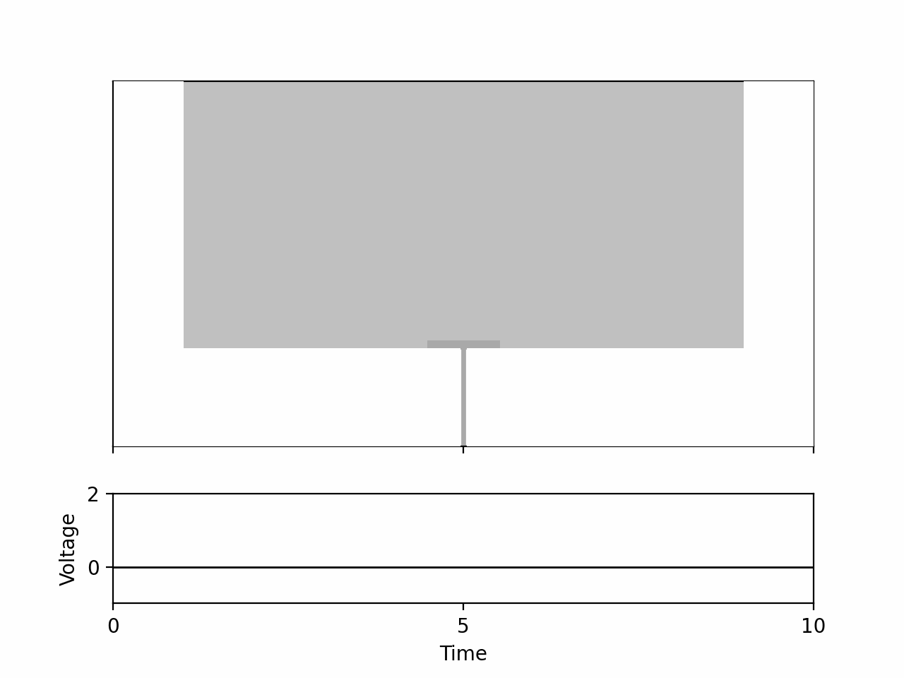
Results
Animation courtesy of ChatGPT

Slide 8
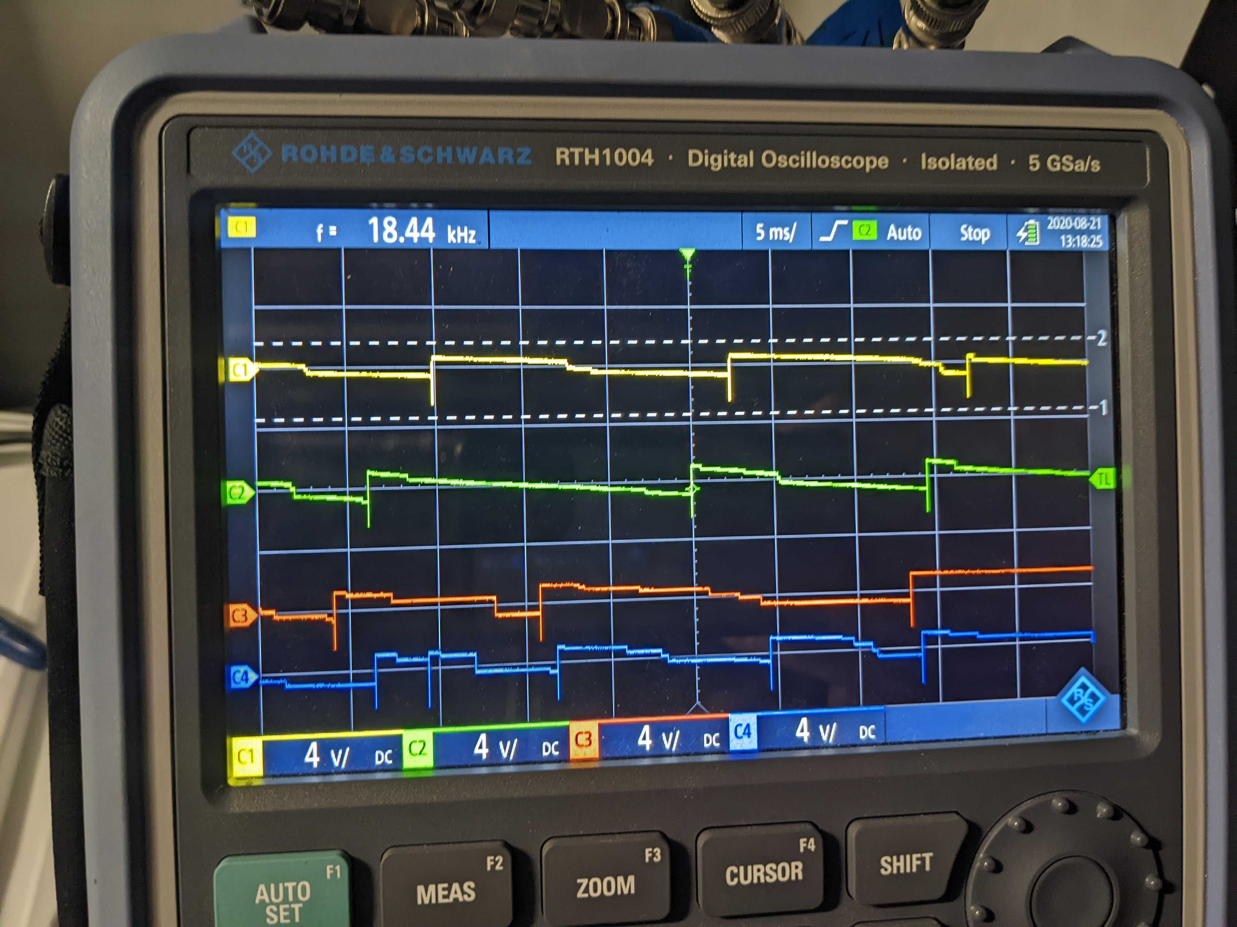
Results

Slide 9
Expected Impact
As our detectors come online we are expected to make the world’s first measurement of CEνNS on germanium.
It will also be the world’s most sensitive measurement of CEνNS.
There is significant physics impact (dark matter, sterile neutrinos, and more).
Important demonstration of technology for reactor monitoring applications.

Slide 10
MTV Impact
It is thanks to MTV that I can pursue this research fully and connect with relevant experts in the nuclear monitoring space.
The experiment is currently deployed at Oak Ridge National Lab where we work closely with Jason Newby.
I plan to spend 6 months at Los Alamos National Lab working with Steve Elliot on detector R&D to further advance ability to detect low energy signals – crucial for potential reactor monitoring applications.

Slide 11
Conclusion
We have successfully deployed the Gemini detectors to Oak Ridge National Lab to measure CEνNS.
Measuring CEνNS at the Spallation Neutron Source is a key first step towards using CEνNS detectors as a tool in the toolbox of negotiating diplomats in any future weapons treaties.

Slide 12
Next Steps
This summer we plan to run in nominal operations.
We expect to measure CEνNS this year.
I will participate in the analysis of the CEνNS data.
I will also go to LANL to advance future iterations of this experiment.

Slide 13


Acknowledgements
The Consortium for Monitoring, Technology, and Verification would like to thank the DOE-NNSA for the continued support of these research activities.
  This work was funded by the Consortium for Monitoring, Technology, and Verification under Department of Energy National Nuclear Security Administration award number DE-NA0003920

