Slide 1
Robust Adversarial Reinforcement Learning for Antineutrino-based Safeguards
2024 MTV Workshop
March 26
Matthew Dunbrack
Ph.D. Candidate, Georgia Institute of Technology
Dr. Anna Erickson
Georgia Institute of Technology

Slide 2
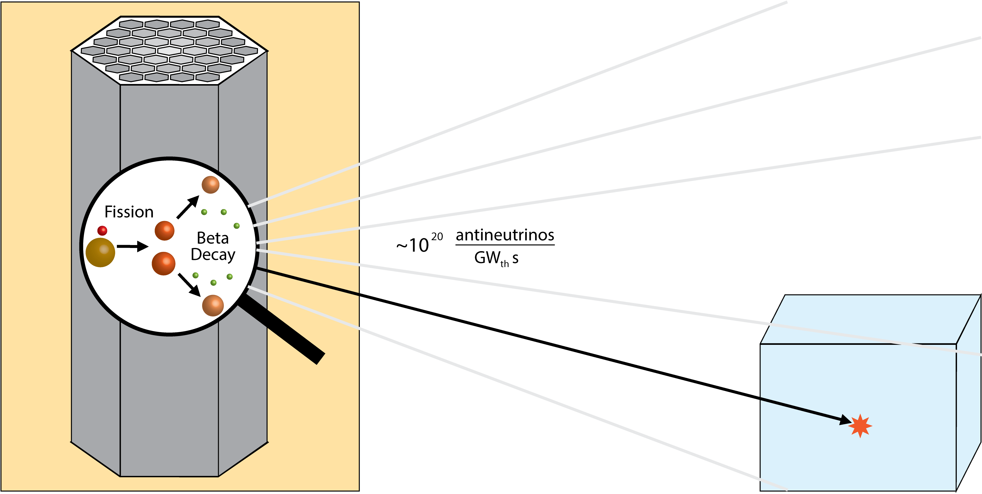
Introduction and Motivation
We want a tool for safeguards researchers and decision-makers
to simulate relevant reactor-detector environments
for antineutrino-based safeguards
Theoretical Detection Capabilities
On-Off Status
Power Monitoring
Inventory Verification

Slide 3
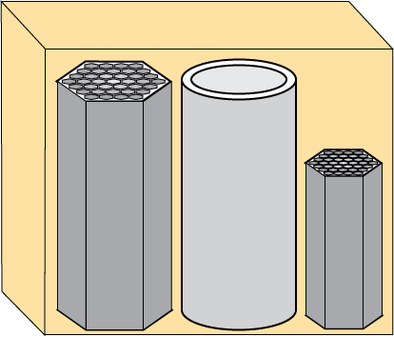
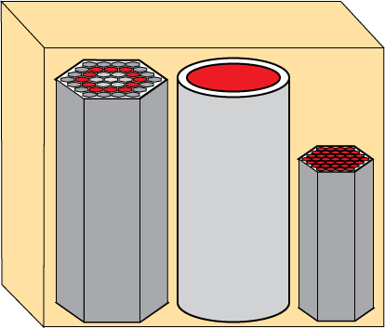
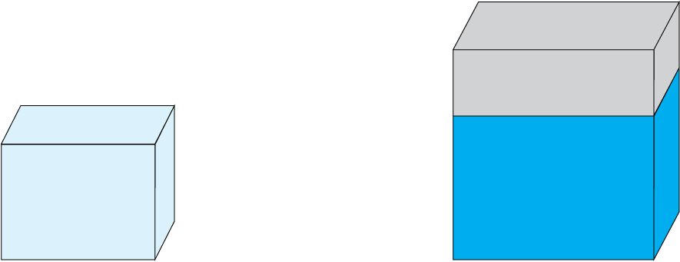
Mission Relevance
We want a flexible, modular tool
for safeguards researchers and decision-makers
to simulate relevant reactor-detector environments
for antineutrino-based safeguards
We want a tool for safeguards researchers and decision-makers
to simulate relevant reactor-detector environments
for antineutrino-based safeguards
Many Potential Reactor Designs
Many Potential Detector Designs
Many Potential Diversion Pathways

Slide 4
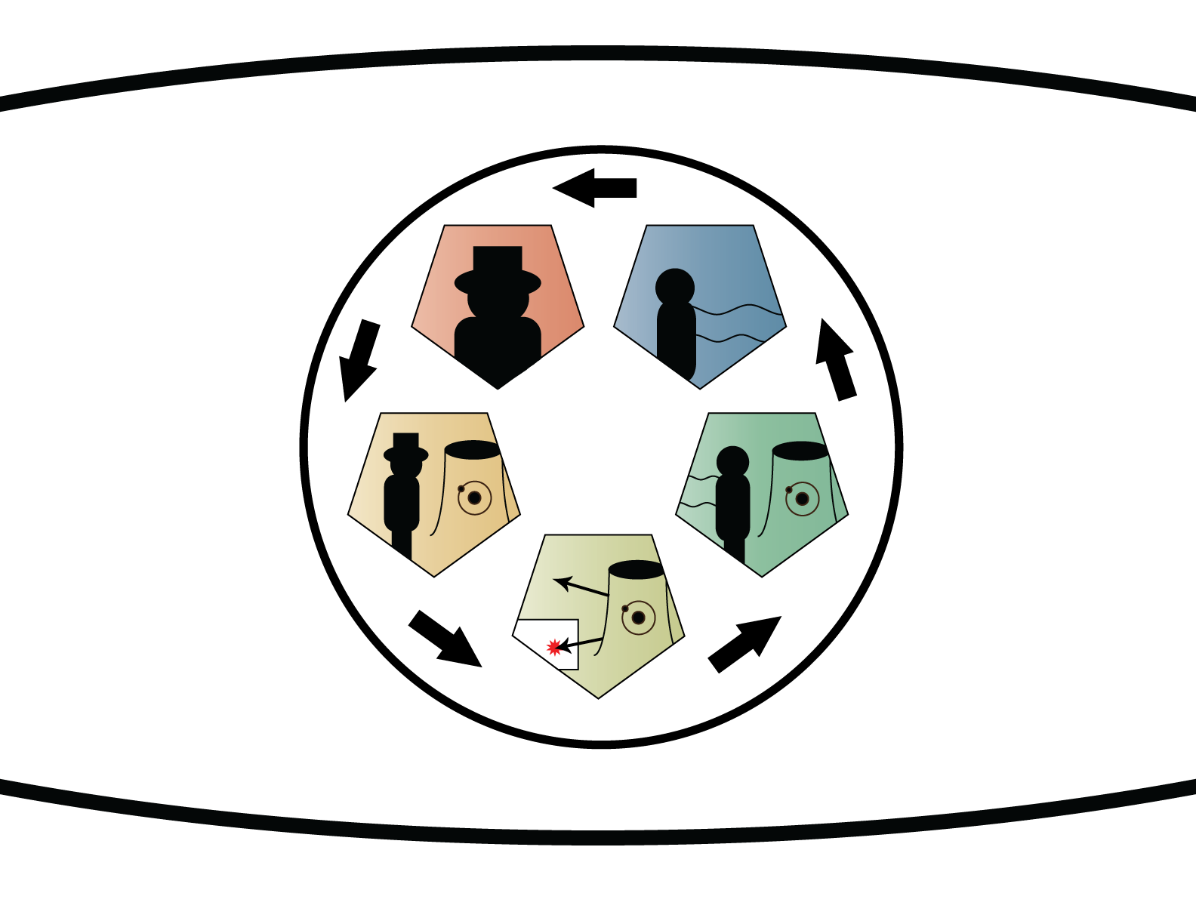
Technical Approach
The Reactor Evaluation Through Inspection of Near-Field Antineutrinos (RETINA) System
Design
Adversarial Agent
Protagonist Agent
Python
Object-Oriented Programming
User defines relevant reactor-detector-scenario environments as objects
Modules for task-specific implementation
Implement all 5 modules for robust adversarial reinforcement learning!
Diversion
Simulation
System
Sensitivity
Spectra Simulation

Slide 5
Robust Adversarial Reinforcement Learning Overview
RARL Convergence
The RETINA System
Module Overview
RARL Process
Most Well-Prepared
Diversion Classifier
Inputs classifier parameters
(state) to select optimal
learning rate (action)
Selects the optimal learning rate for the system sensitivity classifier
Adversarial Agent
Protagonist Agent
Selects the optimal diversion scenarios to simulate
Quantify and distribute safeguards sensitivity (reward) then update classifier parameters
Inputs classifier parameters (state) to select optimal diversion scenario (action)
Most At-Risk
Diversion Scenario
Quantify safeguards sensitivity
(including ML classifier)
Diversion
Simulation
System
Sensitivity
Simulates material diversion within a reactor core
Updates spectra of interest for altered environment
Simulates material diversion within a reactor core
Generates spectra of interest for relevant environments
Spectra Simulation

Slide 6
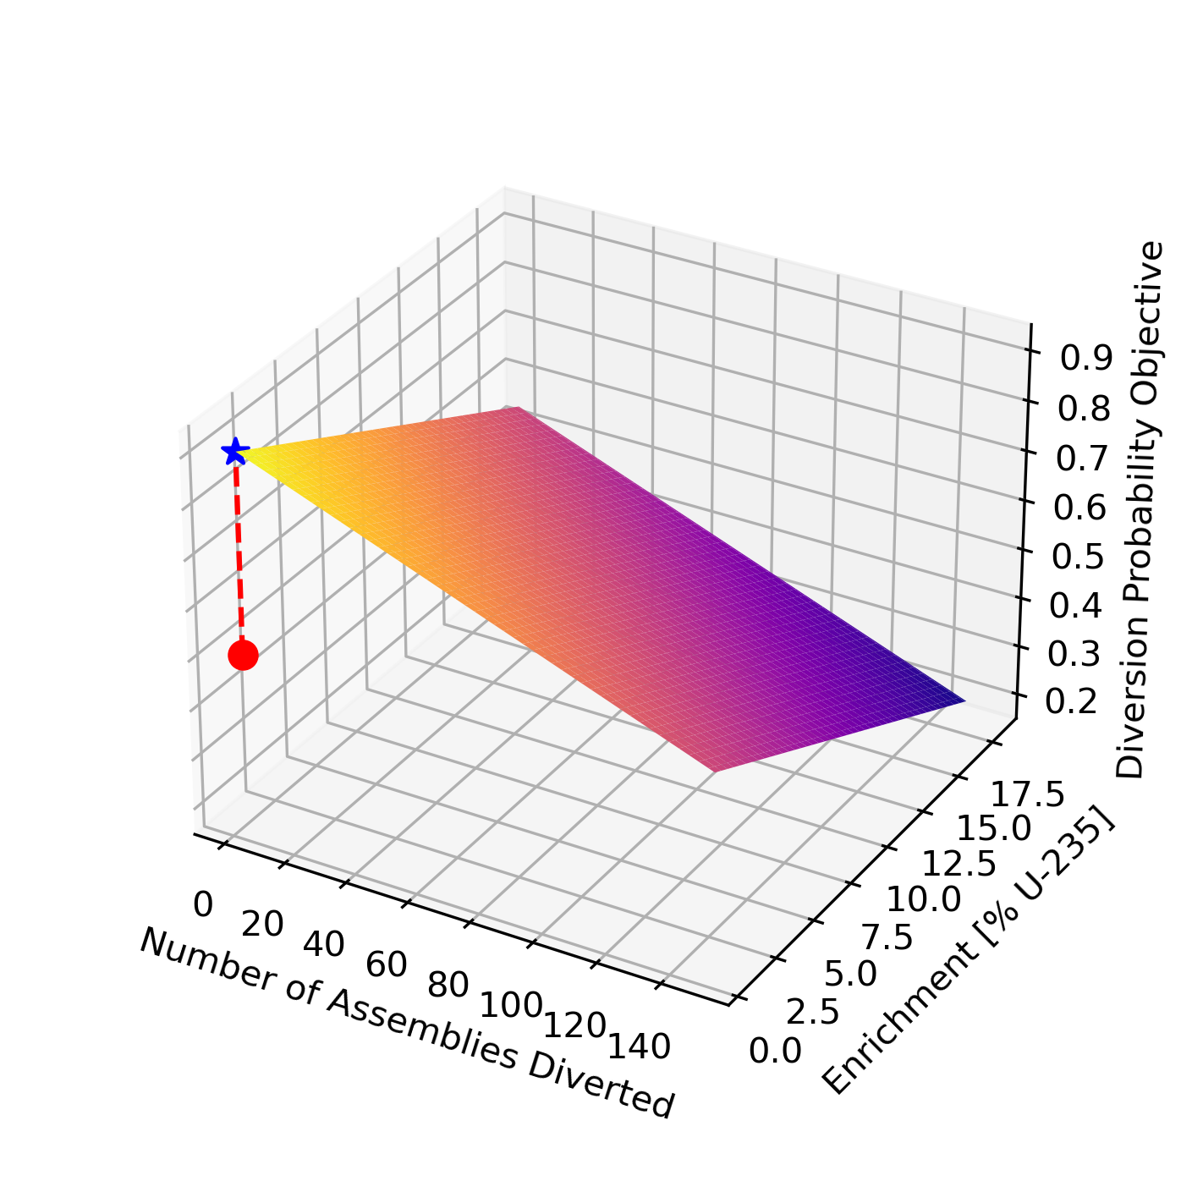
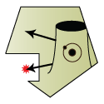
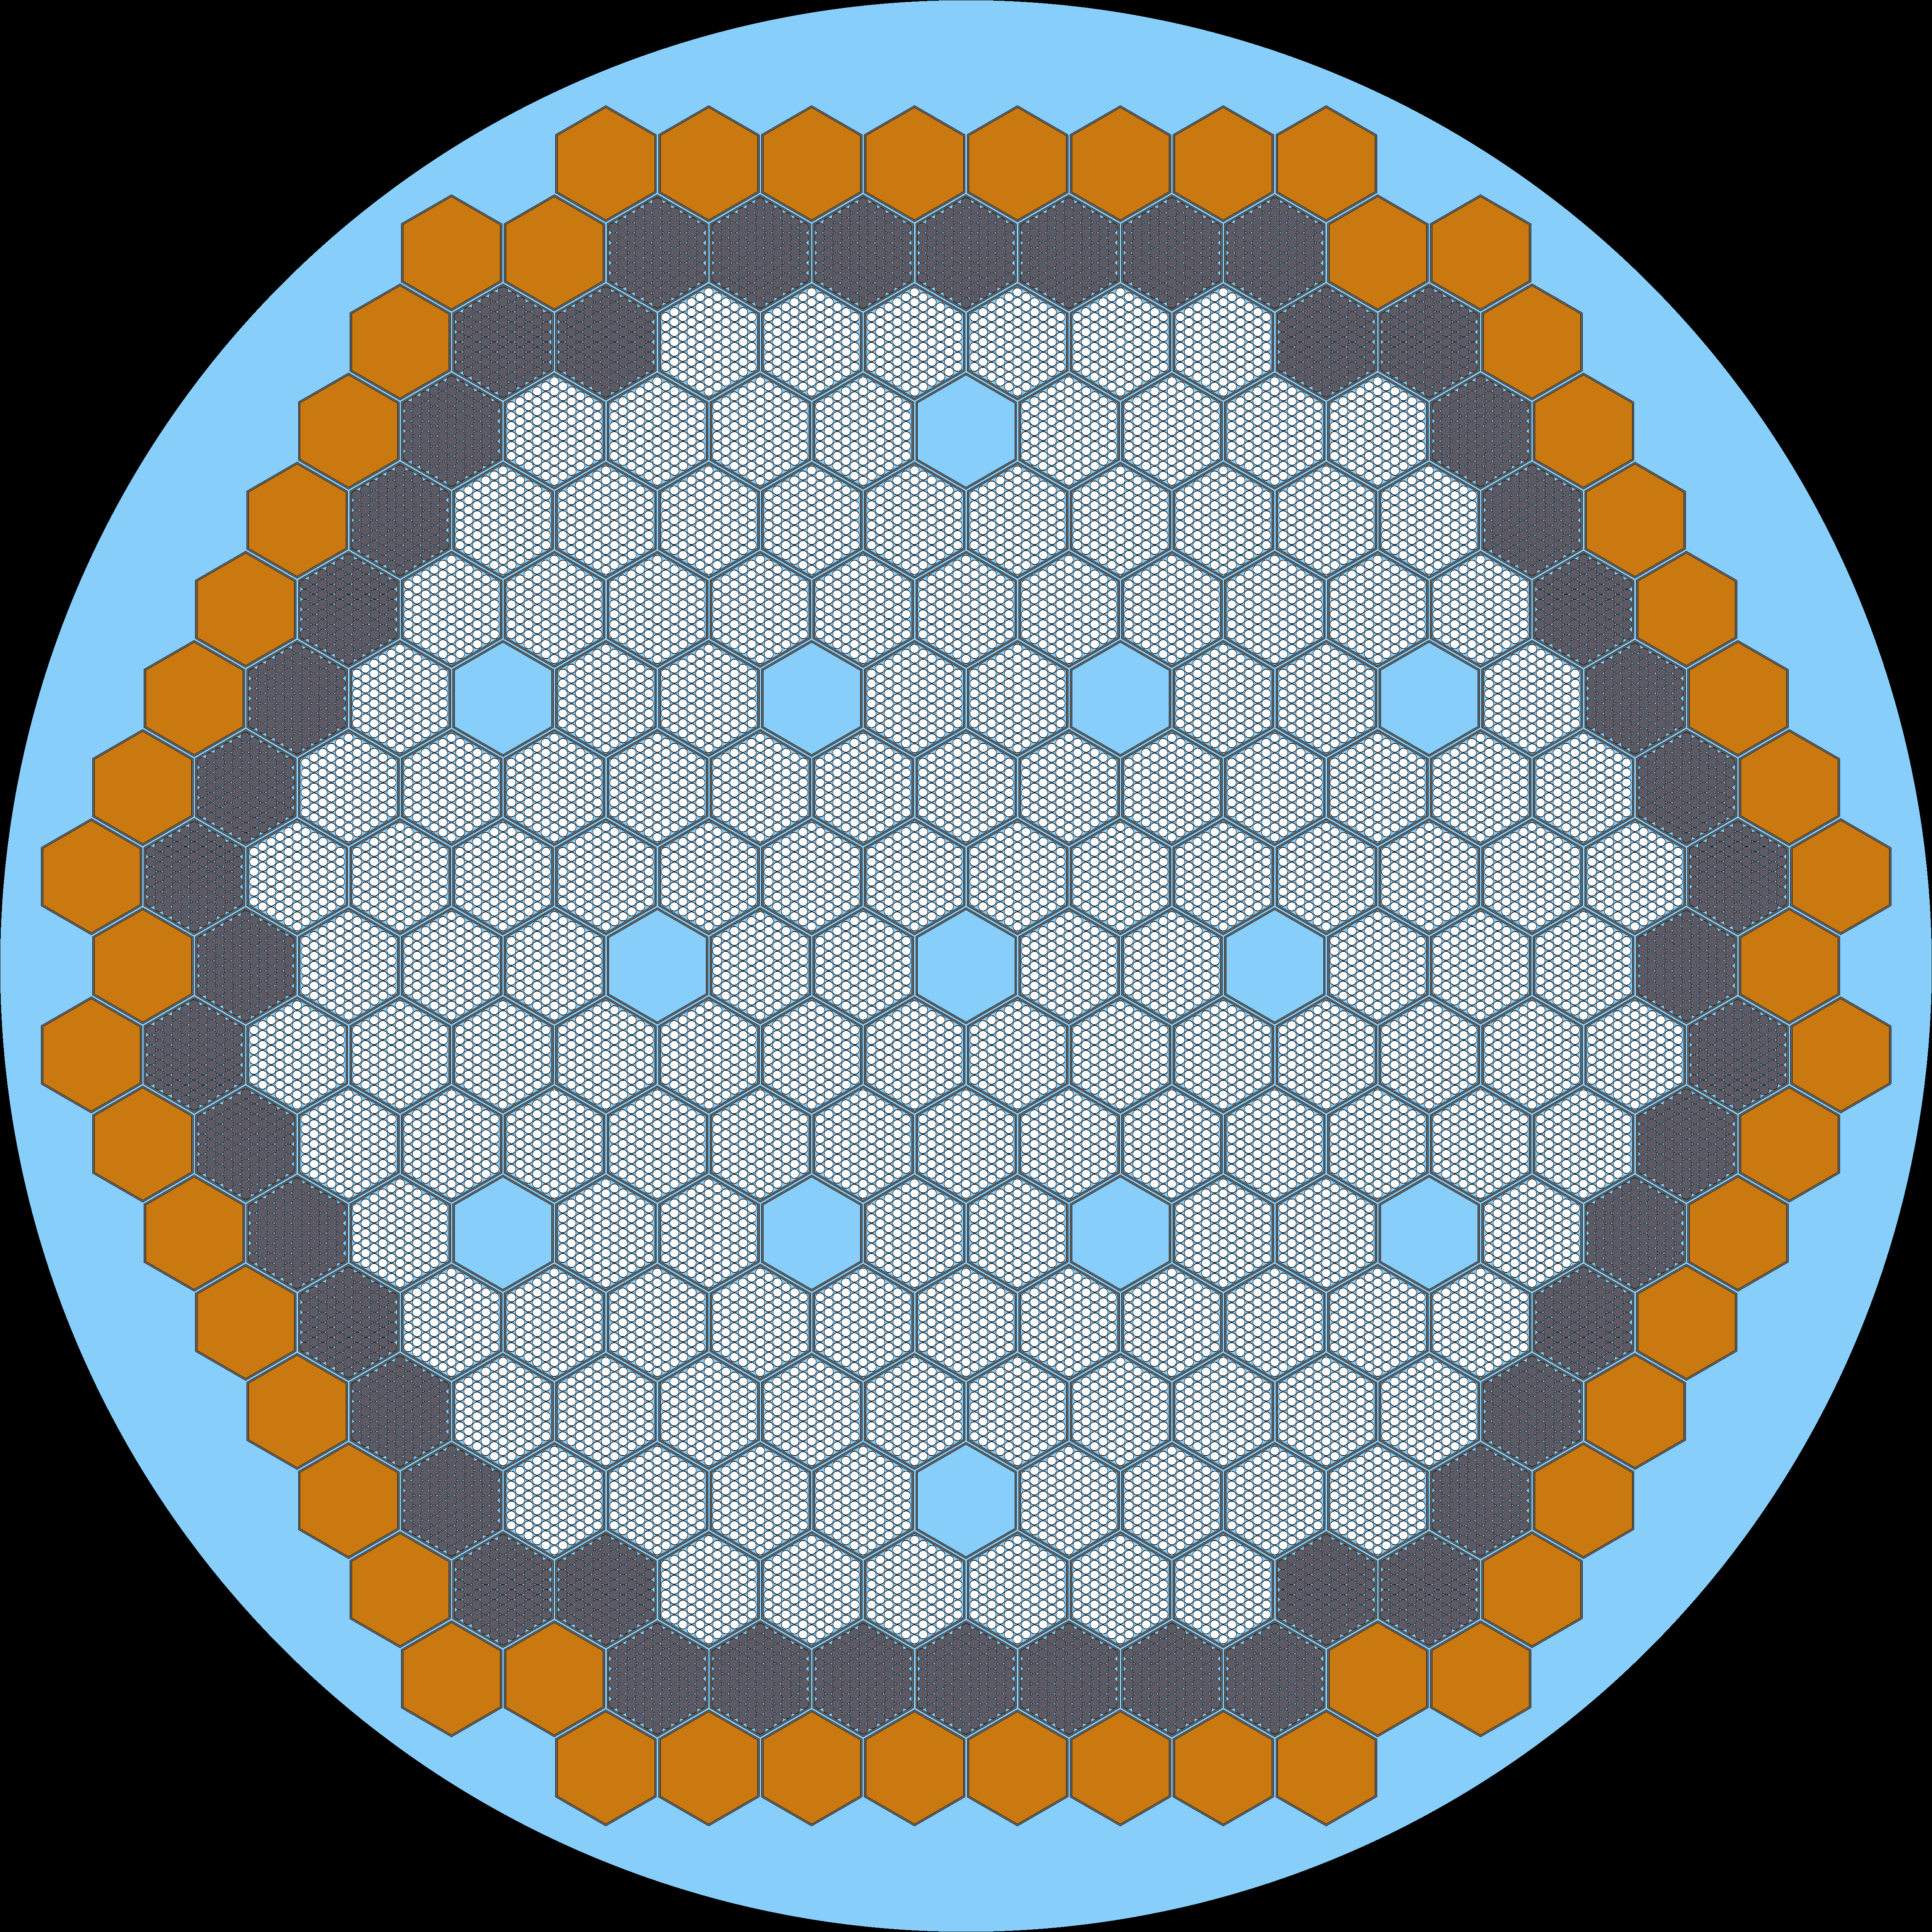
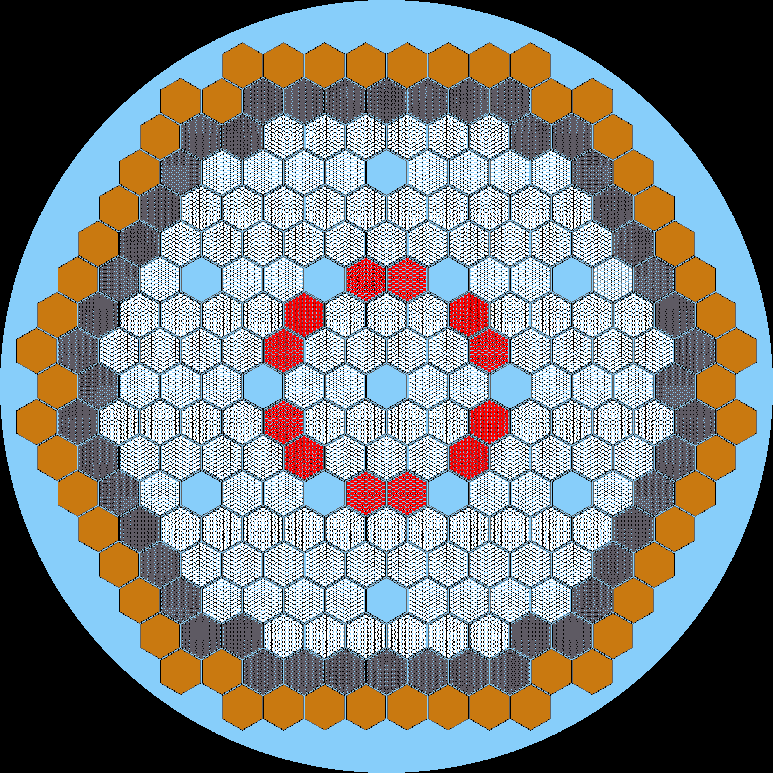
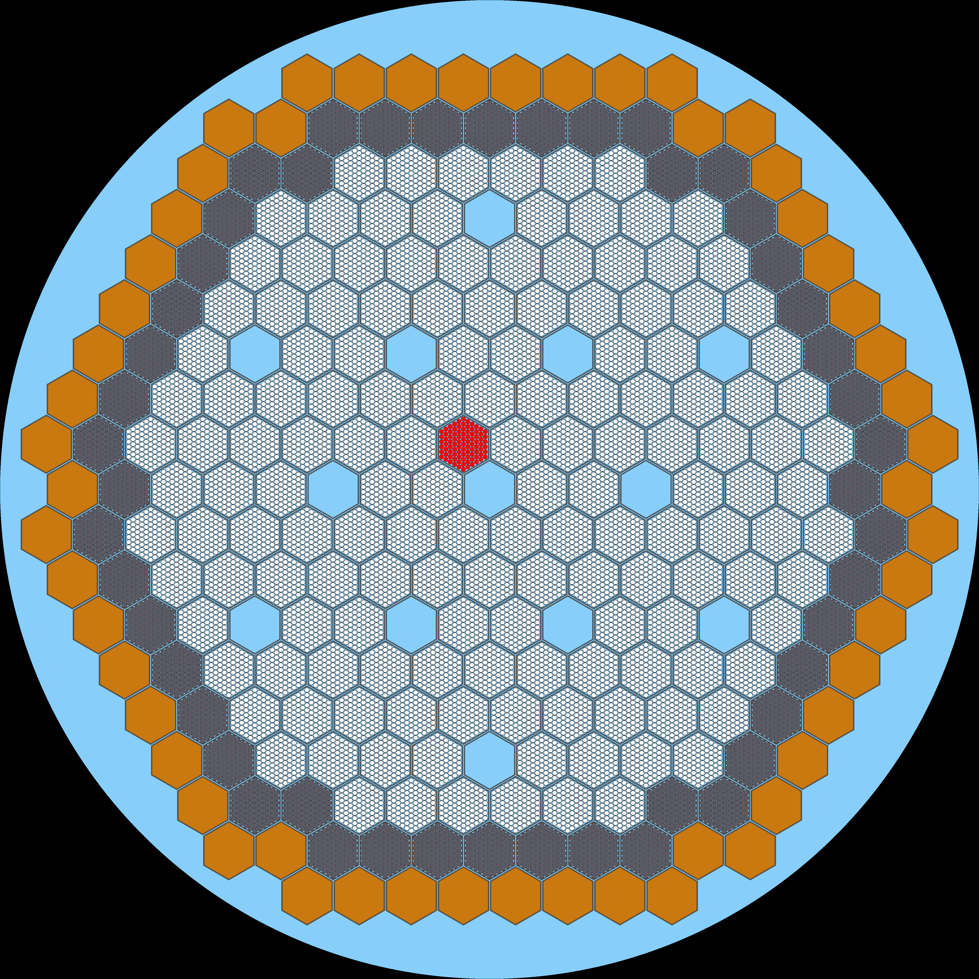
A Case Study – Important Features
RL Architecture: Probabilistic Inference for Learning Control (PILCO)
Action Space: Number of Assemblies Removed, Diversion Ring Location, U-235 Enrichment, Power Level Modified
Reward Space: Squared Difference of Custom Function
Reactor: Advanced Fast Reactor (AFR)-100
Detector: Preliminary Values from Mobile Antineutrino Demonstrator (MAD)
Scenario: 29 EFPY, 17 m Standoff Distance, 30 day Background Collection Period
RL Architecture: PILCO
Reward Space: Negative Squared Difference of Custom Function
Classifier: Perceptron

Slide 7
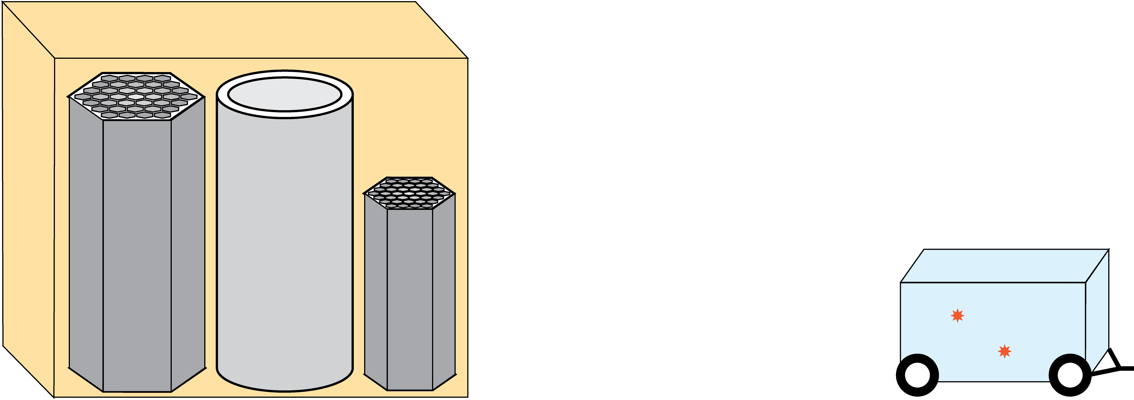
MTV Impact
Mobile Antineutrino Demonstrator (MAD) Project
Collaboration with many universities and national laboratories led by Lawrence Livermore National Laboratory
Demonstrate high sensitivity, applications appropriate antineutrino systems can be implemented in relevant environments

Slide 8
Conclusion and Next Steps
The RETINA System
We have designed a flexible, modular tool for safeguards researchers and decision-makers
to prepare for all relevant reactor-detector environments for antineutrino-based safeguards
Robust Adversarial Reinforcement Learning
Adversarial Agent
Protagonist Agent
Future Work
Now we need to run a case study to make sure it works…
Diversion
Simulation
System
Sensitivity
Spectra Simulation

Slide 9
Acknowledgements
The Consortium for Monitoring, Technology, and Verification would like to thank the DOE-NNSA for the continued support of these research activities.
This work was funded by the Consortium for Monitoring, Technology, and Verification under Department of Energy National Nuclear Security Administration award number DE-NA0003920

