Slide 1
Measurement of ⁹Be(ɑ,n) Cross Section for Safeguards Applications
2024 MTV Workshop
March 26th, 2024
Colton Graham
Graduate Student, University of Michigan
Jason Nattress¹, Igor Jovanovic²
¹Oak Ridge National Laboratory
²University of Michigan

Slide 2
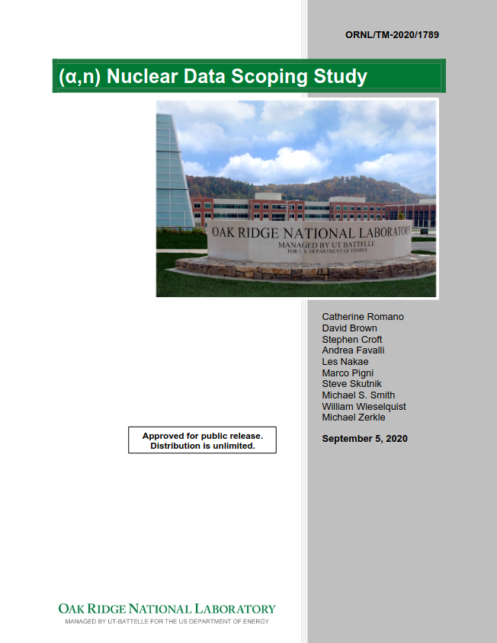
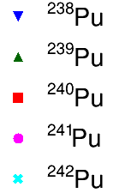
⁹Be(ɑ,n) is an Important Nuclear Reaction for Safeguards Measurements
Be contaminant produces (α,n) backgrounds
Pu/U α decay chains up to ~8 MeV
Safeguarding Gen. IV Reactors (FLiBe molten salt)
Actinide-Be (AmBe, PuBe) neutron spectra
M. Hua, et al., Nuclear Science and Engineering, 194:2, 154-162, (2020)

Slide 3
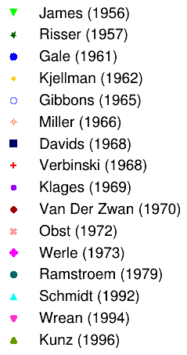
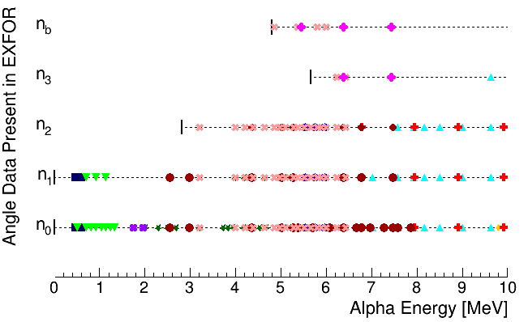
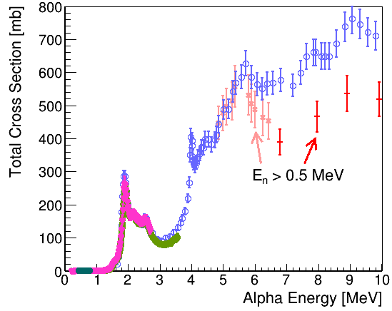
Existing ⁹Be(ɑ,n) Cross Section Data is Sparse & Contradictory for Alpha Energies over 5 MeV
Minimal data for higher energy states
Sparse total σ
Space angle data
Lacking data
Conflicting data
Conflicting data
Conflicting data

Slide 4
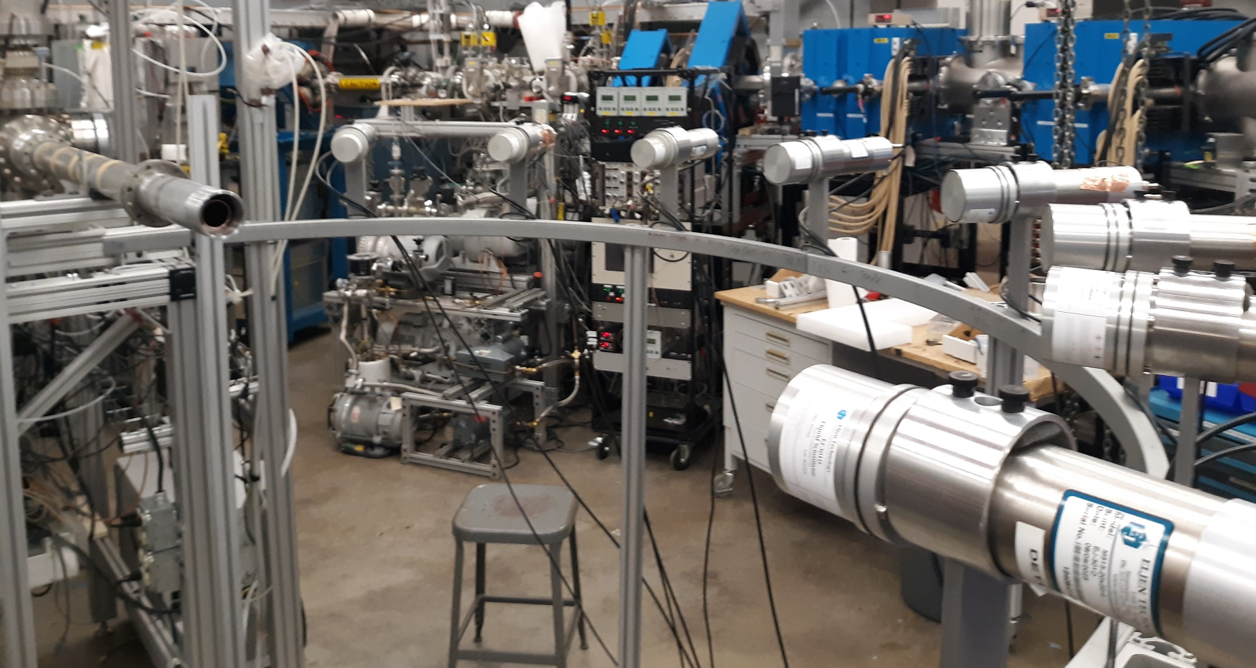
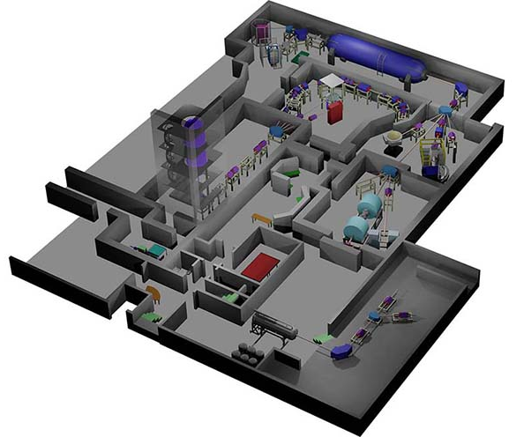
Measurement Campaign Conducted at University of Notre Dame Accelerator Facility
150°
130°
110°
90°
https://isnap.nd.edu/
5U target line
60°
40°
20°
0°
Institute for Structural and Nuclear Astrophysics Nuclear Science Laboratory
Be foil target (125 μm)
HPGe for 4.4 MeV γ-ray

Slide 5
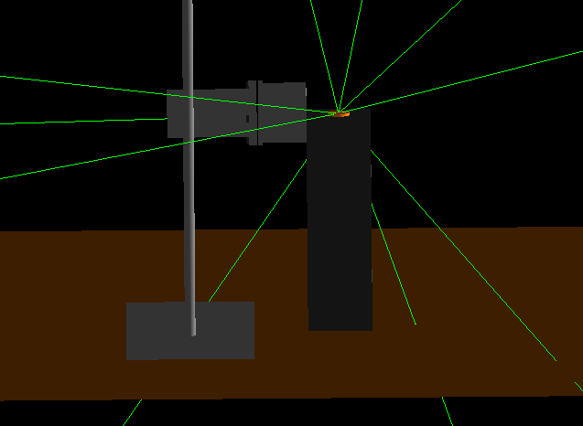
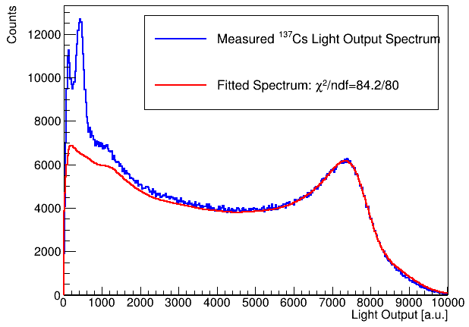
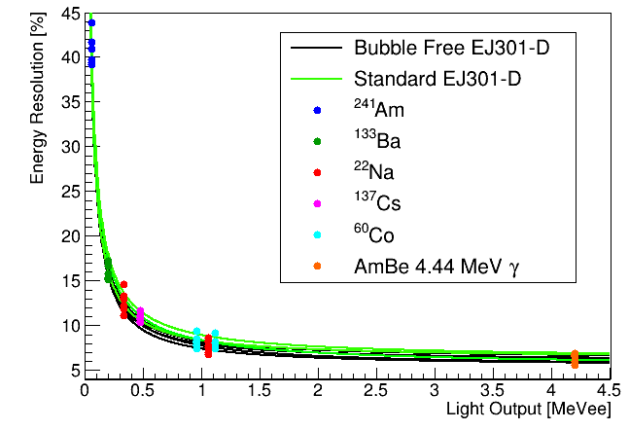
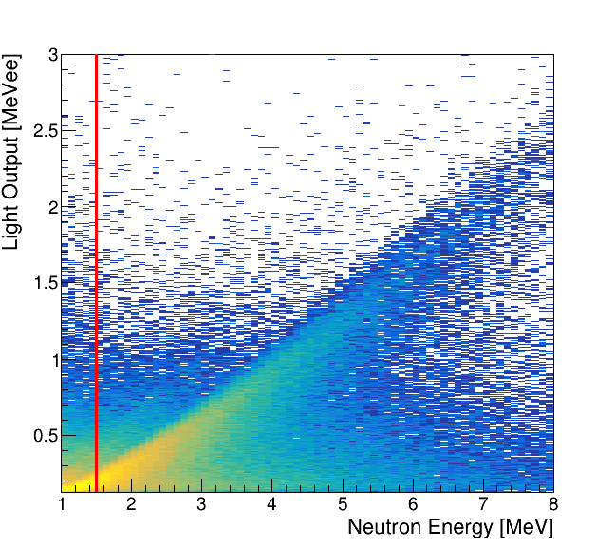
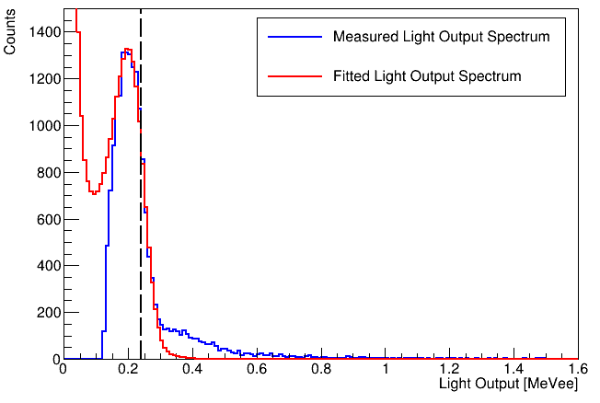
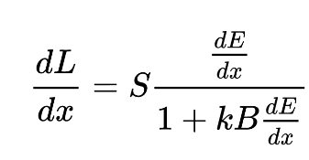
Analysis Highlight: Genetic Algorithm Spectral Fitting

Slide 6
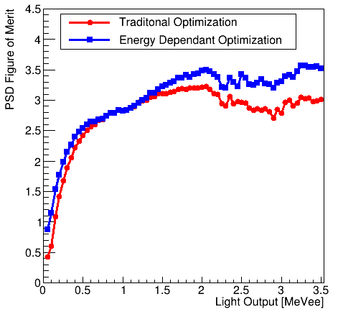
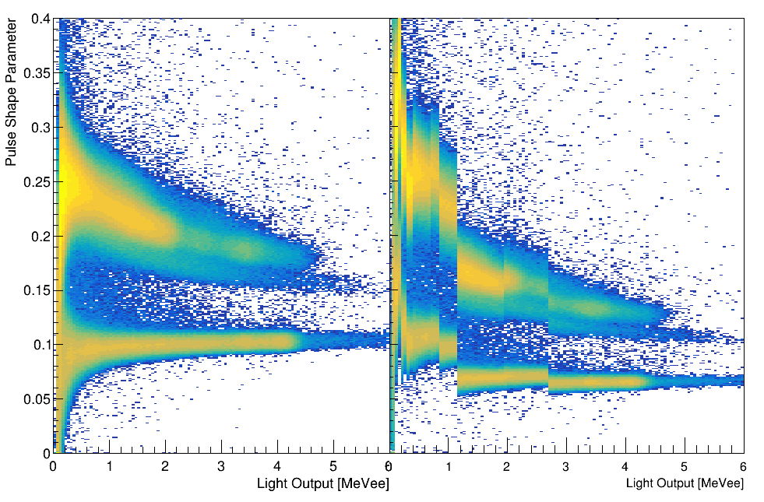
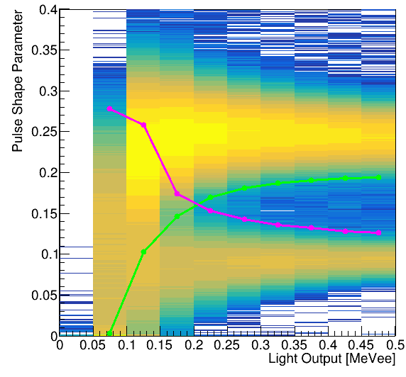
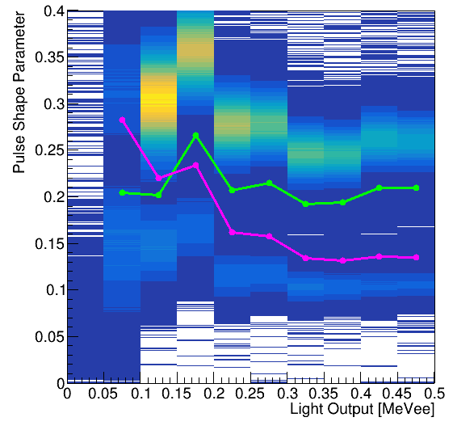
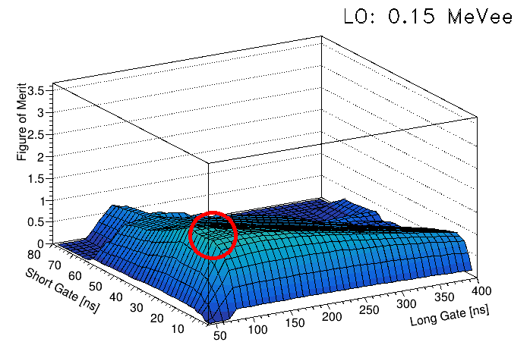
Analysis Highlight: Energy Dependent PSD Gates
Neutron 3σ
Gamma 3σ
Traditional PSD
Energy Dependent PSD

Slide 7
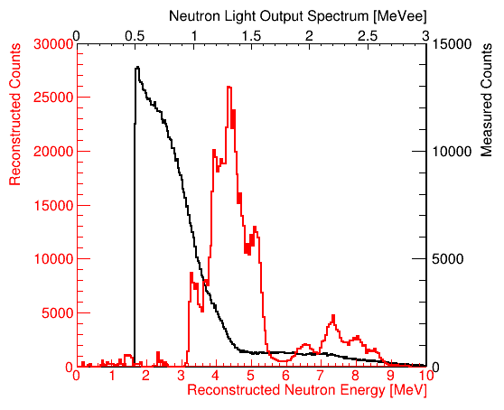
Analysis Highlight: Neutron Spectral Reconstruction
Measured light output spectrum
Detector response matrix
True neutron spectrum
C. Lawrence et al., NIMA, 759, 16-22 (2014)
Light output convolution
MLEM
⁹Be(α,n₁)
Iterative solution to spectral matrix equation
Measured spectrum
⁹Be(α,n₀)
Iterative reconstructed spectrum
B. Pehlivanovic et al., Radiation Measurements, 49, 109–114 (2013)
Detector response matrix

Slide 8
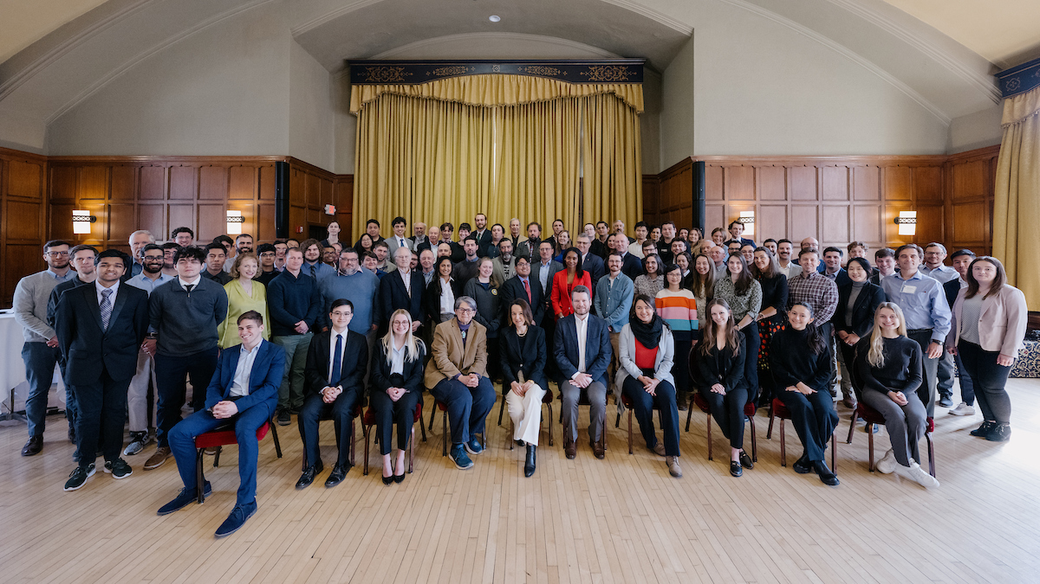
MTV Facilitates National Laboratory Collaboration
Opportunity to intern at Oak Ridge National Laboratory
Collaboration generated directly by 2023 MTV Workshop!
2023 MTV Workshop

Slide 9
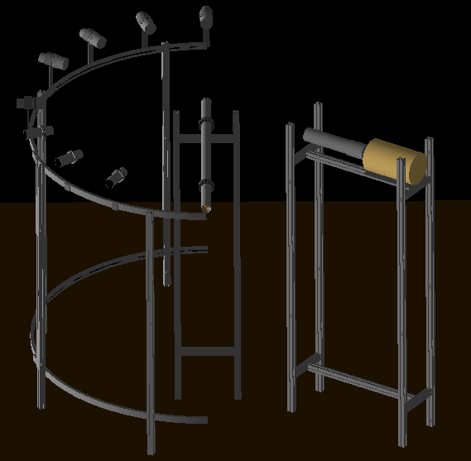
Next Steps
Ongoing analysis of ⁹Be(α,n) cross section
Monte Carlo simulations of neutron transport and room return
Follow up measurements with ³He array for low energy neutron states
Safeguards application measurements
Assay of SNM with varying Be content
AmBe neutron spectrum measurement to validate cross section data
Prototype Geant4 simulation model

Slide 10
Acknowledgements
The Consortium for Monitoring, Technology, and Verification would like to thank the DOE-NNSA for the continued support of these research activities.
This work was funded by the Consortium for Monitoring, Technology, and Verification under Department of Energy National Nuclear Security Administration award number DE-NA0003920

