Slide 1
PSD Performance using CLYC Scintillation Detector for Special Nuclear Materials Measurement
2024 MTV Workshop
March 26, 2024
Cat Barker
PhD Candidate, University of Florida
Brice Turner, Dr. Andreas Enqvist
University of Florida

Slide 2
Introduction and Motivation
Fresh nuclear fuel has similar safeguard and security concerns as spent nuclear fuel but limited research into techniques for radiologically verifying fresh nuclear fuel
Radiological verification requires understanding both nuclear and gamma signatures of fresh nuclear fuel in order to discern small variations in fuel assemblies at a nuclear power plant
Machine learning techniques can prove useful for rapidly identifying and discerning between fresh nuclear fuel
Theory: Refining pulse shaped discrimination (PSD) techniques should aid in providing machine learning algorithms multiple pulse variables for rapid analysis and identification

Slide 3
Mission Relevance
NNSA and members of the nuclear community need high quality, rapid radiological verification equipment that provide much needed information and reassurance in safeguard and security controls
Machine Learning, if developed appropriately, has the capability to improve upon signature verification and potentially increase verification speed

Slide 4
Technical Approach
Previous Work:
Evaluated a system of detectors to measure multiple aspects of a multi-variant field from natural uranium in order to assess effectiveness at discerning different configurations
Fig. 1. A example of several of the natural uranium configurations (left) measured with the system of detectors (right)
Key Findings:
All detectors had ability to measure radiological signature difference with each assembly configuration
Multi-detector system for gamma and neutrons needed to fully capture, identify, and discern fresh nuclear fuel signatures
Additional natural uranium configurations & source combinations needed to develop robust data library
Notes:
CLYC had a lower efficiency rate as a result of a smaller detector volume
CLYC had best gamma energy spectrum, but long count rate was drawback compared to NaI(Tl)
Needed for data for machine learning
No detector able to capture all trends and characteristics as other detectors

Slide 5
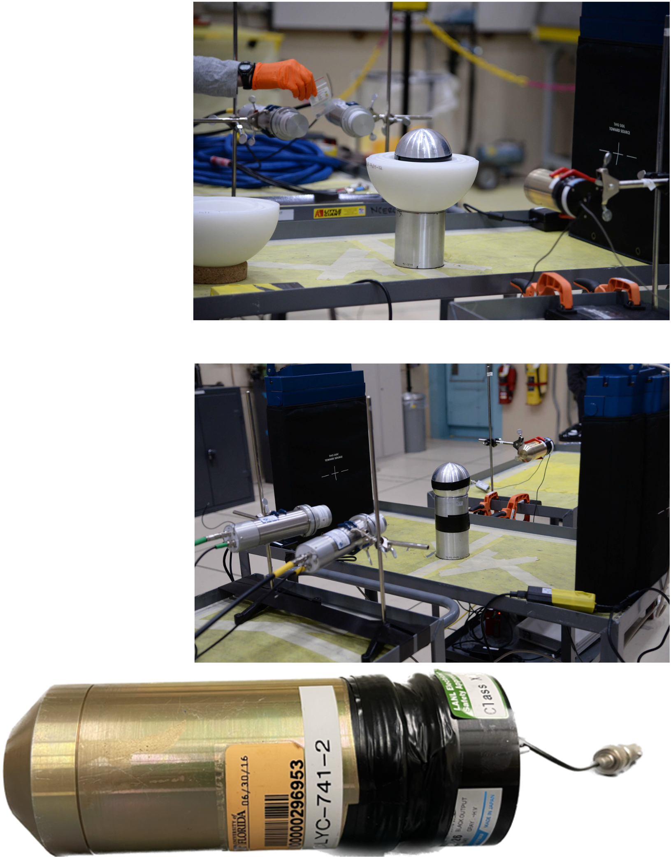
Technical Approach
Fig. 3. Two of the set-ups utilizing both the University of Florida’s CLYC detector and the He-3 NOMAD and EJ-309 detectors provided by LANL (top and middle) photos taken and provided by NCERC; an image of the UF CLYC detector (bottom) photo taken by the author
Key Finding 3 meant needing to obtain data from other avenues than UF
Measurements conducted at Device Assembly Facility at the Nevada Nuclear Security Site
Cs₂LiYCl₆:Ce³⁺(CLYC) scintillation detector used for all measurements
Good at PSD but also great for gamma measurements
High device cost
Utilizes crystal scintillation and discerns both thermal and fast neutrons
8 different experimental configuration datasets used for PSD refinement
Multiple configurations of Rocky Flats (RF) hemishells (highly enriched uranium)
Beryllium-Reflected Plutonium (BeRP) ball
Notes:
⁶Li(n, α)³H reaction allows for thermal neutrons [18, 19, 20]
³⁵Cl(n, p)³⁵S and ³⁵Cl(n, a)³²P reactions allow for fast neutrons [18, 19, 20]

Slide 6
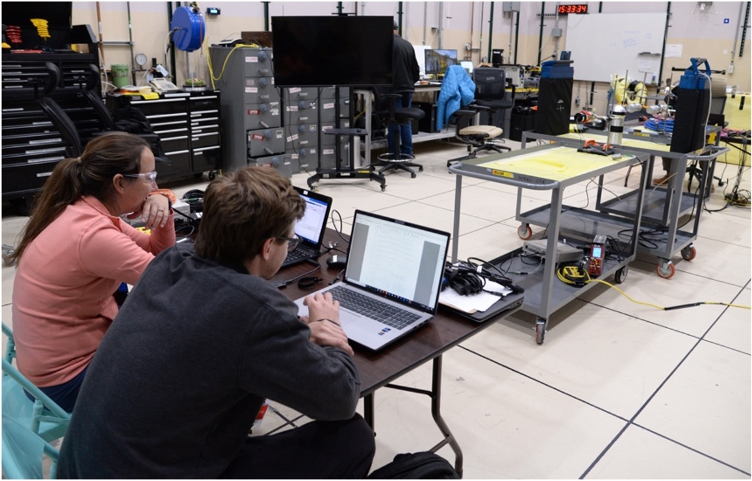
Results: Methodology
Goal:
Refinement of PSD for rapid verification analysis
Gamma Energy Spectrums for Special Nuclear Materials
Six pulse criteria considered
Total area of the pulse (qtotal)
Tail area of the pulse (qtail)
Qratio (qtail/qtotal)
Peak Amplitude (amp)
Difference of the peaks of the tail (jitter)
Logarithmic of the Tail Discrimination Factor (dflog)
Evaluated:
Four different “Tail” lengths for CLYC
Five PSD techniques
Three different pulse smoothing lengths
Gamma energy spectrums for two pulse trigger lengths
Fig. 4. Cat Barker and Brice Turner are pictured in front of the DAF set-up; photo taken and provided by NCERC
Notes:
Quick measurement, quick data analysis, quick results but accurate results

Slide 7
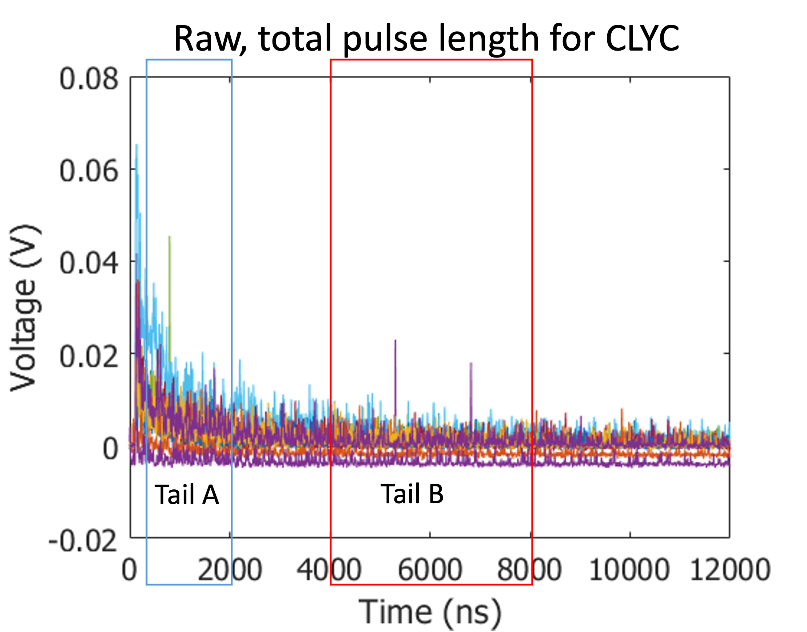
Results: Tail Integration Analysis
Sample of 10 CLYC pulses (12000 ns long)
Tail A: 50-2000 ns
Tail B: 4000-8000 ns
Fig. 5. Raw CLYC pulses using STRUCK digitizer

Slide 8
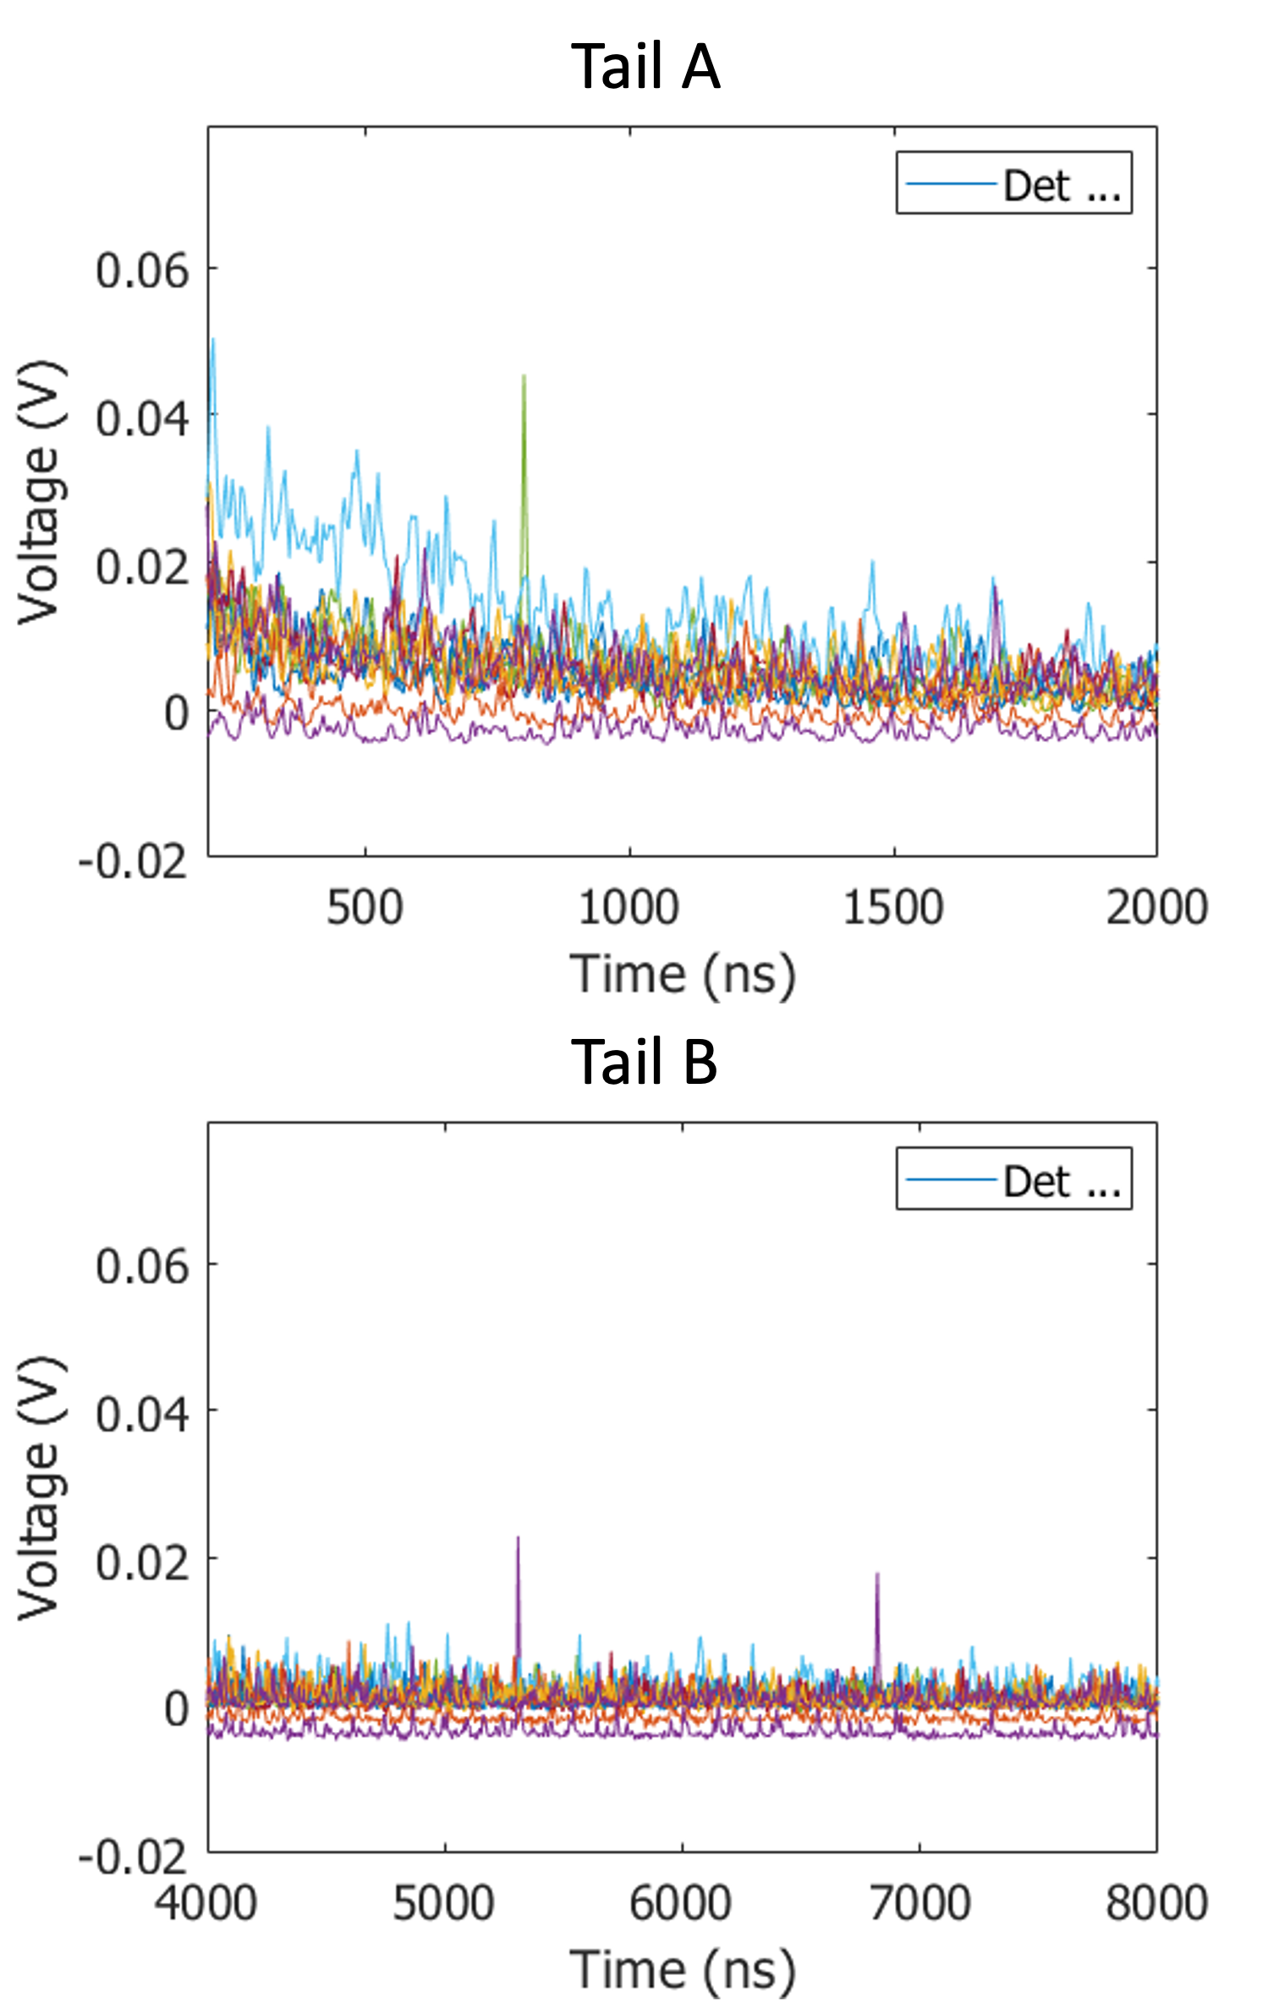
Results: Tail Integration Analysis
Sample of 10 CLYC pulses (12000 ns long)
Tail A: 50-2000 ns
Showed variation
Tail B: 4000-8000 ns
Showed little pulse variation
Fig. 6. Narrowed Tail A of 10 CLYC pulses
Fig. 7. Narrowed Tail B of 10 CLYC pulses

Slide 9
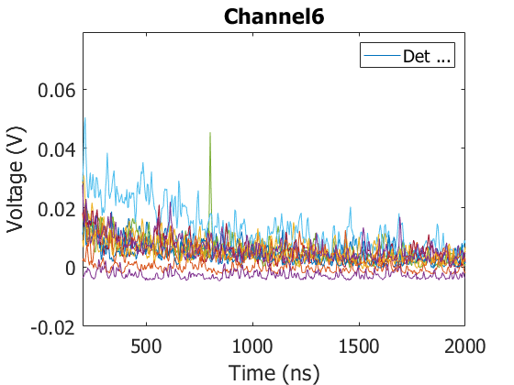
Results: Tail Integration Analysis
Tail A
Sample of CLYC pulses (12000 ns long)
Tail A: 100-2000 ns
Showed greatest variation
Evaluated two additional tail lengths
Tail C: 100-800 ns
Tail D: 1400-2000 ns
Tail B: 4000-8000 ns
Showed little pulse variation
Tail C
Tail D
Fig. 8. Focused look on Tail A pulses divided into two additional tail categories

Slide 10
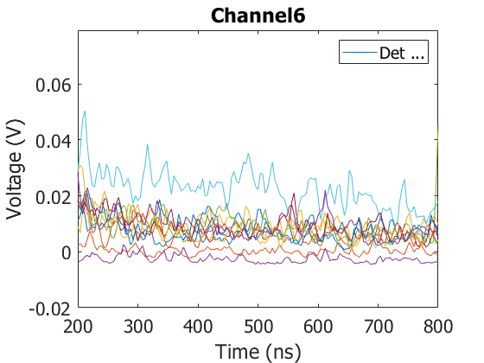
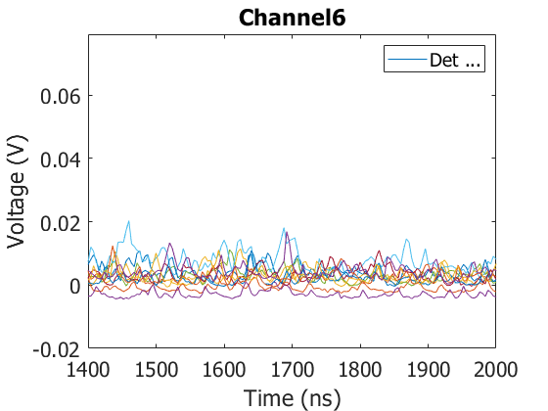
Results: Tail Integration Analysis
Tail C
Sample of CLYC pulses (12000 ns long)
Tail A: 100-2000 ns
Showed greatest variation
Evaluated two additional tail lengths
Tail C: 100-800 ns -- shorter integration length means shorter date processing time
Tail D: 1400-2000 ns
Tail B: 4000-8000 ns
Showed little pulse variation
Fig. 10. Narrowed Tail C of 10 CLYC pulses
Tail D
Fig. 11. Narrowed Tail D of 10 CLYC pulses

Slide 11
Results: Initial PSD Evaluation
Four PSDs demonstrated varying levels of successful separation
PSD D is the weakest of the four and needs the most refinement
PSD B proved ineffective
Could not be used
Fig. 12. Four Pulse Shaped Discrimination Techniques

Slide 12
Results: Smoothing applied
Fig. 14. Three smoothing lengths applied to PSD C
Smoothing of pulses showed removal of “noise”
Data analysis toolsets ran around 50% faster using “smoothing 15” instead of no smoothing

Slide 13
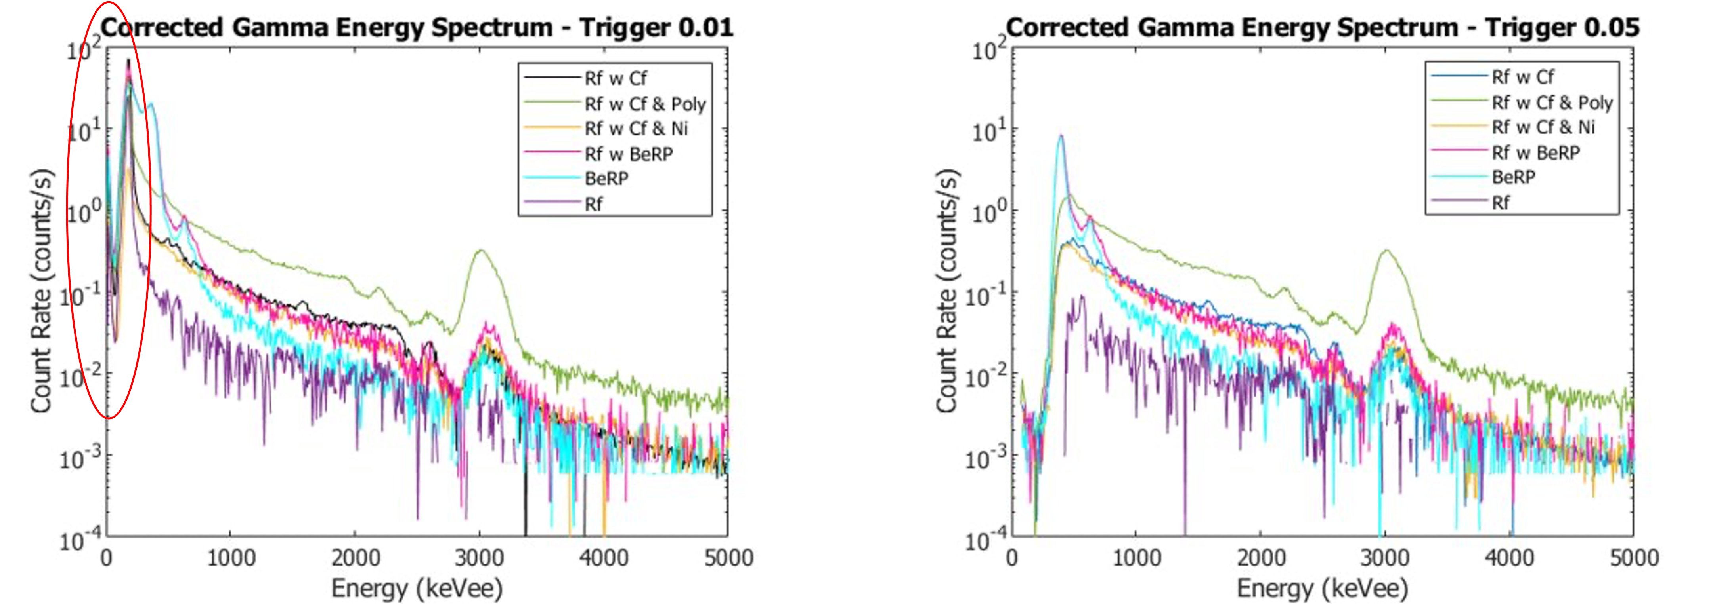
Results: Gamma Energy Spectrum
Fig. 15. Gamma energy spectrums for each trigger during post processing

Slide 14
Conclusion
The PSD refinement resulted in faster processing of the full data set and still obtained gamma energy spectrum data for the CLYC detector that could be used for rapid radiological verification measurements
Next Steps:
Scheduled to conduct measurements with NCERC for Summer 2024 with multiple multi-variant detectors (CLYC, CLLB, & NaIL) in order to provide multi-location data sets future machine learning algorithms
Develop machine learning algorithm to process data faster from a multiple detector system

Slide 15
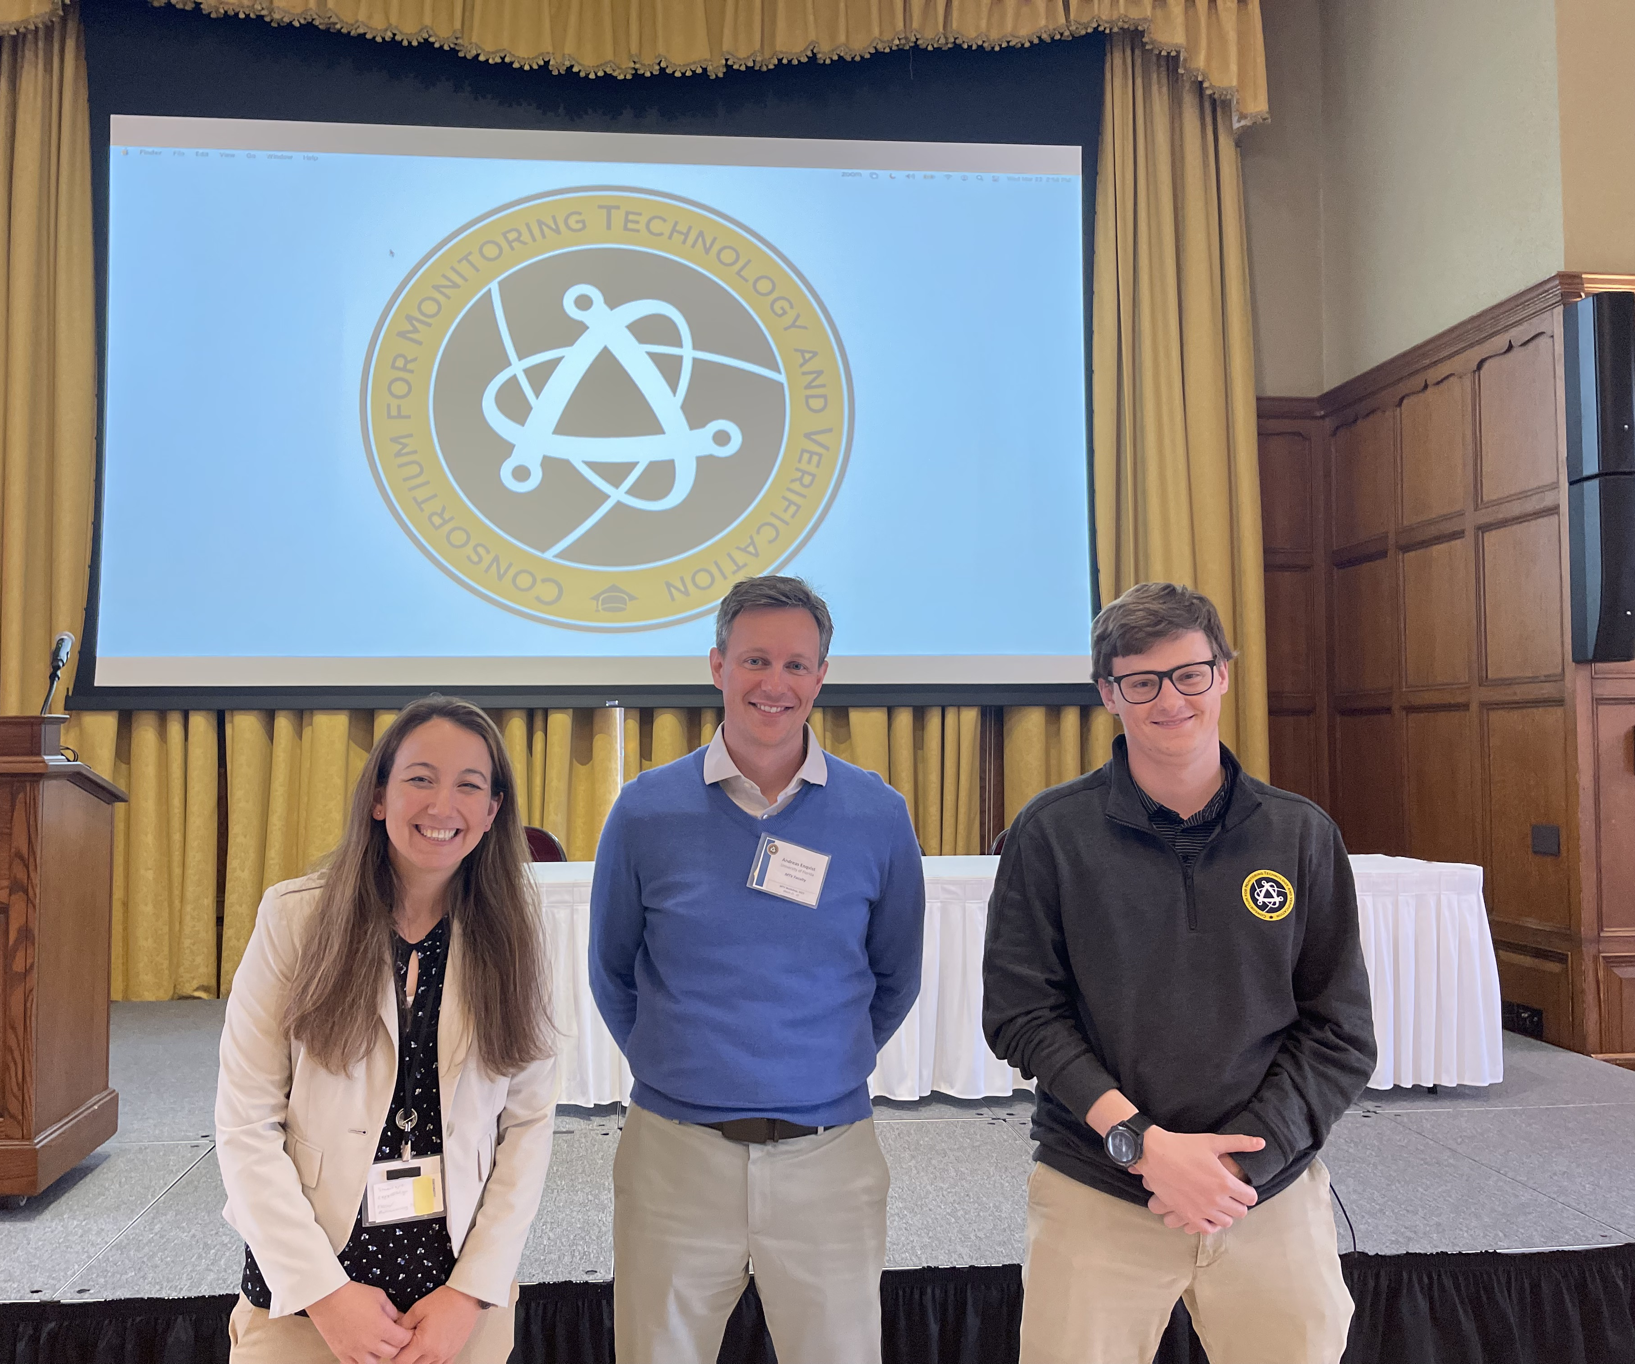
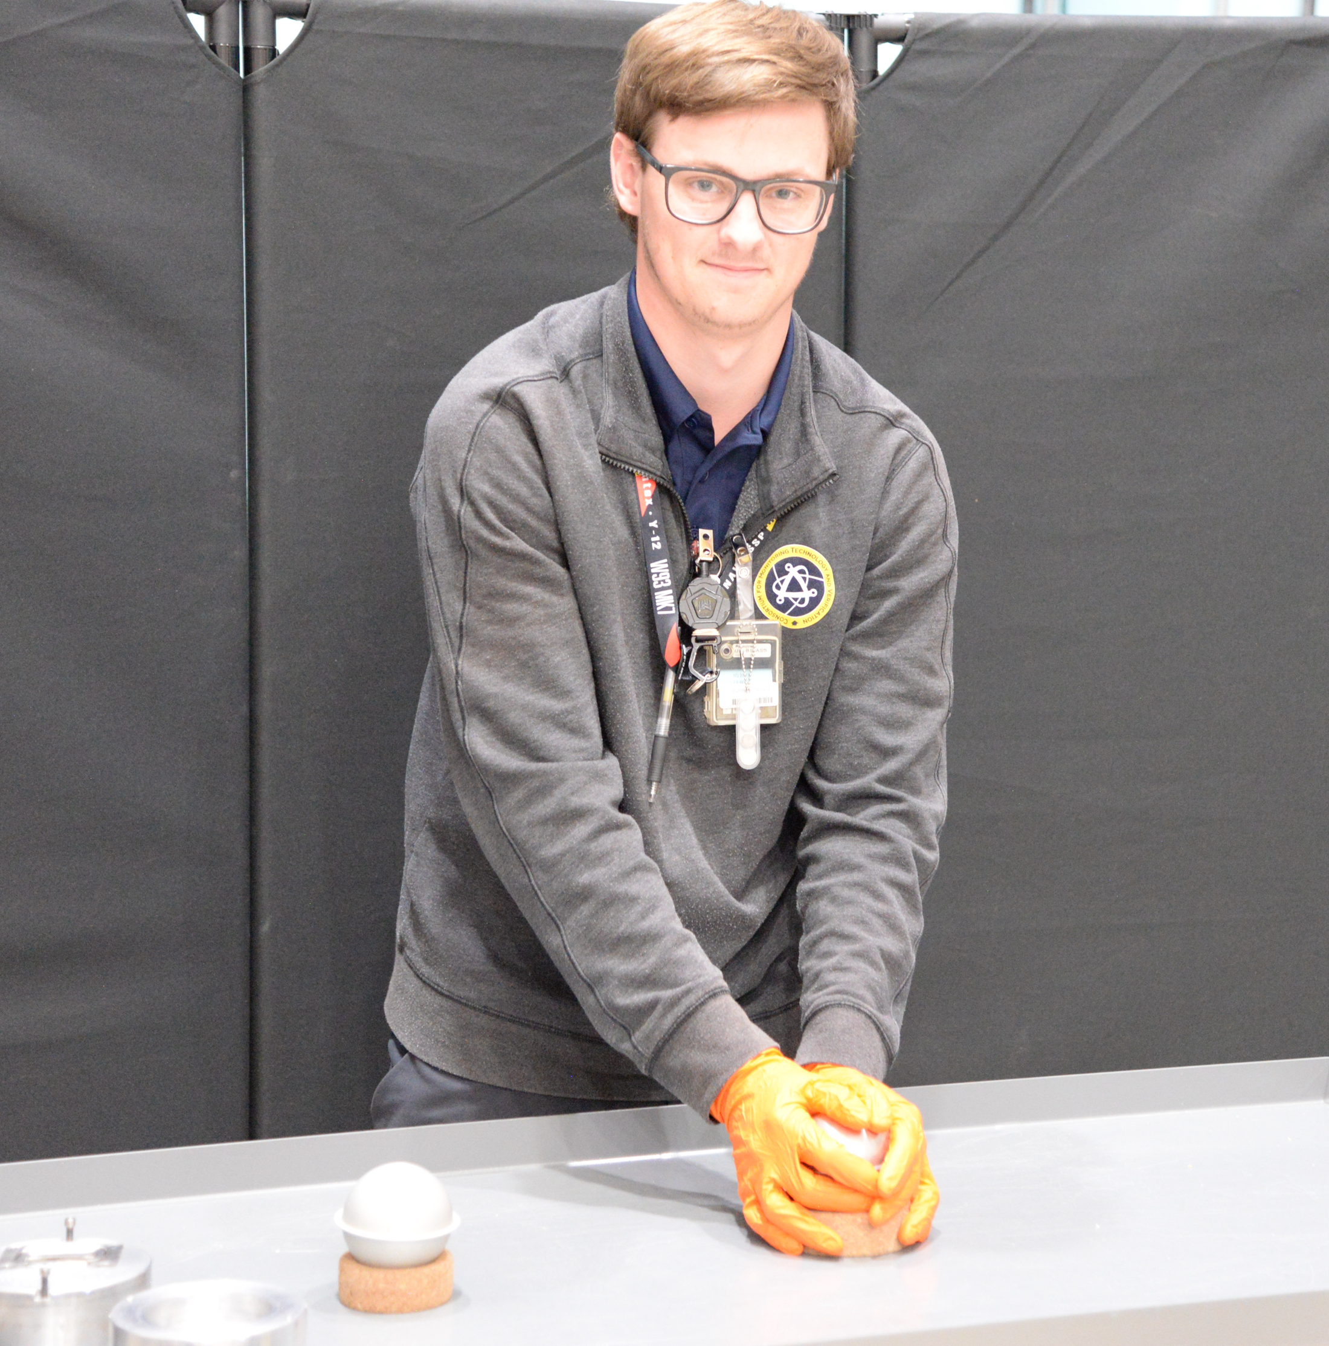
MTV Impact
MTV provides critical networking, lab, and industry connections and support
Acknowledgments: This work was performed at the National Criticality Experiments Research Center, operated for the DOE Nuclear Criticality Safety Program, funded and managed by the National Nuclear Security Administration for the Department of Energy
MTV aids in developing relationships fresh fuel manufacturers and nuclear power plants
Toured nuclear power plant and spoke with fresh fuel manufacturers in Fall 2023
In Memory of Brice Turner
2000-2023

Slide 16
Acknowledgements
The Consortium for Monitoring, Technology, and Verification would like to thank the DOE-NNSA for the continued support of these research activities.
This work was funded by the Consortium for Monitoring, Technology, and Verification under Department of Energy National Nuclear Security Administration award number DE-NA0003920

Slide 17
Results: Jitter Ineffectiveness
Fig. 13. Comparison of PSD B to with different jitter lengths
PSD B relied on Jitter of the tail
Red is RF with Cf-252 data and Blue is Cs-137 data
Unable to discriminate between gamma and neutron events regardless of jitter length

