Slide 1
Leakage Multiplication and Spontaneous Fission Source Strength Estimation Using Non-Point Model Factorial Moments
2024 MTV Workshop
March 26th, 2024
Jawad R. Moussa
Ph.D. Student, University of New Mexico
Advisor: Anil K. Prinja University of New Mexico

Slide 2
Introduction and Motivation
The rapid characterization of special nuclear material is central to the NNSA safeguards and nonproliferation mission
Nondestructive Assay techniques such as Neutron Multiplicity Counting (NMC) and Gamma Spectroscopy are commonly used
NMC is based on measuring the time series of neutron detection events to infer physical properties of the sample
\
We leverage our deterministic implementation of NMC moments in LANL’s PARTISN code to assess the accuracy of the point kinetic model (PKM)
=
Machine learning models are used to infer sample characteristics from factorial moments for increased accuracy over PKMs
Monte Carlo
Deterministic
Point Kinetic Models

Slide 3
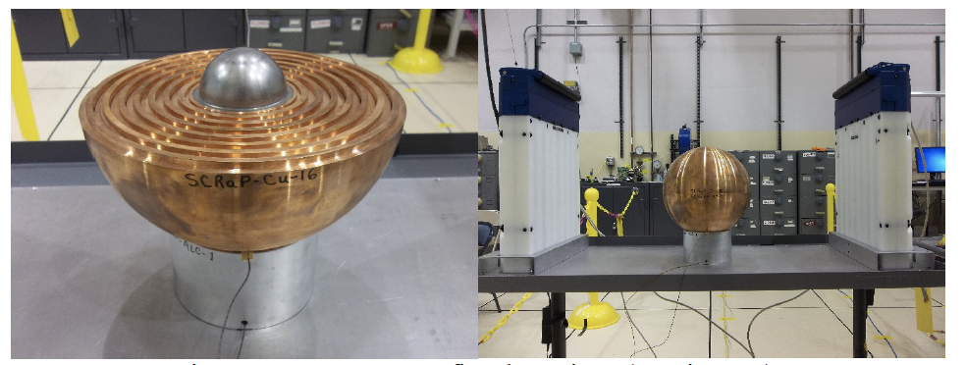
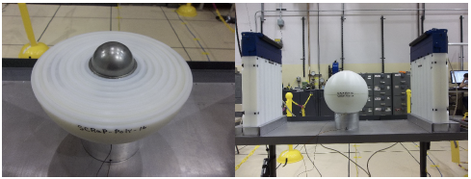
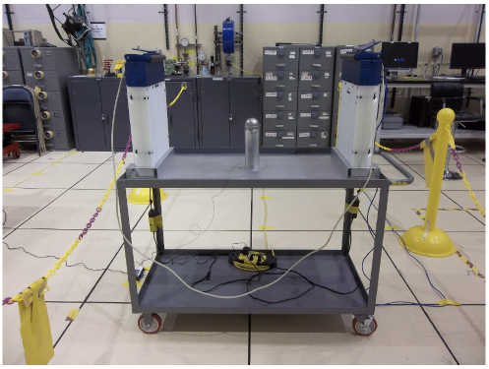
$M_{L}$& $F$ Estimation with Non-point Moments
Leakage Multiplication the number of neutrons leaking from the system per initial source particle
Three configurations of the BeRP ball were simulated
Bare metal sphere
Metal sphere moderated by 1-inch HDPE
Metal sphere reflected by 1-inch Cu
Derived a set of point kinetic model (PKM) equations relating factorial moments to $M_{L}$ and $F$
Consistent with the equations implemented in PARTISN
Figure 2. Various configurations of the LANL BeRP ball illustrating the models simulated for analysis

Slide 4
PKM Estimation of $M_{L}$& $F$
Table 1. $M_{L}$ estimation of various BeRP ball configurations using non-point moments with PKM equations
True leakage multiplication ($M_{L}$) was estimated from MCNP using a fixed source F1 tally
 | Bare BeRP | 1in HDPE | 1in Cu
MCNP F1 Tally | 3.05 | 5.06 | 5.09
Moment Estimate | 3.32 | 4.25 | 5.51
Error | 8.85% | 16.00% | 8.25%
Table 2. $F$ estimation of various BeRP ball configurations using non-point moments with PKM equations
True spontaneous fission source strength ($F$) was obtained from PARTISN input data
 | Bare BeRP | 1in HDPE | 1in Cu
PARTISN Input | 28.19 | 28.19 | 28.19
Moment Estimate | 25.69 | 24.17 | 25.93
Error | 8.88% | 14.25% | 8.02%

Slide 5
Can we improve on the point model?
PARTISN Input Template
The inverse problem is complex, but deterministic approaches for computing NMC moments are efficient and computationally inexpensive
Can machine learning (ML) be leveraged to help address this challenge?
A workflow was developed to generate a dataset for ML training and testing
Three BeRP ball configurations (Bare, 1in HDPE, 1in Cu)
BeRP ball radius is parameterized to achieve various multiplications
True BeRP ball radius was not included in dataset
Various regression algorithms were explored (ex. linear regression, polynomial regression, K-nearest neighbor and decision tree)
Generate PARTISN input files
Bash
Generate slurm submission scripts
Submit to HPC
PARTISN
Compute NMC Moments
Extracts moments from outputs
Python
Generate dataset and train ML model
Predict ML and F from moments

Slide 6
Machine Learning Model Estimation of $M_{L}$& $F$
Table 3. 4 moment $M_{L}$ estimation for various Pu samples using a decision tree model trained on BeRP ball data
 | Bare BeRP | 1in HDPE | 1in Cu | 80% ²³⁹Pu 20% ²⁴⁰Pu
MCNP F1 Tally | 3.05 | 5.06 | 5.09 | 2.77
PKM Estimate | 3.32 | 4.25 | 5.51 | 3.13
DT Prediction | 3.08 | 4.77 | 5.21 | 2.44
Table 4. 4 moment $F$ estimation for various Pu samples using a decision tree model trained on BeRP ball data
 | Bare BeRP | 1in HDPE | 1in Cu | 80% ²³⁹Pu 20% ²⁴⁰Pu
PARTISN Input | 28.19 | 28.19 | 28.19 | 93.70
PKM Estimate | 25.69 | 24.17 | 25.93 | 83.32
DT Prediction | 28.33 | 28.33 | 28.33 | 139.39

Slide 7
Decision Tree Algorithm Performance
Figure 3. 2 moment estimate of $M_{L}$ for various BeRP ball configurations using a DT model trained on model specific datasets
Figure 4. 4 moment estimate of $M_{L}$ for various BeRP ball configurations using a DT model trained model specific datasets

Slide 8
Can we infer more than just $M_{L}$& $F$?
Table 5. Reflector type prediction and model accuracy for two ML classification models
A classification model was trained to distinguish between bare samples and predict moderator type
Various classification algorithms were explored (ex. Decision tree classifier, Support Vector Machine, k-Nearest Neighbor, and Gaussian Naive Bayes)
Generalizations:
Fissile vs. nonfissile distinction
Moderator thickness prediction
Feature importance
 | DT Classifier | KNN Classifier
Bare BeRP | Bare | Bare
1in HDPE | HDPE | HDPE
1in Cu | Cu | Cu
Bare 80-20 ²³⁹Pu:²⁴⁰Pu | Cu | Bare
 | DT Accuracy | KNN Accuracy
Training set | 100% | 100%
Testing set | 100% | 96%

Slide 9
Expected Impact & MTV Impact
The capability to deterministically compute full phase space moments of the neutron count distribution extends existing NMC modeling capabilities
Using ML to infer sample characteristics adds to the arsenal of safeguards and nonproliferation tools and analysis techniques
MTV as facilitated collaborations with LANL
NEN-2: MCNP Modeling
CCS-2: Deterministic Modeling (PARTISN)
XCP-3: PARTISN/MCNP Comparison
LANL Collaborators: Jesson Hutchinson, Nathan Hart, and Erin Davis

Slide 10
Conclusions
Point model predictions of $M_{L}$ & $F$ worsen for heterogenous samples
Estimation is strongly dependent on the accuracy of 1-group data representations
The PARTISN implementation of NMC moments enables the rapid generation of datasets
ML models show great potential for estimating $M_{L}$ & $F$ with improved accuracy over the PKM in addition to predicting sample characteristics not previously accessible
ML approaches require further exploration for practical nonproliferation applications
Optimization is key!

Slide 11
Acknowledgements
The Consortium for Monitoring, Technology, and Verification would like to thank the DOE-NNSA for the continued support of these research activities.
This work was funded by the Consortium for Monitoring, Technology, and Verification under Department of Energy National Nuclear Security Administration award number DE-NA0003920

