Slide 1
Elucidation of Pu Combustion Chemistry and Laser-Particle Interaction for Nonproliferation and Nuclear Forensics Applications
2024 MTV Workshop
March 26, 2024
Justin I. Borrero Negrón^{1*}
Nuclear Engineering Program, University of Florida
EH Kwapis¹, KS Latty¹, J. Darvin², E Villa-Aleman², RW Houim³, and KC Hartig¹
²Savannah River National Laboratory
³Mechanical and Aerospace Engineering, University of Florida
Notes:
Greetings everybody my name is Justin Borrero and I will be presenting on the Elucidations of Plutonium combustion chemistry and laser particle interaction from laser produced plasmas for nonproliferation and nuclear forensic applications. The presentation encompasses the work that my colleagues Emily Kwapis and Kyle Latty and I have been working on along side recent impacts my research group have achieved within the last MTV update\workshop.

Slide 2
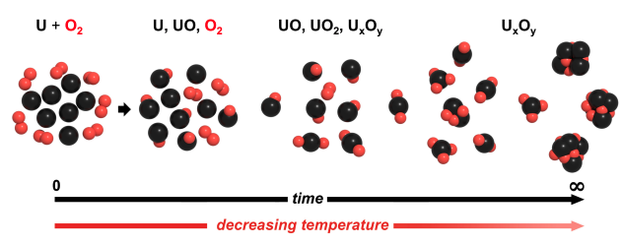
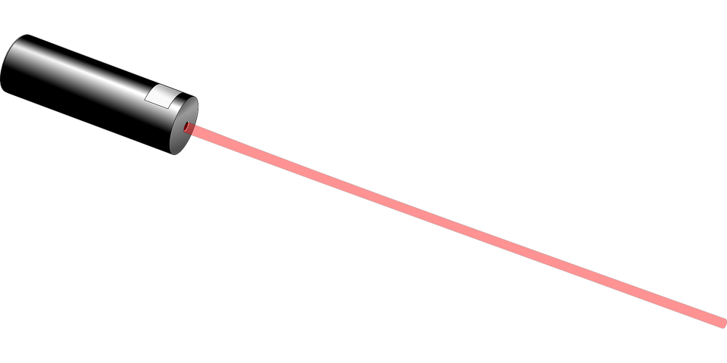
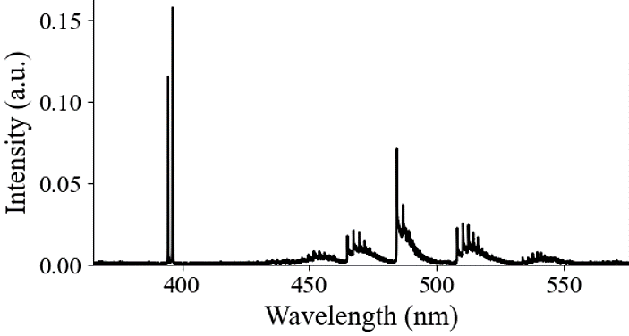
Introduction and Motivation
Laser spectroscopy is a feasible methods for standoff detection of radiological plumes and wide area environmental sampling.
Nuclear (i.e., U, Ce, and Pu) plasmas are highly reactive and readily undergo rapid vapor phase chemical reactions
Proper identification of spectral signatures (e.g., Pu) and a broadened knowledge of laser-particle interactions enhances plume tracking capabilities for nonproliferation applications
Atomic
Molecular
E.J. Kautz et. al., Optical spectroscopy and modeling of uranium gas-phase oxidation: Progress and perspectives, Spectrochimica Acta Part B: Atomic Spectroscopy. 185 (2021) 106283. https://doi.org/10.1016/j.sab.2021.106283.
https://www.beready.af.mil/
Notes:
In the unfortunate event of a radiological release from a nuclear detonation, radiological debris is release and dispersed in the form of nano-to micronized particulates traveling within the radiological plume.
Fortunately, Laser Spectroscopic techniques such as LIBS allows for a feasible method of standoff detection of said radiological plumes as well as the option for a field deployable system for wide environmental sampling which aids in situational awareness for emergency responders.
However, the atmospheric plume comprises of particles undergoing Brownian motion promoting the stochastic nature of laser-particle interaction which is one of the main reasons for collection variability and low-limits of detection while using LIBS. Moreover, Nuclear Fireballs are a highly reactive environment where actinides undergo rapid vapor phase reactions.
Thus, to enhance plume tracking capabilities its important we able to 1. Properly identify spectra signatures of actinide species such as Plutonium and 2. broaden our understanding of laser-particle interactions.

Slide 3
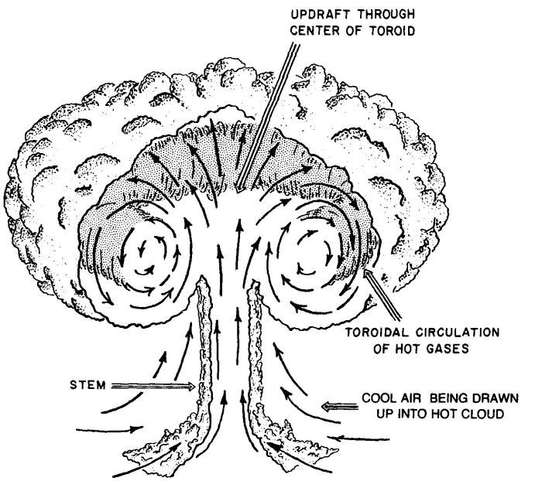
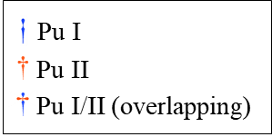
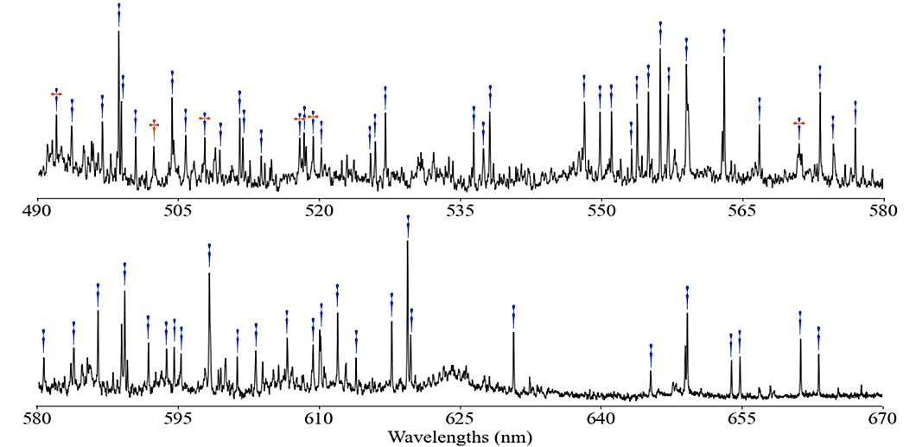
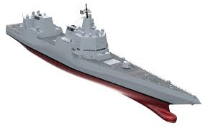
Mission Relevance and Research Objectives
Objective: Investigate ablated particle dissociation mechanisms and identify Pu spectrochemical signatures to improve plume tracking of Pu based nuclear detonations.
Research objectives involve:
Identify and resolve spectral signature associated to molecular formation of Pu_{x}O_{y}
Spatially resolve plasma-particle energy transference of optically trapped particles to improve sampling efficiency
Aim to address the NNSA’s Defense Nuclear Nonproliferation mission by enhancing:
Current knowledge of Pu optical signatures and its high-temperature vapor chemistry
Plume tracking capabilities to assist rapid post-detonation and/or release response
Notes:
That being said, what is our research objective and its relevance to the NNSA mission?
The objective is to: to investigate the ablated particle dissociation mechanism of singly isolated particles and to identify Pu spectrochemical signatures to improve plume tracking of Pu based nuclear detonations.
So our specific research objectives involve: the identification and resolution of spectral signatures associated with the molecular formation of Pu_{x}O_{y} and the second objective is to spatially resolve plasma-particle energy transference of optically trapped particles to improve sampling efficiency.
Our work aims to address the NNSA Defense Nuclear Nonproliferation mission by enhancing: 1.) Current Knowledge of Pu optical signatures and its high-temperature vapor chemistry, and 2.) enhance plume tracking capabilities for rapid post-detonation responses though understadning laser-particle interaction mechanisms.
.

Slide 4
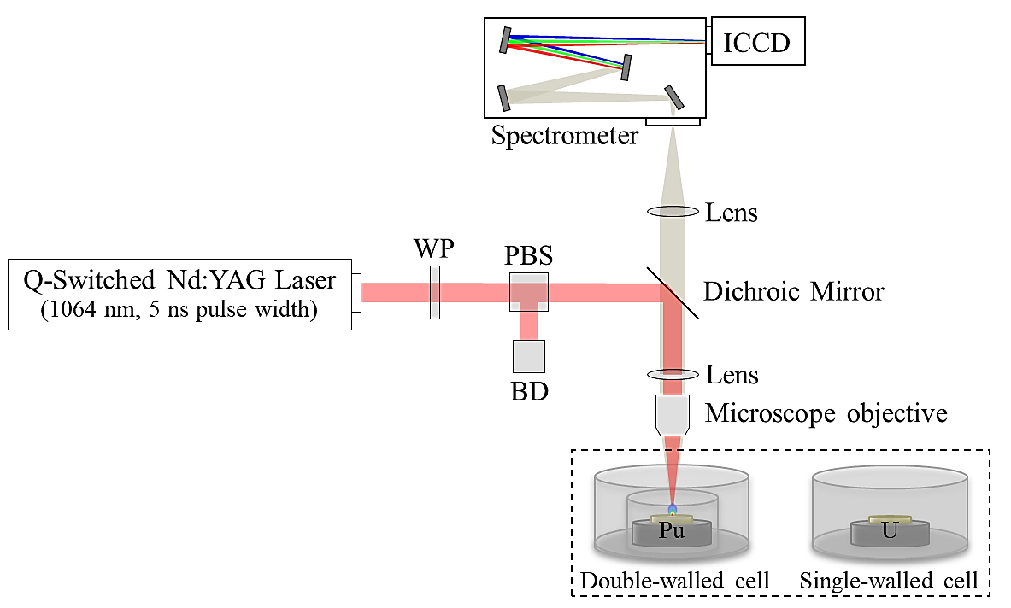
Technical Approach: Resolving Pu Vapor-Phase Chemistry
Sample:
Pu(IV) oxalate calcined to PuO₂
20 mg of PuO₂ pelletized into disks
LIBS Setup:
10 Hz – 1064 nm – 5 ns Nd:YAG Laser
Low energy LIBS (500 $μJ$) used to extend the usable lifetime of the limited actinide samples
<100 µm spot size
Spectrometer and Emission Lines:
Instrumental linewidth at 435.83 nm is either 280 pm FWHM (600 g/mm grating) or 150 pm FWHM (1200 g/mm grating)
Isotope | Weight Percent
Pu-238 Pu-239 Pu-240 Pu-241 Pu-242 | 0.442567% 79.09877% 19.03038% 0.502917% 0.925367%
760 Torr Air
Notes:
The methodology in coming about in resolving Pu vapor phase chemistry and identifying the associated spectrochemical signatures, we rely on the use of a conventional LIBS solid ablation experimental setup as observed here on the right.
With courtesy of Savannah National Lab, microscopic laser ablation of a PuO2 samples was possible. the samples mainly comprised o roughly 80% Pu-239 and 20% Pu-240 making it an appropriate sample close weapons grade plutonium. The chamber designed for these experiments is a patent pending double wall cell that I capable of containing hazardous radiological material while allowing transmission of a pulsed laser for in-situ spectroscopic analysis. Ablation was conducted using a 10Hz Q-switched 1064nm YAG Laser at a low energy of 500uJ In order to extend the lifetime of the sample, its important to notice that the focusing component is a microscope objective, which allows for a microscale ablation that results in a smaller spot size and shorter-lived plasma which also contribute to sample conservation.

Slide 5
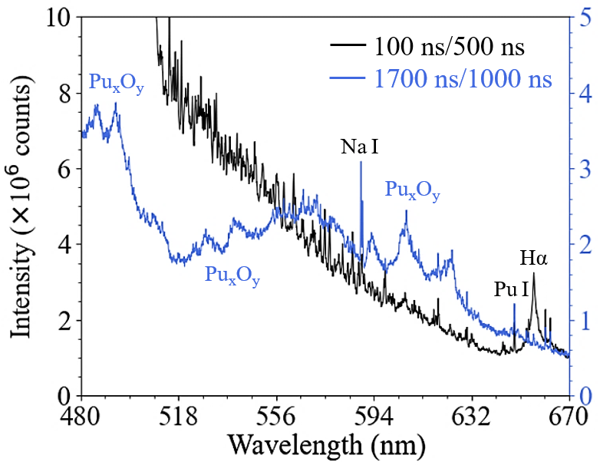
Results: Pu_{x}O_{y} Spectral Signature Identification
LIBS measurements are performed within a controlled atmosphere
760 Torr air
Possible chemical reactions include the formation of either Pu_{x}N_{y} or Pu_{x}O_{y}
Formation of oxides is typically strongly favored over the formation of nitrides for metal and U LPPs
Triangular molecular features identified very likely represent several Pu_{x}O_{y} ro-vibronic transitions
Successful identification of multiple Pu_{x}O_{y} bands at lower wavelength in the visible region than previously reported
Previously unidentified Pu_{x}O_{y} bands
E Villa-Aleman, EH Kwapis, BJ Foley, et al. Laser-Induced Plasmas of Plutonium Dioxide in a Double-Walled Cell. Applied Spectroscopy. 2024;78(4):412-422.
Notes:
LIBS measurements were conducted at atmospheric conditions and resulted in two spectra, one at 100ns and second at 1.7us. At early times you can readily see an atomic Pu signal far off at the right of the spectra however at these early times you wouldn't really expect to see molecular formation. At later times you can see molecular band come to light. Now previous research have already identified PuO species around 600nm however new band were identified in this work at lower regions of the visible spectrum.
Possible chemical reactions can either be PuN or PuO formation, however under present conditions the formation of oxides is typically favored,

Slide 6
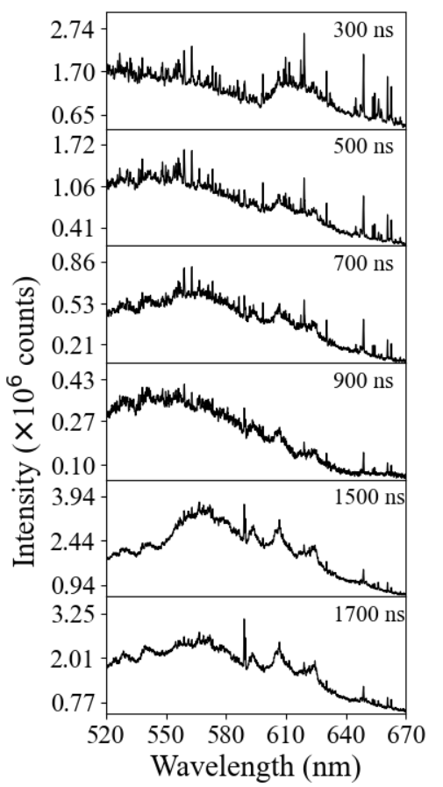
Results: Pu_{x}O_{y} Phase Assignment
PuO_{x}
PuO_{x}
300 ns/500 ns
Phase identification deduced from thermodynamics and dissociation properties of vapor-phase molecules
Molecules with higher dissociation energies form at earlier times when plasma temperature is hotter
Theoretical dissociation energies ($D_{o})$ for PuO_{x}:
$D_{o, PuO}= 600−700$kJ/mol
$D_{o, PuO_{2}}=550−600$kJ/mol
$D_{o, PuO_{3} \& PuO_{4}}<400$kJ/mol
PuO₃ (g) and PuO₄ (g) are believed to be unstable and readily transform to Pu₂O₇ (g)
Conclusion: Molecular bands observed are believed to correspond to either PuO or PuO₂
500 ns/500 ns
700 ns/500 ns
900 ns/500 ns
1500 ns/1000 ns
1700 ns/1000 ns
E Villa-Aleman, EH Kwapis, BJ Foley, et al. Laser-Induced Plasmas of Plutonium Dioxide in a Double-Walled Cell. Applied Spectroscopy. 2024;78(4):412-422.
Notes:
The next step in identifying spectral signatures of molecular bands is to identify their phases. One way we can come about this is by deducing them from thermodynamics and dissociation properties that are quantum chemical computation.
Here we can see that energy dissociation range for PuO and as we know, molecules with higher dissociation energies form a lower temperatures. Thus, we can infer that it is most likely that these PuO bands are associated to either PuO or PuO2.

Slide 7
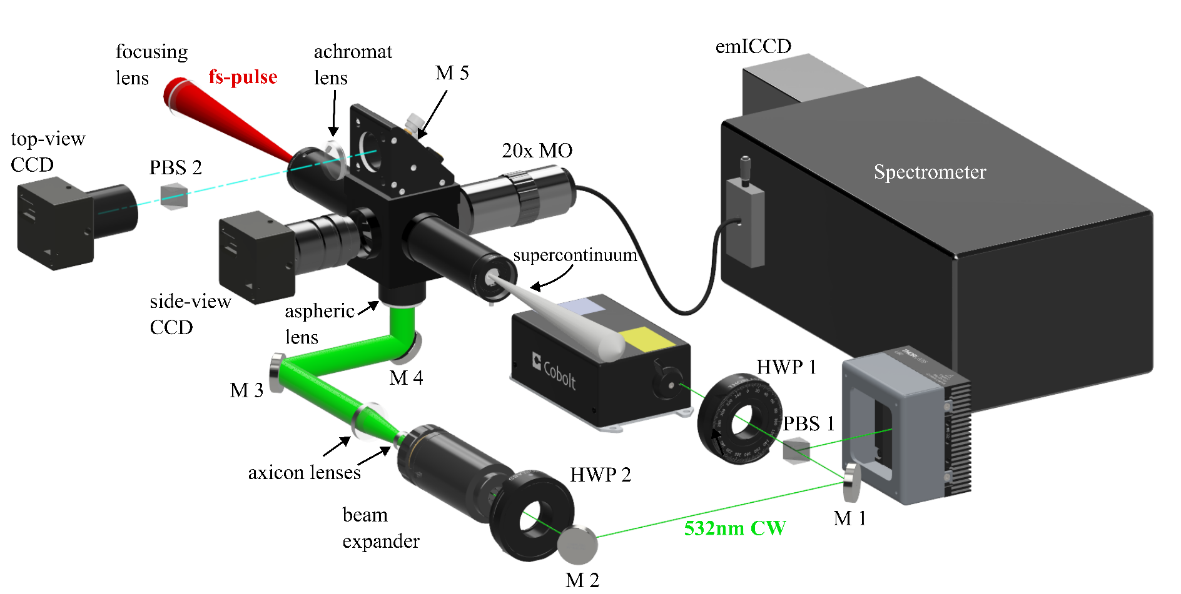
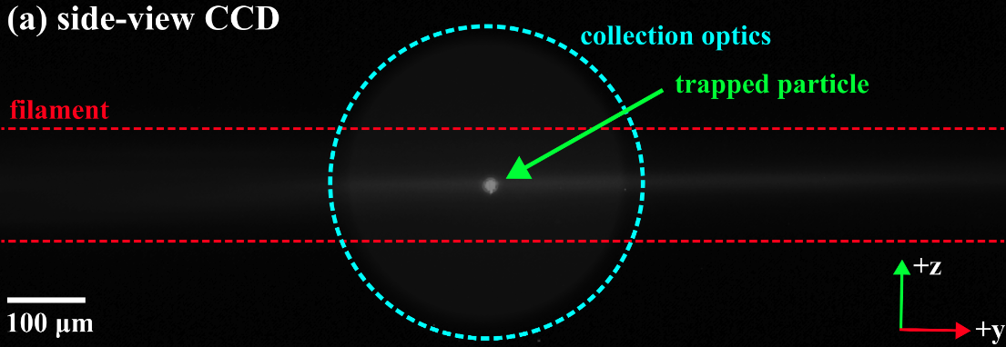
Technical Approach: Plasma-Particle Interaction of Suspended Particles
Sample:
1-5$μm$ CuO powder
Optical Trapping Setup:
1 W – 532 nm CW Gaussian beam converted to Bessel Beam via Dual Axicon Lenses
Vertical photophoretic trapping scheme
3 degree of freedom ($±$ x,y,z) for beam-particle alignment
LIBS Setup:
800 nm – 35 fs Laser operating at 5.3 mJ – 0.15 TW
Short to long focusing length (50 – 300 mm) used
Notes:
With the idenfication of PuO band and their phases, we now look into plasma-particle interactions of optical trapped particles. For standoff detection of airborne particulates, the use of ultra fast filament laser are used due to its ability for a stable light source that able to propagate kilometers away. Essentially a filament is a tightly focused ultrashort pulsed laser that creates a column of light from the the N2+ flourencse along the path of the focal length.
The sample that was used were Cupric oxide ranging from 1-5um. Altough the main goal is to suspend actinide sample, the reason we started with Cupric oxide is because the optical trapping forces acting for suspension are the same that actinide particle would be exposed to, thus it’s a good base of experiments before transitioning to the more difficult to procure samples such as U or Pu particles.
The trapping setup uses a vertical propagating 523nm CW gaussian beam that was converted into a Bessel beam with the use Dual axicon lenses. The set up also is capable of 3 degree of movement for particle–laser alignment
For the ablation study, a femtosecond laser operating at 800nm with a 35fs pulse duration was used. By using 50 to 150mm focus length we are able to assess the effect short to loing focal length have on sampling efficiency

Slide 8
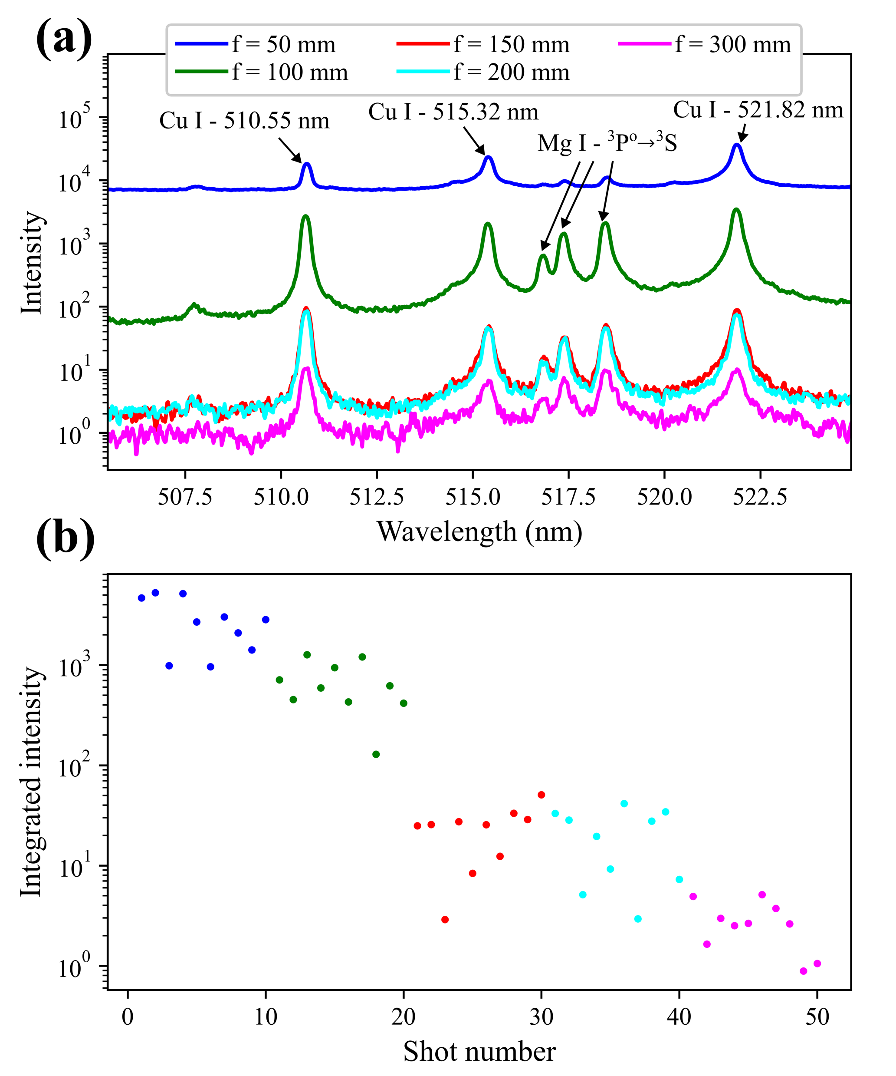
Results: Effect of short and long focusing length on Cu I Emission
Cu I (510 nm) intensity shows a decrease with increasing focal length
F(mm) | I_{510nm} | I_{515nm} | I_{510nm} / I_{515nm}
50 | 2910 | 5680 | 0.52
100 | 677 | 510 | 1.14
150 | 24 | 16 | 1.39
200 | 21 | 11 | 1.68
300 | 2.8 | 1.7 | 2.00
Increase in 510/515 nm intensity ratio suggest:
Downward shift in population of excited states of Cu indicating a decrease in energy deposition.
Notes:
It is commonly observe through ablation of airborne particles, even through short pulse laser such as ns-laser, that the sampling efficiency varies shot-by-shot, and in order for LIBS to utilized a method of standoff detection for radiological releases its important for the sampling to be reproducible. So studying the effects of short and long focusing lengths on Cu I emission lines provides insight to laser-particle interaction for enhance tracking capabilities.
We see that with increasing focal length there's a decrease in in the intensity Cu I(510nm) lines, However to really elucidate the change in energy transference with longer focal length we look at the ratio between 520nm line and the 515nm line. We see that theres an increase in the ratio, since the upper energy level of the 515nm line is about twice of the 510nm, this shows that theres a downward shift in population of excited states of CU, indicating a decreas in energy deposoition.
(make the slides that others can understand, include as much info to make understanding. Why did I do this, make it as nuclear focus as possible)

Slide 9
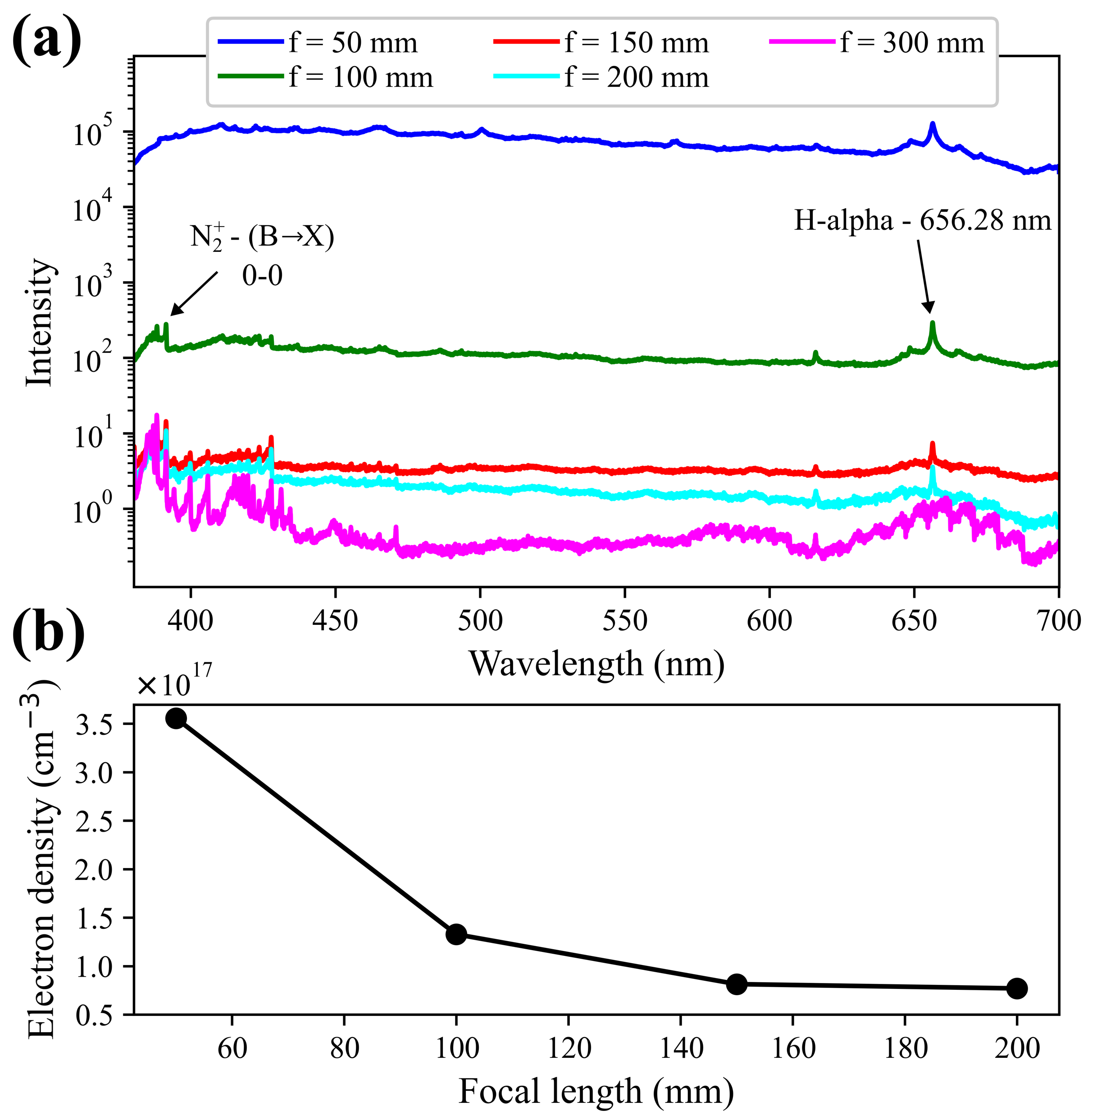
Results: Breaking Point Between Plasma and Laser-Particle Interactions
Decrease in thermal background and electron density indicate:
Drastic changes in plasma characteristics occur under short focal lengths
Does not indicate Cu emission is solely due to plasma-particle interaction
Cu particles (7.72 eV) positioned at N₂⁺ (15.5 eV) result in laser interactions:
Decrease in Cu I at f =150 mm is resulted from emission decaying within the intensity-clamped pulses, as seen during fs-filaments
Emission is cause from limited energy disposition to the surface of the particle
Notes:
By studying the effect of focal length we can show that there are regime at which plasma particle interaction dominates over laser-particle interactions. We see that with increase in focal length theres a drastic decrease in thermal background and electron density indicating that there's drastic changes in plasma characteristics under short focal length. However, although we see a change in overall emission and electron density at longer focal lengths, this doesn’t indicate that plasma-particle interaction is the sole mechanism for emission.
As we increase in foal length, self focusing and intensity clamping are approached through laser filamentation. Thus, the fact that observe emission under these conditions is that the most intense region of the laser field interacts with the surface of the particle where partial energy transference results in Cu I emission.

Slide 10
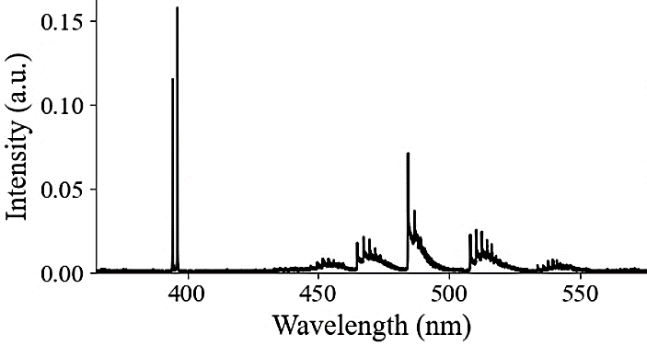
Conclusions and Next Steps
Supports the NNSA nuclear nonproliferation mission by researching optical measurements and signatures towards the characterization of nuclear materials in the environment
Identify Pu spectral signatures and structural phase transitions during plasma evolution
Unravel fundamental laser-particle interaction for standoff detection during short-long focal length of fs-lasers
Future plans and deliverables
Continue studying excitation/dissociation mechanisms of optical trapped particles
Design a universal trapping system for future actinide single particle ablation
Al I
AlO
Notes:
With that our research supports the NNSA nuclear nonproliferation mission by indentifying Pu spectra signatures and phase transitions during plasma evolution ,
We also unravelled fundamental laser-particle interaction for standoff plume detection
Our future plans and deliverables involve, to continue studying excitation and/dissociation mechanism of optical trapped particles
By designing an universal trapping system for future actinide single particle ablation.

Slide 11
MTV Impact and Deliverables (past year)
Two Cover Article Publications
Research Deliverables and Collaborations
2023 INMM Early Career Award: Prof. Kyle C. Hartig
Conference presentations: SciX (x4), CLEO, INMM
Upcoming Conferences: INMM, LIBS 2024, SciX (x3)
Journal publications:
Recently published: EH Kwapis (x3)
In-press: KS Latty (x1)
Research collaborations: SRNL, ORNL, LLNL, SNL, AFTAC, UM
Student Involvement and Accomplishments
PhD Dissertation Defense: Dr. Emily H. Kwapis (Feb. 16, 2024)
Current internships (summer 2024)
Undergraduate students: AFRL, NRL, LANL
Graduate students: SRNL, AFRL
DoD SMART graduate fellowship (x3)
Current & Future Collaborators
E Villa-Aleman, EH Kwapis, BJ Foley, et al. Laser-Induced Plasmas of Plutonium Dioxide in a Double-Walled Cell. Applied Spectroscopy. 2024;78(4):412-422.
EH Kwapis, J Borrero, KS Latty, HB Andrews, S Phongikaroon, KC Hartig. Laser Ablation Plasmas and Spectroscopy for Nuclear Applications. Applied Spectroscopy. 2024;78(1):9-55.
Notes:
So our group has had a busy year. From conferences to publications and we continue our hardwork by participating in upcoming conferences and collaborative work. There are some highlights worth mentioning though, My PI professor Kyle Hartig was recently awarded the 2023 INMM early Career Award, Emily Kwapis recently defended her PhD dissertation and finally we were able to publish two cover Articles, 1.) a review article on laser ablation plasma and spectrscopy for nuclear applcations, which is in collaboration with ORNL, and 2.) laser induced plasmas of plutonium dioxide in a double-walled cell, in collaboration SRNL.

Slide 12
Acknowledgements
The Consortium for Monitoring, Technology, and Verification would like to thank the DOE-NNSA for the continued support of these research activities.
This work was funded by the Consortium for Monitoring, Technology, and Verification under Department of Energy National Nuclear Security Administration award number DE-NA0003920
Notes:
Thank you university of Michigan for hosting the MTV workshop.

