Slide 1
Explosion Detection using Ensemble Learning
2024 MTV Workshop
(03/26/2024)
Samuel Kei Takazawa
MTV Graduate Fellow, University of Hawaiʻi at Mānoa
Milton A. Garces¹, Luis Ocampo Giraldo², Jay Hix², David Chichester², Scott Thompson², Cleat Zeiler³
¹University of Hawaiʻi at Mānoa, ²Idaho National Laboratory, ³Nevada National Security Site

Slide 2
Introduction and Motivation
Big picture, what are the underlying reasons for the work?
Develop a machine-learning (ML) models for the prompt detection of explosions
Improve accuracy and reduce false positive rates for the model
What is the fundamental problem you are trying to solve?
Real time explosion detection using smartphones
No comprehensive training set has been developed to identify explosions

Slide 3
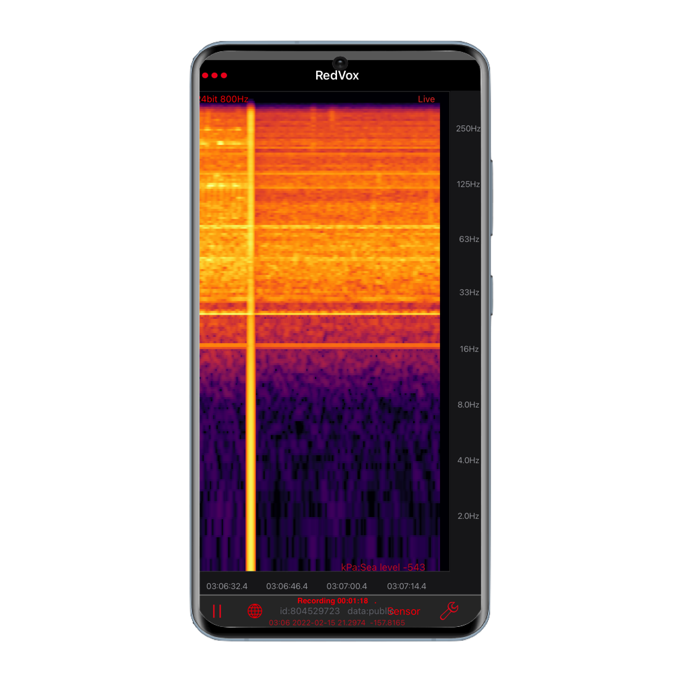
Mission Relevance
How does this work, and the problem you are trying to solve, relate to the NNSA mission?
Explosion detection is a vital part of non-proliferation monitoring
Utilize smartphones as ubiquitous sensors network for explosion detection

Slide 4
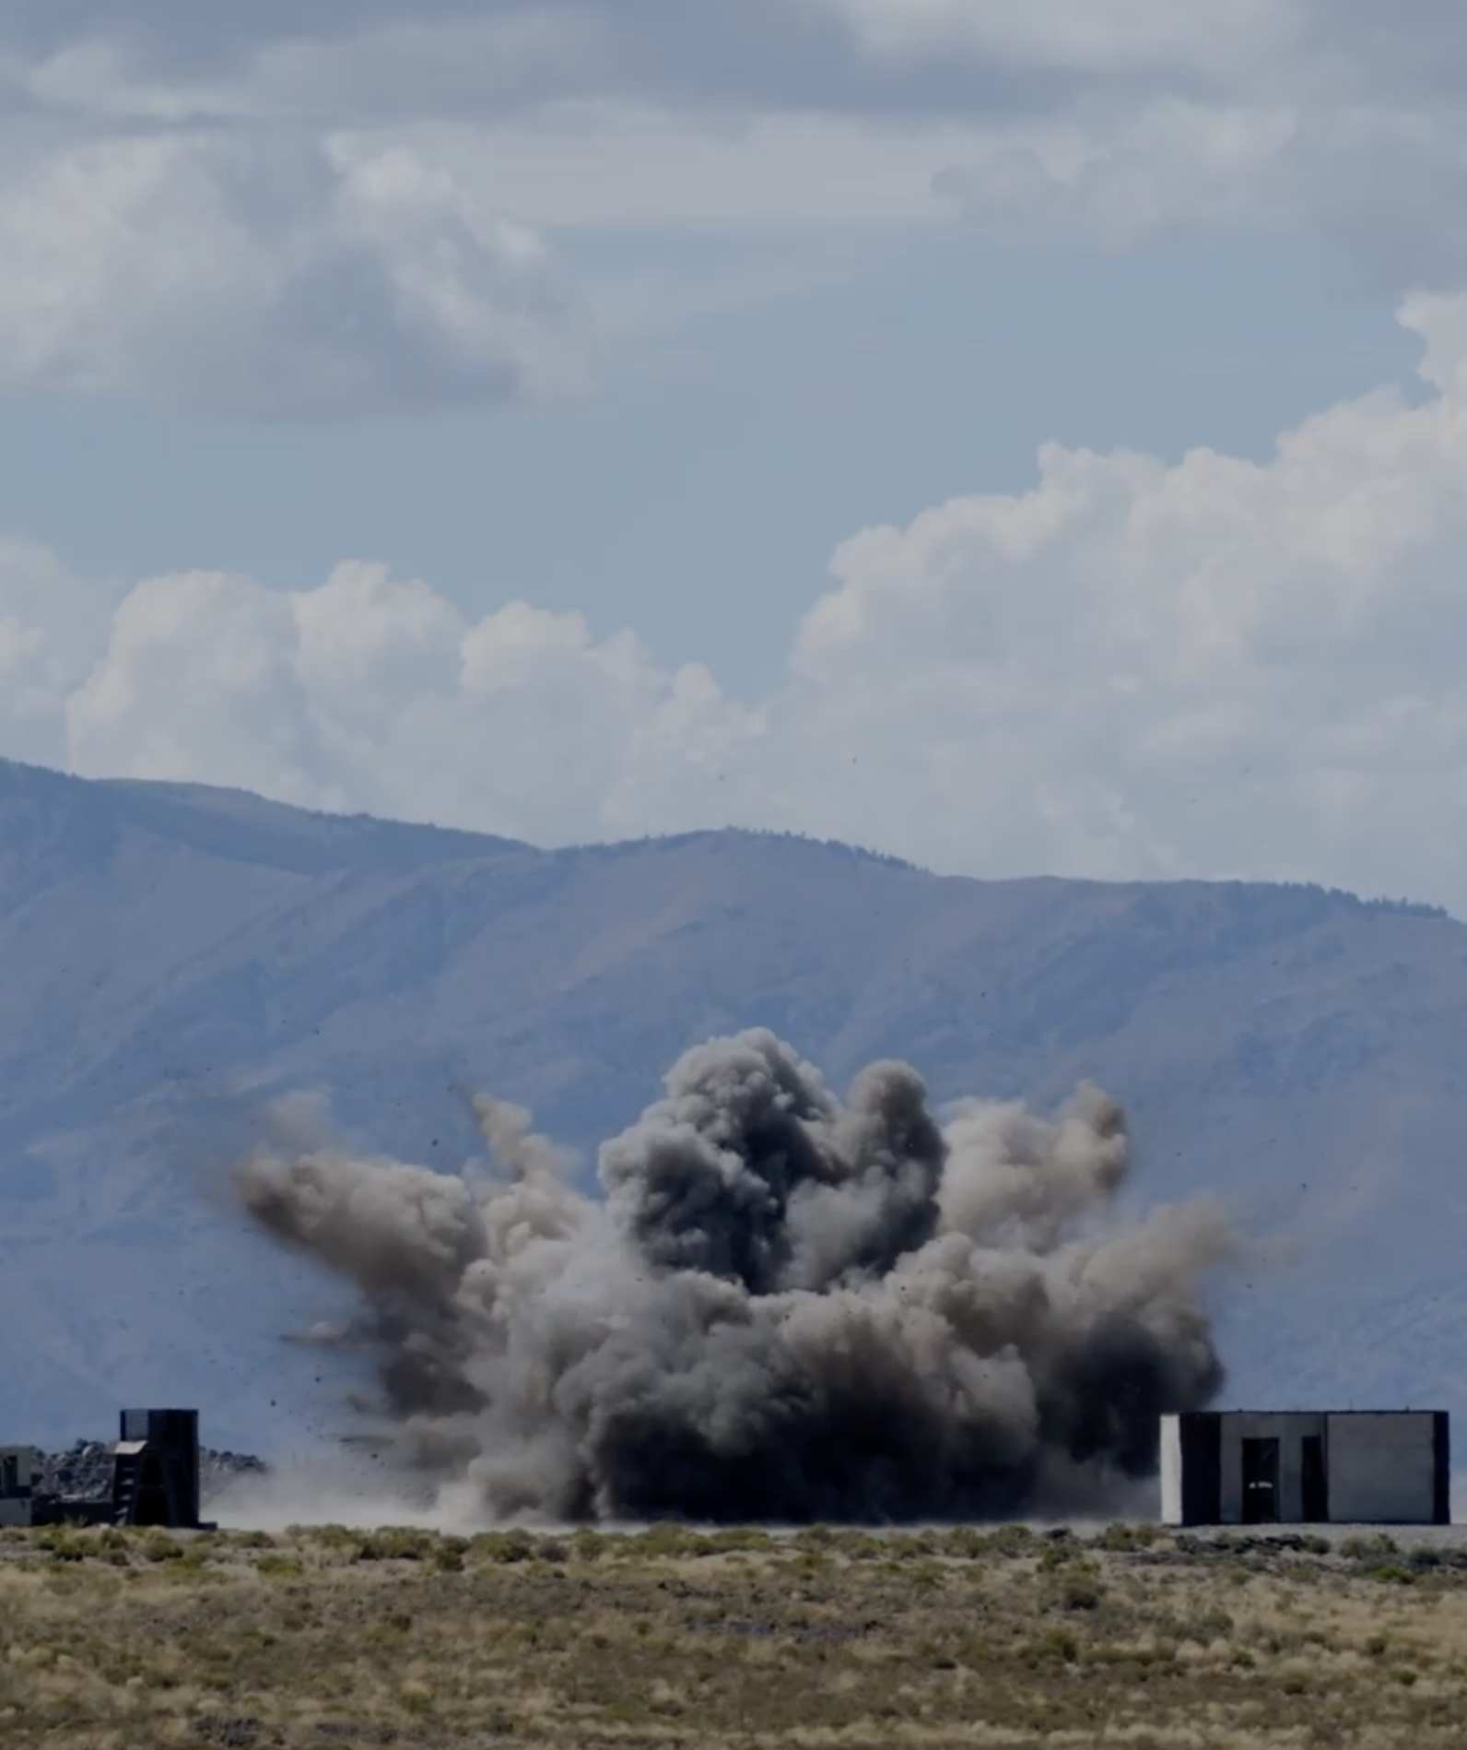
Background Terms
Transfer Learning
ML method using a pre-trained model as the start for a new model
Compensates for smaller amounts of available data
Ensemble Learning
ML method which combines trained machine learning models
Improves accuracy by reducing limitations from individual models
YAMNet
A pre-trained neural network that classifies audio data.
521 classes from over 2 million human-labeled sound clips.
ESC-50
A label collection 2,000 environmental audio recording from 50 classes
Broad categories: Animal, Human, Nature, Domestic, Urban

Slide 5
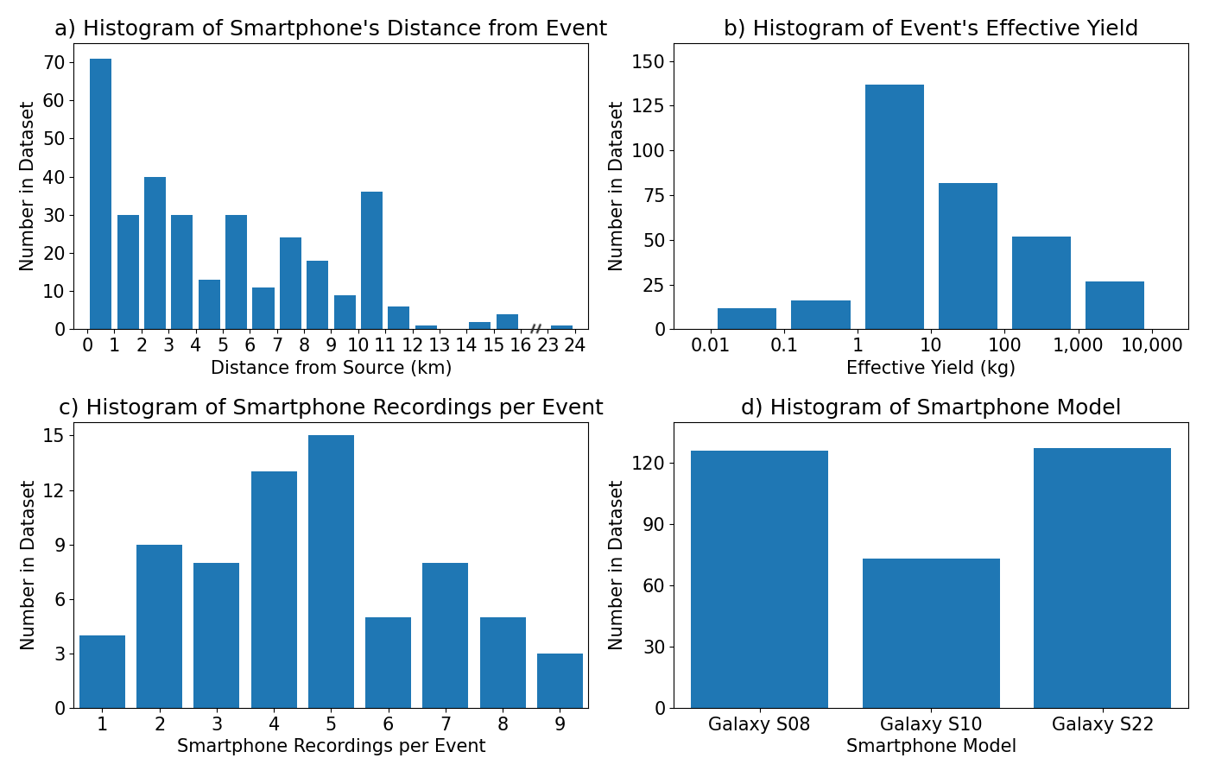
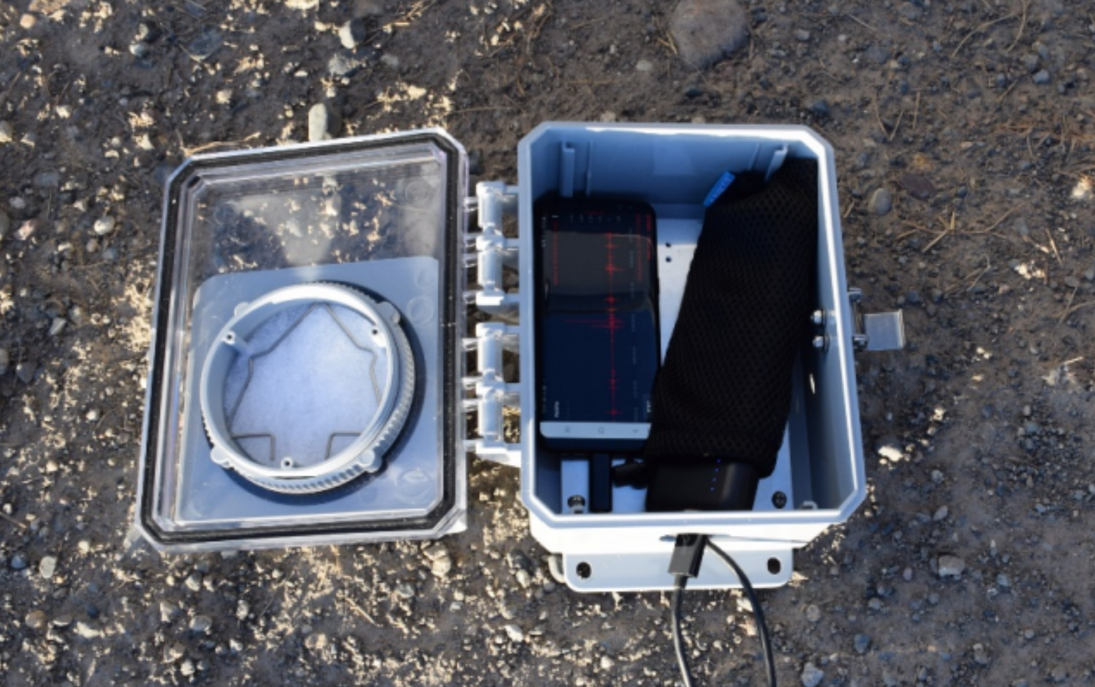
Smartphone Explosion Data
Explosions collected at:
Idaho National Laboratory
Nevada National Security Site
Recorded with RedVox App
Sample Rate (800 Hz / 8000 Hz)
326 explosion waveforms from 70 explosion events

Slide 6
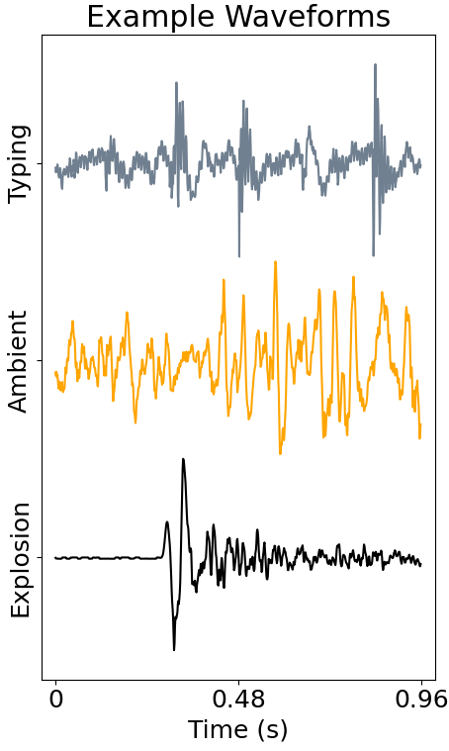
Training Data
Data Used for Training:
Explosion Data
Up-sampled for YAMNet Transfer Learning
Down-sampled Low Frequency Network
Ambient Data
Taken either before or after the explosion
ESC-50 Data
All the different categories were labeled as “other”
Data Split
Train (60%), Validation (20%), Test (20%)
Explosion and Ambient are split by event
Other
Ambient
Explosion

Slide 7
Machine Learning Models
YAMNet Transfer Learning
16 kHz sample rate data
Embeddings to dense layer
Pros:
Pre-trained model
Cons:
Ignores frequencies < 125 Hz
Low Frequency Network
800 Hz sample rate data
1D convolution to dense layer
Pros:
Uses the whole input data
Cons:
Limited number and sample rate

Slide 8
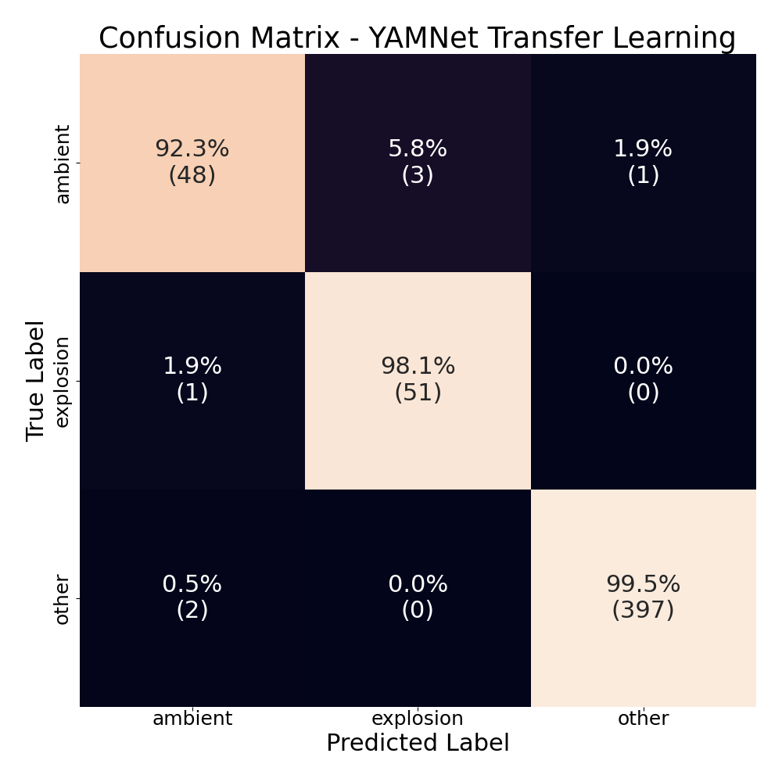
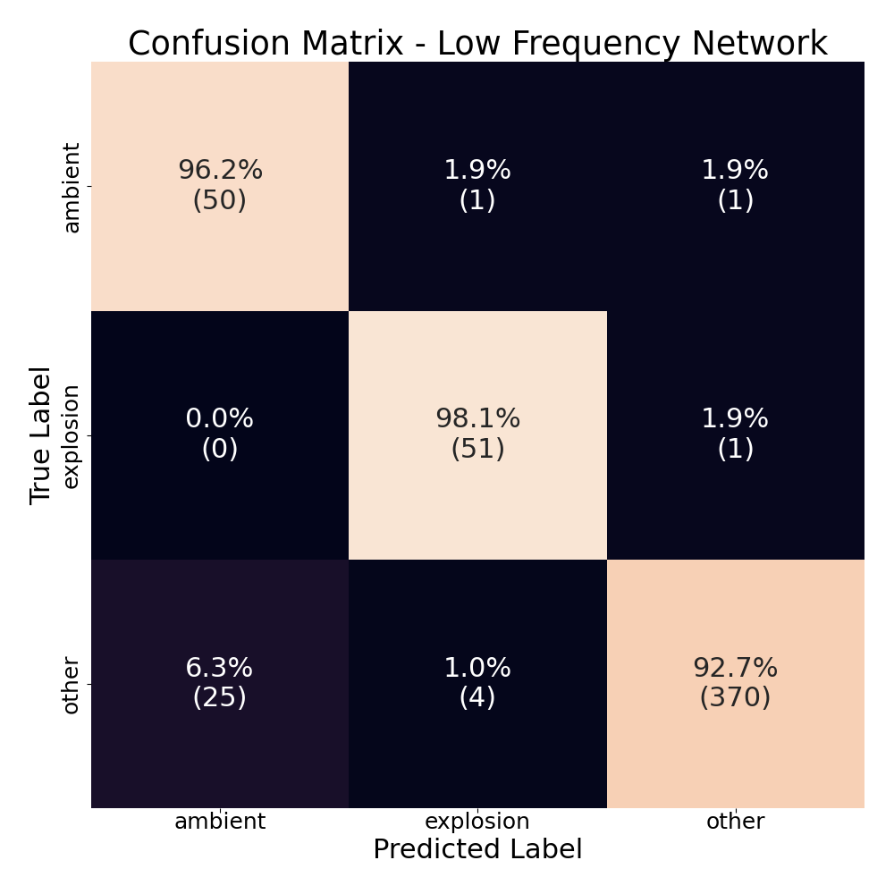
Results
Accuracy: 96.6 %
Accuracy: 95.7 %

Slide 9
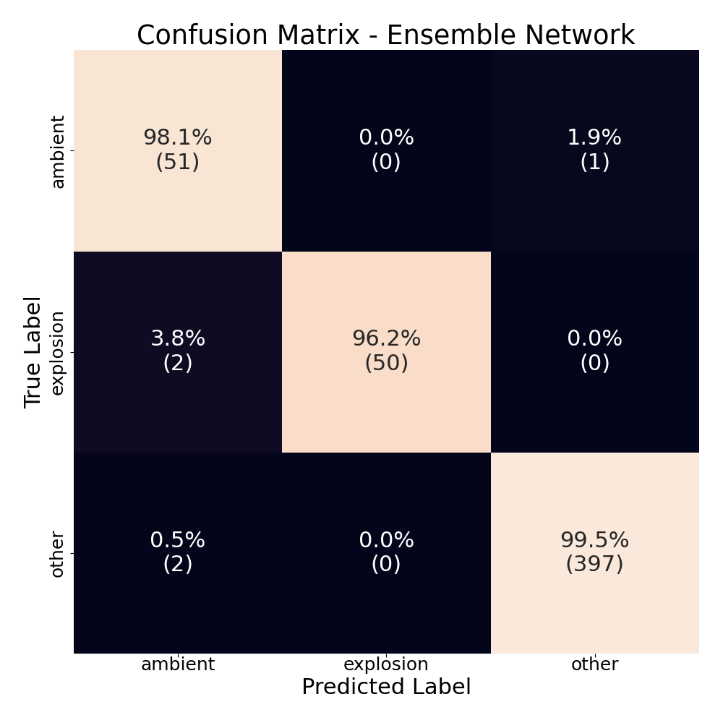
Results – Ensemble
Explosion
If both models predict explosion
Other
If YAMNet model predicts “other”
Ambient
All other cases
Accuracy: 97.9 %

Slide 10
Expected Impact / MTV Impact
Machine Learning Model for Explosion Detection
Ensemble learning has proven to effectively increase the reliability of explosion detection from false positive cases.
MTV
Data collection partnerships
Idaho National Laboratory (internship)
Nevada National Security Site (visit)
Continued research on the performance of the ML models
Real-time tests on the sites
Adding more data to the current explosion database

Slide 11
Conclusion / Next Steps
Improvements with Ensemble Learning
More robust model for deployment
Reduced false positive rate
Higher accuracy
Future Tests with the Ensemble Model
Testing the ensemble model on smartphones for live detection
Detection algorithm based on a network of smartphones

Slide 12
Acknowledgements
The Consortium for Monitoring, Technology, and Verification would like to thank the DOE-NNSA for the continued support of these research activities.
This work was funded by the Consortium for Monitoring, Technology, and Verification under Department of Energy National Nuclear Security Administration award number DE-NA0003920

