Slide 1
HITMAN: Bridging Analytic and Deep Learning Inference Techniques for Optical Neutrino Detectors
2024 MTV Workshop
March 26th, 2024
Garrett Wendel
Doctoral Candidate, Penn State
Prof. Douglas Cowen, Penn State

Slide 2
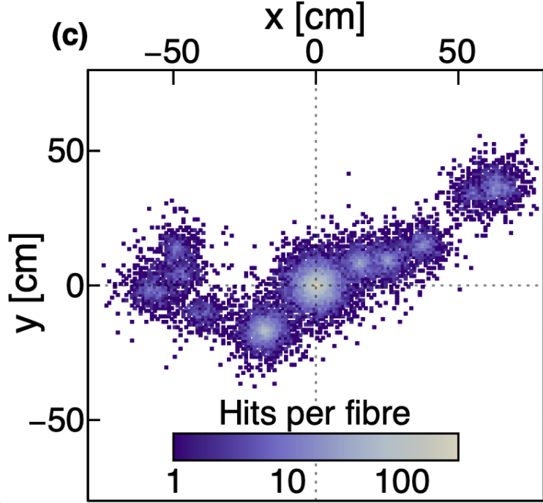
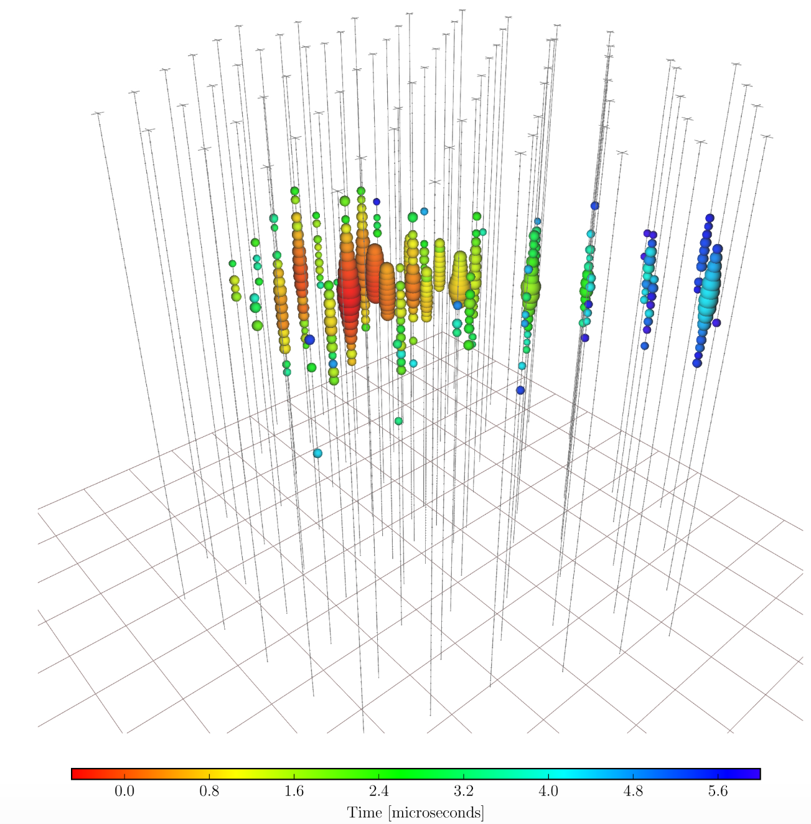
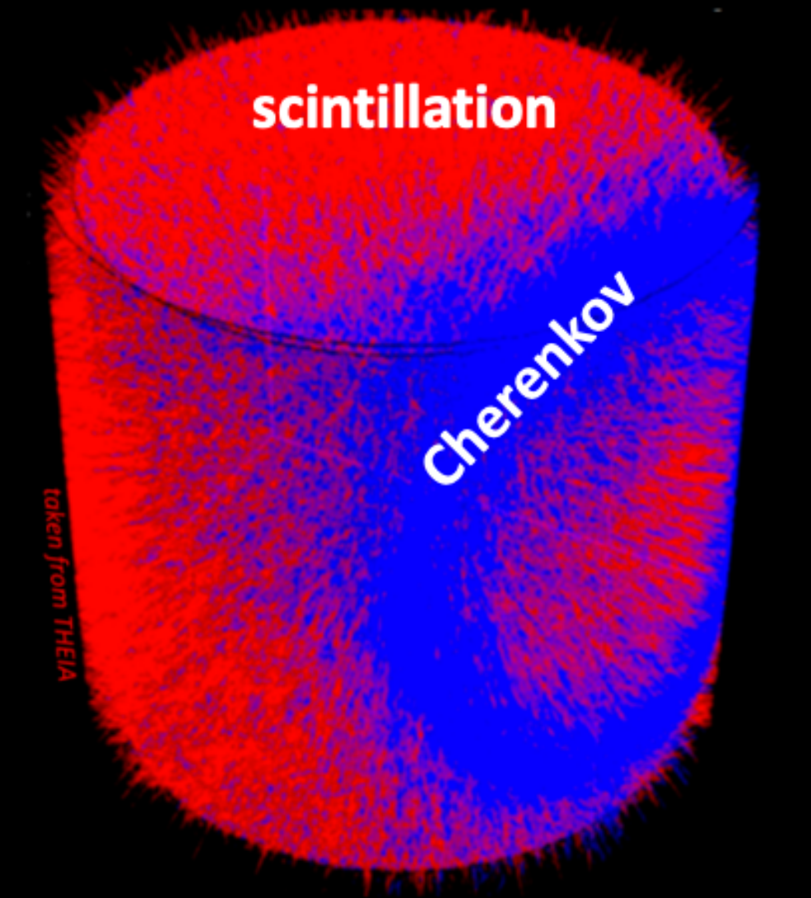
Inference in Novel Particle Detectors
Modern optical particle detectors yield intricate spatial and temporal data
Advances in materials, photosensors, and geometries have improved measurements
Monte Carlo models for complex interactions describe detector response
Challenge: Fully utilize detector signal by extracting detailed features directly from Monte Carlo output.
Event displays for various neutrino detectors:
[1]
[2]
[3]

Slide 3
Mission Relevance
HITMAN (Highly-parallelizable Inference Technique for Monitoring AntiNeutrinos)
Quantification of performance for novel detection technologies:
AIT/NEO (LLNL)
Eos (LBL, BNL, LLNL)
LiquidO
Reconstructions for antineutrino detections for reactor monitoring
U/Pu Composition of fuel, Reactor on/off monitoring
Reconstruction method applicable to arbitrary optical particle detectors
Framework for supporting R&D efforts for new detection technologies

Slide 4
The Inference Problem:
For a given particle event we have:
Observables $x:$[Photon arrival time, location, wavelength, …]
Hypothesis $θ$: [particle interaction vertex, direction, energy]
HITMAN combines two techniques to infer particle kinematics from complex detector outputs [4]
Neural ratio estimators (NRE) [5]
Extended Maximum Likelihood (EML) decomposition [6]
Observables: $x$
Particle Hypothesis :$θ$
$$p$$
$n$
$$\overline{ν_{e}}$$
$$β^{+}$$

Slide 5
Combining NRE & EML
Neural Ratio Estimators:
Information theoretic approach to density estimation
Leverages deep learning tools with hardware acceleration capabilities
Extended Maximum Likelihood:
Operates on a per-photon basis: Condenses input parameter space to ~10 dimensions, irrespective of detector geometry and channel count.
$$EML=L_{c}(θ|N_{t})∗ \prod_{photon}{L_{h}(θ|x_{photon})}$$
Total Detector Charge (Chargenet)
Information per photon (Hitnet)

Slide 6
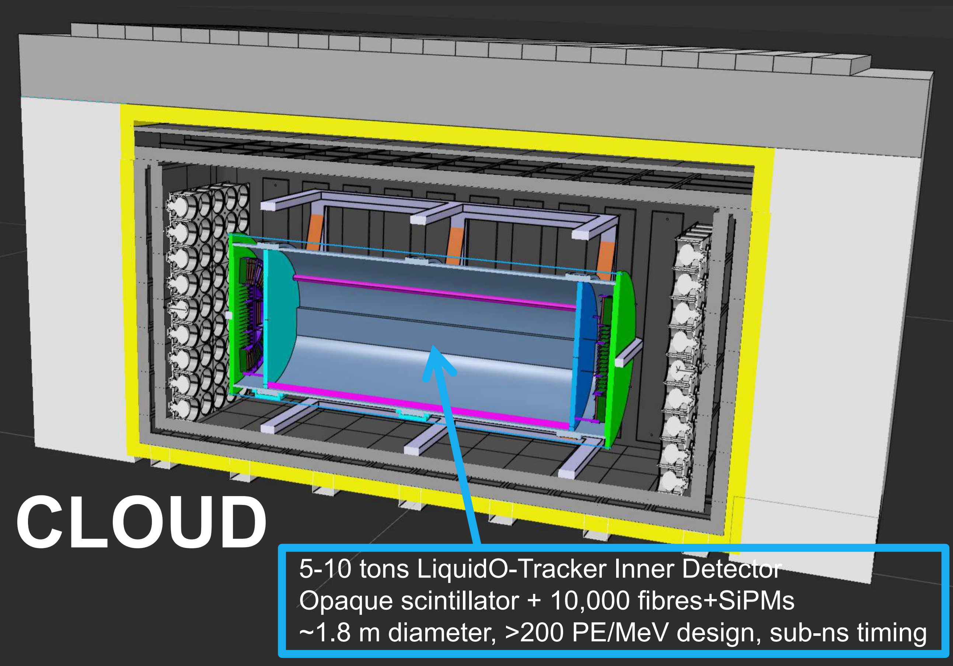
HITMAN Applied to CLOUD
Reactor ${\overline{ν}}_{e}$ measurement with LiquidO technology
35m offset from Chooz-B
10k ${\overline{ν}}_{e}$ interactions per day
Reactor characterization
Reactor-fuel monitoring
(J. Hartnell)

Slide 7
Example Study: CLOUD Stereo Layers
Non-Stereo Layers:
Use HITMAN to reconstruct events in two different geometry configurations:
Non-stereo layers, only timing information about z
Alternating stereo layers (20° tilt), timing and spatial information for z
Expectation for Stereo z Resolution:
$∝1/sin(θ_{tilt})$
Photosensors
Wavelength Shifting Fibers
Target Volume
Stereo Layers:
$$z$$
$$θ$$
$$y$$
$$x$$

Slide 8
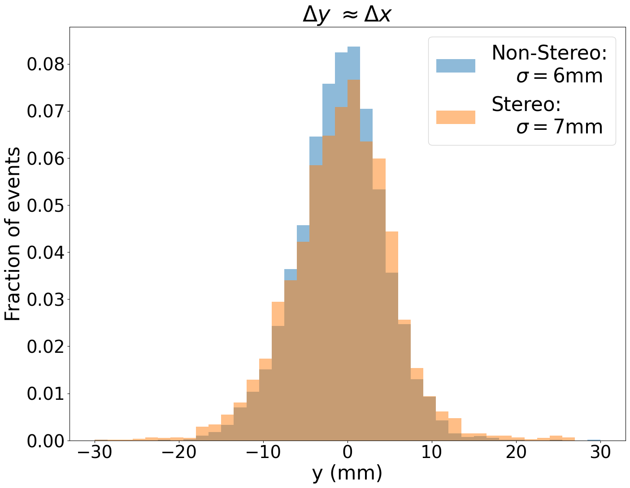
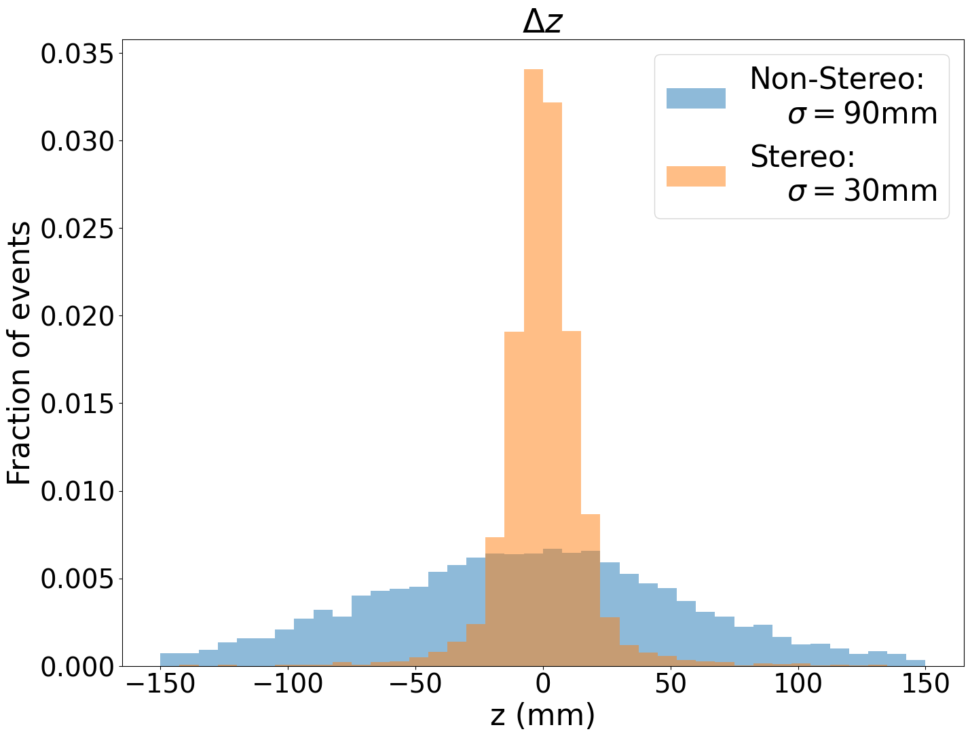
Results
PRELIMINARY
PRELIMINARY
Expectation: $σ_{z stereo}≈\frac{σ_{y stereo}}{\sin{(θ_{tilt})}}≈20mm \text{🗹}$

Slide 9
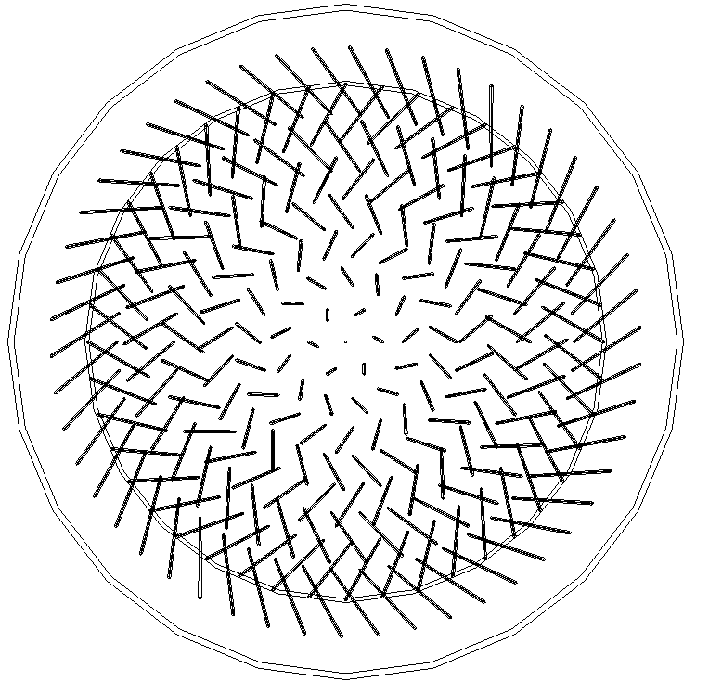
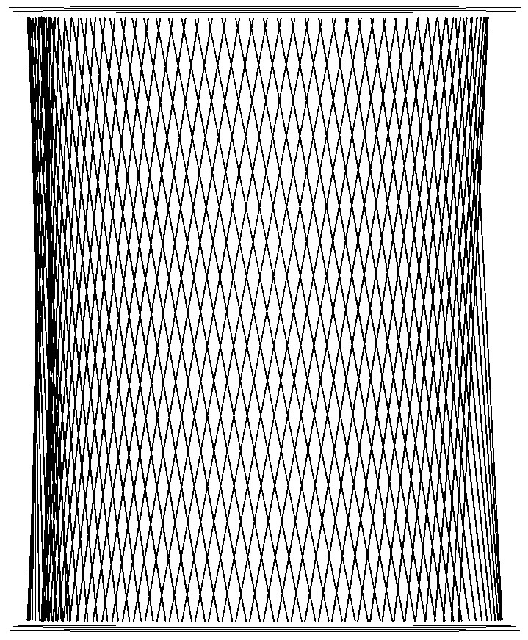
Conclusion
HITMAN suitable for in LiquidO style detectors
Enables studies of advanced stereo geometries
Translate kinematic performance to reactor characterization capabilities in CLOUD
Ethos from last presentation holds true:
“If you can simulate your detector, we can reconstruct it”
Advanced stereo geometries
(S. Wakely)

Slide 10
Impact of HITMAN
Studying physics sensitivities:
Eos – hybrid Cherenkov/Scintillation scintillator, wavelength sensitive PMTs, High QE fast timing PMTs, etc.
LiquidO/CLOUD –scattering scintillator, localized event topology, >10,000 channels
Calibration: Tuning of Monte Carlo models with known source reconstructions
Deployment: Unknown source characterization through event kinematics and event rate resolutions determine interrogation capabilities

Slide 11
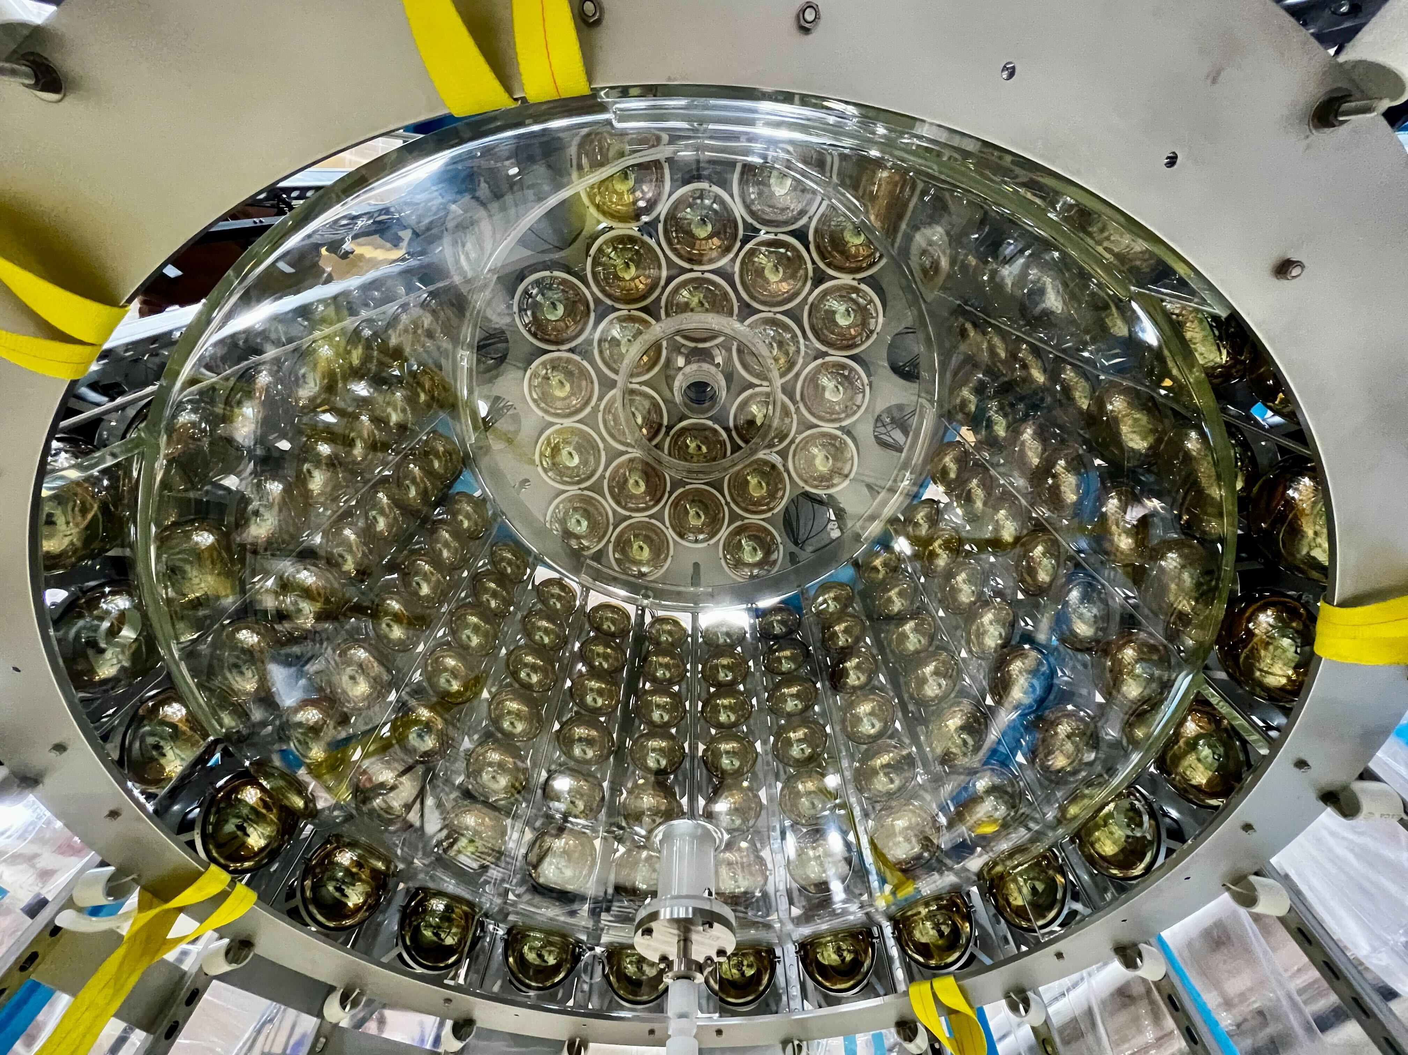
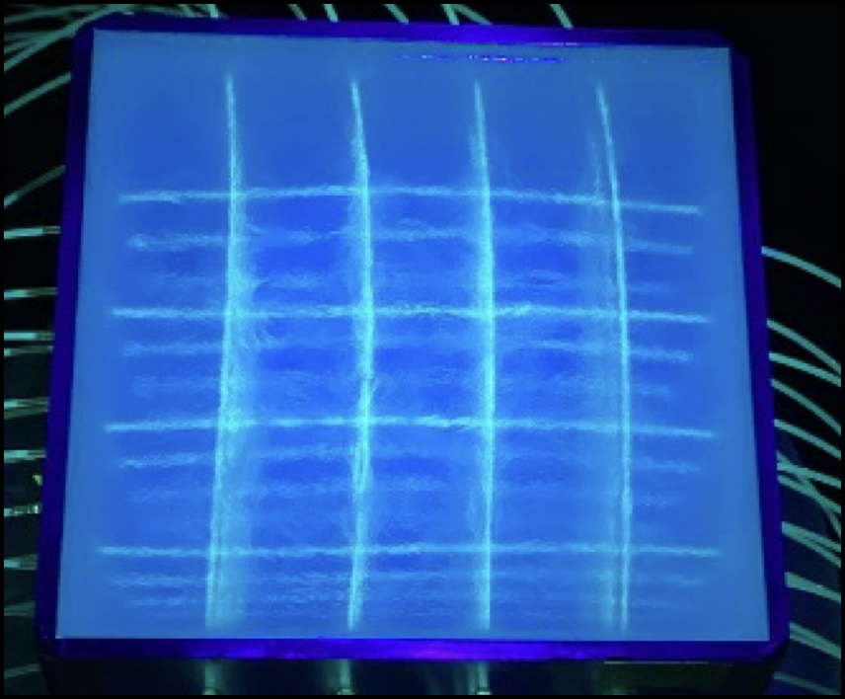
Next Steps
Work with real detector data!
Eos expected to take data this year
LiquidO prototype at U. Mich. (A. Wilhelm) with data under collaboration review
Continue software integration efforts:
Refine ratpac-two integration efforts (LBL/LLNL simulation toolkit)
Link HITMAN with Chroma (GPU accelerated Monte Carlo)
Eos Inner Volume (above)
U. Mich. LiquidO Prototype (right)

Slide 12
MTV Impact
MTV supported collaborations
Prof. Gabriel Orebi Gann (LBNL; PI of Eos)
Dr. Marc Bergevin (LLNL; AIT/NEO, Eos)
Dr. Minfang Yeh (BNL; Eos, LiquidO)
UK collaboration at University of Sussex on LiquidO
Technology transitions
Apply technique to nuclear reactor monitoring for non-proliferation; particle physics; PET scanners

Slide 13
Acknowledgements
The Consortium for Monitoring, Technology, and Verification would like to thank the DOE-NNSA for the continued support of these research activities.
This work was funded by the Consortium for Monitoring, Technology, and Verification under Department of Energy National Nuclear Security Administration award number DE-NA0003920

Slide 14
Citations
[1] LiquidO Consortium. Neutrino physics with an opaque detector. Commun Phys 4, 273 (2021). https://doi.org/10.1038/s42005-021-00763-5
[2] Evidence for High-Energy Extraterrestrial Neutrinos at the IceCube Detector, IceCube Collaboration: M.G. Aartsen et al. Science 342 (2013)
[3] M. Wurm Introduction to THEIA and low-energy neutrino program https://indico.fnal.gov/event/21535/contributions/63283
[4] Eller, P., Fienberg, A. T., Weldert, J., Wendel, G., Böser, S., & Cowen, D. F. (2023). A flexible event reconstruction based on machine learning and likelihood principles. Nuclear Instruments and Methods in Physics Research Section A: Accelerators, Spectrometers, Detectors and Associated Equipment, 1048, 168011. doi:10.1016/j.nima.2023.168011
[5] Barlow, R. (1990). Extended maximum likelihood. Nuclear Instruments and Methods in Physics Research Section A: Accelerators, Spectrometers, Detectors and Associated Equipment, 297(3), 496–506. doi:10.1016/0168-9002(90)91334-8
[6] Anderson, T., Anderssen, E., Askins, M., Bacon, A. J., Bagdasarian, Z., Baldoni, A., … Zimmerman, E. D. (2023). Eos: conceptual design for a demonstrator of hybrid optical detector technology. Journal of Instrumentation, 18(02), P02009. doi:10.1088/1748-0221/18/02/P02009

Slide 15
Example Study: Configuration
Training set; 1M events for each geometry:
0.1-5 MeV $β^{−}$
Vertex Homogeneously distributed; Direction: Isotropic
Reconstruction set; 10k events for each geometry:
1-4 MeV $β^{−}$
Vertex: middle 10% of z direction; Direction: Isotropic
Detector Characteristics:
Light collection efficiency 400 photons/MeV
Photon decay time (Scintillator + Fiber) 10ns
$$z$$
$$y$$
$$x$$

Slide 16
Neural Ratio Estimator: Theory
1) Generate two sets of data:
Set 1 is a joint distribution describing correlated events $p_{1}=p\left(x,θ\right)$
Set 2 is a product of the marginal probabilities $p_{2}=p\left(x\right)p\left(θ\right)$ describing uncorrelated events
2) Define a classification function $\{d\left(x,θ\right)|0≤d\left(x,θ\right)≤1\}$ that describes the likelihood $(x,θ)$ are correlated (from Set 1). Thus:
$q_{1}=d\left(x,θ\right)$ the probability $(x,θ)$ is from Set 1
$q_{2}=1−d(x,θ)$ the probability $(x,θ)$ is from Set 2
3) Define binary cross entropy between distributions $p$ and $q$: $H\left(p,q\right)=−\sum_{i}{p_{i}ln(q_{i})}$
$H=−p_{1}ln(d(x,θ))−p_{2}ln(1−d(x,θ))$
4) Find a $d^{∗}(x,θ)$ such that it satisfies ${\left.\frac{δH}{δ\left(d\left(x,θ\right)\right)}\right|}_{d^{∗}}=0$, implying:
$\frac{d^{∗}}{1−d^{∗}}=\frac{p(x|θ)}{p(x)}∝L\left(θ | x\right)$ (for constant x)
See Likelihood-free MCMC with Amortized Approximate Ratio Estimators (arxiv.org) for more information

Slide 17
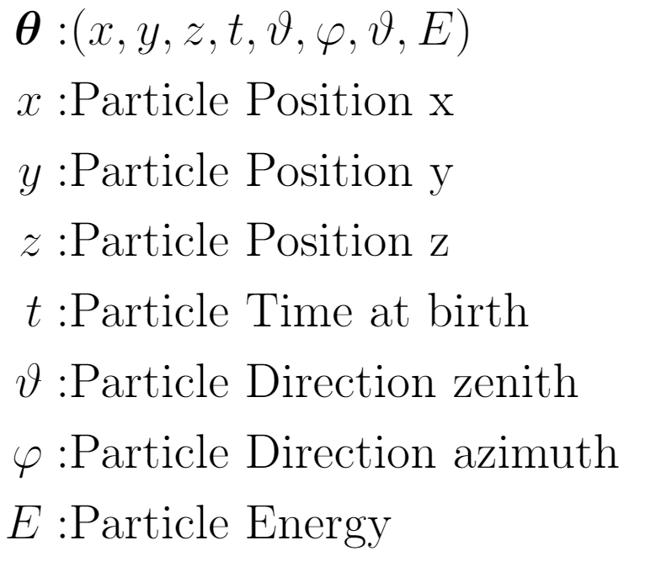
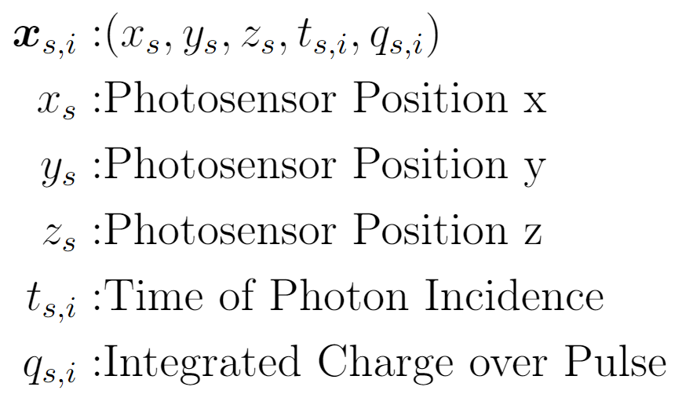
The Extended Maximum Likelihood: Explicit Inputs
Include information about total charge collected and each photon’s arrival time
Extended Maximum Likelihood
Total Detector Info
(Chargenet)
Information per photon (Hitnet)

Slide 18
Network Architecture:

