Slide 1
Neutron Signatures for Nondestructive Assay in Thorium Fuel Cycles
2024 MTV Workshop
March 26, 2024
Oskar Searfus
Ph.D. Candidate, University of Michigan
Peter Marleau², Heather Reedy², and Igor Jovanovic¹
¹University of Michigan
²Sandia National Laboratories

Slide 2
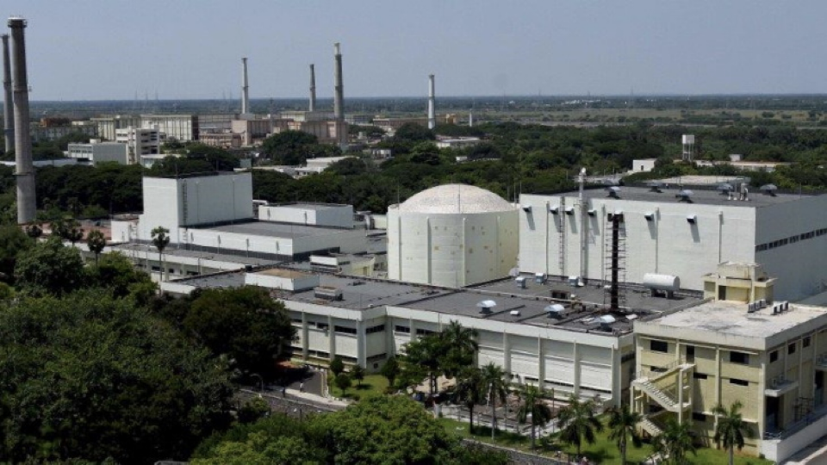
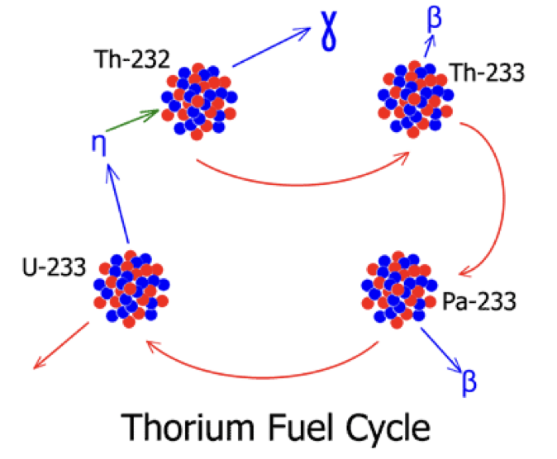
Intro: the Thorium Fuel Cycle
²³²Th used as fertile isotope:
$${}_{}^{232}{Th}+n\underset{→}{}{}_{}^{233}{Th\underset{→}{β^{−}}{}_{}^{233}{Pa\underset{→}{β^{−}}{}_{}^{233}U}}$$
Minimal transuranic production
Th more abundant than U
Breeding possible with thermal reactor
Th fuel cycle already commercially demonstrated
India: FBTR in operation, more reactors planned
China: TMSR construction complete, startup imminent
Export of these technologies to NPT signatory non-nuclear weapon states possible, but safeguards will be required

Slide 3
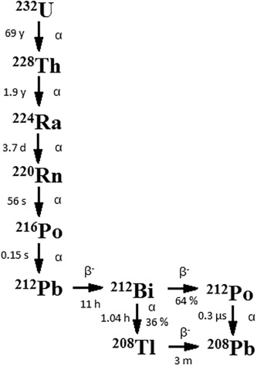
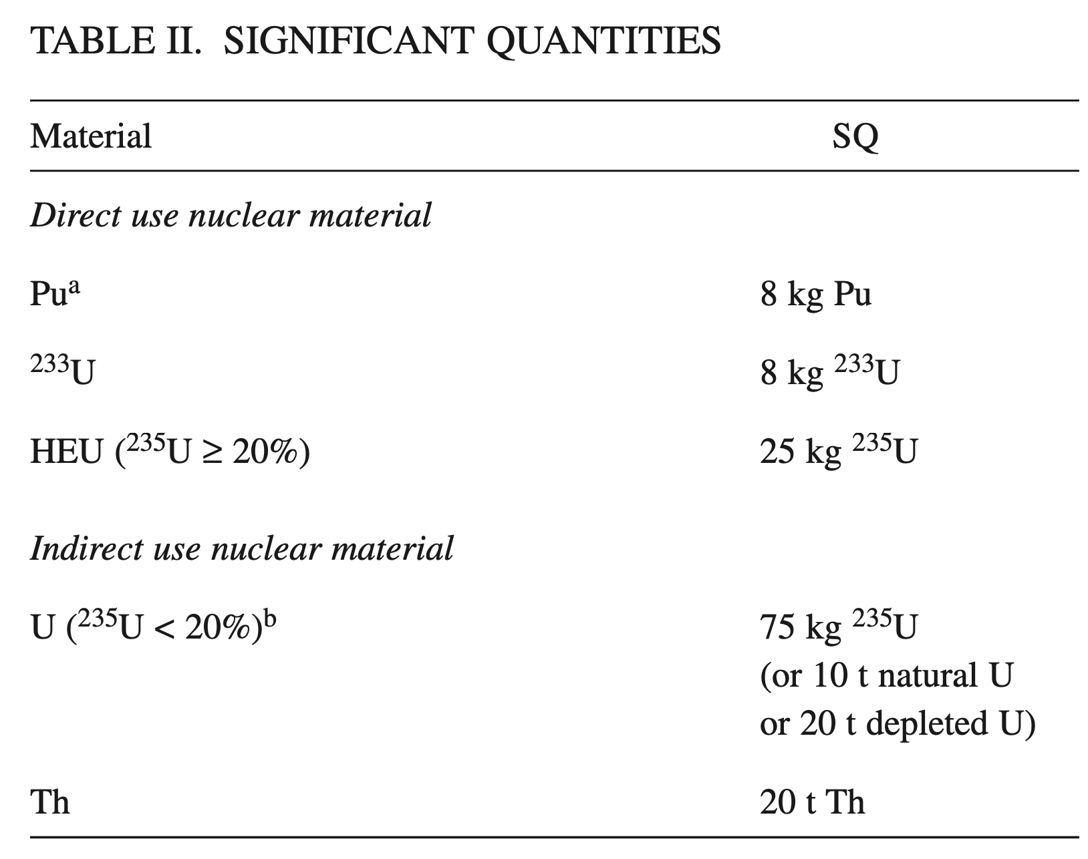
Mission Relevance: Challenges in Safeguarding ²³³U
IAEA sets conservative significant quantity (SQ) for ²³³U
8 kg for ²³³U vs. 25 kg for ²³⁵U
Th fuel cycle designs – ²³³U/²³⁵U mixtures
²³³U & ²³⁵U must be quantified separately
²³²U contaminates ²³³U
Produced in (n,2n) reactions
Typical concentration ~100-2000 ppm U
²⁰⁸Tl decay → 2.6 MeV γ: extreme γ environment – 6.04 Ci/SQ @ 100 ppm:
2.6 MeV γ

Slide 4
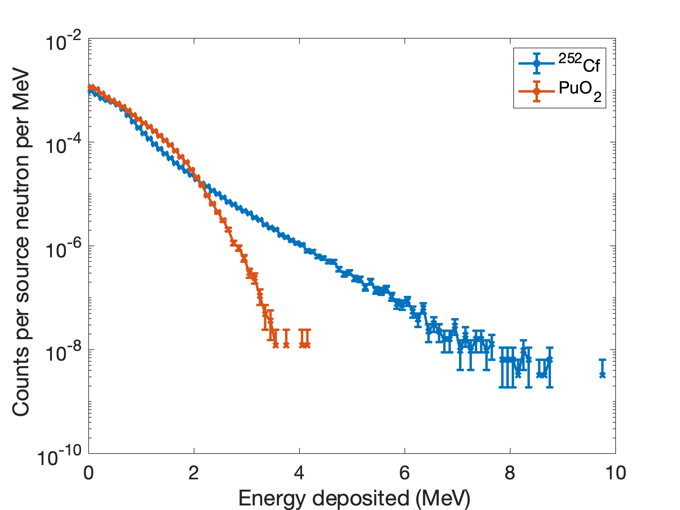
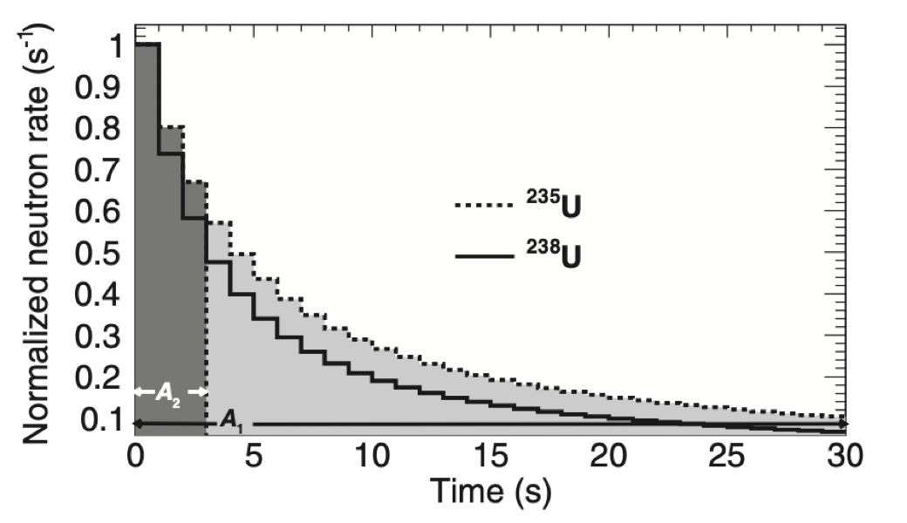
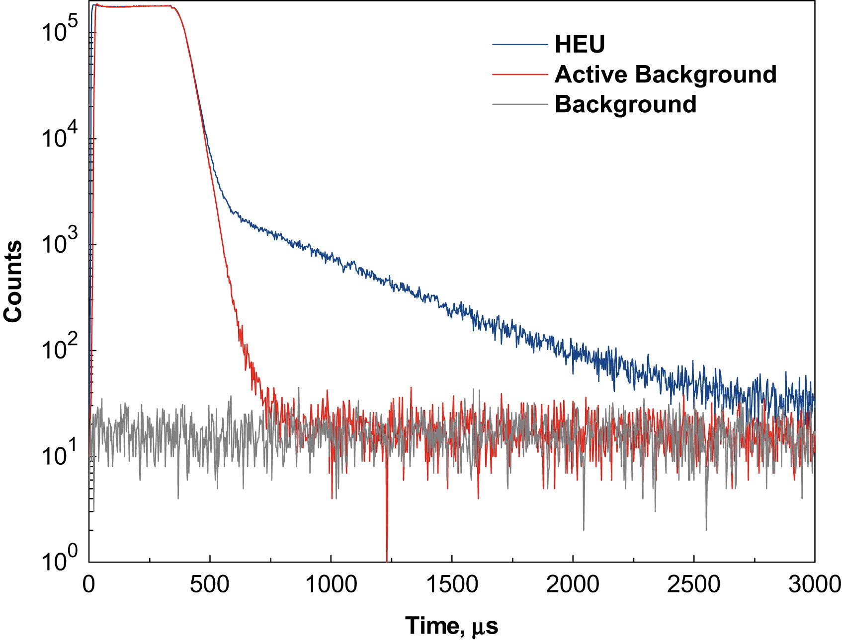
Technical Approach: Candidate Neutron Signatures of ²³³U
Simulation (⁴He detector)
Fast neutron spectroscopy:
Distinguish between fission & non-fission neutrons
Differential die-away:
Indicates fissile material
Delayed neutron time profile: isotope-specific

Slide 5
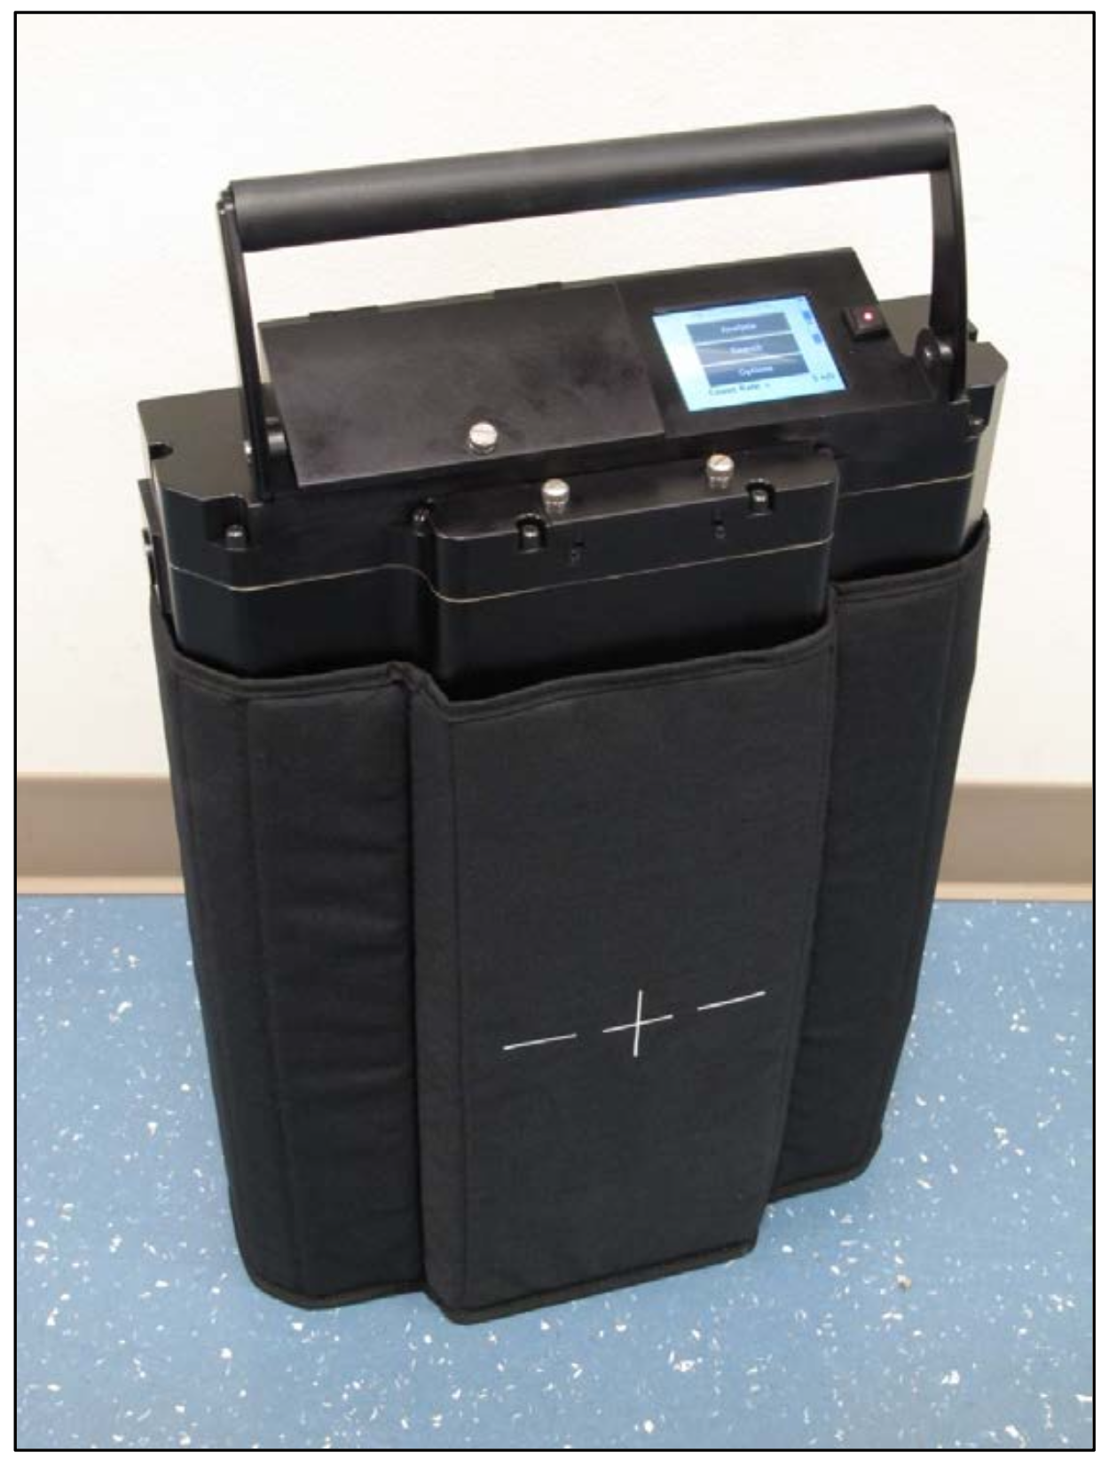
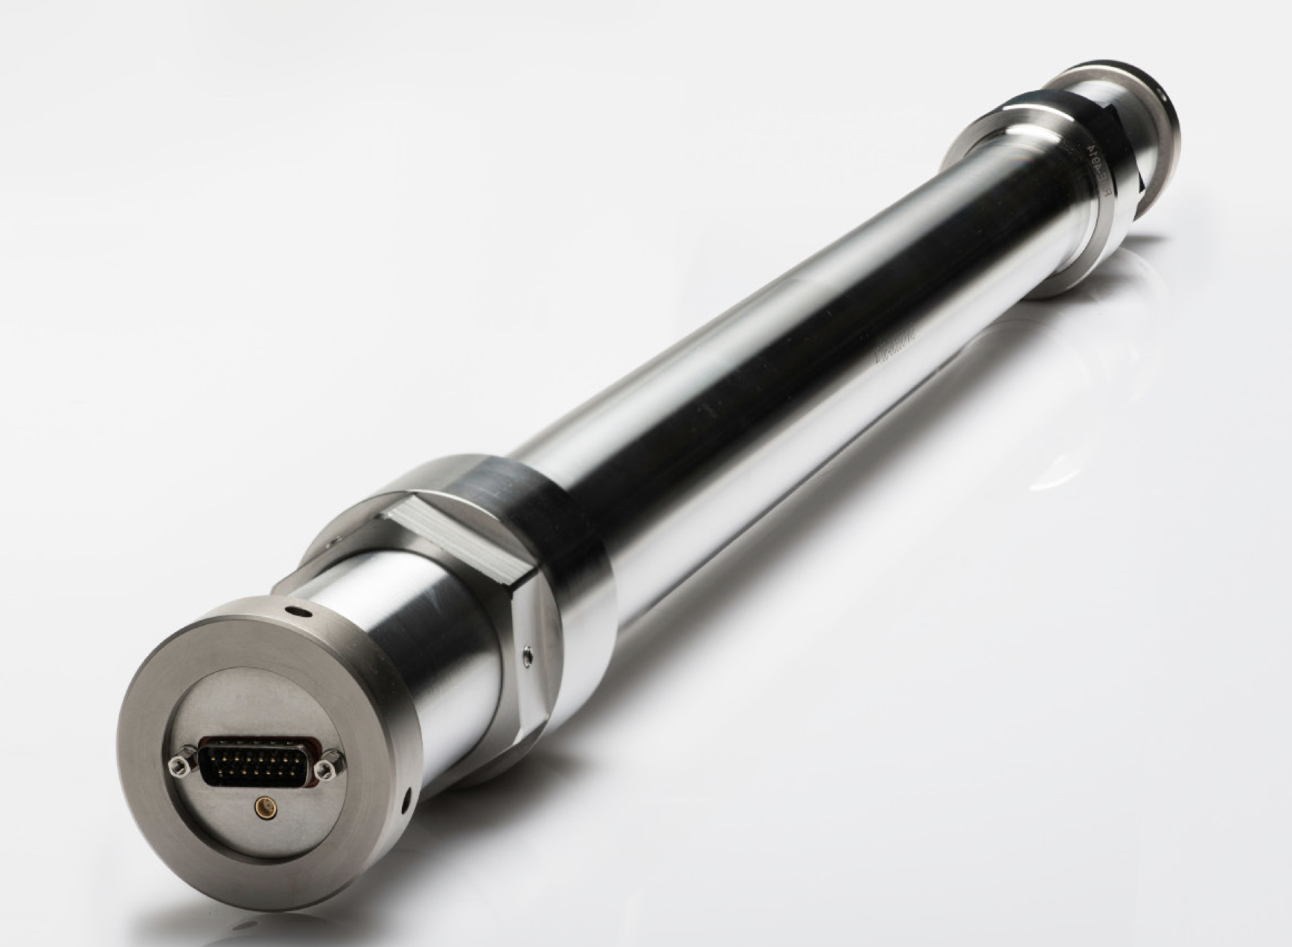
Selection of Detectors
Arktis S670 ⁴He detector
Insensitive to γ-rays
Sensitive to neutron spectrum
MC-15 ³He detectors
Insensitive to γ-rays
High-efficiency thermal neutron detector

Slide 6
Experimental Overview
Measurement performed at the National Criticality Experiments Research Center (NCERC):
Nuclear material repository @ Nevada National Security Site (NNSS)
Thermo Scientific P211 D-T generator
1 x Arktis S670 ⁴He fast neutron detector¹
¹O. F. Searfus, K. Ogren, and I. Jovanovic, NIM A 1046, 167703 (2023)
AT-400R container: 36 Zero Power Reactor (ZPR) plates, 33 g ²³³U₃O₈ / plate; lined with 1.25” lead
2 x MC-15 ³He thermal neutron detectors

Slide 7
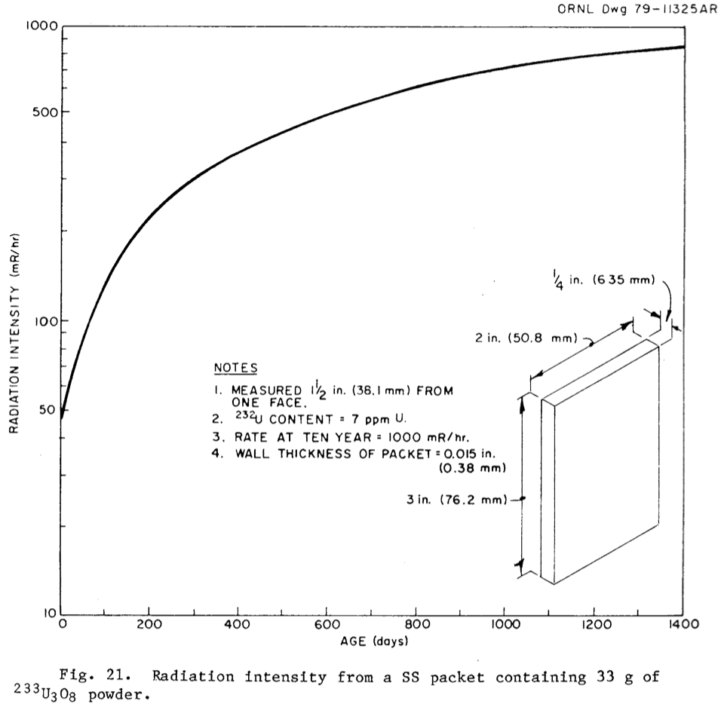
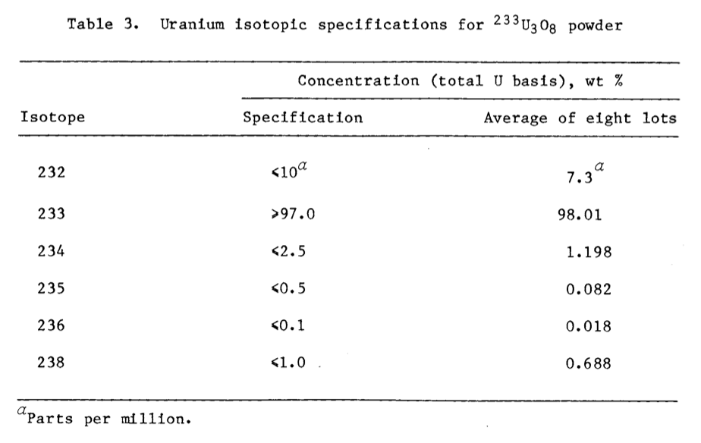
Material Composition & γ-ray Environment

Slide 8
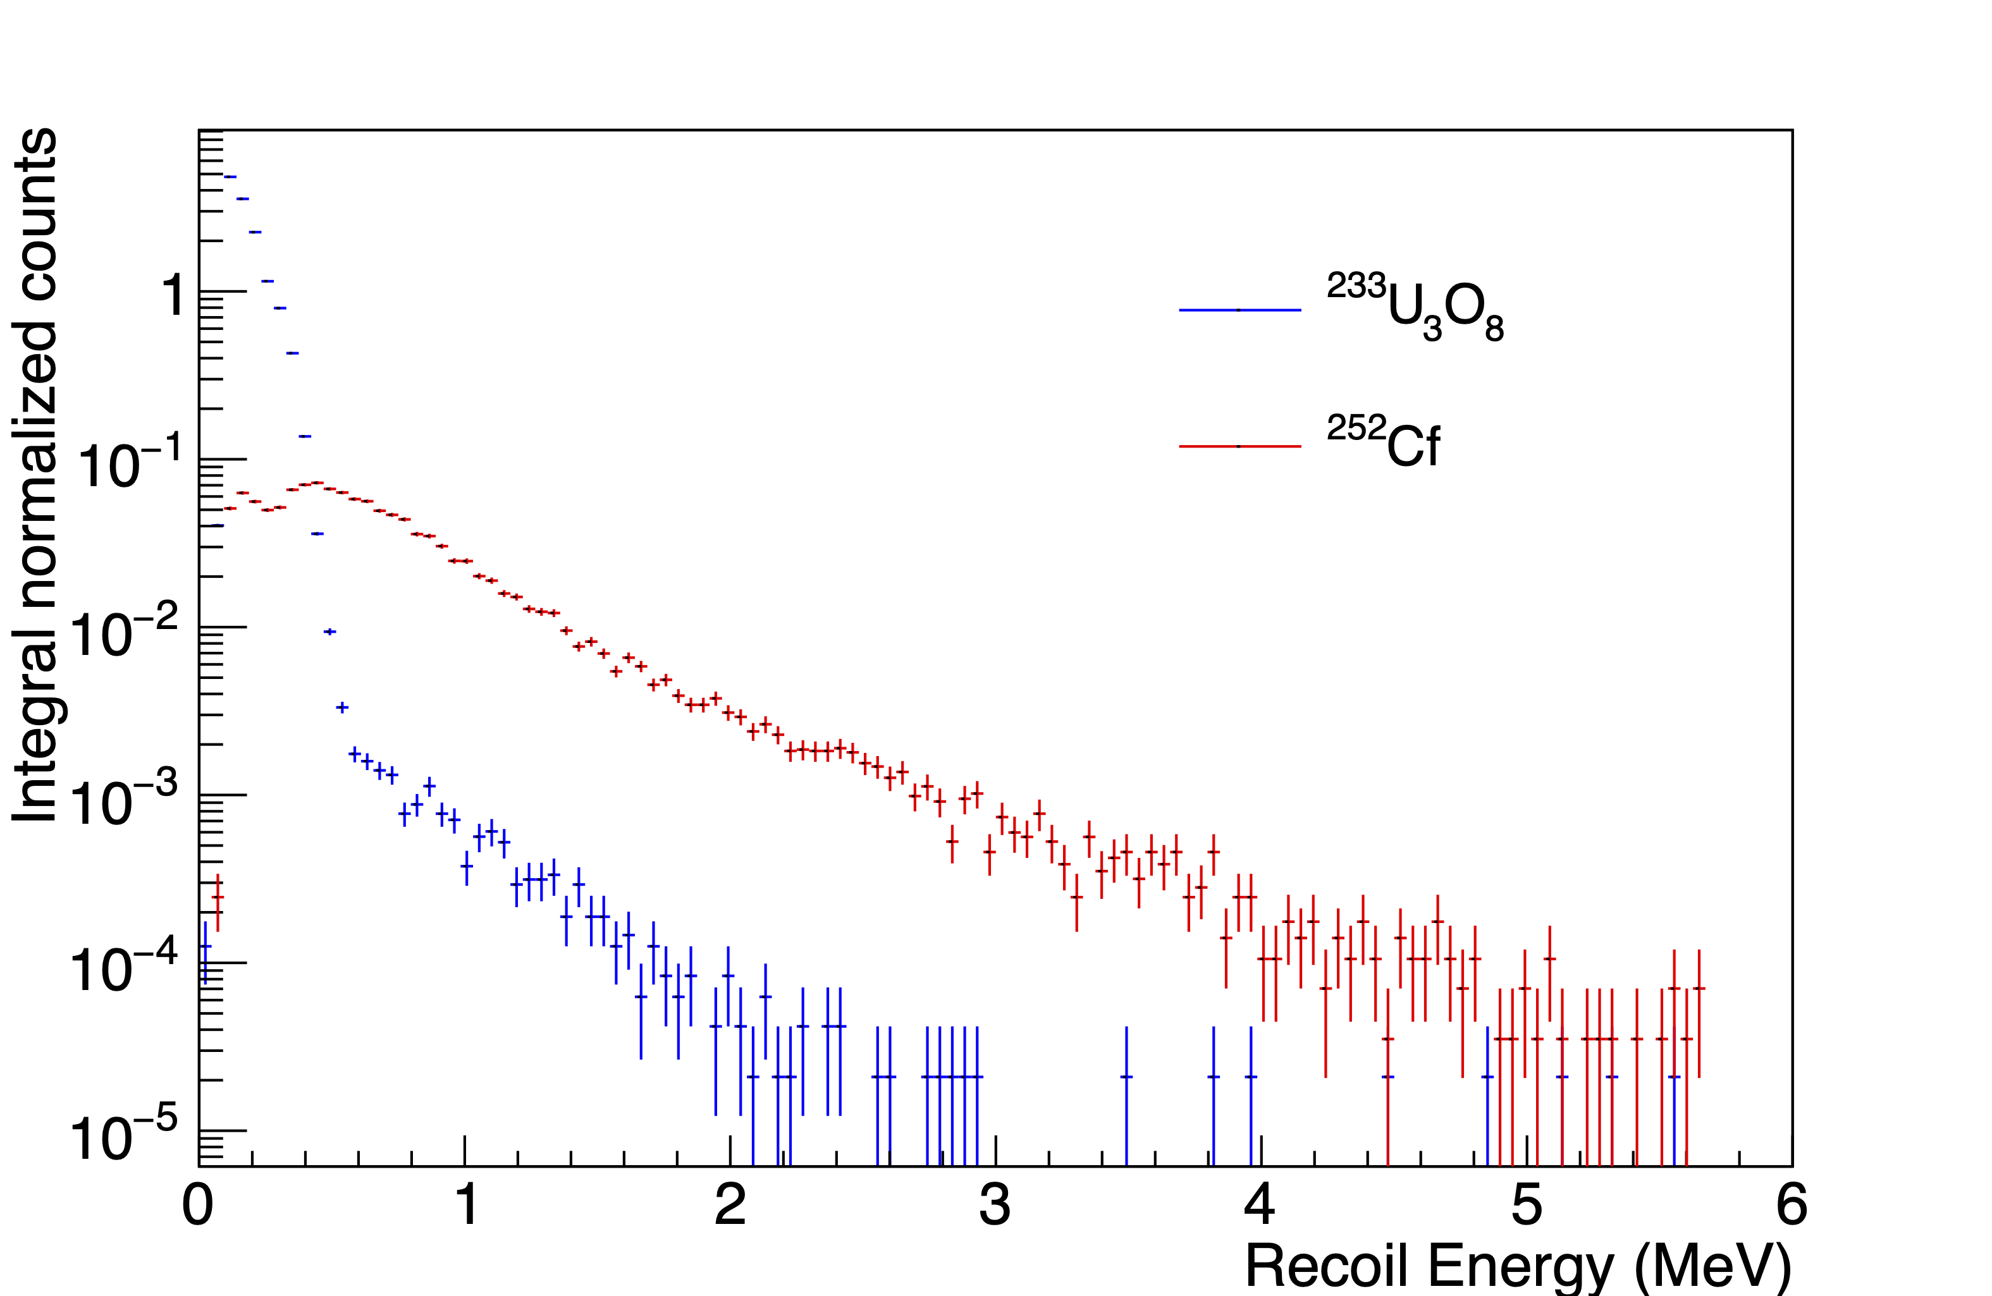
Results: Passive Neutron Spectral Signature
O(⍺,n) neutrons spectrally distinct from fission neutrons
(⍺,n) fraction
induced/spontaneous fission fraction

Slide 9
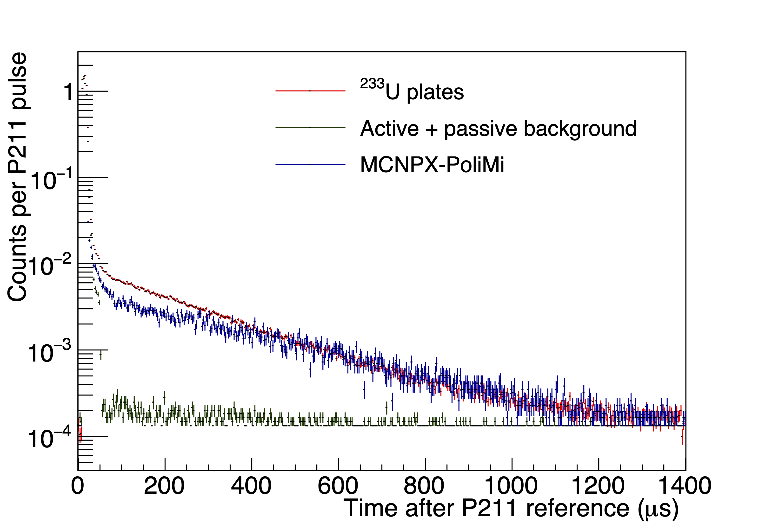
Results: Differential Die-Away
Measured time constant for DDA consistent with simulated time constant
Potential unique capability of ⁴He detector: other fast neutron detectors inoperable in intense γ environment (70 mR/hr)

Slide 10
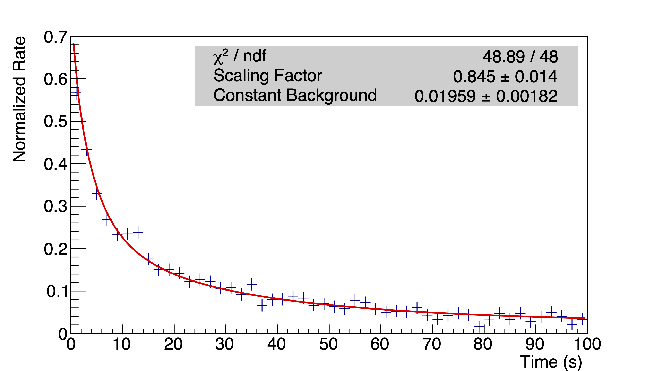
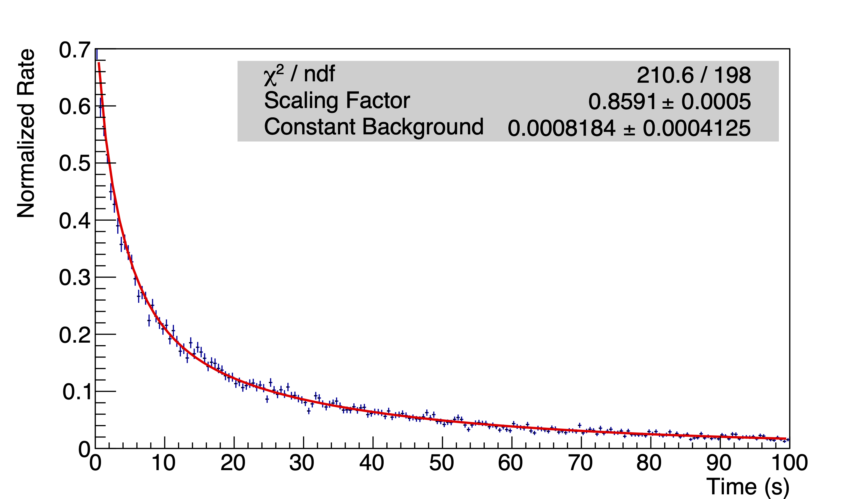
Results: Delayed Neutrons
$$P\left(t\right)=B+C\sum_{i=1}^{6}{(1−e^{{−λ}_{i}t_{irrad}})A_{i}e^{−λ_{i}t}}$$
measurement
MC-15 measured & simulated delayed neutrons are good fit to tabular 6-group DN parameters.
Fitting parameters:
scaling factor (C)
flat background (B)
simulation
Methodology previously demonstrated for ²³⁵U / ²³⁸U:
J. Nattress et al., Phys. Rev. Applied 10, 024049 (2018)
K. Ogren et al., Phys. Rev. Applied 14, 014033 (2020)

Slide 11
Expected Impact
This work is the first demonstration of nontraditional neutron signature measurements on ²³³U
These signatures can now serve as a benchmark for future nondestructive assay technology developments for emerging thorium fuel cycles
Since traditional safeguards technology may not be appropriate for thorium fuel cycles, the findings of this work address a key challenge for the international safeguards portfolio

Slide 12
MTV Impact
MTV helped connect me with my current colleagues at Sandia National Laboratories, and support the experimental research efforts for my Ph.D.
SNL Collaborators:
Pete Marleau, Heather Reedy, Scott Kiff, and others.
I will be transitioning to staff at SNL in April
Technology transitions
ESARDA nondestructive assay working group meeting in May
Past collaborations with ORNL
Plan to disseminate project findings to IAEA and EURATOM

Slide 13
Conclusion
I demonstrated a proof-of-concept for three novel neutron signatures of ²³³U, taking the first step toward safeguards technology for thorium fuel cycles.
This work was recently published:
O. Searfus, P. Marleau, E. Uribe, H. Reedy, and I. Jovanovic, “Passive and active neutron signatures of ²³³U for nondestructive assay,” PRApplied 20 6 064038 (2023) doi.org/10.1103/PhysRevApplied.20.064038

Slide 14
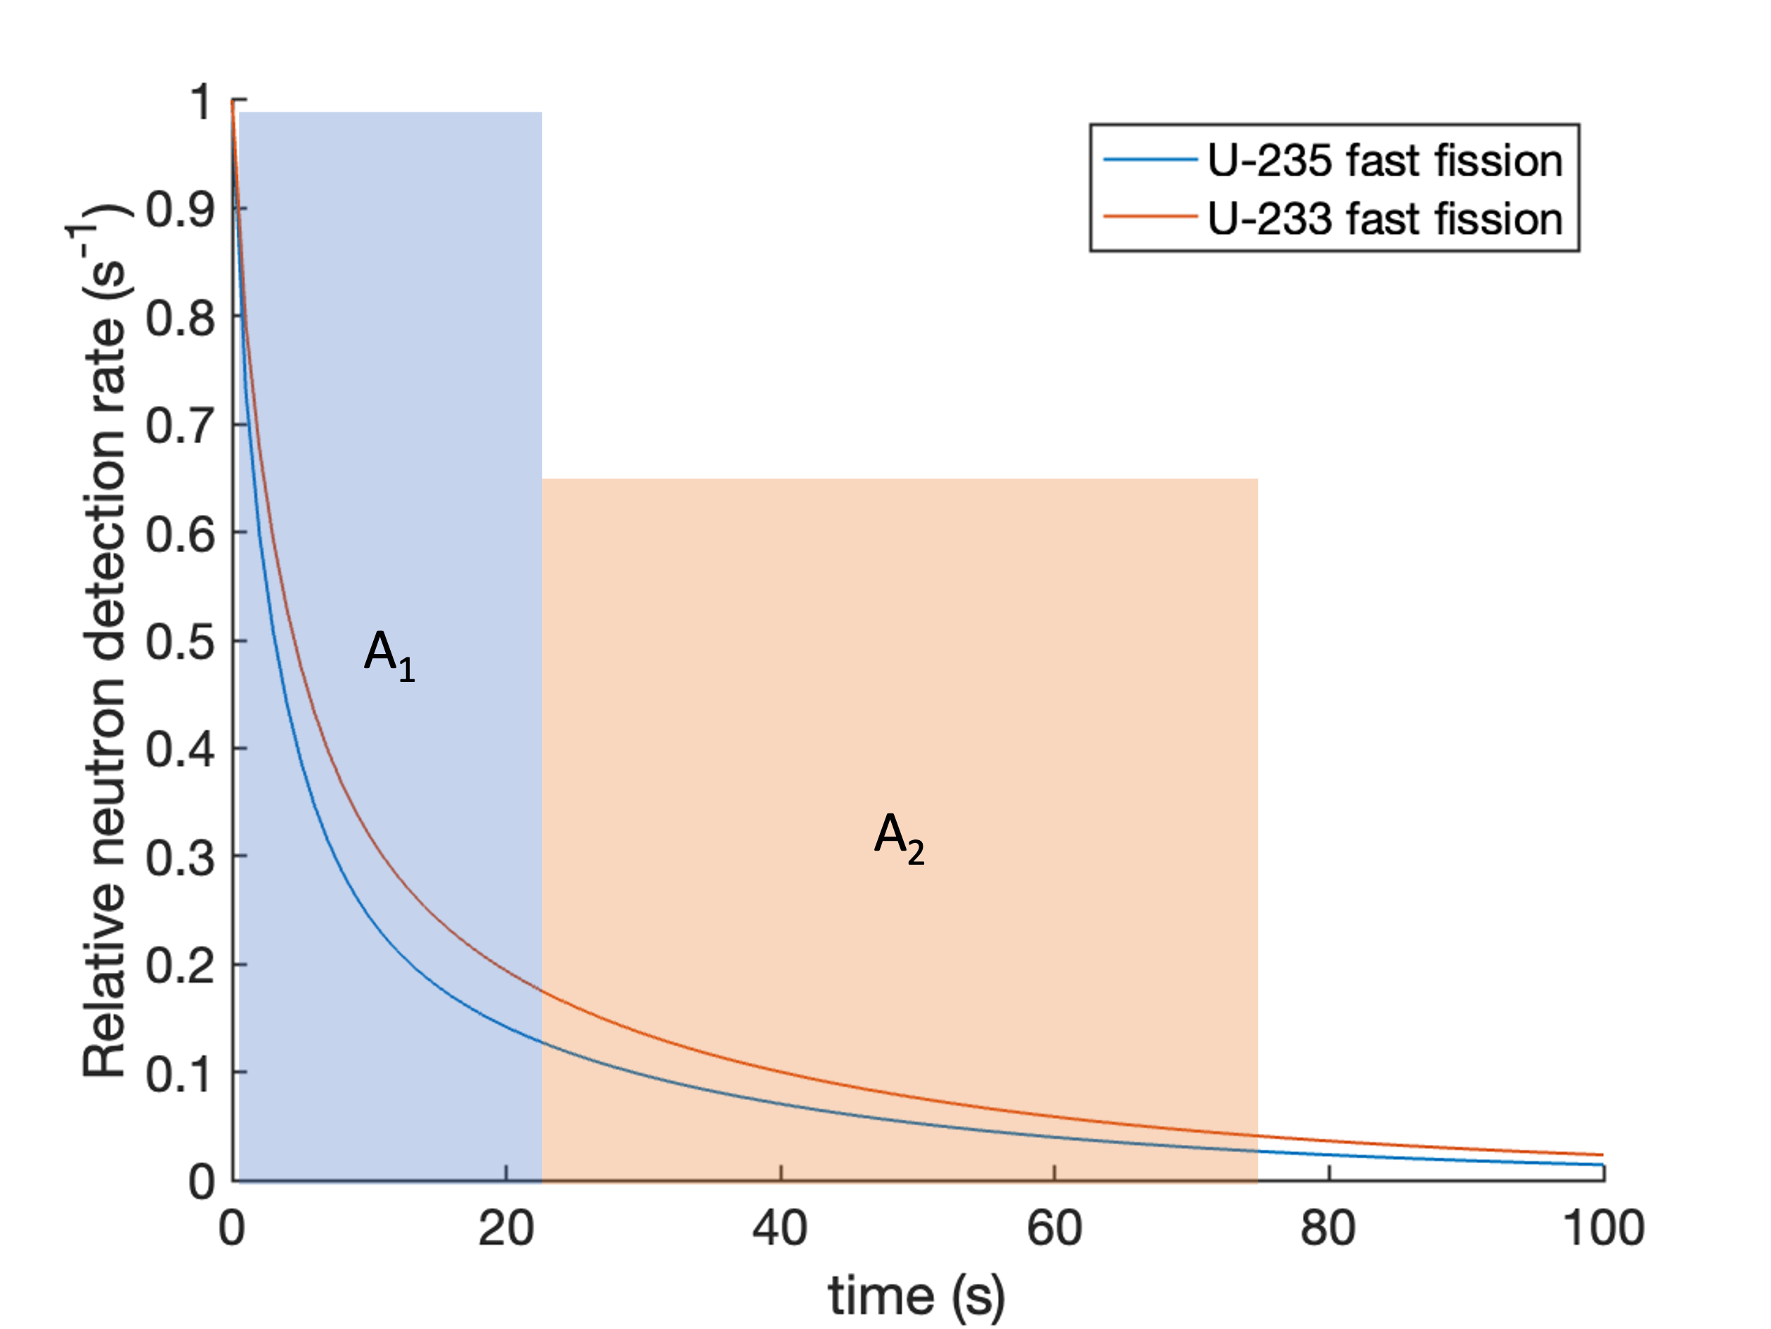
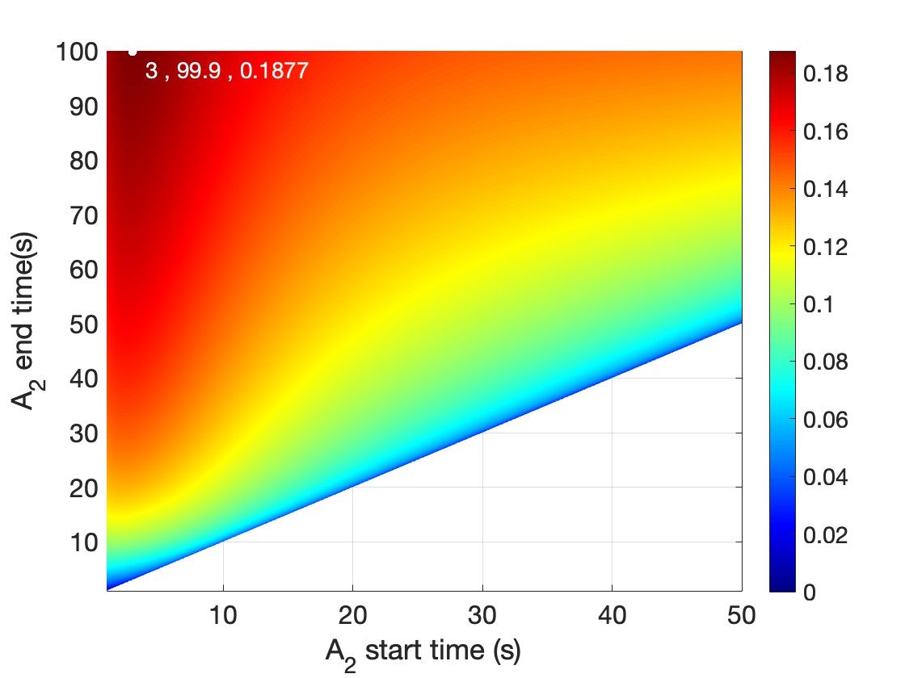
Next Steps: Delayed Neutron Isotope Ratio
Experiment recently performed at Oak Ridge National Laboratory
Delayed neutrons from ²³³U/²³⁵U mixed isotope items measured with modified active well counter
Measure ²³³U/²³⁵U ratio nondestructively by quantifying shape of DN time profile
$$D= \frac{\left|F_{233}−F_{235}\right|}{σ_{233}+σ_{235}}$$

Slide 15
Acknowledgements
The Consortium for Monitoring, Technology, and Verification would like to thank the DOE-NNSA for the continued support of these research activities. The work of O. Searfus was performed under appointment to the Nuclear Nonproliferation International Safeguards Fellowship Program sponsored by the National Nuclear Security Administration’s Office of International Nuclear Safeguards (NA-241). Sandia National Laboratories is a multimission laboratory managed and operated by National Technology Engineering Solutions of Sandia, LLC, a wholly owned subsidiary of Honeywell International Inc., for the U.S. Department of Energy’s National Nuclear Security Administration under contract DE NA0003525. The National Criticality Experiments Research Center is supported by the DOE Nuclear Criticality Safety Program, funded and managed by the National Nuclear Security Administration. This work was funded by the Consortium for Monitoring, Technology, and Verification under Department of Energy National Nuclear Security Administration award number DE-NA0003920

