Slide 1
Update on Prompt-Gamma Response to Epithermal-Neutron Activation for Nuclear Forensics Brad Nethercutt, 3rd year PhD student at the Pennsylvania State University PI: Dr. Marek Flaska, Associate Professor of Nuclear Engineering

Slide 2
Introduction and Motivation
A time-of-flight neutron chopper system has been designed for the Penn State Breazeale Nuclear Reactor which will allow for the isolation of 0.5-40 eV epithermal neutrons along a beamline
Penn State recently flagged the project as strategic initiative for university
NSF MRI proposal focused on multi-disciplinary aspect of the project
One proposed use for this system is neutron activation analysis (NAA) for nuclear forensic characterization
NAA at epithermal energies leverages strong capture cross sections in resonance region
Especially useful for assay of trace elements such as rare earth elements
Recent work has focused specifically on prompt gamma activation analysis for determining sample provenance and processing history

Slide 3
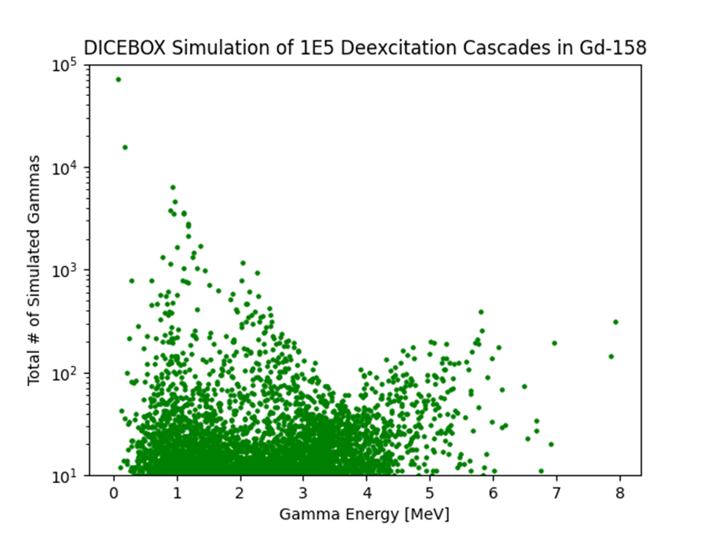
Accomplishments
Performed prompt gamma deexcitation simulations for potential target isotopes using DICEBOX
There is a significant lack of reliable prompt gamma data
Available data were almost always obtained from thermal neutron capture, and are only applicable to resonance captures in epithermal energy region with compatible spin and parity
Developed data tool which identifies potential signals of interest within 0.5-40 eV energy range, to help optimize energy selections for chopper system

Slide 4
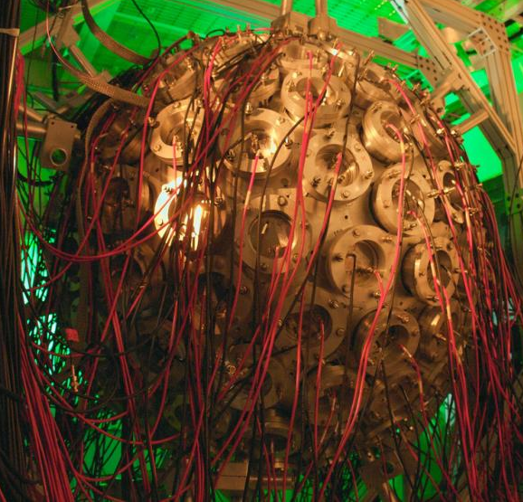
Conclusions and Ongoing Work
Currently planning an experiment at the DANCE detector array at Los Alamos Neutron Science Center
160 BaF₂ detectors covering nearly 4π around beamline target
Possible to slot in our own HPGe detectors
Identifying which specific gammas will be our signals of interest to determine composition of our target
Examining prompt gammas from stable rare earths present in uranium-bearing ore for provenance assessment
Examining various combinations of Mo isotopic ratios for processing history
MTV connections helped facilitate both this collaboration with LANL and a summer opportunity at ORNL

