Slide 1

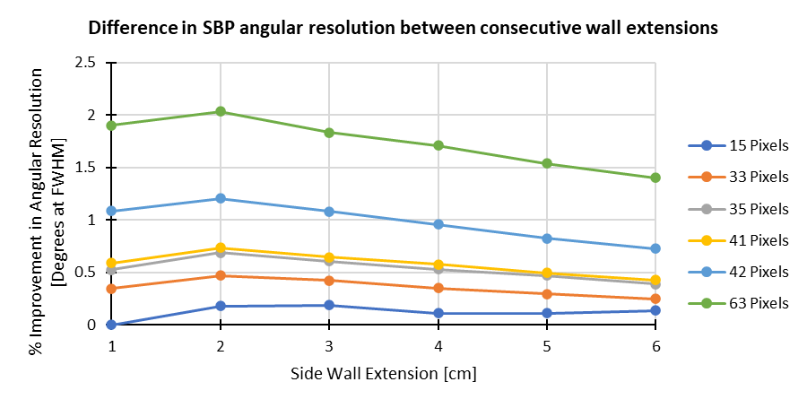
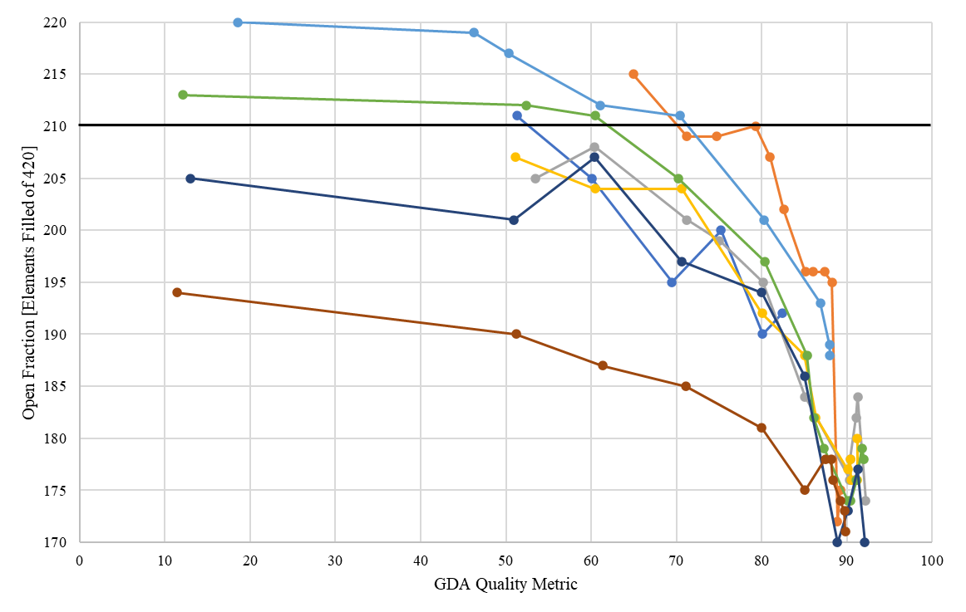
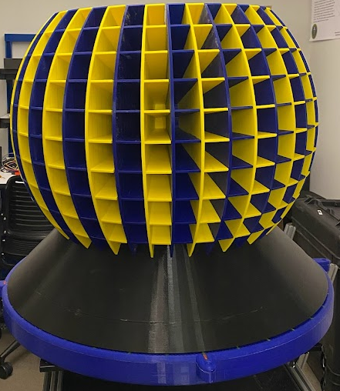

2D Cylindrical Time-Encoded Imager Design
John R. Kuchta
Ph.D. Student, University of Michigan
David K. Wehe
University of Michigan
Introduction
Technical Approach
MTV Impact and Mission Relevance
Cylindrical time-encoded imaging (cTEI) allows for a non-pixelated detector to achieve imaging capabilities by surrounding it with a rotating coded-aperture mask.
Design parameters are investigated using MCNP for the trade-offs of angular resolution, collimation, and weight.
Optimization with the Great Deluge Algorithm (GDA) assessed any coded-aperture pattern imaging capability.
Higher detector energy resolution should influence angular resolution.
A 2D imager is currently being constructed for use with high-purity germanium and scintillators with a 42x10 coded aperture mask.
Automated the simulation of 1D cTEI masks in MCNP, which allowed for the testing of several coded-aperture mask patterns created with the GDA.
Several imaging parameters can now efficiently be simulated for the 2D cTEI system: pixel pitch, aperture collimation thickness and length, field-of-view, etc.
Different pixel pitches were tested using available Uniformly Redundant Arrays (URA) and coded-aperture patterns pseudo-optimized with the GDA, as seen in Fig. 2 where pixel pitch was varied for different aperture collimation lengths.
The GDA was run 8 times to converge on a pattern, with each run having its own unique origin seed (initial random pattern) at different open fractions. Each run converged to a ~40% open fraction with a 1” CLLBC’s relative detector noise level, seen in Fig. 3.
This resulting 42 x 10 pattern is seen in Fig. 4 for the 2D imager. It has a 41.4% open fraction and 6 cm of radially extending side walls between open and closed voxels.
The MTV has allowed for the graduate student to intern at Sandia National Laboratories. This collaborative work led to Sandia’s Dr. Peter Marleau joining the graduate student’s Ph.D. committee, as well as co-authoring a paper from work presented at the 2023 Symposium on Radiation Measurements and Applications (SORMA XIX).
The MTV has allowed the graduate student to attend and present at several conferences, most notably three IEEE NSS MIC & RTSD conferences.
This project, as well as previous MTV projects by this research group, has created new time-encoded imaging designs that are advancing the possibilities of imaging devices used for nuclear nonproliferation.
NNSA Mission:
https://www.energy.gov/nnsa/missions/nonproliferation
▼Fig. 3: GDA convergence of 8 different runs for a 42x10 coded-aperture pattern.
Motivation and Expected Impact
A cTEI image x is created by a modulation of counts (observation vector, y) and the mask pattern (which determines the system response matrix, A), as seen in Eq. 1.
Using HPGe should show improvement in image quality of cTEI systems due to its high energy resolution.
An ROI can be placed on narrow photopeaks, allowing for the observed count rate to be free of background and scatter counts.
Conclusion and Next Steps
$y=A.x$ (1)
▲Fig. 2: Difference in simple back projection angular resolution for each consecutive addition of a 1 cm radially extending sidewall for several pixel pitches.
A 2D cTEI system has been designed, and construction is nearing completion.
This will allow for the testing of side walls for improved collimation and testing the image quality improvement achieved with HPGe detectors.
Simulation of the 2D cTEI shows a degradation of detection efficiency with HPGe for voxels further away from the
▼Fig. 4: 2D cTEI coded-aperture mask pattern optimized with the Great Deluge Algorithm. 0’s and 1’s represent closed and open voxels, respectively.
A 1D imager was used to validate this hypothesis, as shown in Fig. 1.
The FWHM of the resulting images are 34.4º and 13.3º for total counts and photopeak counts, respectively.
▼Fig. 6: Path length from voxel edges through an HPGe detector from the equator (voxel 0) to the top of the mask (voxel 4). Upper and lower bounds are the top and bottom edges of the voxel.
aperture equator. This will be the first measurement validated upon completion of the 2D cTEI system.
The 2D system response matrix is being designed, and the plastic components have been printed.
The lead collimation pieces are being machined, and upon their completion, the 2D system will be ready for initial measurements and testing. The current setup is shown to the right.
▲Fig. 1: Images of a collimated Cs-137 source in the near-field using an Ortec HPGe Well Counter and a 42x1 GDA coded aperture. Total counts (red) and 662 keV photopeak counts (black).
▲Fig. 5: 3D printed mask test bed pieces..
This work was funded in-part by the Consortium for Monitoring, Technology, and Verification under
DOE-NNSA award number DE-NA0003920

