Slide 1
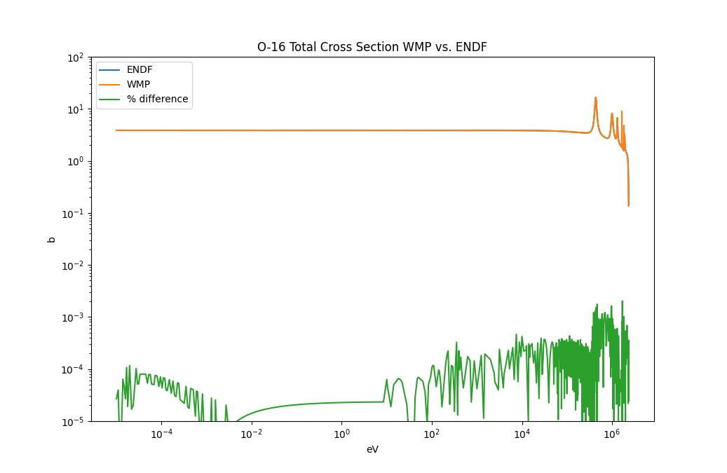
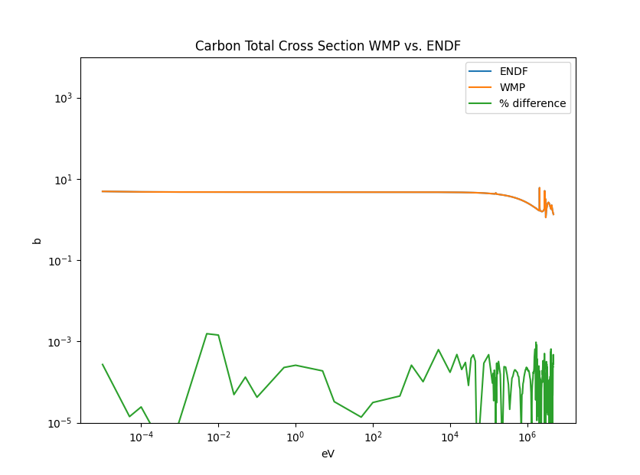
Windowed Multipole Implementation into MCNP6.3 Matthew Lazaric PhD Candidate, University of New Mexico C. Perfetti, M. Rising University of New Mexico, Los Alamos National Laboratory
Your
Logo
Introduction and Motivation
Technical Approach
MTV Impact
The Windowed Multipole (WMP) method of generating cross sections reduces storage requirements and allows for analytic on-the-fly doppler broadening
MCNP6.3 is a monte carlo code developed at Los Alamos National Laboratory
The integration of WMP into MCNP is necessary for future work in generating sensitivity-based improvements to our nuclear data
Developed a suite of libraries for Fortran/C/C++ that can read WMP data files and produce cross sections at arbitrary temperatures
Worked alongside members of XCP-3 to modify the mcnp6.3 source code to utilize these cross sections
Working on this project with guidance from the developers of MCNP6.30 strengthened my tie to the lab
helped develop unique skills crucial to working on production level modeling and simulation tools
Mike Rising, a senior developer at XCP-3, was a crucial resource in navigating the MCNP source code
Technology transitions
Other codes have started implementing their own versions of WMP (openmc), implementing this capability broadens the ability of the code
Results
Verification and Validation still taking place
Test cases taken from ICSBEP and MCNP test suite
Mission Relevance
Sensitivity analysis techniques provide insight into the sources of uncertainty present in modeling and simulation methods.
Increasing the scope and ease of use of these techniques, increases the likelihood that these methods are utilized.
A more comprehensive understanding of the sources of error helps better identify gaps in our knowledge.
Conclusion
Thus far, the WMP implementation is incorporated into the history flow allowing for optional use of the new cross section calculation method
Better characterization of uncertainty and error in our simulations translates to better characterization of the risks present in our physical systems
Expected Impact
A successful implementation of the WMP method of calculating cross sections will allow for the following:
On-the-fly doppler broadening of continuous energy neutron cross sections
Reduction in the memory storage needed to hold cross section tables
Adds an analytic temperature sensitivity capability
Calculation of
Next Steps
Future work includes:
further testing of otf doppler broadening capability
Parallel implementation of cross section calculation
Integration with the CLUTCH sens. Analysis code
This work was funded in-part by the Consortium for Monitoring, Technology, and Verification under DOE-NNSA award number DE-NA0003920

